Slide 1


Year 1 Science

Slide 2
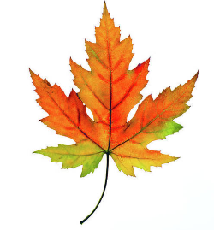
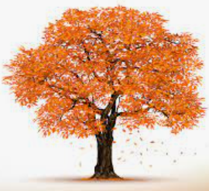
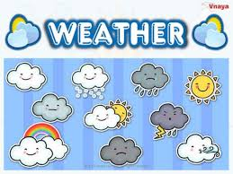
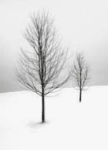
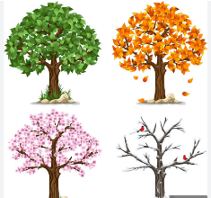
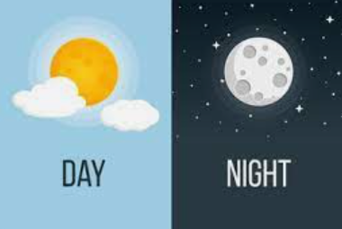
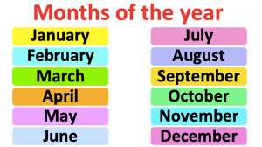
Sticky knowledge
Year group: 1 | Term: Autumn 1 | Subject: Science | Topic: Seasonal change
Key vocabulary and definitions:
Seasons- a season is a part of the year where weather changes. Month- a part of the year. Year- 12 months, 365 days Winter – The season after autumn and before Spring- falls in December, Jan and Feb Autumn -the season after summer and before winter Weather- what the sky and air is like outside
Substantive knowledge:
There are 12 months in a year. Jan, Feb etc There are 4 seasons. Spring, summer, Autumn and Winter There are 24 hours in a day that is split into day and night In Spring the trees grow blossom and buds In Summer the weather is hotter In Autumn, temperatures will start to drop In Autumn, daytime hours become shorter In Autumn, the leaves change colour and begin to fall off the trees In winter the weather is colder and the days are shorter Different types of weather happen through the year and the seasons

Slide 3
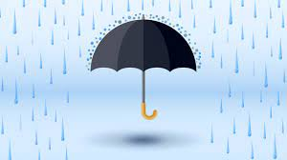
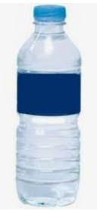
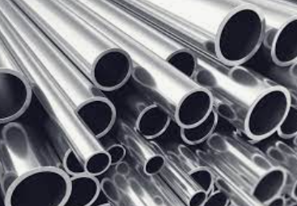
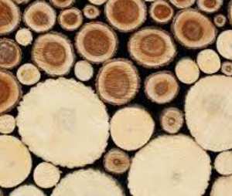
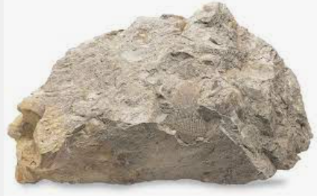
Sticky knowledge
Year group: 1 | Term: Autumn 2 | Subject: Science | Topic: Everyday Materials
Key vocabulary and definitions:
Hard- something that is rigids, doesn’t move and easily broken Soft- something that is not firm to touch Stretchy- to spread out or reach out to the full length to make loose and flexible Stiff- something that is not easily bent or stretched Rough-Something that has not have soft and uneven surface Smooth- has an even surface; not rough Bendy-something that is soft and flexible Waterproof-something that keeps water out. Absorbent- to be able to soak water in easily Opaque- something that is not seen though; not transparent Transparent- something that allows light to pass through so that the objects behind can be easily seen; see though Heavy- an object that is difficult to lift or move Rigid- when something is strong and does not bend
Substantive knowledge:
Common materials around us include wood, plastic, glass, metal, water and rock. A cover for the ark needs to be made from waterproof materials Everything around us and things we use is made of some form of material. Wood is hard and can be used to make everyday objects like tables. Plastic and metal are smooth Water is wet Materials can be grouped together by their properties e.g.- hard, smooth, transparent etc. Some materials can be changed by squashing, bending, twisting and stretching.

Slide 4
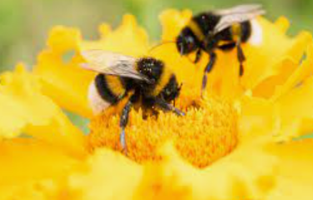
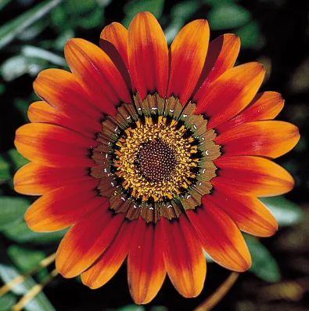
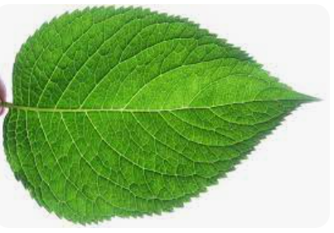


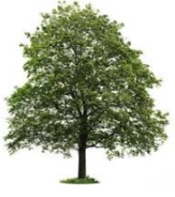
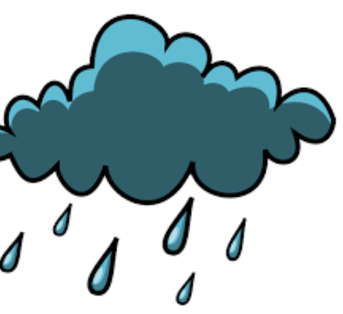
Sticky knowledge
Year group: 1 | Term: Spring 1 | Subject: Science | Topic: Plants and seasonal change
Substantive knowledge:
There are a variety of common wild and garden plants, including deciduous and evergreen trees. All plants grow from a seed. Plants have roots, a stem, leaves, some have a flower There are 12 months in a year. Jan, Feb etc There are 4 seasons. Spring, summer, Autumn and Winter There are 24 hours in a day that is split into day and night. In Spring the days begin to get longer. Plants begin to grow in spring and animals are born.
Prior learning:​
EYFS: ​ Exploring how to care for plants and help them grow. Beginning learn about and name the basic parts of plants.
Key vocabulary and definitions:
Leaf- part of a plant attached to the stem, they help the plant collect sunlight. Flower – part of the plant that blossoms and produces seeds. Petal-one of the leaves that makes up a flower. Seasons- a season is a part of the year where weather changes. Month- a part of the year. Year- 12 months, 365 days Deciduous tree- sheds its leaves every year Evergreen trees-the leaves stay green and don't fall off

Slide 5
Sticky knowledge
Year group: 1 | Term: Spring 2 | Subject: Science | Topic: Plants
Key vocabulary and definitions:
Deciduous- a tree or shrub that shreds its leaves annually. Evergreen- a tree or shrub that keeps green leaves all year. Tree- a tree is a woody plant that has a trunk and branches. Leaf- part of a plant attached to the stem, they help the plant collect sunlight. Flower – part of the plant that blossoms and produces seeds. Petal-one of the leaves that makes up a flower.
Substantive knowledge:
Plants have roots, a stem, leaves, some have a flower Trees have roots, trunk, branches, leaves and some have blossom or fruit. The roots make the plant stable and suck up the water and nutrients from the ground. The stem/trunk is the main structure and hold its up. The water and nutrients travel through the stem. The flower attracts bees. The leaves absorb sunlight. Common trees in the UK are oak, sycamore, beech, willow and ash. Common flowers in the UK are daffodils, sunflowers, daisies, dandelion, poppy

Slide 6




Sticky knowledge
Year group: 1 | Term: Summer 1 | Subject: Science | Topic: Animals
Prior learning:​​
EYFS: ​Gain an understanding of a typical type of pet, such as dogs, cats, fish and birds. To survive pets, need food, water, warmth and shelter just like humans. Some pets need lots of exercise to stay healthy. Cats are carnivores. Horses and rabbits are herbivores .​
Key vocabulary and definitions:
Carnivore- only eats meat Herbivores- only eats only plants Omnivore- eats both meat and plants. Mammals- something that gives birth to a live baby and feeds it’s baby its own milk. Amphibians- a cold-blooded vertebrate animal of a class that comprises the frogs, toads, newts, salamanders, and caecilians. They can live both on land and water. Reptile- animal of a class that includes snakes, lizards, crocodiles, turtles, and tortoises. They are distinguished by having a dry scaly skin and typically laying soft-shelled eggs on land.
Substantive knowledge:
A herbivore is an animal that eat plants for example a rabbit. An omnivore is an animal that eats plant and other animals. For example, a zebra or most people. A carnivore is an animal that only eats other animals. For example, a lion. A reptile is a vertebrate animal for example a tortoise, a snake and a lizard. They all lay eggs when birthing their young. Fish are a limbless, cold blooded vertebrate with gills and fins and lives only in water. For example, a clown fish, a shark and a goldfish, tuna, cod, sea horse. A mammal has warm blood and a vertebrate and are distinguished by having hair or fur. The feed their young with their own milk and give birth to live young. for example: a dog, giraffe, human, elephant. An amphibian is an animal that is cold blooded, they live on land and in water. For example, a frog, newt and toad. A bird is an egg laying animal that has feathers and wings and usually can fly. For example, a chicken, flamingo, robin and blackbird and ostrich.

Slide 7
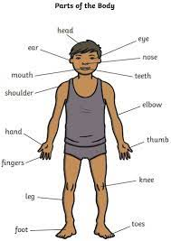
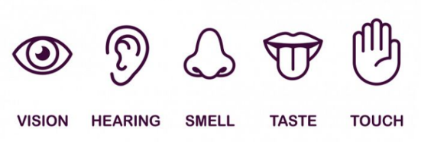
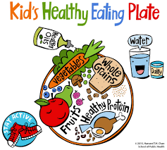
Sticky knowledge
Year group: 1 | Term: Summer 2 | Subject: Science | Topic: Humans and seasonal change
Key vocabulary and definitions:
Senses- 5 senses are physical abilities to explore the world, see, hear, smell, taste and touch. Vertebrate- a back bone i.e.- a spine in a human. Mammals- something that gives birth to a live baby and feeds it’s baby its own milk. Summer- summer is in the month of June, July and August and tends to be warmer.
Substantive knowledge:
Humans are mammals and have 2 hands to touch, two ears to hear, one nose to smell, two eyes to see and a tongue to taste. A person has a head, nose, ears, neck, shoulders, arms, elbows and wrists, hand back, chest, hip and legs, knee, ankles, feet. Humans need a healthy diet to grow. This includes eating 5 portions of fruit or vegetables a day The weather in summer is usually hot. The days in summer are longer than the nights. The sun is very powerful, and you need to wear sun cream, so it doesn’t burn your skin. Plants and trees are in full bloom. Leaves are extremely green and Lucious on the trees.

