Slide 1


Year 2 Science

Slide 2
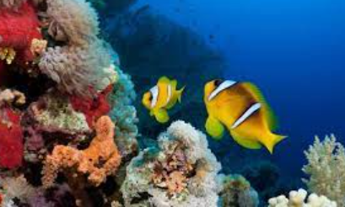
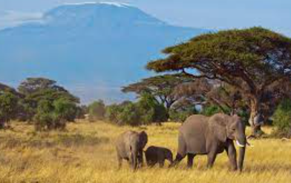
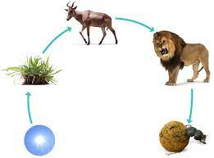
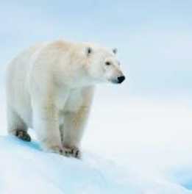
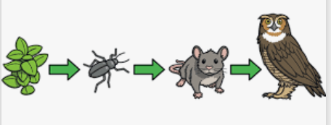
Sticky knowledge
Year group: 2 | Term: Autumn 1 | Subject: Science | Topic: Living things and their habitats
Substantive knowledge:
A habitat is a place that an animal lives. It provides the animal with food, water and shelter. There are many different sorts of habitats around the world from forests, grasslands, mountains and deserts. Some things are alive, for example humans, insects, animals, trees Some things are dead, but used to be alive such as twigs, shells and leaves Somethings have never been alive, such as glass, plastic and cars A polar bear lives in an arctic habitat because it has thick fur to keep warm. Sharks are a type of fish, which means that they breathe through gills and need to live in the water Lions live in savannahs and grassland where some cover and plenty of water can be found Insects live under rock and logs to provide a safe refuge. They can hide and temperatures stay stable
Key vocabulary and definitions:
Food chain- A food chain shows how each animal gets its food. Food sources- This is the place a living thing’s food comes from. Habitat- A habitat is the natural place something lives. Microhabitat- Is a very small habitat in places (such as under rocks or under leaves).

Slide 3
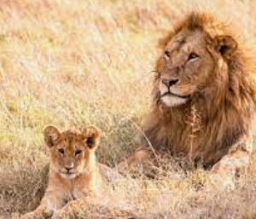
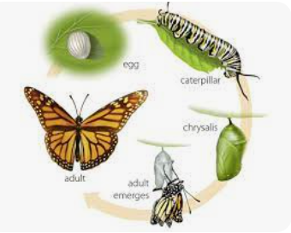
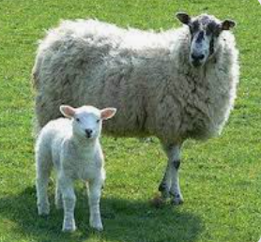
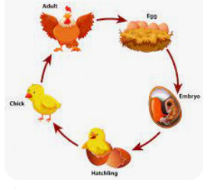
Sticky knowledge
Year group: 2 | Term: Autumn 2 | Subject: Science | Topic: Animals including humans
Prior Learning
EYFS: The chrysalis protects the caterpillar whilst it turns into a butterfly, and it takes 3-5 weeks for a caterpillar to turn into a butterfly Year 1: An understanding of what an herbivore, omnivore, carnivore, reptile and fish has been developed. Children are taught that a mammal has warm blood and a vertebrate and are distinguished by having hair or fur, they feed their young with their own milk and give birth to live young. An amphibian is an animal that is cold blooded, they live on land and in water. A bird is an egg laying animal that has feathers and wings and usually can fly.
Substantive knowledge:
Some offspring look like their adult when they are born. Some offspring don’t look like their adult when they are born. Some animals lay eggs, such as birds, reptiles, amphibians and fish Mammals don't lay eggs All young animals change as they go through the different stages of their life cycle and grow into adults. Animals need shelter, air, food and water to survive
Key vocabulary and definitions:
Life Cycle- The changes living things go through to become an adult. Offspring- The child of an animal. Grow- Growth is an increase in size Life stages- Life stages are the ages and stages we go through as we learn and grow, from infancy to adulthood.

Slide 4
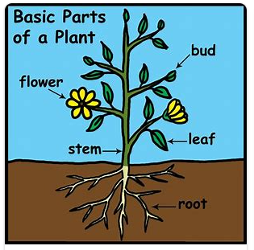
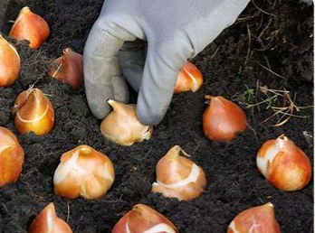
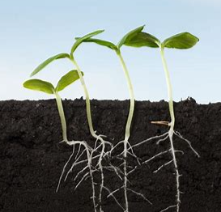
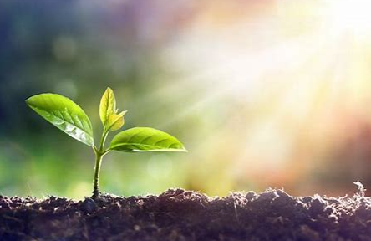
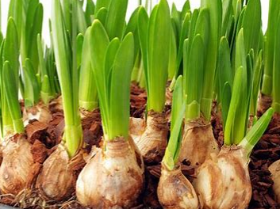
Sticky knowledge
Year group: 2 | Term: Spring 1 | Subject: Science | Topic: Plants
Substantive knowledge:
When a plant sprouts, it grows new shoots. A shoot grows upwards from the seed or plant to find sunlight. All plants need water and sunlight to grow. Seeds and bulbs need watering to grow The bulb stores all the food for the next plant to grow Bulbs are normally found underground Seeds need water, soil and nutrients to germinate
Key vocabulary and definitions:
Stem- The stem is the main part of the plant. It supports the weight of the leaves, flowers or fruits and transports water from the roots Bulbs- Bulbs are underground food storage. Sunlight- Light from the sun is a form of energy that helps plants to grow. Root- It is the part of a plant usually hidden under the ground. They keep the plant stable and give it nutrients. Petals- Petals are part of a flowering plant that attracts insects such as bees.
Prior learning:
EYFS: Experience of planting and taking care or plants. Children learn that plants need water and sun to grow. Year 1: Children are taught about a variety of common and wild plants, including deciduous and evergreen trees. All plants grow from a seed and have roots, a stem, leaves, some have a flower. Children also gain an understanding that there are 12 months in a year, 4 seasons. Spring, Summer, Autumn and Winter, 24 hours in a day that is split into day and night. Furthermore, in Spring the days begin to get longer.

Slide 5
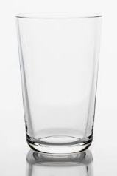
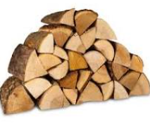
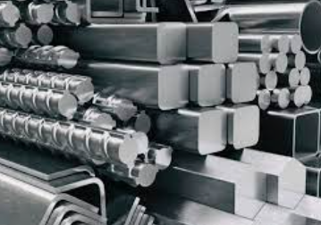

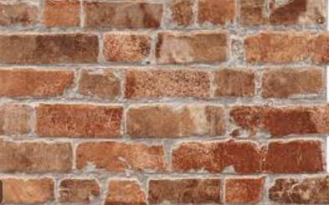
Sticky knowledge
Year group: 2 | Term: Spring 2 | Subject: Science | Topic: Use of everyday materials
Prior Learning:
EYFS: Exploring plastic and its effect on the environment. Vocab linked to the 'touch lens' to describe natural and man-made materials. Year 1: Common materials around us include wood, plastic, glass, metal, water and rock were identified; an understanding that wood is hard, plastic and metals are smooth, and water is wet was developed; children also started to identify what objects are waterproof, hard and squishy.
Key vocabulary and definitions:
Flexible- A material that can bend or stretch. Rigid- A material you cannot bend or stretch. Absorbent – A material or object that soaks up liquid Opaque – Light cannot pass through Transparent – light can pass through Property – How a material can be described
Substantive knowledge:
Brick and stone are the best material to build a house because they are strong and weather resistant. Bricks are also fire resistant Metal and plastic are waterproof materials Glass is transparent and easily breakable but can also be strong. It can be made into different shapes Fabric can be absorbent, stretchy or insulating Wood is opaque and strong The properties of materials can be considered for sorting

Slide 6
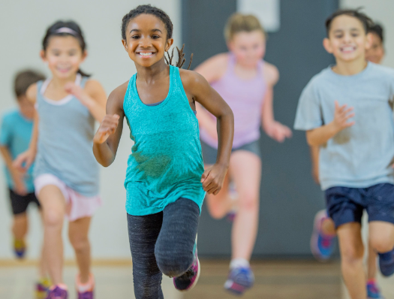
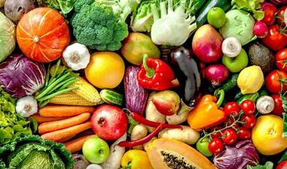
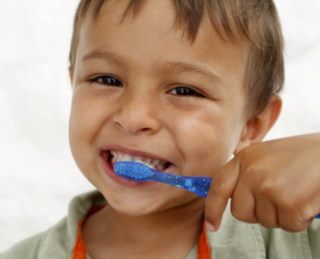
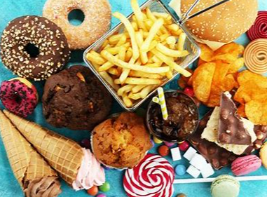
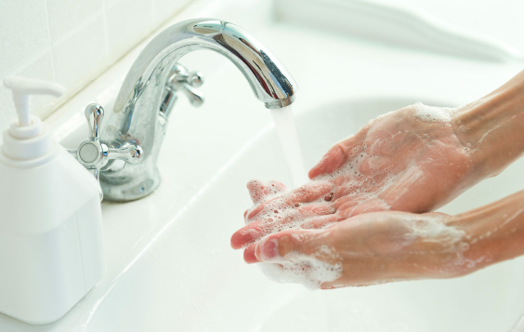
Sticky knowledge
Year group: 2 | Term: Summer 1 | Subject: Science | Topic: Animals including humans
Prior Learning
EYFS: The five senses are sight, touch, taste, smell, hearing (supporting the use of the FANTASTICS) Year 1: Humans are mammals and have 2 hands to touch, two ears to hear, one nose to smell, two eyes to see and a tongue to taste. Furthermore, a person has a head, nose, ears, neck, shoulders, arms, elbows and wrists, hand back, chest, hip and legs, knee, ankles, feet. Alongside this, humans need a healthy diet to grow.
Substantive knowledge:
Exercise is good for us to stay fit and healthy When we do exercise our heart rate goes up We must wash our hands and bodies to stay clean, so we don’t get poorly Humans brush their teeth to keep them clean To grow into a healthy adult, we must eat the right types of food in the right amount and exercise. To stay alive, all humans have four basic needs for survival: water, food, shelter and air. Know that animals and humans have offspring which grow into adults.
Key vocabulary and definitions:
Exercise- A physical activity to keep your body fit. Food groups – (carbs, protein, fruit and vegetables, dairy, fats) Hygiene – Keeping your body clean and free from disease Balanced diet- Eating the right amount of food from each of the food groups.

