Slide 1


Year 3 Science

Slide 2

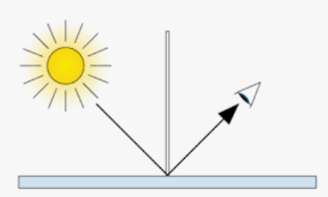

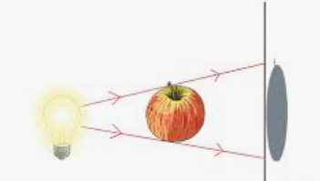
Sticky knowledge
Year group: 3 | Term: Autumn 1 | Subject: Science | Topic: Light
Substantive knowledge:
We need light in order to see things Dark is the absence of light Light reflects from surfaces Light from the sun can be dangerous- wearing sunglasses is a way to protect eyes Shadows are formed when the light from a light source is blocked by an opaque object The closer to the light source an object is, the bigger the shadow will be. This is because the object blocks more of the light. The further away from the light source an object is, the smaller the shadow will be. This is because the object blocks less of the light.
Key vocabulary and definitions:
Light- a source of energy that allows us to see Light source- where light comes from (eg lamp, sun, streetlight) Transparent- light can pass through an object- it is see through Translucent- some light can pass through an object (eg tracing paper) Opaque- no light can pass through an object- it is not see through

Slide 3
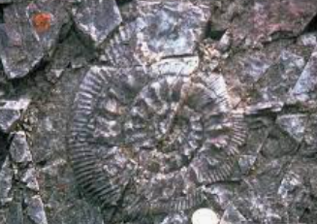
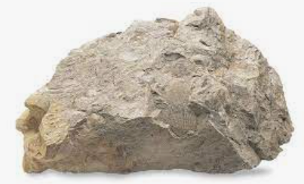
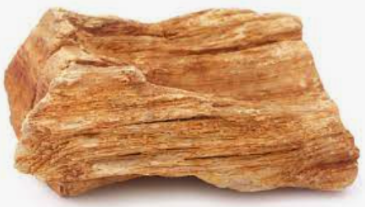
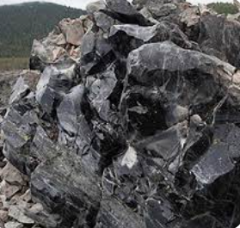
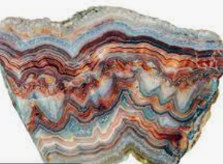
Sticky knowledge
Year group: 3 | Term: Autumn 2 | Subject: Science | Topic: Rocks
Prior Learning:​
EYFS: Exploring plastic and its effect on the environment.​ Vocab linked to the 'touch lens' to describe natural and man-made materials. ​ Year 1: Common materials around us include wood, plastic, glass, metal, water and rock were identified; an understanding that wood is hard, plastic and metals are smooth, and water is wet was developed; children also started to identify what objects are waterproof, hard and squishy.​ Year 2: Understanding the uses of materials, such as: brick and stone are the best material to build a house; metal and plastic are waterproof materials; glass is transparent; fabric is absorbent; wood is opaque, and the properties of materials can be considered for sorting.
Substantive knowledge:
There are three main types of rocks: igneous, metamorphic and sedimentary Hard types of rocks are usually resistant to erosion Some soft rocks hold a lot of water Soil is a mixture of tiny particles of rock, dead plants and animals, air and water Fossil is the preserved remains or traces of a dead organism Fossils are formed after animals die the soft parts of its body decompose leaving the hard parts like skeletons behind. This becomes buried by small particles of rock called sediment. As sediment builds up it turns to rock More sediment builds up and the skeleton turns to rock to become a fossil.
Key vocabulary and definitions:
Sediment- small bits of matter that have been broken down (eg sand, pebbles, etc) Erosion- gradual destruction/ wearing away Igneous rock- rock formed from cool magma Sedimentary rock- rocks which are formed from smaller particles- usually caused by erosion Metamorphic rock- rock formed by extreme pressure

Slide 4
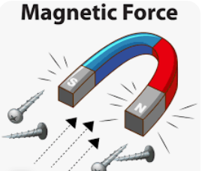
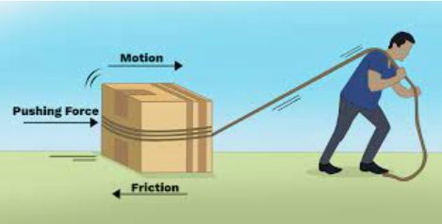
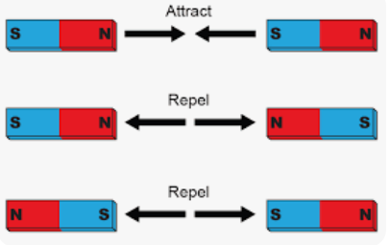
Sticky knowledge
Year group: 3 | Term: Spring 1 | Subject: Science | Topic: Forces
Key vocabulary and definitions:
Force – A force is a push or a pull in a particular direction. Friction – A force that describes what effect a surface has on the travelling ability of an object. Attract – The ability of objects to pull towards each other. Repel – The ability of objects to push away from each other.
Substantive knowledge:
Friction is the force that is created when an object travels along a surface. Rough surfaces create lots of friction. Smooth surfaces create little friction. Magnets attract/repel. Magnets can cause magnetic objects to move without being in contact with each other Iron, nickel, and cobalt are magnetic. Wood, plastic, steel, and rubber are examples of non-magnetic materials Two North/South poles of a magnet repel each other. A North against a South pole of a magnet attract each other.

Slide 5
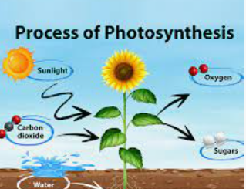
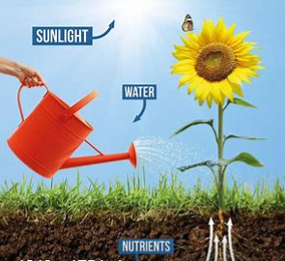
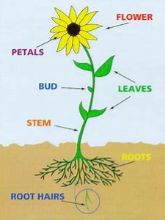
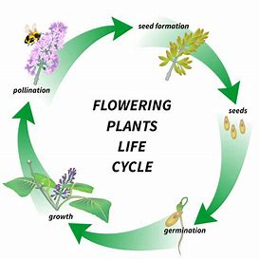
Sticky knowledge
Year group: 3 | Term: Summer 1 | Subject: Science | Topic: Plants
Prior learning:​
EYFS: Experience of planting and taking care or plants. Children learn that plants need water and sun to grow. ​Year 1: Children are taught about a variety of common and wild plants, including deciduous and evergreen trees. All plants grow from a seed and have roots, a stem, leaves, some have a flower. Children also gain an understanding that there are 12 months in a year, 4 seasons. Spring, Summer, Autumn ​ and Winter, 24 hours in a day that is split into day and night. Spring the days begin to get longer. ​ Year 2: When a plant sprouts, it grows new shoots, those shoots grow upwards from the seed or plant to find sunlight. All plants need water and sunlight to grow is taught. What seeds and bulbs need to grow, where they are found and how they grow is explored.
Substantive knowledge:
Plant stems have special cells called xylem. These cells form long thin tubes that run from the roots up the stems to the leaves. The life cycle of flowering plants, include pollination, seed formation and seed dispersal Leaves help the plant to get nutrients from the sunlight using a process called photosynthesis Plants need air, light, warmth, water and nutrients to be healthy Roots transfer water from the soil into the plant The stem is the transportation route of water from root to the leaves
Key vocabulary and definitions:
Roots- holds the plant in the ground and collects water Leaves- attached to the stem. Leaves help to make food for the plant using photosynthesis Photosynthesis- using sunlight to get nutrition Petal- sections around the edge of a flower Stem- supports the plant and carries water and nutrition from the roots to the leaves flowers- the seed bearing part of the plant Pollination- how pollen is transferred Seed dispersal- when seeds are moved to another place

Slide 6
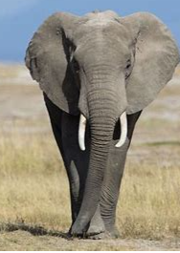
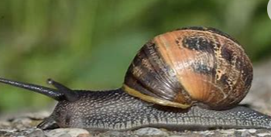
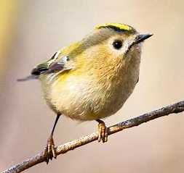
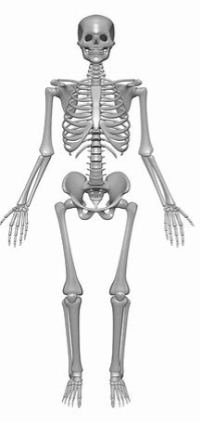
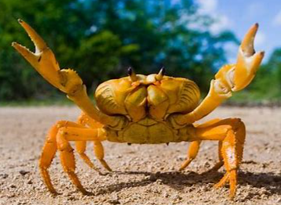
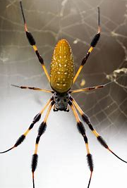
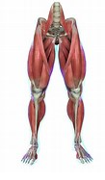
Sticky knowledge
Year group: 3 | Term: Summer 2 | Subject: Science | Topic: Animals including humans
Prior Learning​
EYFS: The five senses are sight, touch, taste, smell, hearing (supporting the use of the FANTASTICS)​ ​ Year 1: Humans are mammals and have 2 hands to touch, two ears to hear, one nose to smell, two eyes to see and a tongue to taste. A person has a head, nose, ears, neck, shoulders, arms, elbows and wrists, hand back, chest, hip and legs, knee, ankles, feet. Alongside this, humans need a healthy diet to grow.​ Year 2: Children explore what food is healthy and unhealthy. The importance of exercise is also acknowledged and what happens to our heart when we exercise. Hygiene and its importance is also discussed. . To grow into a healthy adult, we must eat the right types of food in the right amount and exercise. To stay alive, all humans have three basic needs for survival: water, food and air. The importance of teeth (brushing teeth) is also touched upon.
Key vocabulary and definitions:
Nutrition- getting the right food for growth and development Skeleton- bones inside a body Muscles- help your body to move Vertebrate- animal with a backbone Invertebrate- animal without a backbone
Substantive knowledge:
Humans need the correct nutrition to be able to grow and develop. We get out nutrients from the food we eat The nutrients our bodies need to grow and function include carbohydrates, protein, fats, vitamins and minerals A skeleton supports and shapes our body A skeleton protects our vital organ, such as our brain, heart and lungs Our muscles move body parts by contracting and relaxing Vertebrates include fish, birds and mammals Invertebrates include spiders, worms, snails and crabs

