Slide 1


Year 4 Science

Slide 2
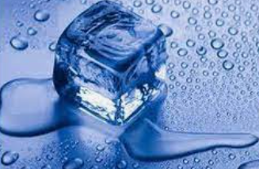
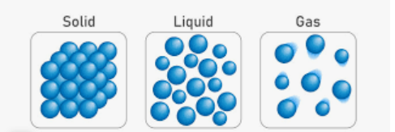
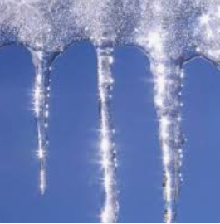
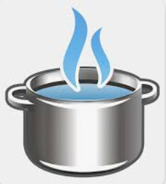
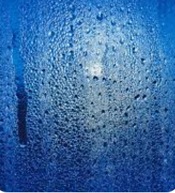
Sticky knowledge
Year group: 4 | Term: Autumn 1 | Subject: Science | Topic: State of matter
Substantive knowledge:
A solid can hold its shape (for example, water in solid form is ice) A liquid like water forms a pool: it flows or runs but it cannot be stretched or squeezed A gas can flow, expand and be squeezed; if it is in an unsealed container it escapes (water in gas form is steam) Solids and liquids can be changed from one state to another by heating or cooling Ice (solid) when heated, changes to water (liquid) – this is called melting Water (liquid) when cooled, changes to ice (solid) – this is called freezing If water (liquid) is heated, it changes to water vapour (gas) - this is called evaporation If water vapour (gas) is cooled down, it changes into water (liquid) – this is called condensation.
Key vocabulary and definitions:
Evaporation – when a liquid is heated and changes into a gas. Condensation – when a gas is cooled and changes into a liquid. Solidify – Make or become hard or solid. Melting- when something is liquified by heat Freezing- to turn from liquid to solid when heat is lost

Slide 3
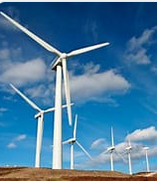
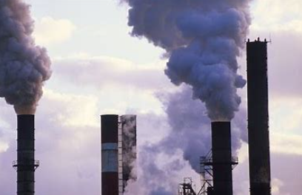
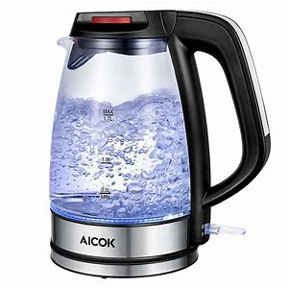
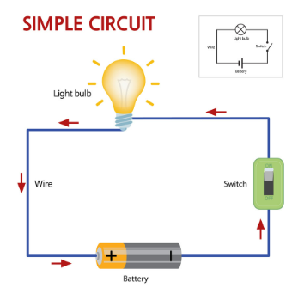
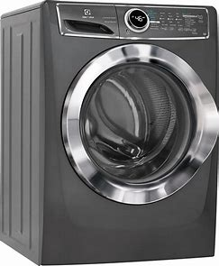
Sticky knowledge
Year group: 4 | Term: Autumn 2 | Subject: Science | Topic: Electricity
Substantive knowledge:
Many household appliances run on electricity- these include a fridge, kettle, television and dishwasher Electricity flows through all the components in a circuit - a circuit has a power source, wires and other components such as bulbs or buzzers Electricity only flows through a complete circuit An open switch breaks the circuit stopping electricity from moving around the circuit Insulators do not allow electricity to pass through them; plastic, wood, glass and rubber are good electrical insulators. Conductors are materials that let electricity pass through them easily; metals, such as copper, iron and steel, are good electrical conductors A switch creates a break by opening and closing a circuit A cell needs a complete circuit to light up The basic parts of a series circuit include cells, wires, bulbs, switches and buzzers Renewable resources can naturally replenish themselves while non-renewable resources cannot The main hazards of electricity include rick of electric shock and burns from touching live parts
Key vocabulary and definitions:
Electricity- supply of electric current to a building for heating, lighting, or powering appliances Circuit- a complete and closed path around which electric current can flow Terminal- a point at which a connection can be made to an electrical circuit

Slide 4
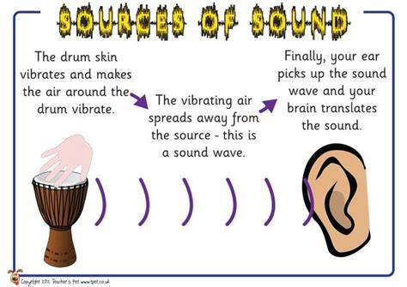
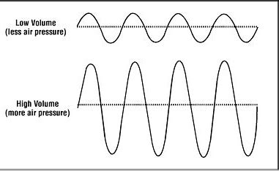
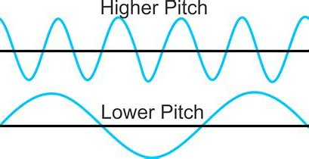
Sticky knowledge
Year group: 4 | Term: Spring 1 | Subject: Science | Topic: Sound
Key vocabulary and definitions:
Pitch- describes how low or high a sound is Volume- is how loud or quiet the sound is Vibration- quickly moving back and forth or up and down Sound - vibrations that travel and can be heard when they reach your ear Source- what makes the sound
Substantive knowledge:
Sound is made when objects vibrate When objects vibrate the air around the object vibrates and the air vibrations then travel to and enter your ear Sound waves can travel through solids, liquids and gases High pitched sound is made from smaller, shorter, thinner, tighter and denser objects Low pitched sounds are made from longer, thicker, looser and less dense objects If a nail is hit hard by a hammer, it will make strong vibrations which create a louder sound If a nail is hit gently by a hammer, it will make weaker vibrations which means it will make a quiet sound As sound vibrations travel, they start to lose energy so a sound gets fainter the further away it is from the source

Slide 5
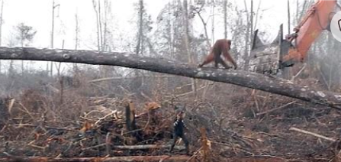
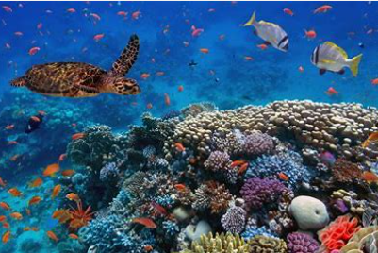
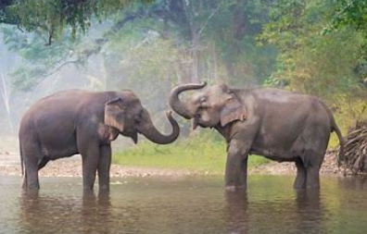
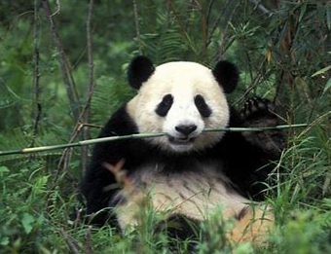
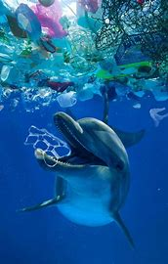
Sticky knowledge
Year group: 4 | Term: Spring 2 | Subject: Science | Topic: Living things and their habitats
Key vocabulary and definitions:
Characteristics- are the distinguishing features or quality of something. Characteristics as those qualities that make a person or a thing different from others. For example, the ability to camouflage is a characteristic of the chameleon. Classify- To classify something means to arrange (a group of people or things) in categories based on their shared qualities or characteristics Habitat- A habitat is the place where living things naturally live and grow. Habitats provide them with the food, water and shelter they need to live.
Prior Learning​​
Year 2: Children are taught that a habitat is a place that an animal lives. It provides the animal with food, water and shelter. There are many different sorts of habitats around the world from forests, grasslands, mountains and deserts. Some animals are specifically identified and discussed such as; a polar bear lives in an arctic habitat because it has thick fur to keep warm. The idea that some things are alive, some things are dead and somethings have never been alive is investigated.
Substantive knowledge:
Habitats are where plants and animals live that suit their needs best. Habitats can be changed, damaged, and destroyed. Humans are usually the most responsible for destroying animal habitats. Some animals are in danger of being extinct because their habitats are being destroyed Animals and plants can be grouped according to their characteristics. Classifying is labelling animals and groups according to their characteristics which can be the same or different All living things share 7 of the same characteristics- reproduction, respiration, excretion, senses, nutrition, movement, and growth.

Slide 6
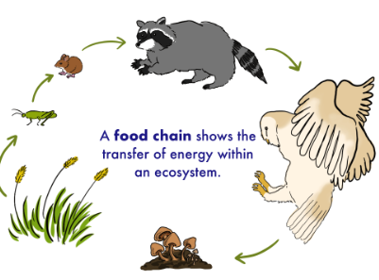
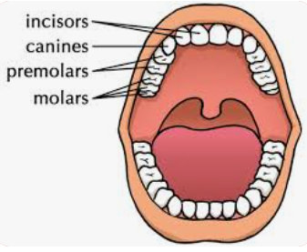
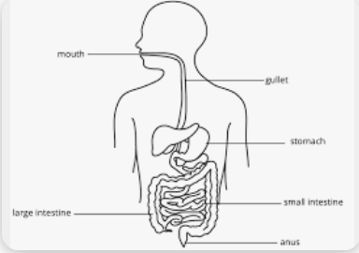
Sticky knowledge
Prior Learning​​
EYFS: The five senses are sight, touch, taste, smell, hearing (supporting the use of the FANTASTICS)​​ ​​ Year 1: Humans are mammals and have 2 hands to touch, two ears to hear, one nose to smell, two eyes to see and a tongue to taste. A person has a head, nose, ears, neck, shoulders, arms, elbows and wrists, hand back, chest, hip and legs, knee, ankles, feet. Humans need a healthy diet to grow.​​ ​ Year 2: Children explore what food is healthy and unhealthy. The importance of exercise is also acknowledged and what happens to our heart when we exercise. Hygiene and its importance is also discussed. . To grow into a healthy adult, we must eat the right types of food in the right amount and exercise. To stay alive, all humans have three basic needs for survival: water, food and air. The importance of teeth (brushing teeth) is also touched upon. Year 3: Nutrition is explored and the idea that humans need the correct nutrition to be able to grow and develop. The importance of a skeleton is acknowledged and what part our muscles play within our bodies is identified. The different types of animals are retrieved with invertebrates and vertebrates being added to the children's knowledge.
Year group: 4 | Term: Summer 1 | Subject: Science | Topic: Animals, including humans
Substantive knowledge:
The main organs that make up the digestive system (in order of their function) are the mouth, esophagus, stomach, small intestine, large intestine, rectum and anus. The digestive system breaks down food into tiny particles which are absorbed into the blood. The different types of teeth include molars, incisors and canines Teeth have three main functions of breaking down food, enabling us to pronounce words and shaping the face. Sugary foods and drinks cause the most damage to teeth. Carnivores – eat meat and have long pointed canines, sharp incisors and very few molars at the back. Herbivores – eat plants and have sharp incisors and wider flatter molars. They do not have any canines. Plants that produce the energy are eaten by herbivores. Carnivores eat the herbivores. Energy is transferred from one to the other.
Key vocabulary and definitions:
Small intestine - The small intestine (small bowel) lies between the stomach and the large intestine (large bowel). Large intestine - The long, tube-like organ that is connected to the small intestine at one end and the anus at the other. Oesophagus - The oesophagus is the long tube that carries food from the throat to the stomach. Producers - plants make their own food through photosynthesis Predators- are carnivores, which means their diet consists of meat. Prey-animals that are killed and eaten by other animals.

