Slide 1


Year 5 Science

Slide 2
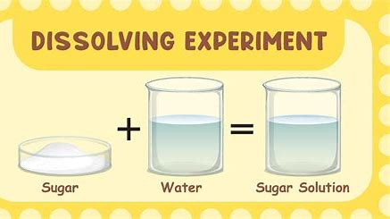
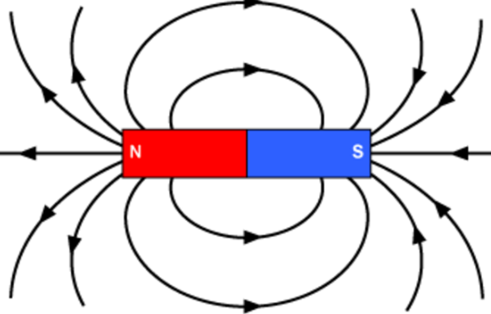
Sticky knowledge
Year group: 5 | Topic: Properties and changing materials | Term: Aut 1
Prior Learning:​
EYFS: Exploring plastic and its effect on the environment. Vocab linked to the 'touch lens' to describe natural and man-made materials. Year 1: Common materials around us include wood, plastic, glass, metal, water and rock were identified; an understanding that wood is hard, plastic and metals are smooth, and water is wet was developed; children also started to identify what objects are waterproof, hard and squishy. Year 2: Children explore the best materials to build a house .What materials are waterproof, transparent, absorbent and opaque are investigated and sorted. Year 3- magnets and forces Year 4- states of matter- solids, liquids and gases, condensation, evaporation, freezing and melting
Key vocabulary and definitions:
Matter: What everything is made out of either as a solid, liquid or gas. Evaporation: When a solid is heated and turns into gas. Condensation: When a gas cools down and turns into a liquid. Fair Test: When only one variable is changed. Variables: The aspects of a test that we change to record results. Control Variable: The one variable that is changed to make a fair test. Insulation: Where heat is trapped by materials Thermometer: What we use to measure temperature. Magnetism: Means that something is affected by magnetic force. Magnetic Field: The amount of magnetism generated by a magnet. Ferromagnetic: Means it contains either iron, nickel or cobalt, which are magnetic. Transparent: You can see completely through it. Translucent: You can see partially through it. Opaque: You cannot see through it Separating: When types of liquid, solid or gas are separated from each other. Filtration: When liquids or solids or gases are separated using filters. Reversible Change: When a change is permanent and cannot be undone. Irreversible Change: When a change is not permanent and it can be undone.
Substantive knowledge:
Objects are either transparent, translucent or opaque Some materials are magnetic- such as iron and nickel Magnets can attract or repel each other Magnets always have a north and south magnetic pole Magnets are used in a lot of electronic devices Magnets can be used to speed up or slow down objects, including trains or rollercoasters The Earth has its own magnetic field with a North and South pole – like a giant magnet Thermal insulation can be used to keep things warm Different materials have different thermal properties Layers of material trap air which can be used as a thermal insulator When we dissolve a solid into a liquid, we create a solution When you cannot dissolve any more solid it means the solution is saturated If a solid dissolves in water, it is soluble, if not it is insoluble Objects in a solution can be separated through filtration or evaporation Solids can be separated using sieves or magnets.

Slide 3
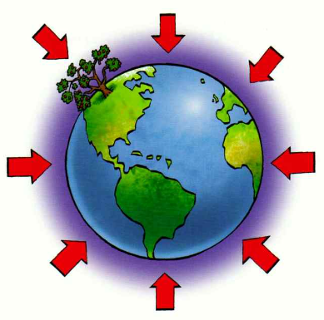
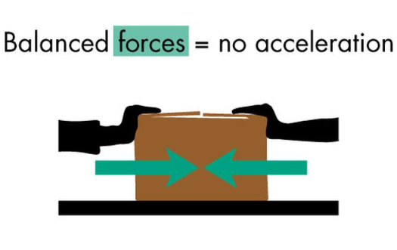
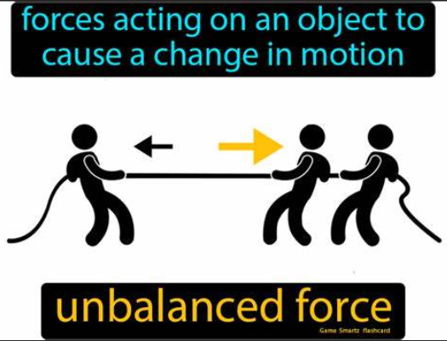
Sticky knowledge
Year group:5 | Topic: Forces | Term: Aut 2
Prior Learning​​​​
Year 3: Children explore friction and the fact it is the force that is created when an object travels along a surface. Magnets attract/repel, North/South is investigated and what materials are magnetic is identified. The concept that rough surfaces create lots of friction and smooth surfaces create little friction.
Substantive knowledge:
Friction is a force between two surfaces that are sliding Friction always works in the direction opposite to the direction in which the object is moving Friction always slows a moving object down Gravity is force that pulls things to the ground on Earth (and other planets) Gravity holds Earth and the other planets in their orbits around the Sun When two forces are balanced, it means the forces are the same size but are acting in opposite directions When two balanced forces are acting on an object, that object will not change its motion A lever is a long, sturdy body that rests on a support called a fulcrum On a lever, you apply force in one direction, and the pivot point re-directs the force in another direction.
Key vocabulary and definitions:
Gravity – is an invisible force that pulls objects towards each other Air resistance is a type of friction between air and another material Water resistance is a type of force that uses friction to slow things down that are moving through water Levers/Pulley/Gears/and or Springs - allow a smaller force to have a greater effect.

Slide 4
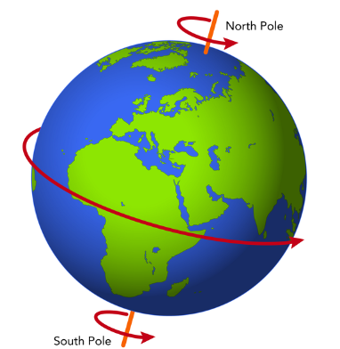
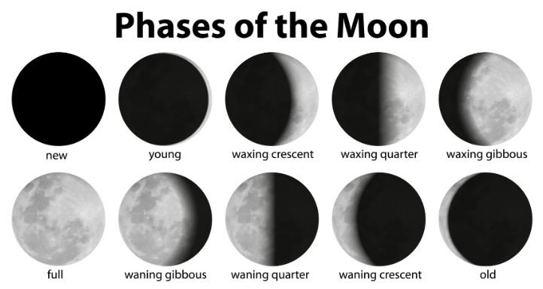
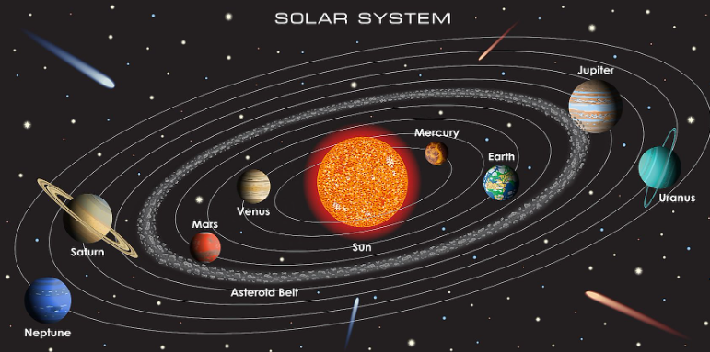
Sticky knowledge
Year group: 5 | Topic: Earth and Space | Term: Spring 1
Prior Learning​​​
EYFS: The moon stays in place because of gravity. The children are taught about meteor showers and how they are often called shooting stars and explore some planets names. The children are introduced to Mae Jemison and the fact she was the first African American woman in space. Year 2- Children learn about Neil Armstrong in history and the first moon landing
Substantive knowledge:
8 planets in our solar system – Mercury, Venus, Earth, Mars, Jupiter, Saturn, Uranus, and Neptune. Earth is spherical. Planets in our solar system orbit the Sun. Moon orbits the Earth while it rotates, and the Earth orbits the Sun Phases of the moon: new moon, waxing crescent, first quarter, waxing gibbous, full moon, waning gibbous, third quarter and waning crescent Earth takes 24 hours to rotate Earth takes 365 ¼ days to orbit the Sun Earth is tilted on an axis
Key vocabulary and definitions:
Orbit = how long it takes a planet to complete a journey around the sun. Rotation = how long a planet takes to independently turn on its axis. Solar system = the sun and everything that orbits around the sun.

Slide 5
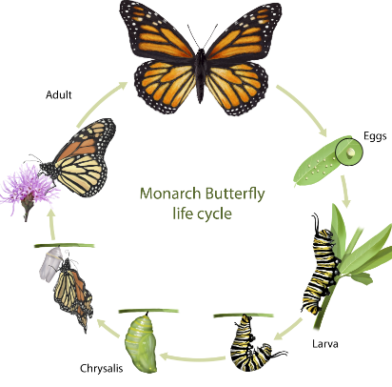
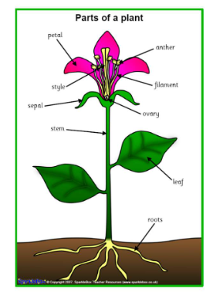
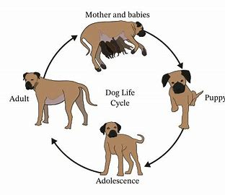
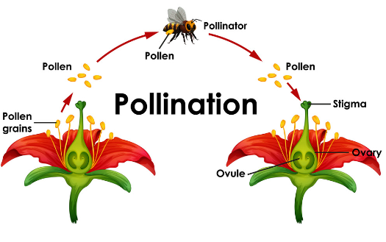
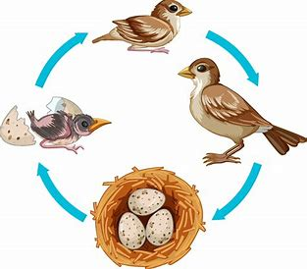
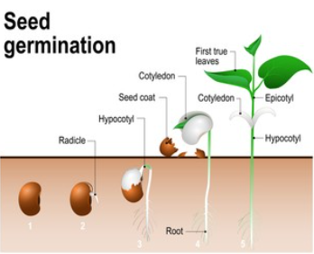
Sticky knowledge
Year group: 5 | Topic: Living things and their habitats | Term: Spring 2
Prior Learning​​​
EYFS- life cycle of butterfly observed Year 2: Children are taught that a habitat is a place that an animal lives. It provides the animal with food, water and shelter. There are many different sorts of habitats around the world from forests, grasslands, mountains and deserts. Some animals are specifically identified and discussed such as; a polar bear lives in an arctic habitat because it has thick fur to keep warm. The idea that some things are alive, some things are dead and somethings have never been alive is investigated. Year 4: Children explore which habitats suit the needs of plants and animals best. Children are introduced to the idea that habitats can be changed, damaged, and destroyed, including how and what is responsible for their demise (humans). The definition of classification is taught and how this supports with grouping animals. All living things share 7 of the same characteristics- reproduction, respiration, excretion, senses, nutrition, movement, and growth is explored.
Key vocabulary and definitions:
Invertebrate : an animal with no backbone (spine) Vertebrate: an animal with a backbone (spine) Classify: sort according to shared qualities or characteristics Amphibian:
Substantive knowledge:
Animals with no backbone are called invertebrates. Animals with a backbone are called vertebrates. Animals can be sorted into different groups: fish, mammal, amphibian, bird, reptile. Every living animal goes through a process called a life cycle. Lifecycles are different for mammals, amphibians, insects and birds Sexual reproduction involves a mother and a father while asexual reproduction involves 1 parent producing an identical clone. Parts of the flower: stigma, stamen, petal, anther, filament, sepal, style, ovary Pollination is the transfer of pollen from male part to the female part to produce seeds Germination is when seeds settle in suitable ground, breaks down and starts to grow.

Slide 6
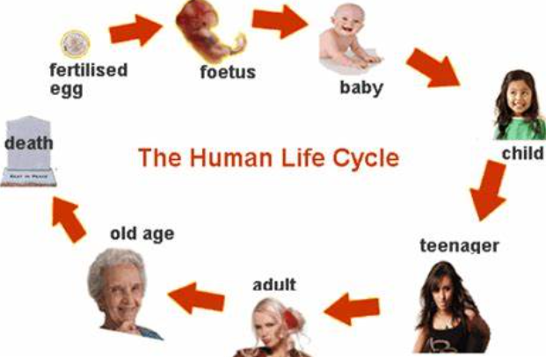
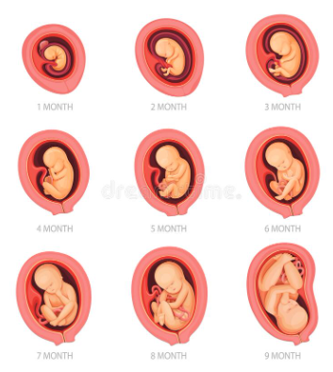
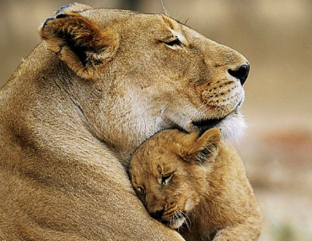
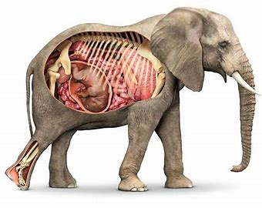
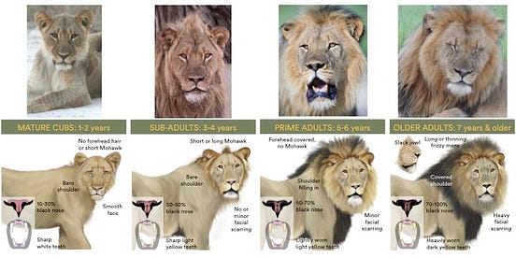
Sticky knowledge
Year group: 5 | Topic: Animals including humans | Term: Summer 1
Prior Learning​​​
EYFS: The five senses are sight, touch, taste, smell, hearing (supporting the use of the FANTASTICS) Year 1: Humans are mammals and have 2 hands to touch, two ears to hear, one nose to smell, two eyes to see and a tongue to taste. Children were taught basic body parts Year 2: Children explore what food is healthy and unhealthy. The importance of exercise and hygiene (including oral health). To grow into a healthy adult, we must eat the right types of food in the right amount and exercise. To stay alive, all humans have three basic needs for survival: water, food and air. Year 3: Children learnt that we need nutrients to be able to grow and develop. Children learnt about the function of our skeletons and muscles. Year 4: Children learnt about digestive system and its main parts- the mouth, esophagus, stomach, small intestine, large intestine, rectum and anus. Children are taught that the digestive system breaks down food into tiny particles which are absorbed into the blood. Children identify the different types of teeth including molars, incisors and canines and the importance of teeth. Children are also introduced to how energy is passed from herbivores to carnivores.
Substantive knowledge:
Puberty is when a child's body begins to develop and change as they become an adult. Animals’ bodies develop and change over time, for example a male lion will grow a mane as it becomes an adult Animals start as an embryo in the womb of the female. Foetus is the unborn offspring of an animal. Different animals have different gestation periods, a humans gestation period is 9 months, whereas an elephant's is 22 months Humans cycle is: Embryo, foetus, baby, toddler, child, teenager, adult, elderly adult. All animals grow and develop with age. Human bodies develop most before the adult stage of life.
Key vocabulary and definitions:
Growth - Growth in animals happens when the cells inside the organism start to divide and multiply. Development - Animal development, the processes that lead eventually to the formation of a new animal starting from cells derived from one or more parent individuals. Puberty – When the body begins to change and the child changes into a grown up. Gestation - The time period between conception until birth, during which the foetus develops in the womb.

