Slide 1


Year 6 Science

Slide 2
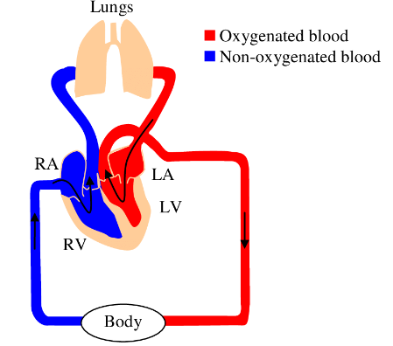
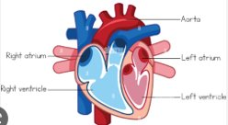
Sticky knowledge
Year group: 6 | Topic: Animals including humans | Term: Aut 1
Prior Learning​​​​
EYFS: The five senses are sight, touch, taste, smell, hearing (supporting the use of the FANTASTICS) Year 1: senses and simple body parts explored Year 2: Food, importance of exercise and hygiene were taught. Children learnt that we need air, water and food to survive. Children learnt about oral hygiene Year 3: Children learnt that we need nutrients to be able to grow and develop. Children learnt about the function of our skeletons and muscles. Year 4: Children learnt about digestive system and its main parts- the mouth, esophagus, stomach, small intestine, large intestine, rectum and anus. Children are taught that the digestive system breaks down food into tiny particles which are absorbed into the blood. Children identify the different types of teeth including molars, incisors and canines and the importance of teeth. Children are also introduced to how energy is passed from herbivores to carnivores. Year 5: Puberty is discussed and explored. Children learnt that animals’ bodies develop and change over time. The understanding that an embryo starts in the womb of the female, a foetus is the unborn offspring of an animal and that animals have different gestation periods. The human cycle is embryo, foetus, baby, toddler, child, teenager, adult, elderly adult.
Substantive knowledge:
The heart, blood vessels, arteries, veins and blood are parts of the circulatory system Arteries carry oxygenated blood away from the heart to the rest of the body Veins carry deoxygenated blood back to the heart The function of the heart is to pump blood around your body The heart is a muscle at the centre of the circulatory system Diet, exercise and drugs can impact the way the body functions Nutrients and water are absorbed in the stomach, small and large intestines Nutrients and water enter the bloodstream via the capillaries where they are passed through the arteries.
Key vocabulary and definitions:
Circulatory system (cardiovascular system or vascular system) – made up of vessels and muscles that help and control the flow of the blood around the body. Oxygenated blood – Blood that has a high concentration of oxygen in the red blood cells. Deoxygenated blood - blood rich in carbon dioxide Arteries – critical part of your cardiovascular system, are blood vessels that distribute oxygen-rich blood to your entire body Aorta – the largest artery of the body and carries blood from the heart to the circulatory system Valves - prevent the backward flow of blood.

Slide 3
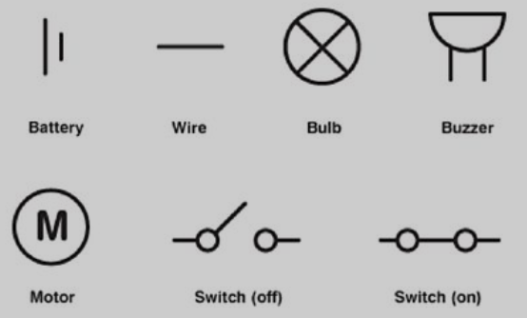
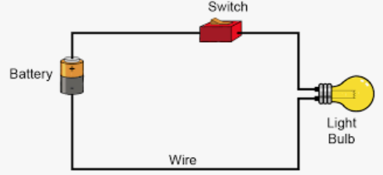
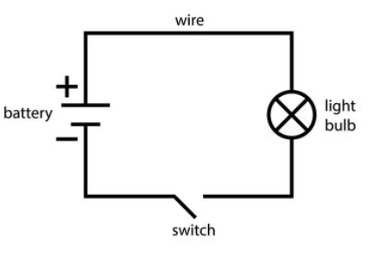
Sticky knowledge
Year group: 6 | Topic: Electricity | Term: Aut 2
Prior Learning​​​​​
Year 4: Children are taught that eelectricity flows through all the components in a circuit. Children investigate how an open switch breaks the circuit stopping electricity from moving around the circuit; a closed switch maintains electricity flow. Insulators are introduced and children learn that these do not allow electricity to pass through them. Alongside this, children learn about conductors and the idea that these are materials that let electricity pass through them easily. Renewable and non-renewable electricity is also explored.
Substantive knowledge:
The brightness of a lamp or the volume of a buzzer are linked to the number and voltage of cells used in a circuit A battery is a source of power so that electrical objects can work Electricity flows from one end of a circuit to another A switch will break the flow of electricity A fuse it is an emergency switch that cuts power when there is too much power When all the electrical components are connected in a ring or loop, this is a series circuit Each component follows the next in a loop In parallel circuits, each electrical component shares a direct link to the battery - this allows each component to work even if the other component is broken. Understand how components function including the brightness of a bulb, the loudness of buzzers and the on/off position of switches Common conductors include metal and graphite Common insulators include plastic and paper
Key vocabulary and definitions:
Resistance – is a measure of the opposition to current flow in an electrical circuit Insulator – A material which does not easily allow electric current to pass through it. Conductor - a material which allows an electric current to pass through it. Electrons – A small particle with a negative charge that is found in all atoms. Resister – an electrical component that limits or regulates the flow of electrical current in an electronic circuit.

Slide 4
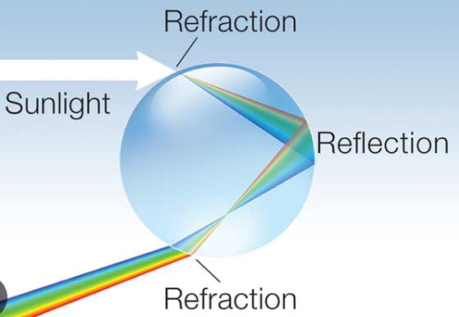
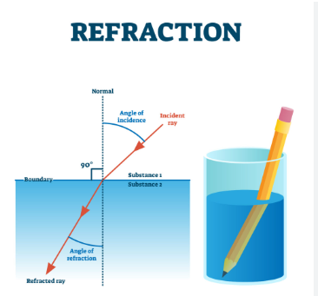
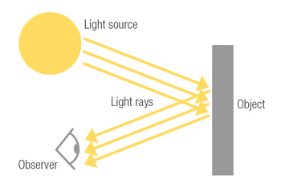
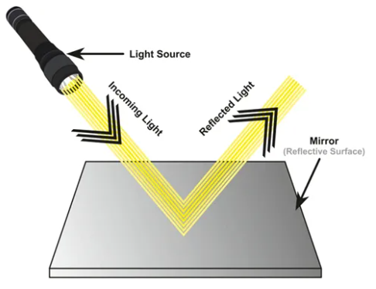
Sticky knowledge
Year group: 6 | Topic: Light | Term: Spring 1
Prior Learning​​​​​
​ Year 3: Children were taught that: light is reflected from surfaces , light from the sun can be dangerous, shadows are formed when the light from a light source is blocked by an opaque object and they investigated how the size of shadows can change
Key vocabulary and definitions:
Reflection is when light bounces off an object or surface and changes direction Refraction is the bending of light as it passes from one transparent substance to another Spectrum is the intensity of light as it varies with wavelength or frequency.
Substantive knowledge:
A light ray or beam is a source of light Light seems to travel in a straight line When we see something, what we actually see is reflected light Light bounces off the object- that is how we see it Shadows are formed when light from a source is blocked by an opaque object The closer an object is to the source of light the bigger the shadow Rainbows are formed when light shines through water, like when the sun shines through the rain When light is bent and reflected, like a reflection in a mirror, this causes the rainbow of colours that you see

Slide 5
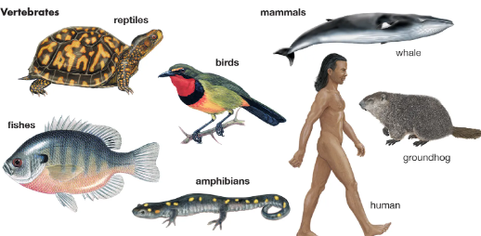
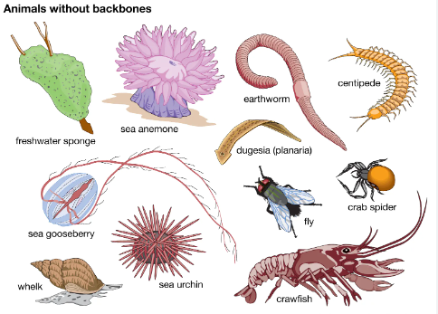
Sticky knowledge
Year group: 6 | Topic: Living things and their habits | Term: Spring 2
Prior Learning​​​​
Year 2: Children learnt what a habitats is and that it provides the animal with food, water and shelter.. They learnt about different habitats and the animals that live there. They learnt that some things are alive, some things are dead and somethings have never been alive. ​ Year 4: Children learnt that habitats can be changed, damaged, and destroyed. Humans are usually the most responsible for destroying animal habitats. Animals and plants can be grouped according to their characteristics. All living things share 7 of the same characteristics- reproduction, respiration, excretion, senses, nutrition, movement, and growth. ​ Year 5: Animals with no backbone are called invertebrates. Animals with a backbone are called vertebrates. Animals can be sorted into different groups: fish, mammal, amphibian, bird, reptile. Every living animal goes through a process called a life cycle. Sexual reproduction involves a mother and a father while asexual reproduction involves one parent producing an identical clone. Parts of the flower are explored. Children learn that pollination and germination.
Key vocabulary and definitions:
Classification – Grouping living things together by common characteristics Vertebrates - Animals with a backbone Invertebrates - Animals lacking a backbone Microorganisms – A microscopic organism Reptiles – A vertebrate usually distinguished by having dry scaly skin
Substantive knowledge:
Vertebrates are classified into 5 main groups (Mammals, Reptiles, Amphibians, Birds and Fish) Organisms can be divided into groups or 'classified' by looking at the similarities and differences between them Animals are divided into two main groups- vertebrates and invertebrates A key is a set of questions about the characteristics of living things - you can use a key to identify a living thing or decide which group it belongs to by answering the questions Microorganisms are tiny living organisms - they are so small they can only be seen with a microscope Yeast is a helpful microorganism which makes bread rise Bacteria is a microorganism which breaks down plants into nutrients Plants could be classified by those that have seeds and those without seeds

Slide 6
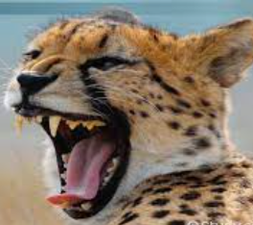
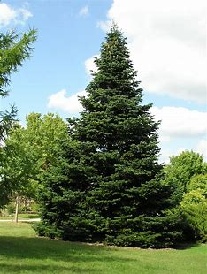
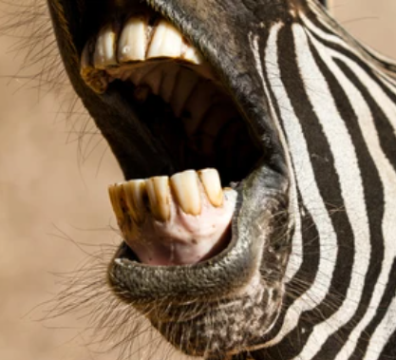
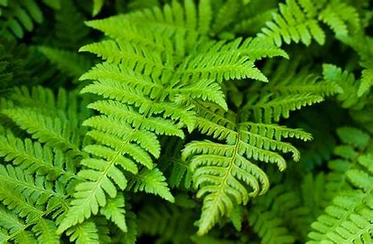
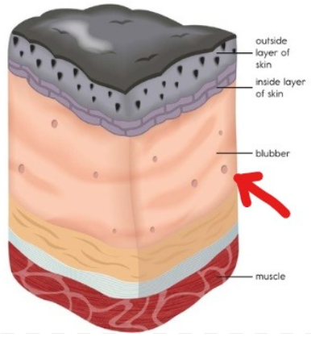
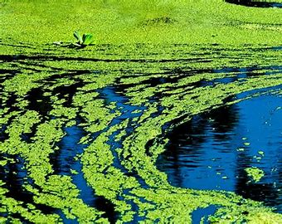
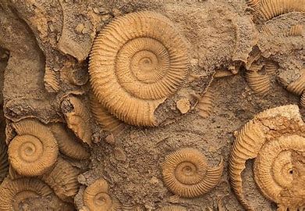
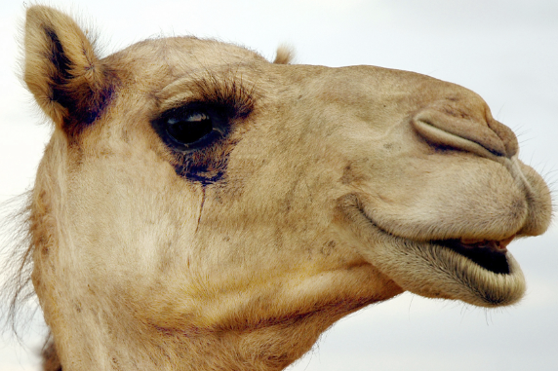
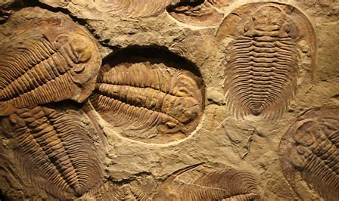
Sticky knowledge
Year group: 6 | Topic: Evolution and Inheritance | Term: Summer 1
Substantive knowledge:
Fossils are imprints of long dead plants and animals found in rocks-they provide information. Livings things produce offspring of the same kind Normally offspring vary and are not identical to their parents Animals and plants are adapted to suit their environment Adaptation may lead to evolution Herbivores have broad, flat molars (back teeth) with rough surfaces, which are used for grinding up tough plant tissues Carnivores have sharp back teeth to tear the flesh and swallow it whole Omnivore have adaptations that allow them to consume both meat and vegetables Penguins have adapted to their cold environments by their layer of thick blubber under their skin- this keeps their vital organs safe from the cold Camels have adapted to have long eye lashes to help keep the sand out of their eyes
Key vocabulary and definitions:
Conifers – mostly evergreen trees or shrubs with scale-like leaves or needles and seed-bearing cones Ferns - a plant that has long stems with feathery leaves and no flowers. Mosses – non-flowering plants which produce spores and have stems and leaves, but don't have true roots. Algae – group of predominantly aquatic (found in water) plants Plantae – refers to all plants Fungi – a plant like organism that does not make chlorophyll (helps plants absorb light)

