Slide 1

Phonics and Early Reading at Nottingham Academy Primary

Slide 2
What is phonics ?
Welcome
Purpose
Aims
What is phonics?
Phonics is a way of teaching children to read quickly and skilfully. They are taught how to: - recognise the sounds that each individual letter makes; - identify the sounds that different combinations of letters make such as /sh/ or /ee/; and - blend these sounds together from left to right to make a word
Notes:
Emma

Slide 3

New DFE Guidance for Early Reading and Phonics
The journey to independent reading and writing begins with Phonics
littlewandlelettersandsounds.org.uk
Why Little Wandle?
- Excellent training for all staff to ensure consistency,
- Every aspect of phonics and reading included in a detailed, thorough and
systematic approach,
- Engaging resources without distracting from the learning,
- Comprehensive system for identifying and supporting children requiring
extra help and useful support for parents.
Notes:
Emma
Government changes mean a change (for the better) in how we teach phonics and reading at school - make sure there is consistency throughout
Early reading is the stage where children are learning to become fluent readers through the use of phonics

Slide 4

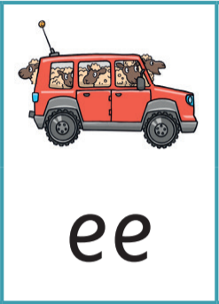

Vocabulary
Phonics (also known as ‘synthetic phonics’) – The teaching of reading by developing awareness of the sounds in words and the corresponding letters used to represent those sounds.
Phoneme - Any one of the 44 sounds which make up words in the English language.
Grapheme – How a phoneme is written down. There can be more than one way to spell a phoneme. E.g. the phoneme ‘ay’ is spelt differently in each of the words ‘way’, ‘make’, ‘fail’, ‘great’, ‘sleigh’ and ‘lady’.
Blending – Putting together the sounds in a word in order to read it, e.g. ‘f – r – o – g, frog’
Segmenting – Breaking a word into sounds in order to spell them, e.g. ‘frog, f – r – o – g’’
Digraph- 2 letters making one sound
Trigraph- 3 letters making one sound
Notes:
Emma

Slide 5
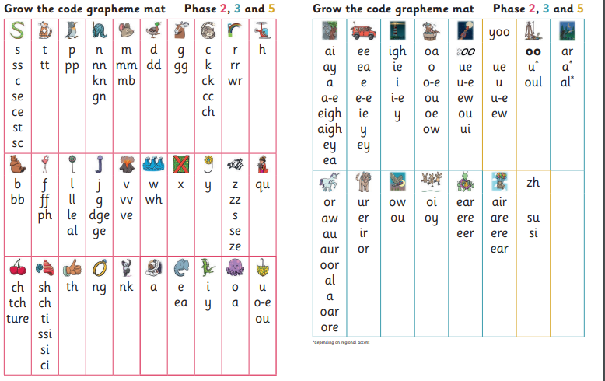
44 phonemes
Multiple spellings/graphemes for the phonemes
Notes:
Jess

Slide 6
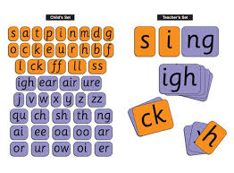
Phonics in the Early Years
F1 phonics (Foundations)-
  Rhyme
  Rhythm
  Environmental sounds
F2 phonics-
  Formally introduced
  Daily sessions
  Specific order of teaching
  Repeated practice
Notes:
Jess

Slide 7
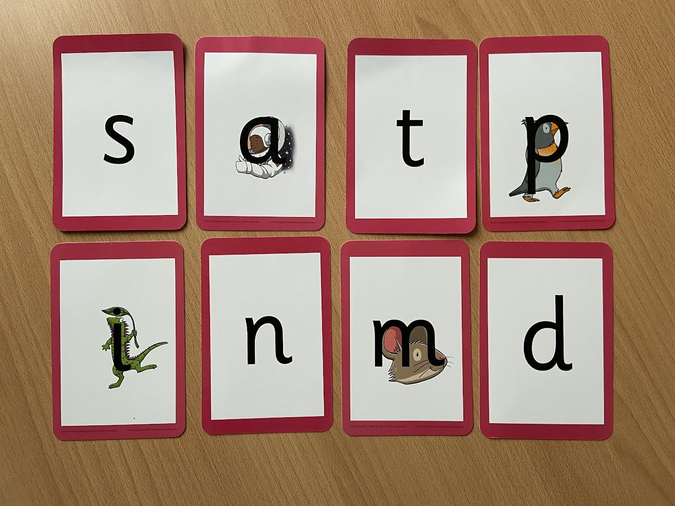
Phonics in Nursery (Foundations)
Focusing on early language development
Importance of rhythm and rhyme
Phonological awareness
Oral blending games
https://www.littlewandlelettersandsounds.org.uk/resources/my-letters-and-sounds/weekly-reading-and-phonics/little-wandle-foundations/phonics/
Notes:
Jess

Slide 8
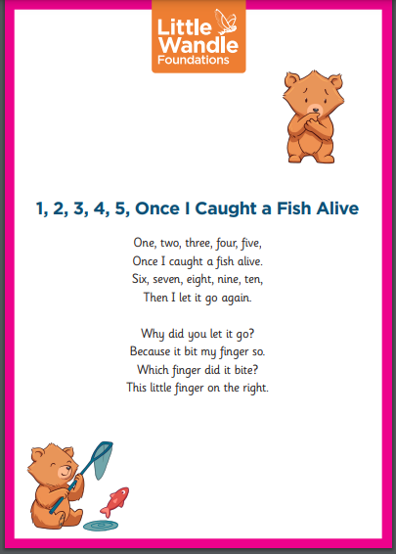
Rhyme Time
Newly introduced for F1 and F2
Each class will have a rhyme of the week
Sent home on ClassDojo
Importance of practicing to support pronunciation, speech and language, rhythm and rhyme
Notes:
Jess

Slide 9
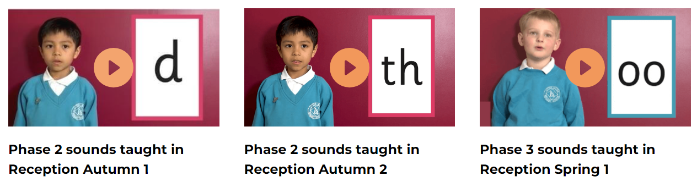
Phonics in F2
Focusing on the Pure Sound
https://www.littlewandlelettersandsounds.org.uk/resources/for-parents/
Notes:
Jess

Slide 10
Phonics in F2
Specific order
Reading as soon as possible
Notes:
Jess

Slide 11
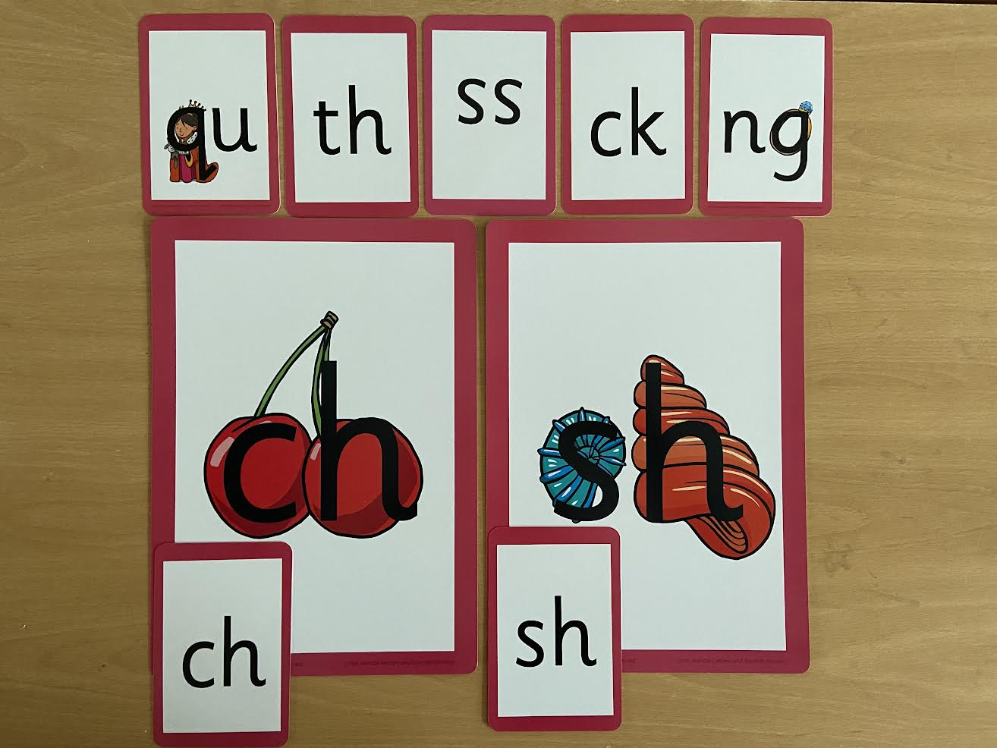
Phonics in F2
Early diagraphs
2 letters 1 sound
Picture mnemonic
Notes:
Jess

Slide 12
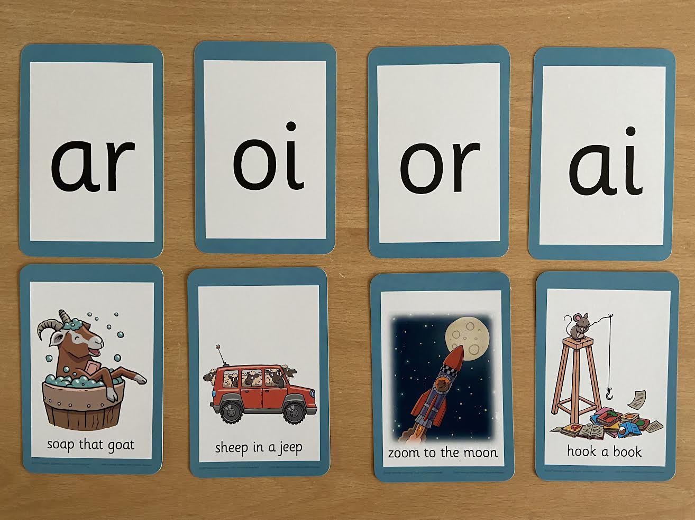
Phonics in F2
Vowel diagraphs
Short captions
Includes trigraphs
Notes:
Jess

Slide 13
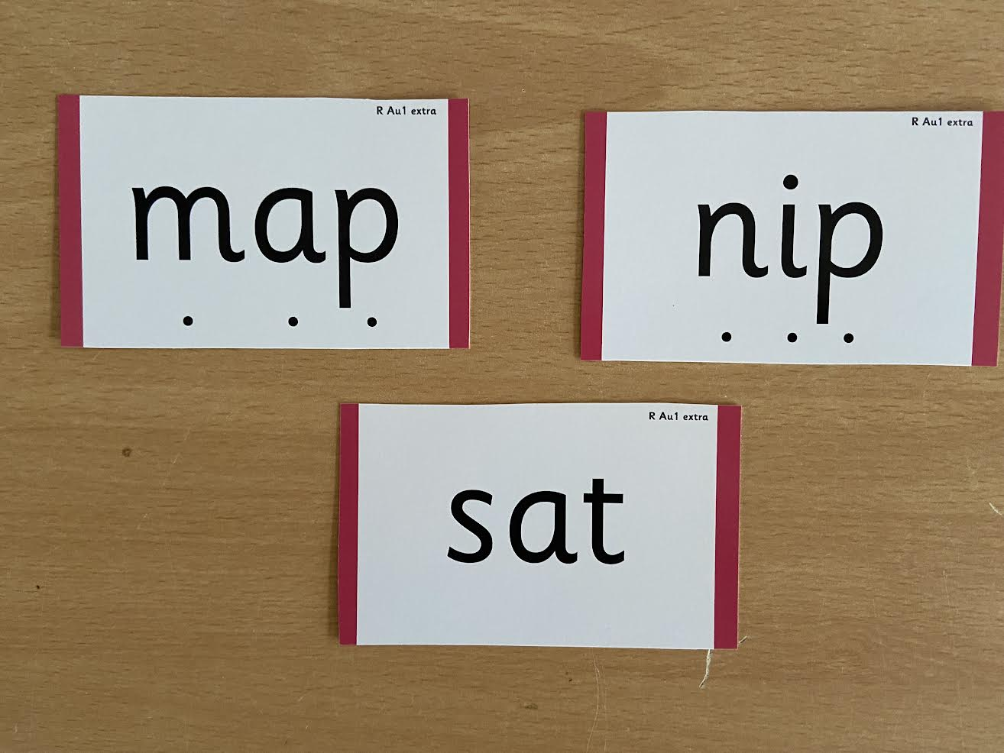
Phonics in F2
With and without sound buttons
Notes:
Jess

Slide 14
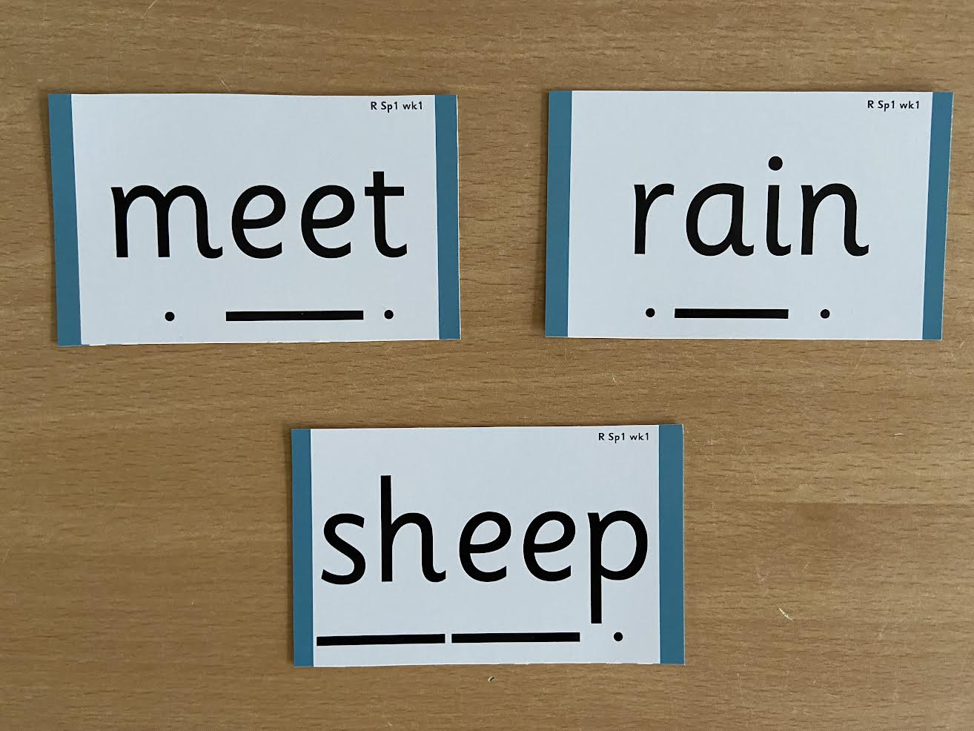
Phonics in F2
Sound buttons
Lines highlight the diagraphs
Notes:
Jess

Slide 15

Phonics in F2
Tricky words
Words that do not follow the phonics rules
Notes:
Jess

Slide 16
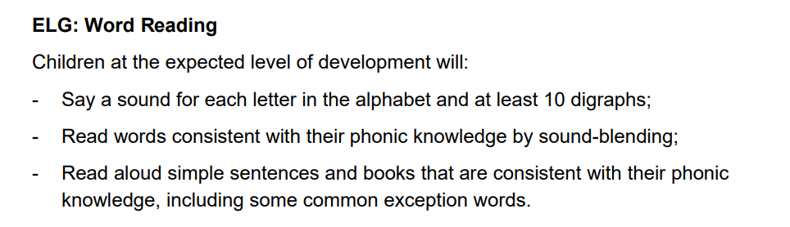
Phonics in the Early Years
End of EYFS Expectations
https://assets.publishing.service.gov.uk/government/uploads/system/uploads/attachment_data/file/974907/EYFS_framework_-_March_2021.pdf
Foundations for education
Early development of reading for pleasure
Transferable skills
Supports transition into Year 1- National Curriculum
Notes:
Jess

Slide 17
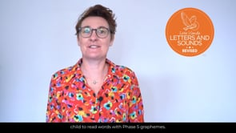

Phonics in Year 1
Continuation of teaching through the programme
Starting points
Daily sessions and Keep up
Notes:
Emma

Slide 18
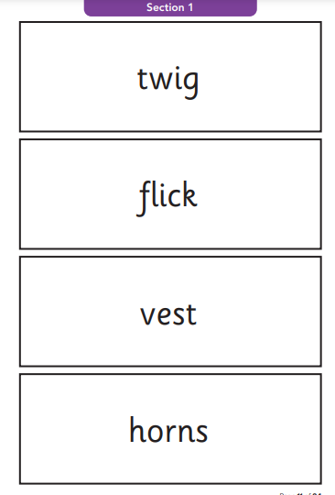
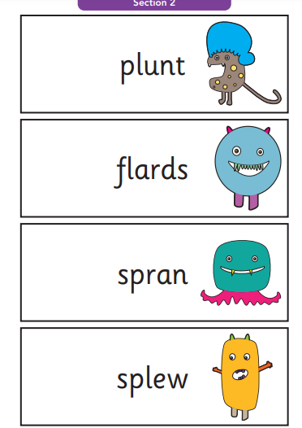

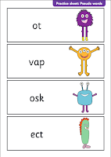
Phonics screening check
Year 1 children- National
Pseudo (alien) and real words
Notes:
Emma

Slide 19

Reading
Reading underpins children’s everything we do. It allows access to the entire curriculum and clearly impacts on their achievement in all areas.
Proven measurable impact upon later life choices and success.
Phonics- teaching how to decode
Through phonics assessments children are matched carefully to their reading books
Our aim- Fluency, comprehension and pleasure
Notes:
Emma

Slide 20
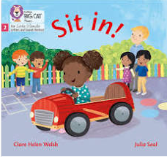


F2- Guided Reading
Taught in addition to reading in phonics and reading through continuous provision
Books are matched carefully to phonics sounds known and fluency level
2 x weekly guided reading sessions (From Autumn 2)
  1x decoding session
  1x prosody and comprehension
Sessions are repeated on a two week cycle- consolidating learning and developing fluency
Notes:
Jess

Slide 21
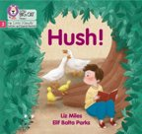


Year 1- Guided reading
In addition to reading in phonics and reading throughout the curriculum.
3 x weekly guided reading sessions
Reading Practice Books carefully matched so children can read fluently and independently
3 Reads – each one begins with some quick sounds and words practice
1) Decoding
2) Prosody
3) Comprehension
Reducing the cognitive load through repeated reading.
Notes:
Emma

Slide 22
Reading Books- F1 and F2
Nursery-
Children can take home a sharing book.
These are available outside the nursery classroom, and you can change these as often you would like.
Children are not expected to read this story, but instead share this with you to develop a love of reading.
F2-
Children will get one colour band book each week which is matched to their phonic ability.
This book will be changed once a week.
When children take their book home to read, they should be approximately 95% fluent.
Please do not worry that a book seems too easy– your child needs to develop fluency and confidence in reading.
Notes:
Jess

Slide 23
Reading Books- Year 1
Children in Year 1 will bring home the book they have been reading in their guided sessions
When children take their book home to read, they should be approximately 95% fluent.
Please do not worry that a book seems too easy– your child needs to develop fluency and confidence in reading.
Re-reading a book they have had before helps develop fluency– this is the goal.
Celebrate their success!!!
Notes:
Emma

Slide 24

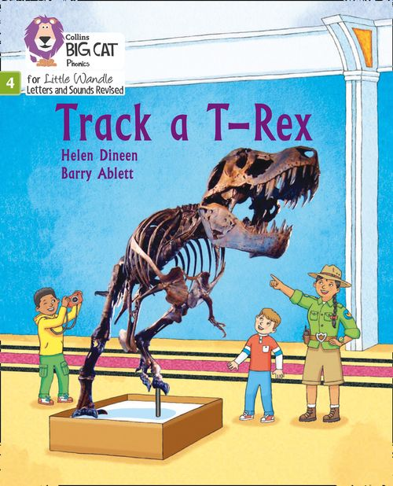
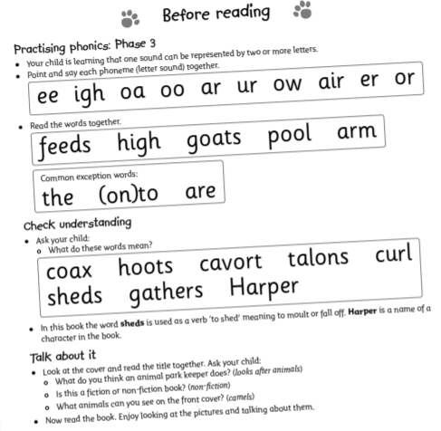
How do we decide which books children read?
Children are assessed, then LW , and teacher knowledge, matches
which books should be allocated for their secure phonic knowledge.
Share the front cover page before reading – this
cover sounds and words contained in the book.
Celebrate, praise, talk about the book with you child.
Please make sure books are in book bags and
returned on Monday as they may be
needed for other groups.
Please look after our books.
Notes:
Emma

Slide 25




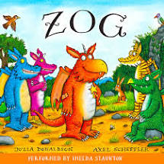
Sharing Books
Children will also bring home a ‘sharing book’ from our class or year group libraries each week
To become lifelong readers, it is essential that they read for pleasure
Children may not be able to read this book independently, but these books offer a wealth of opportunities for talking about the pictures and enjoying the story or information text.
Enjoy the book together and foster a love of reading- ‘pair and share’
Notes:
Emma

Slide 26
What can parents do to help?
  Read at home as much as possible with your child, with both their phonics and sharing book
  Read to your child too! This develops prosody and a love of reading.
  Talk about books with your children. This supports comprehension.
  Encourage reading of print in all aspects of life to develop reading for pleasure and recognition of print and text e.g., recognising supermarket signs or reading a menu together at the coffee shop.
  Write in your child’s reading diaries. Children will receive points towards reading rewards in school for this.
  Encourage your child to bring their bookbag, reading books and reading diary into school every day.
Notes:
Jess

Slide 27
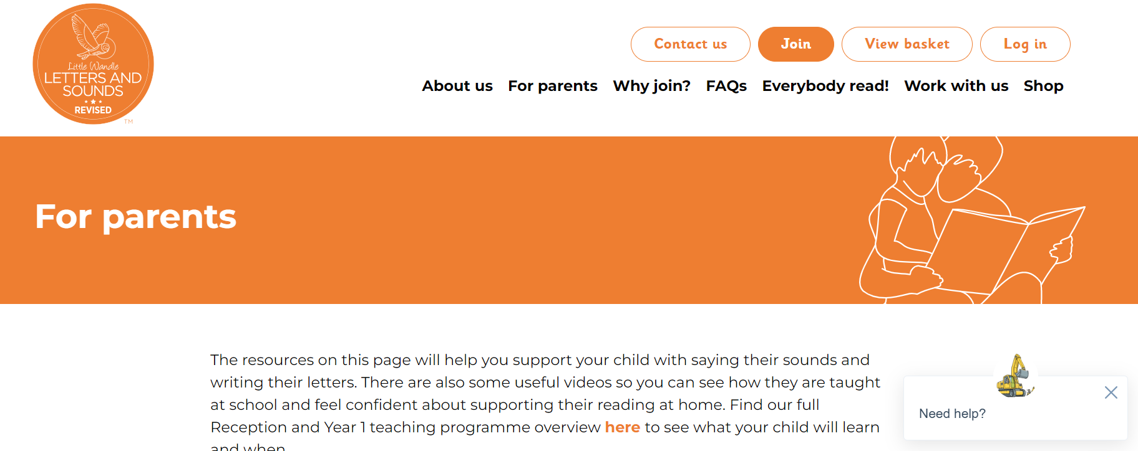
Further support
  Little Wandle Parents website- You can access all the at home resources and watch the videos as many times as you like at- https://www.littlewandlelettersandsounds.org.uk/resources/for-parents/
  Parent handouts at the end of the session
  Class teacher support anytime
Notes:
Jess

