Slide 1
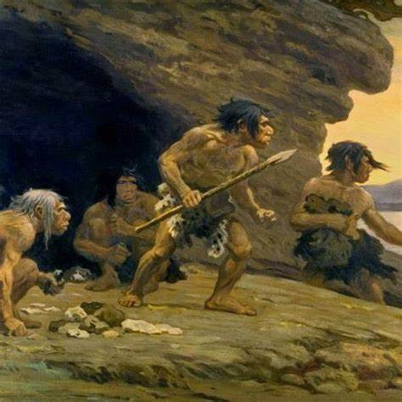

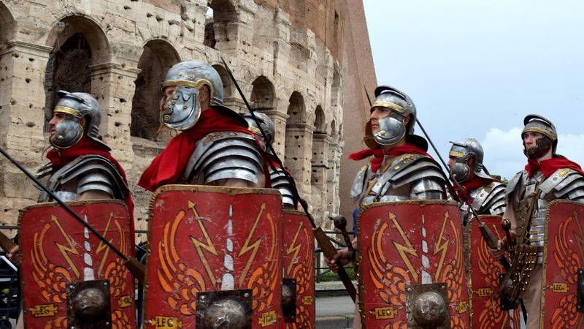
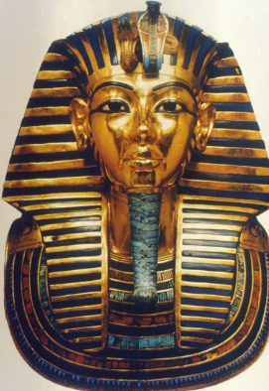
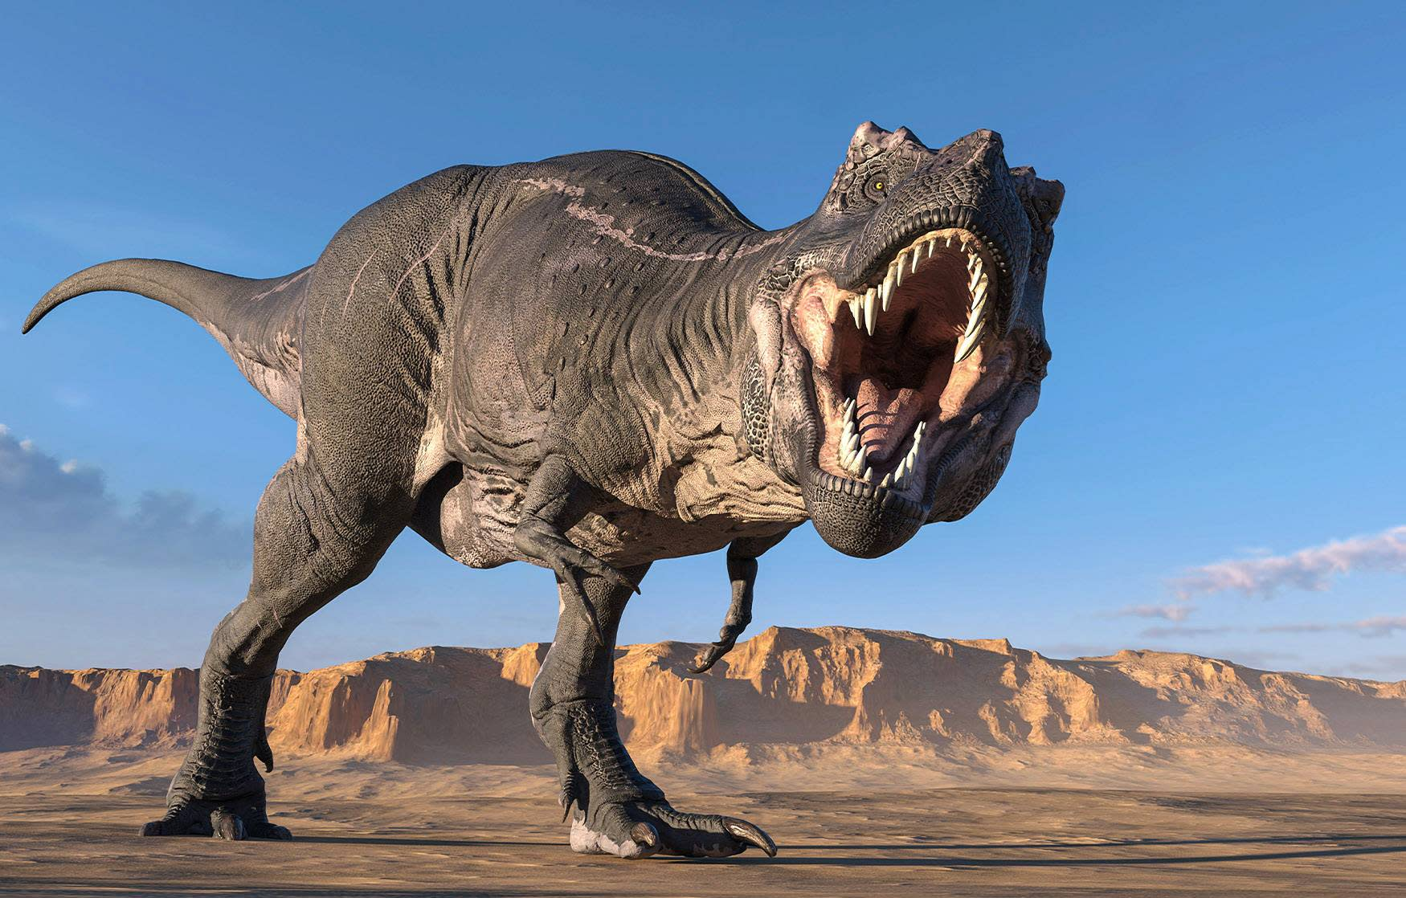
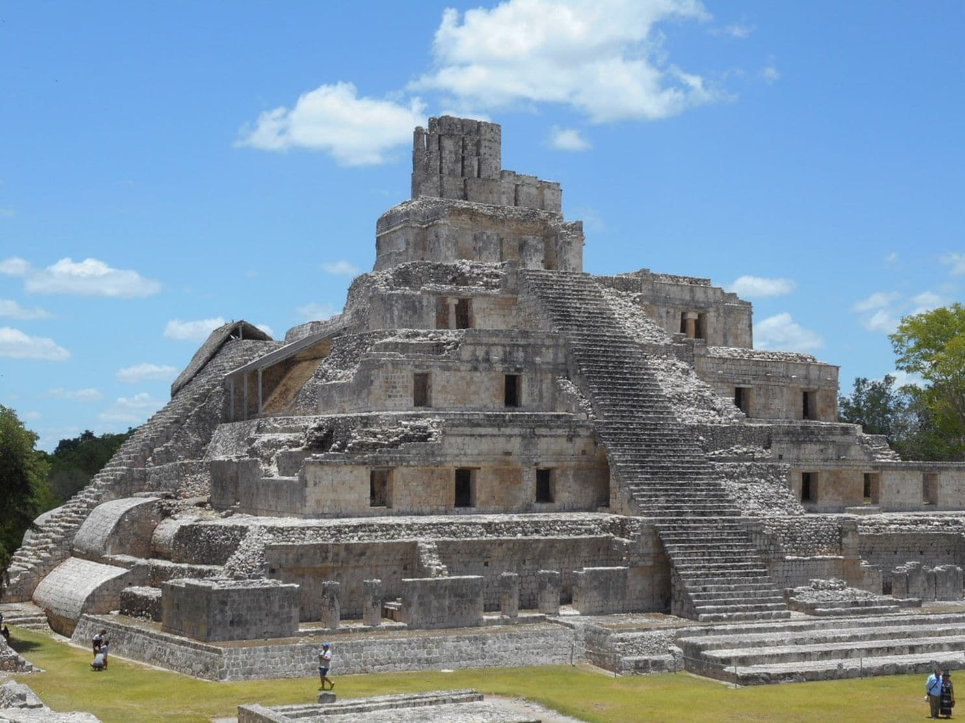
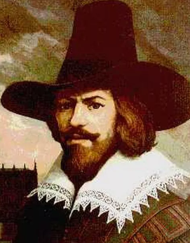
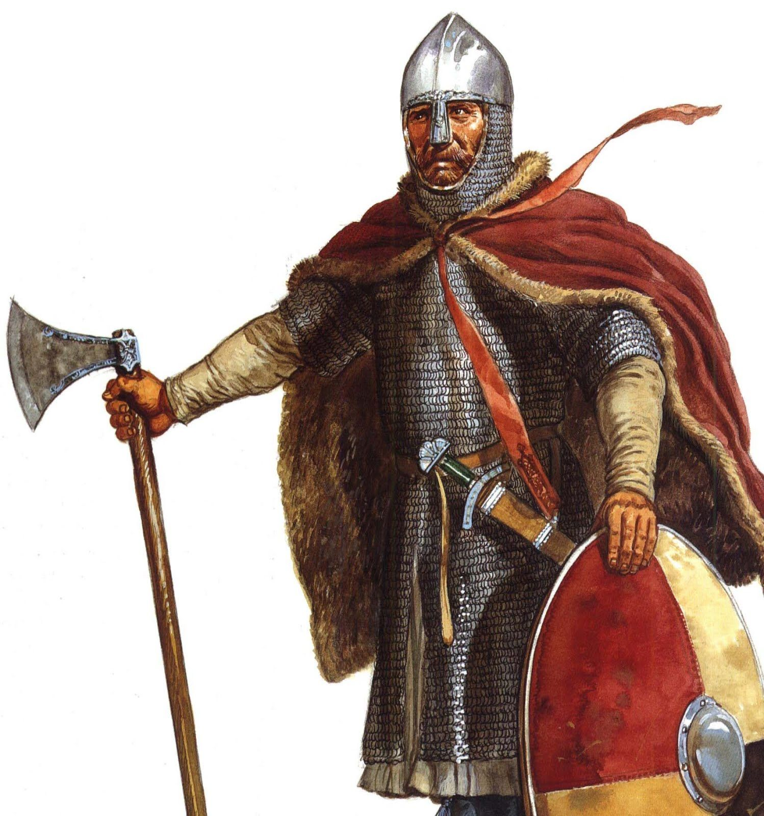
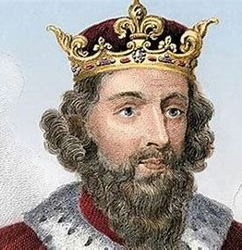
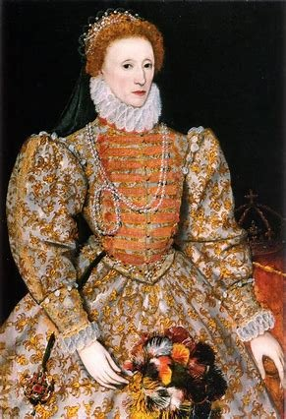
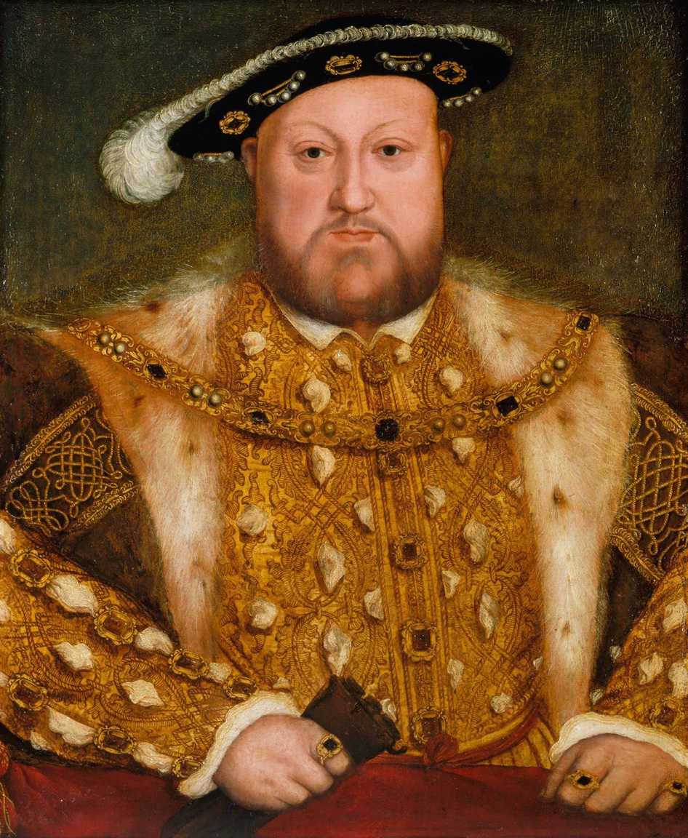
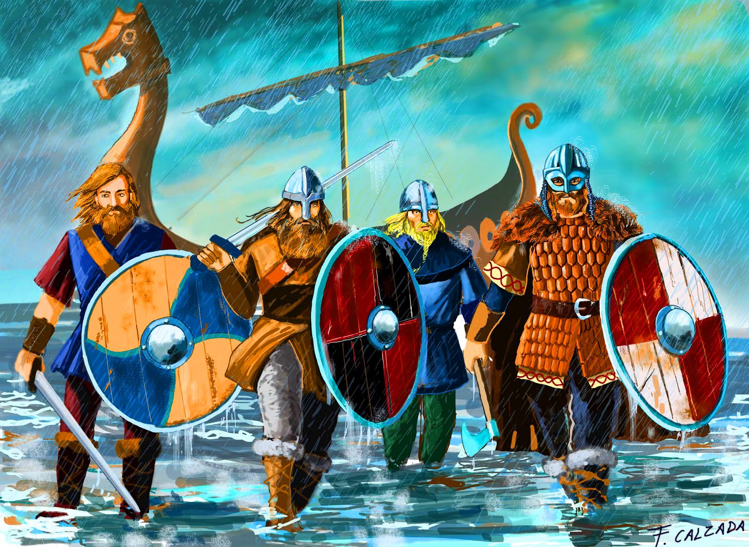
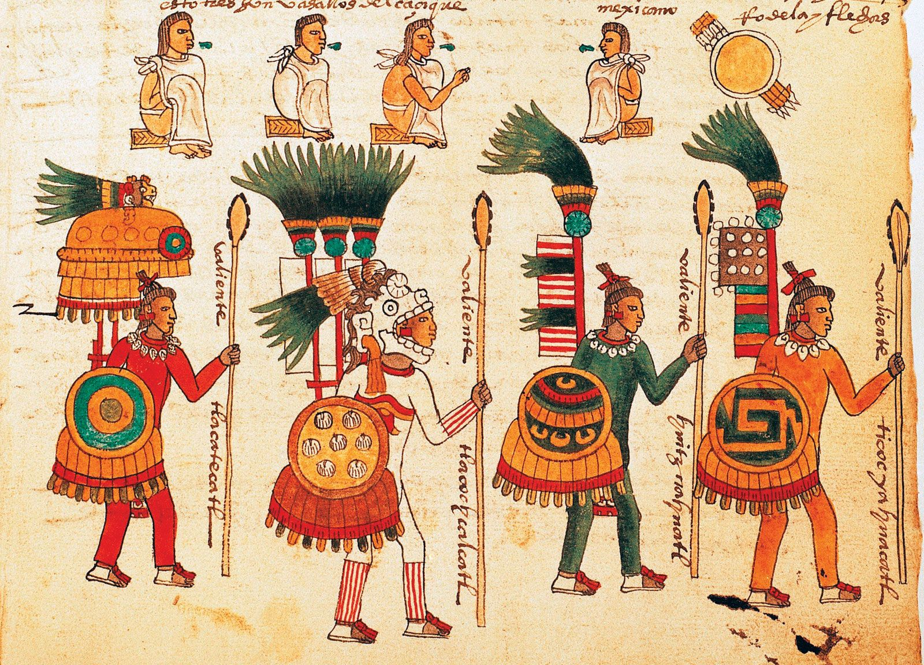
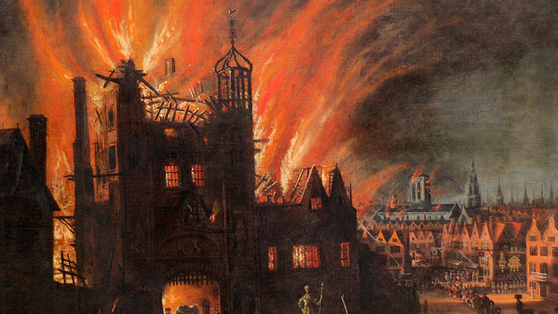
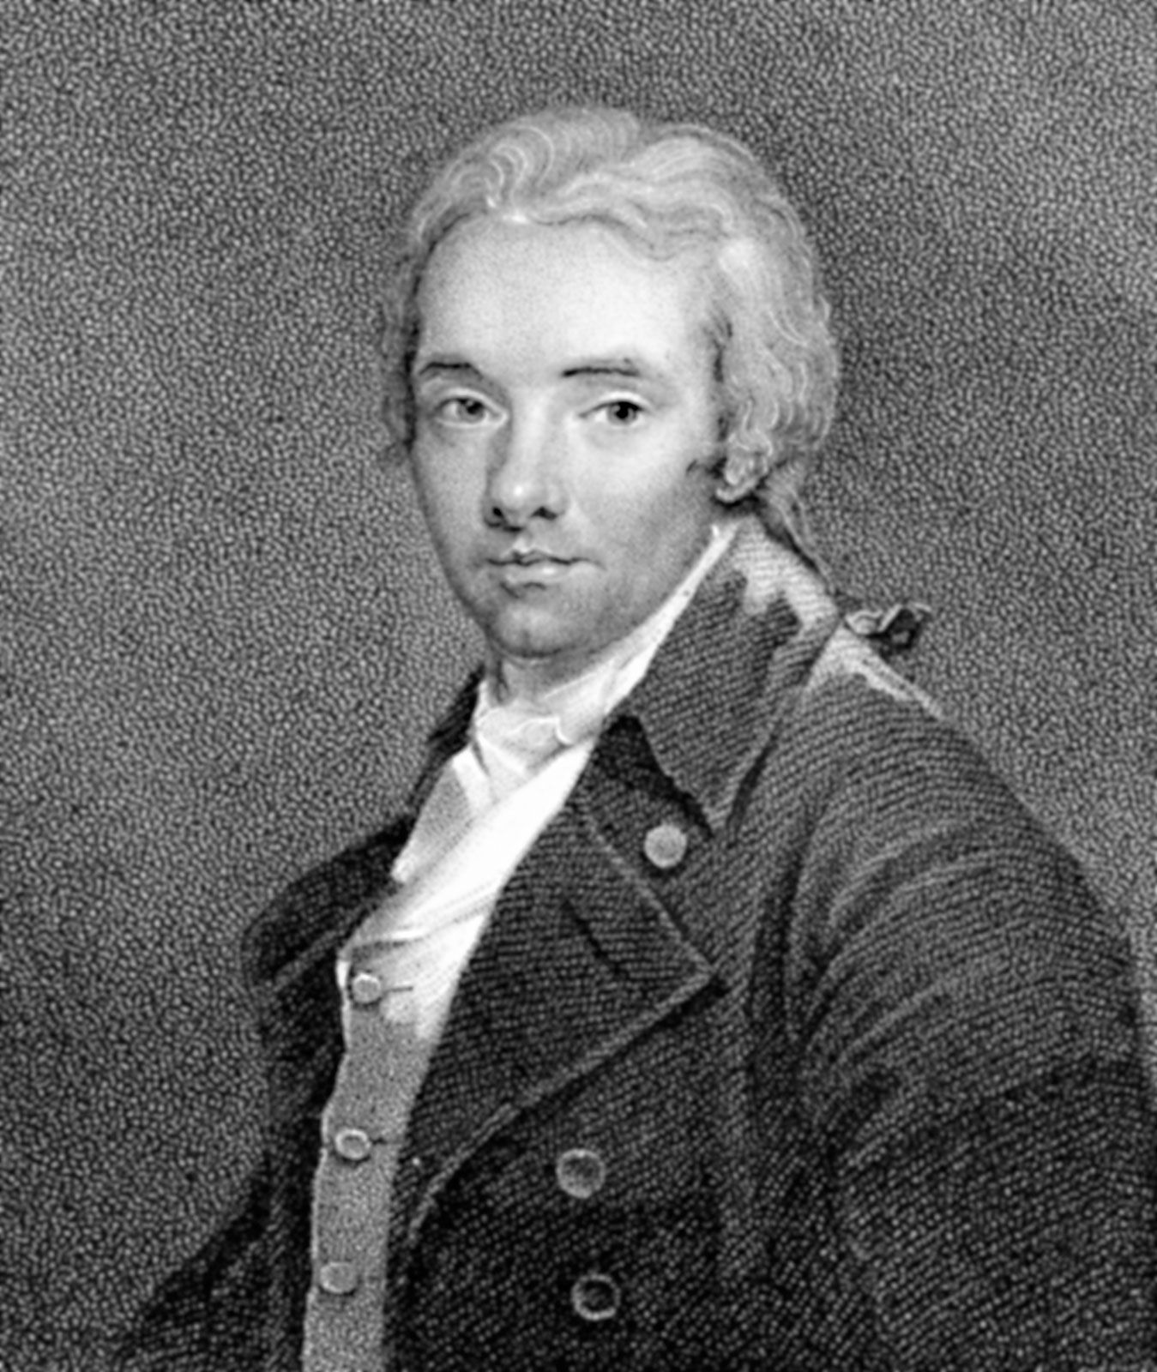
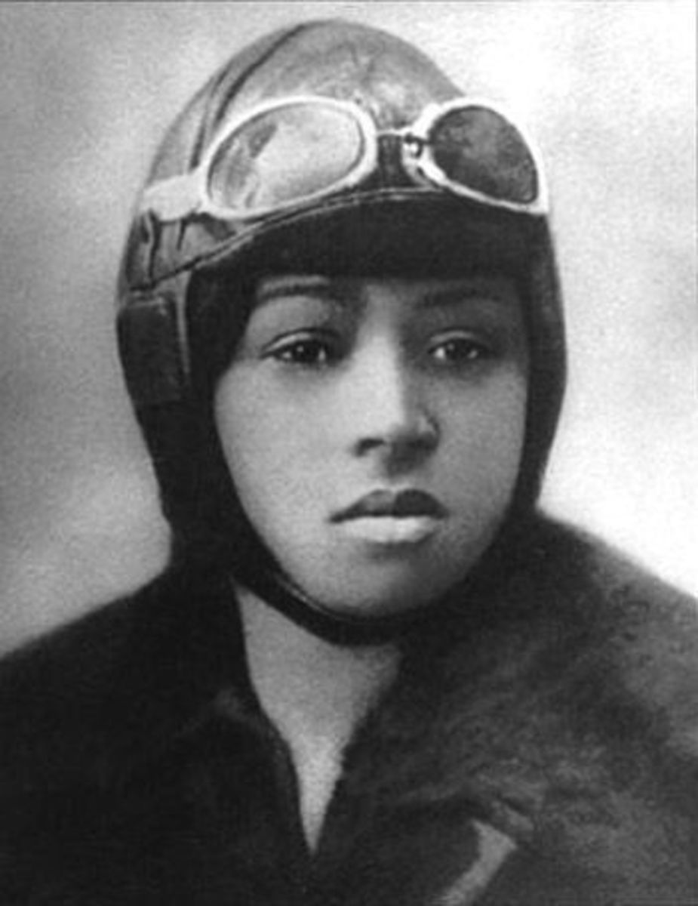

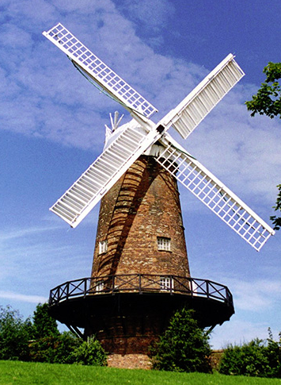
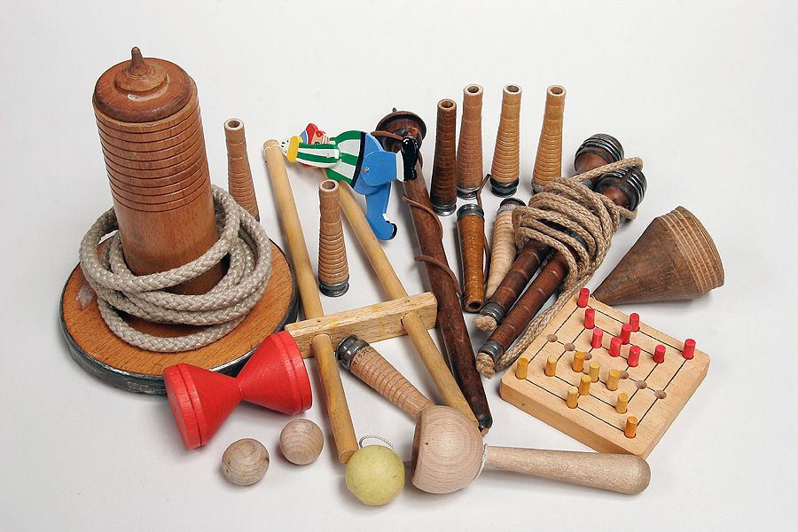
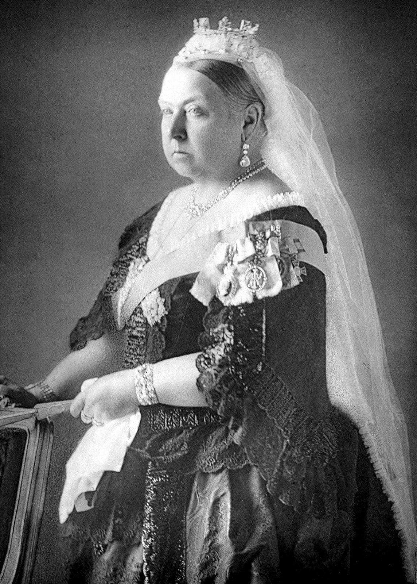
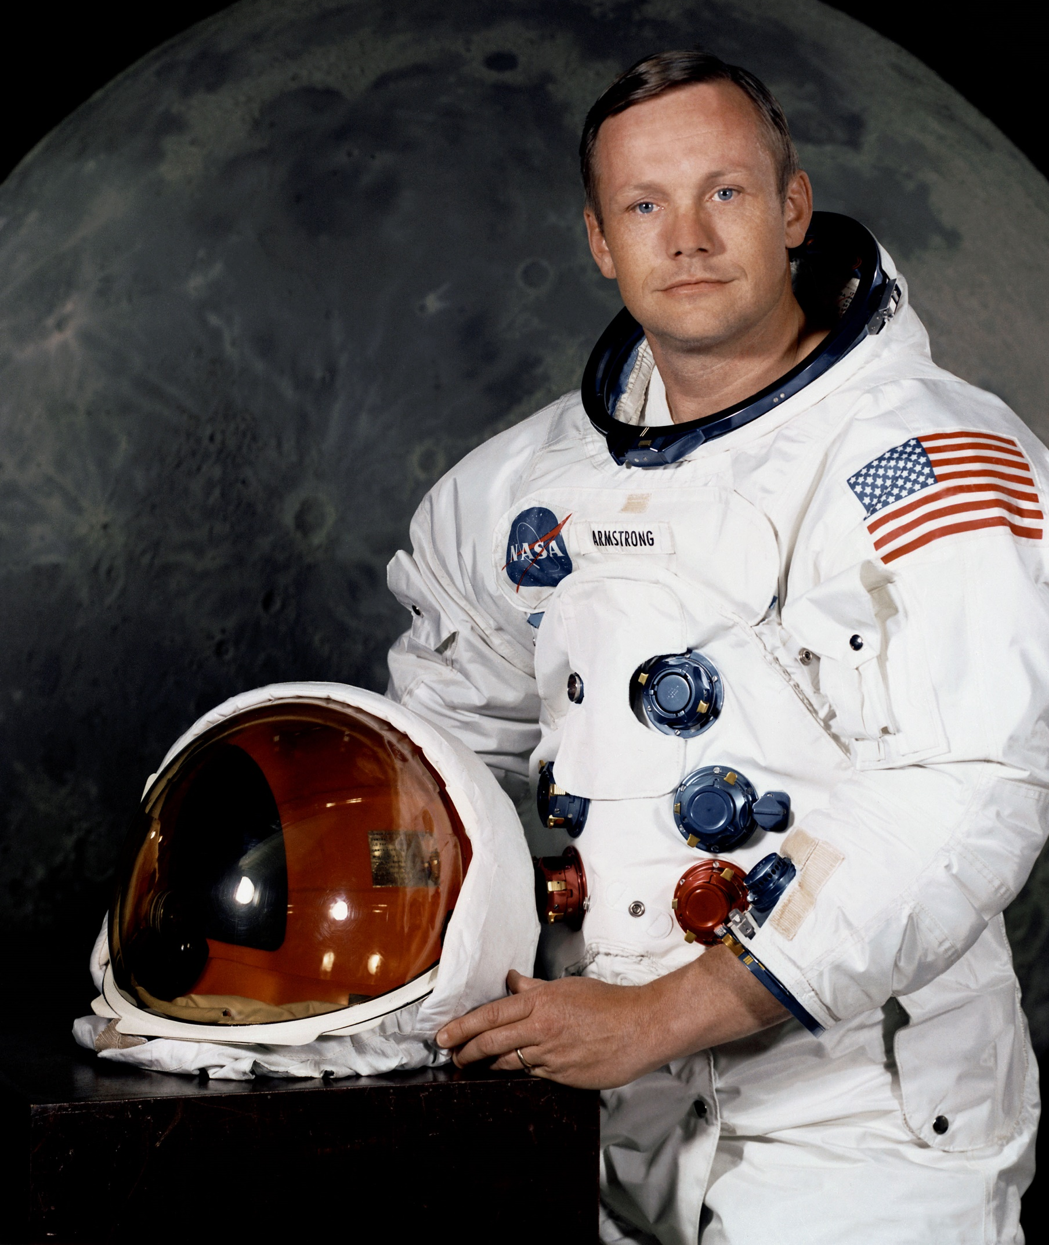

Our Nottingham Academy History Curriculum Timeline
Dinosaurs
65 million years ago
Stone Age
2.6 million years ago
Ancient Egypt
3100 BC
Mayan
2000 BC-1600AD
Ancient Greece
800BC-146 BC
The Romans
27 BC- 395 AD
Guy Fawkes
1570-1606
Anglo Saxons/ Alfred the Great 410-1066 AD
Elizabeth I
1533- 1603
Henry VIII 1491-1547
Aztecs
1300-1521 AD
The Vikings
800-1150 AD
Great Fire of Lindon
1666
British Empire
1833
Slavery abolished
The Victorians/ Victorians toys/ British Empire
1834-1901
Bessie Coleman
First flight
1892- 1926
Neil Armstrong-
First Moon Landing
1930-2012
WW2
1939-1945
George Green
1793-1841
Present day

