Slide 1


Year 1 Geography

Slide 2
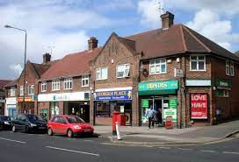

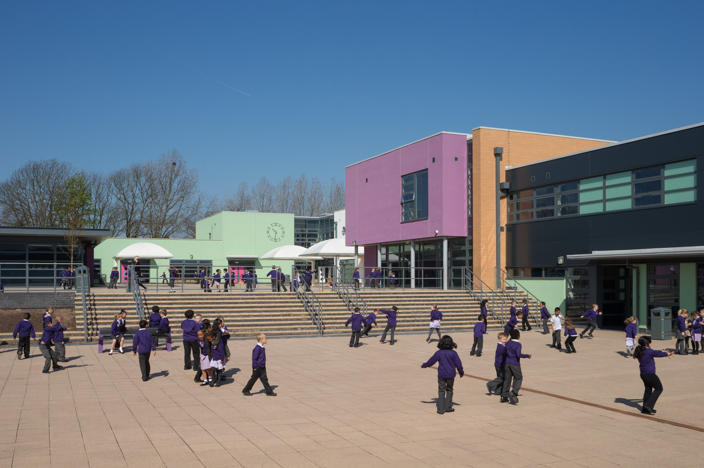
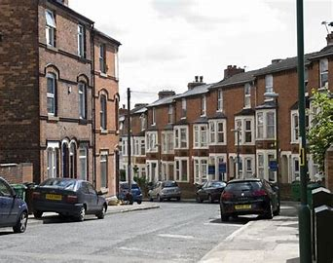
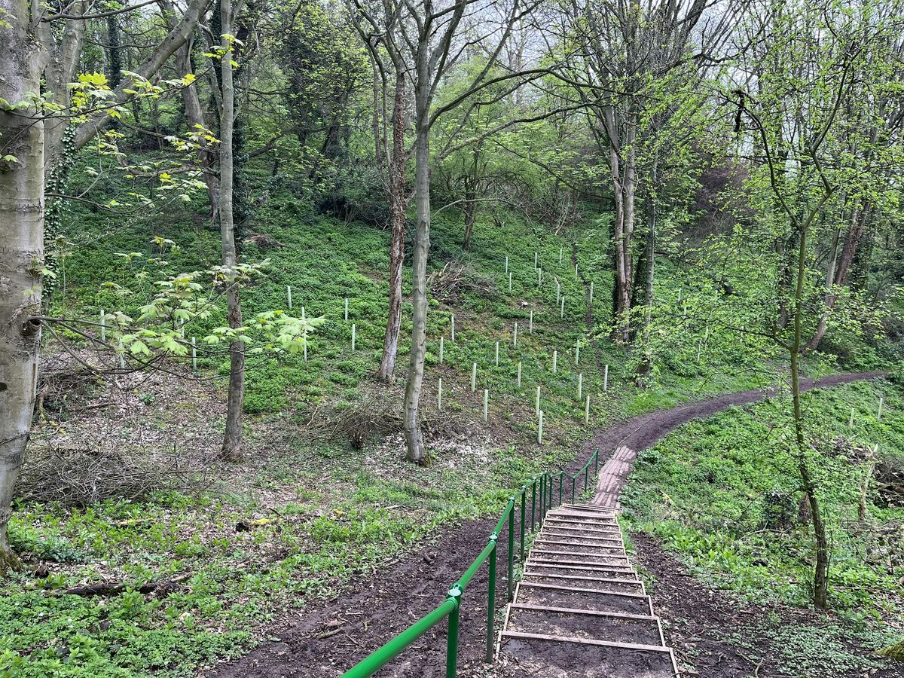



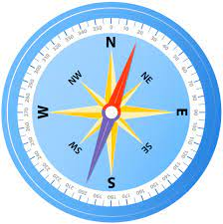
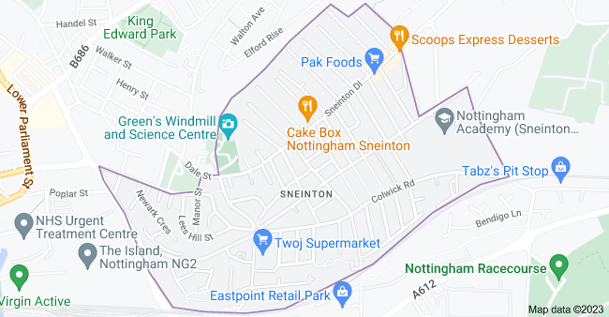
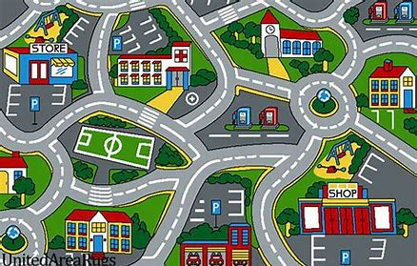
Sticky knowledge
Year group: 1 | Topic: Exploring Sneinton | Term: 1
Key vocabulary and definitions:
Map – a representation of an area of land and sea City – a large town House – a building for people to live in Shop – a building where things are sold Library- a building containing a collection of books Hill – a raised area of land Forest – woods – A large area filled with trees. Compass – tells us the direction of North, South, East and West Direction – the course along something moves Human feature- things that are made or built by humans Physical feature- natural features of the Earth
We live in Nottingham Nottingham is a city in England Our school is in Sneinton on Greenwood Road Maps show us where places are and how to get to them. Some places are close together and some are far apart. If a place is far away, we will travel by car, bus, train, boat or plane. Roads and train tracks link places together. Maps can be digital or hand drawn. A compass shows us direction, North, South, East and West.
Substantive knowledge and geographical concepts:
In our local area we can see human features such as our school, shops, houses, a library, a park and bus stops. Physical features near us include Colwick woods.

Slide 3
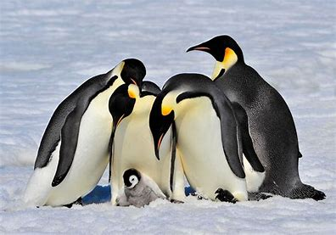
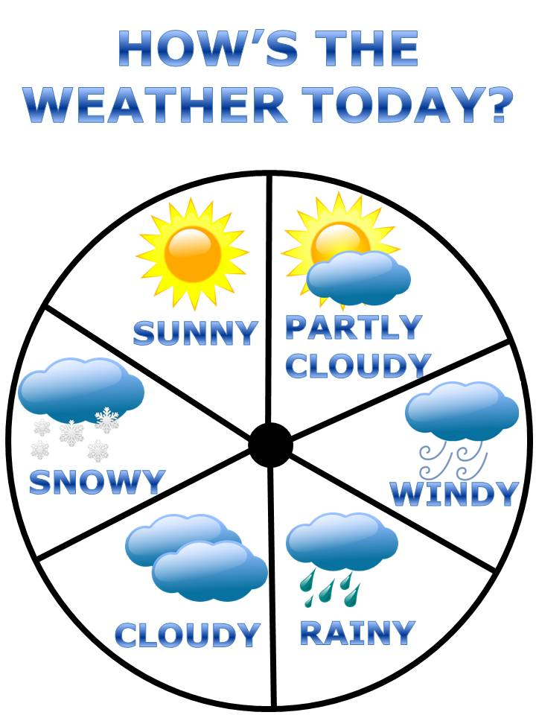
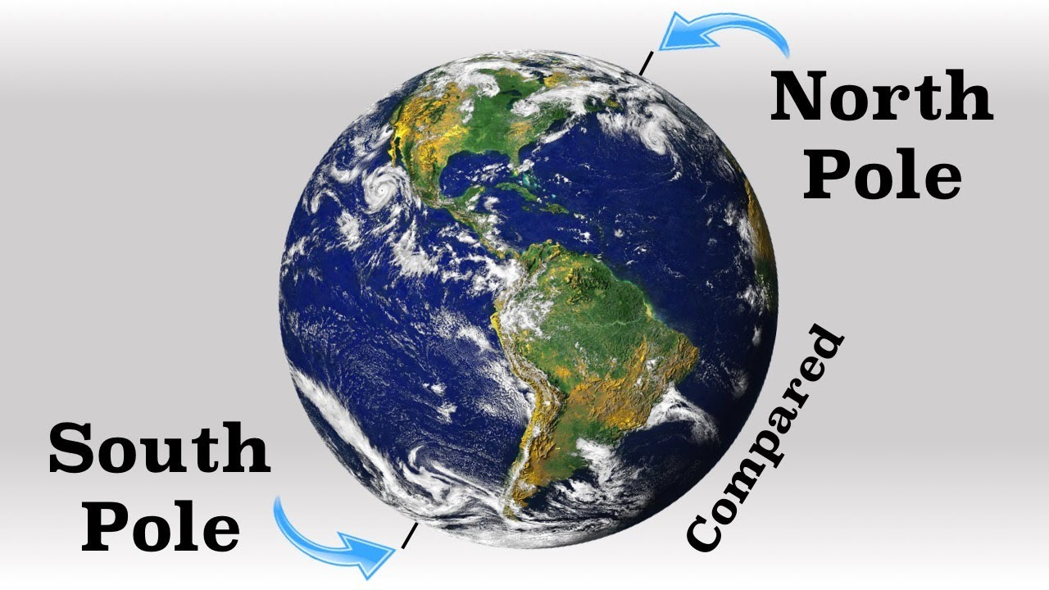

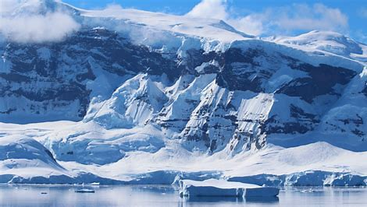


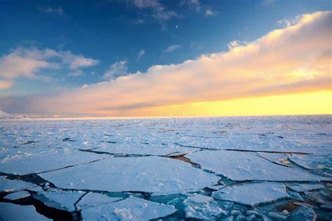
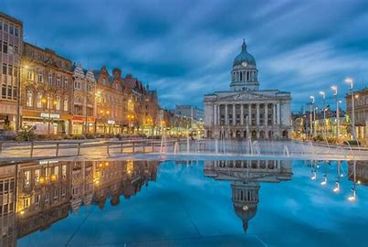
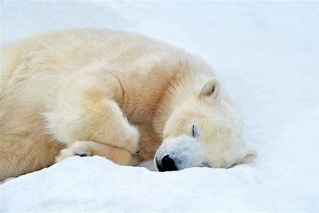
Sticky knowledge
Year group: 1 | Topic: Pole to Pole | Term: 3
Key vocabulary and definitions:
Weather – the temperature and outside conditions. Temperature – how we measure how hot or cold something is. Equator – an imaginary line around the middle of earth. Seasons - As the year passes, there are regular changes in the weather. This cycle of change of weather is divided into four parts, which are called seasons. Sun – warmth coming from the sun. Rain – water drops that fall from clouds. Cloud – a large collection of very tiny droplets of water or ice crystals. Hail – solid water drops in the form of balls or pieces of ice Snow – Tiny crystals of ice that fall to Earth Wind – a natural movement of air
Substantive knowledge and geographical concepts:
The Arctic is the most northern part of Earth. Antarctica is the most southern continent on Earth. The countries closest to the equator are hottest, the places furthest away from the equator are coldest. Atlases, nonfiction books and videos can tell us what it is like in the north and south pole. We can measure the temperature of the weather using thermometers.
The Poles In the North and South poles the weather is much colder- it is full of ice. No one lives in Antartica, it is too cold. There are no human features in Antartica because no humans live there. Antarctica and the Artic have just 2 seasons- Summer and Winter. During the Winter in Antartica and the Artic there is no sunlight. It stays dark for months. | The UK The weather in the UK changes with its 4 seasons. The UK has many human features, including buildings, bridges, roads and railways. We see less sunlight in the Winter months and more in the Summer.

Slide 4
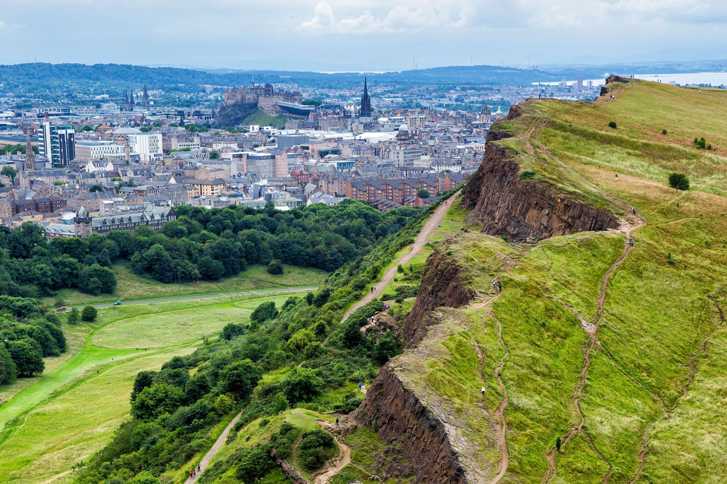
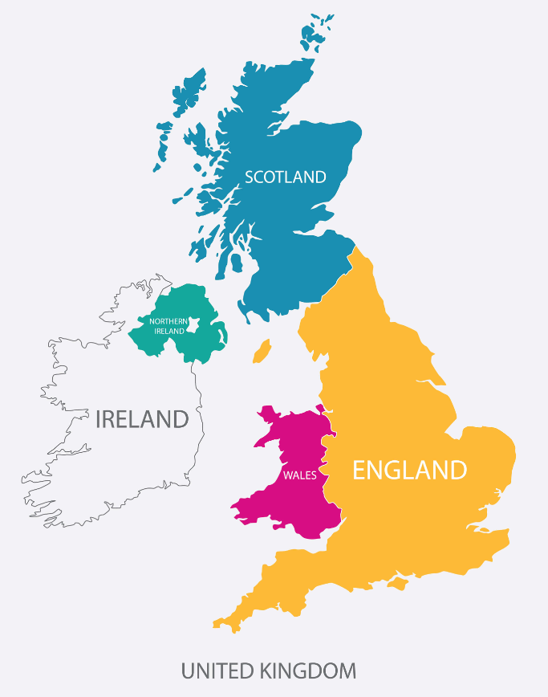
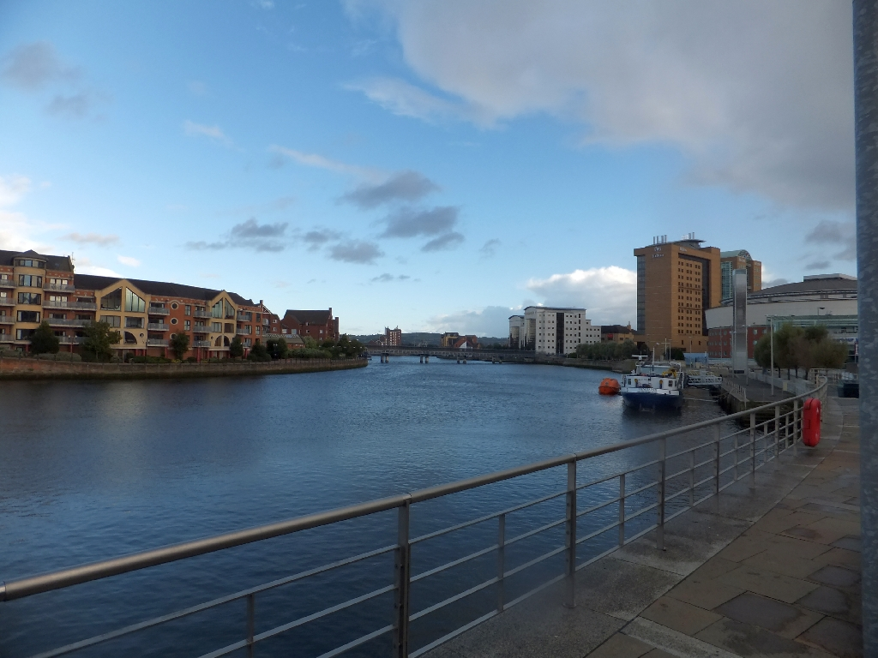
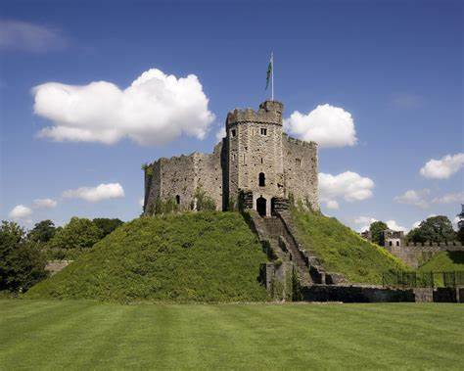
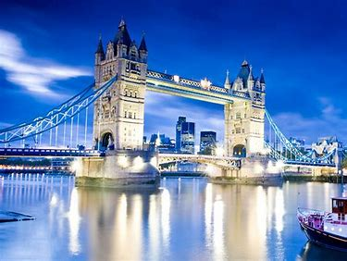
Sticky knowledge
Year group: 1 | Topic: Cool Capitals | Term: 5
Key vocabulary and definitions:
Country – a land that is controlled by one government. Capital city – the main city of a country. Where the government is based. Human feature- things that are made or built by humans Physical feature- natural features of the Earth Forest – a large area filled with trees. Hill – an area of land that rises higher than the land around it. Sea – the salty water that covers a large part of the earth. River - the path that water takes as it flows downhill towards the ocean. Dock- a place to load and unload materials. Castle- a large fortified building. Port- a place where ships and load or unload materials.
Substantive knowledge and key geographical concepts
Our school is in Sneinton, Greenwood road Sneinton is close to Nottingham City centre The UK is made up of 4 countries, England, Scotland, Wales and Northern Ireland. Each country has a capital city, England – London. Scotland – Edinburgh, Wales – Cardiff, Northern Ireland – Belfast.
London’s physical features includes the River Thames London’s human features include Tower Bridge and the London Eye. Edinburgh’s physical feature includes the extinct volcano ‘Authur’s seat’ and Pentland Hills. Edinburgh’s human features include Edinburgh Castle. Cardiff’s physical feature includes River Taff. Cardiff’s human features include Cardiff Castle and Cardiff docks. Belfast’s physical features include River Lagan and Belfast Lough. Belfast’s human features include the port and parliament buildings.

