Slide 1


Year 3 Geography

Slide 2


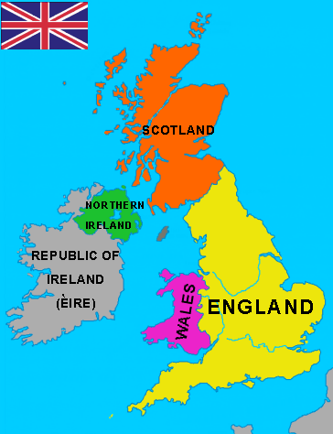

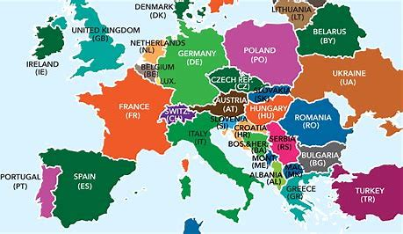
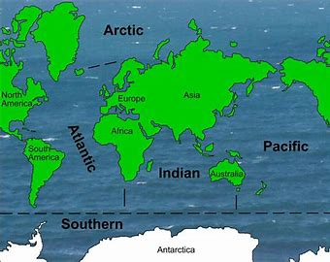
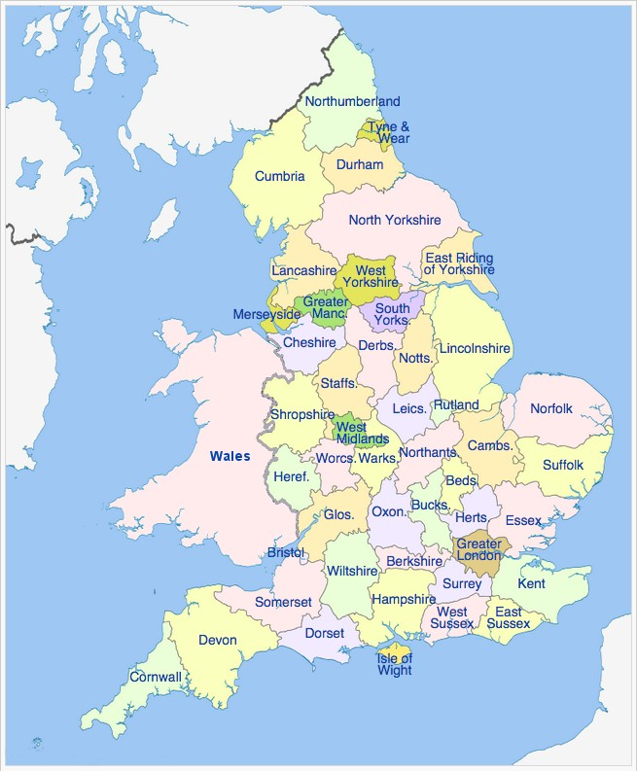
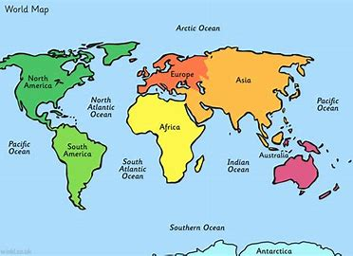
Sticky knowledge
Year group: 3 | Topic: Land, masses and sea | Term: 1
Key vocabulary and definitions:
Continents: A continuous mass of land Ocean: A continuous body of water Country: an area of land controlled by its own government County- division of a country, includes towns and cities (eg Nottinghamshire, Derbyshire, Staffordshire, etc). City- A settlement which is larger than a town. In UK, most cities have a cathedral. Town- a built up area which is smaller than a city but larger than a village. Village- small settlement Topographical- physical features of an area
Substantive knowledge:
There are four countries which make up the United Kingdom- England, Scotland, Wales and Ireland The capital cities of the UK are London, Cardiff, Edinburgh and Belfast There are 7 continents- Africa, Antarctica, Asia, Australia/Oceania, Europe, North America, and South America There are 5 oceans- Atlantic Ocean, Pacific Ocean Indian Ocean , Southern Ocean Arctic Ocean There are 44 countries in Europe There are 48 counties in England. Topography refers to the physical features of an area. The UK has many different topographical areas (eg coast, mountains, hills, cities, etc).

Slide 3
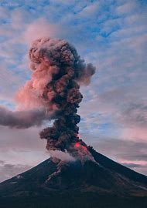

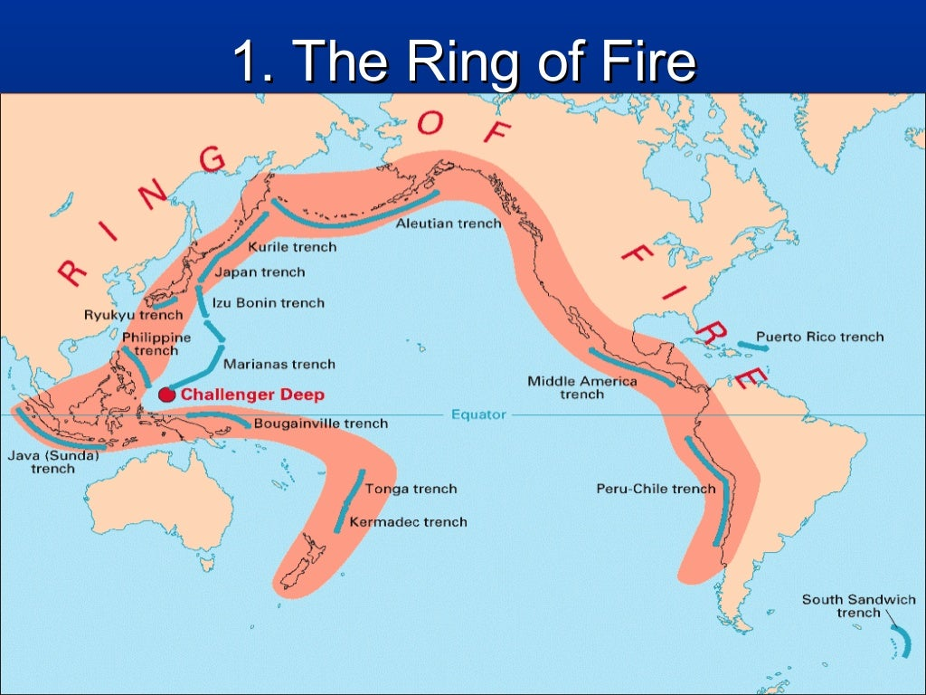

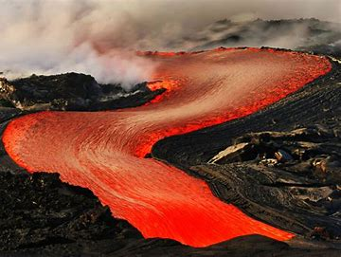
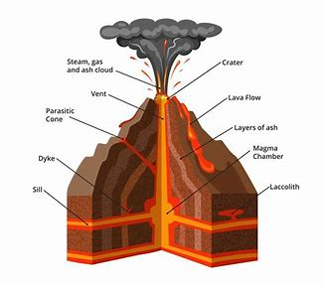
Sticky knowledge
Year group: 3 | Topic: Extreme Earth- Volcanos | Term: 4
Key vocabulary and definitions:
Renewable energy- energy provided from a natural sources that is replenished Volcano- is an opening in the earth's crust through which lava, volcanic ash, and gases escape. Mountain- a landform that rises high above its surroundings Active volcano- a volcano that has erupted recently or is likely to erupt again Dormant volcano- have not erupted for a long time but may erupt in the future Extinct volcano- volcanoes that are not expected to erupt again Lava- hot molten rock Eruption- gas or lava is released from a volcano
Substantive knowledge:
Volcanoes are physical features. Some natural resources are found everywhere- such as sunlight and wind. Other natural resources are unevenly distributed- such as oil, coal and natural gases. Natural resources can provide energy for us to use and are renewable, for example, the sun and wind. Sources of energy also include coal and oil- these are not renewable There are three main types of volcano (active, dormant and extinct). An active volcano is a volcano that has erupted recently or is likely to erupt again Dormant volcanoes have not erupted for a long time but may erupt in the future Extinct volcanoes are - volcanoes that are not expected to erupt again Settlements can be built near volcanoes The ‘Ring of Fire’ is where over 75% of Earth’s volcanoes are. The Ring of Fire is a chain of volcanoes which surrounds the Pacific Ocean- the volcanoes frequently erupt in fiery explosions. Many earthquakes occur in the region as well. The chain passes along the west coast of North and South America. 15 countries are in the ‘Ring of Fire’ Mount Etna is located in Sicily.

Slide 4
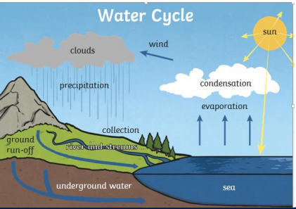

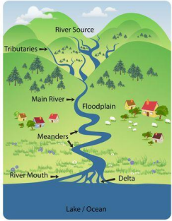
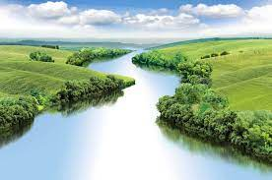
Sticky knowledge
Year group: 3 | Topic: Raging Rivers | Term: 6
Key vocabulary and definitions:
River – a large flow of water that eventually meets the sea Stream- a flow of water which is smaller than a river Water source- where water comes from Channel- where a river or stream runs Tributary- a small river or stream which meets a larger river/stream Meander- a bend or curve in a river Estuary- where a river joins the sea Water cycle- how water moves around the Earth Urban- developed areas with human structures e.g cities and towns Rural – less human structures e.g countryside
Substantive knowledge and geographical concepts:
A river is a large flow of water. The water cycle is how water moves around the Earth. Evaporation is when the heat from the sun warms the water, so it turns into a vapour (gas) and rises because it is lighter. When one stream meets another, it forms a smaller stream called a tributary. Many tributaries form a river. The majority of rivers flow to make an ocean, sea or large lake. The end of a river is called the mouth. Rivers provide water supply and transportation routes in urban locations In rural areas, rivers support agriculture and manufacturing River Trent is located in Nottingham. Rivers begin at their source. In higher ground such as mountains where melted snow and rainwater collects and forms tiny streams.

Slide 5
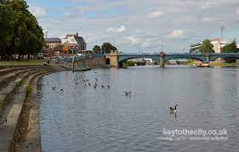
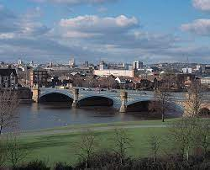
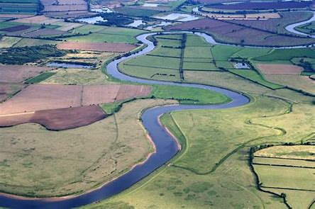
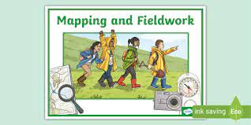
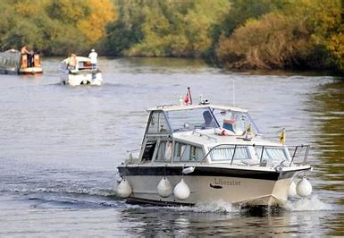
Sticky knowledge
Year group: 3 | Topic: Fieldwork with links to the River Trent | Term: 6
Key vocabulary and definitions:
River- a large flow of water that eventually meets the sea Meander- a bend or curve in a river Source- where water comes from Mouth- where a river flows into a large lake or the ocean Sediment- matter that settles at the bottom of a river Fieldwork – investigating and collecting data from the environment Floodplains – flat area next to a river which floods when the water level rises
Substantive knowledge:
River Trent is in Nottingham River Trent is the third longest river in England River Trent is 298km long River Trent starts in Staffordshire. It flows through the centre of England until it joins the River Ouse to form the River Humber, which empties into the North Sea. In Celtic times, the River Trent flooded frequently. River Trent flows through Nottingham city, but also flows through more rural areas.

