Slide 1


Year 4 Geography

Slide 2
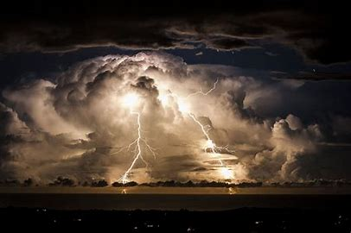

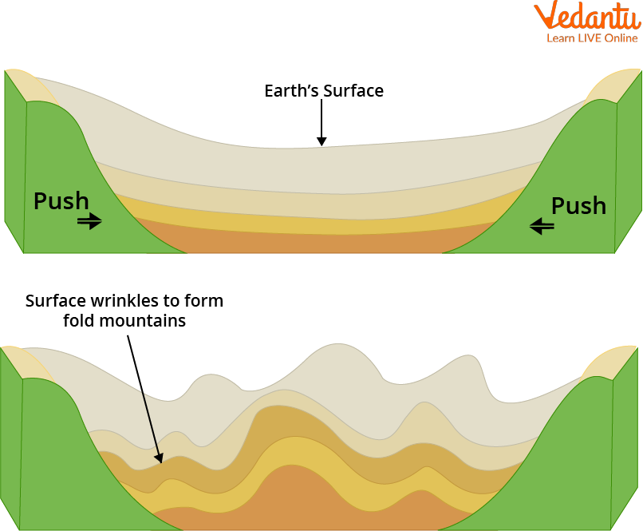
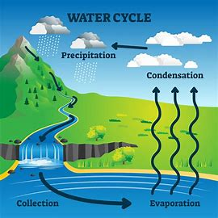
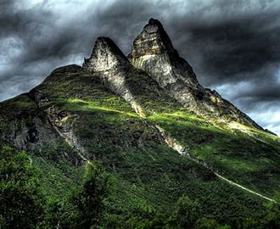

Sticky knowledge
Year group: 4 | Topic: Whacky weather | Term: 1
Key vocabulary and definitions:
Evaporation- the process of liquid turning into vapour Condensation- the process of water vapour turning into liquid Precipitation- The liquid and solid water particles that fall from clouds and reach the ground Thunder- is the sound that happens after a flash of lightning when the air around it gets hot Lightning- a bright flash of electricity produced by a thunderstorm Atmosphere- a mixture of gases that surround the Earth
Substantive knowledge and geographical concepts:
Physical geography is the study of the natural features of the Earth's surface. Mountains are formed when huge areas of land hit each other. This caused the plates to push the crust upwards to form mountains. Thunderstorms happen when hot, moist air rises quickly to cooler parts of the atmosphere- the air cools and clouds/ rain form. Lightning (a form of electricity) develop in the clouds. Lightning heats the air and makes it expand- this causes the sound of thunder. Water from the Earth (e.g from rivers, the sea, lakes) evaporates because of the sun's heat. The water in the form of vapours then cools down at a certain height and condenses to form clouds. When the clouds get too heavy the water falls from the sky in the form of rain, snow or hail- the water gathers and the cycle starts again. Water cycle experiments and models will provide an opportunity to observe, measure and record what happens to water during the water cycle.

Slide 3
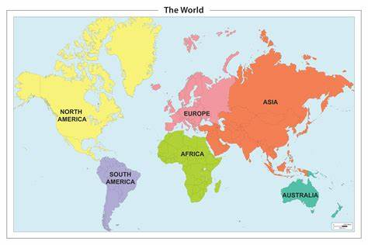


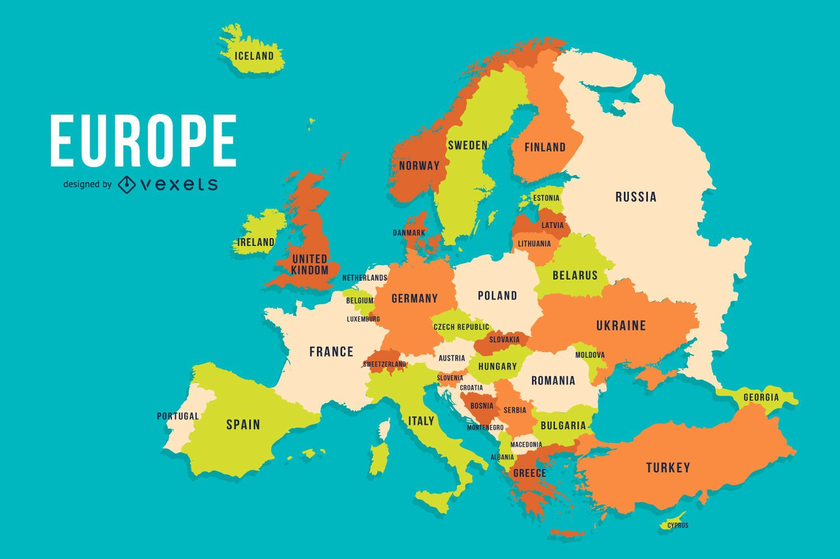

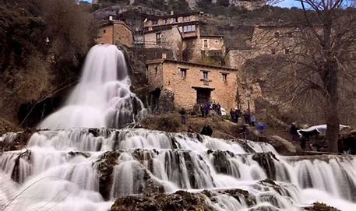
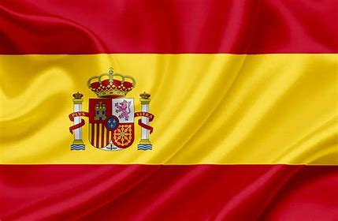


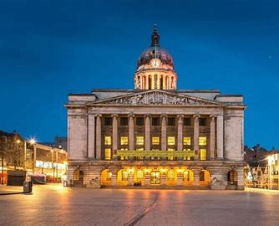
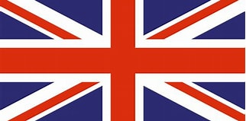
Sticky knowledge
Year group: 4 | Topic: UK vs Spain | Term: 3
Key vocabulary and definitions:
Capital City – usually where countries are governed from. Country – land area controlled by a single government, its territory. Continent – a large area of solid land separated from other large areas by water or natural features. Europe – a continent in the western part of the landmass lying between the Atlantic and Pacific Oceans, separated from Asia by mountains. Equator - an imaginary line around the middle of the Earth, halfway between the north pole and the south pole. Northern Hemisphere - the half of the Earth that is north of the Equator. Southern Hemisphere - the half of the Earth that is south of the Equator. Climate - the typical weather conditions in an entire region for a very long time. Urban - where many people live and work, resulting in very dense development of human structures: houses, commercial buildings, roads, bridges, etc. Rural – land often used for farming or agricultural
Substantive knowledge and geographical concepts:
The 4 capital cities in The UK: London, Cardiff, Edinburgh, Belfast. The 7 continents: Europe, Asia, Africa, North America, South America, Antarctica, Australasia. Countries in Europe include Russia, Germany, United Kingdom, France, Spain and Italy. The capital of Russia is Moscow, the capital of Germany is Berlin and the capital of Spain is Madrid. The climate near the equator is hot and wet all year round this creates a humid climate. Spain's total population is 47 million. The climate varies in different parts of Spain. Spain is closer to Equator so is hotter than the UK. UK's total population 67 million. Its climate can be colder than Spain because it further from the Equator. Spain has lots of mountain ranges. Rivers run to the coasts making good farmland. Spain has lots of beaches. There are wetlands and plains. The UK's physical features include hills, mountains valleys, rivers, cliffs and beaches. Nottingham is an urban location with physical features including the River Trent and Sherwood forest surrounding it Nottingham is an urban location with physical features including the River Trent and Sherwood forest surrounding it. Nottingham's human features include the council house, shopping centres and Nottingham Forest football stadium. Orbaneja del Castillo's human features include little streets, little medieval houses. When people travel for pleasure they are called tourists. Many people go on holiday because they want a break from their everyday lives, or to experience a warmer climate. Others enjoy learning about different cultures, tasting new cuisines, and observing different lifestyles.

Slide 4
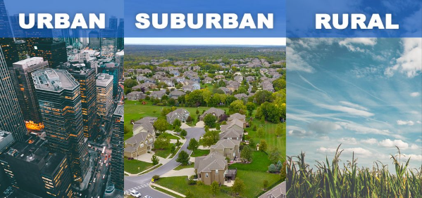


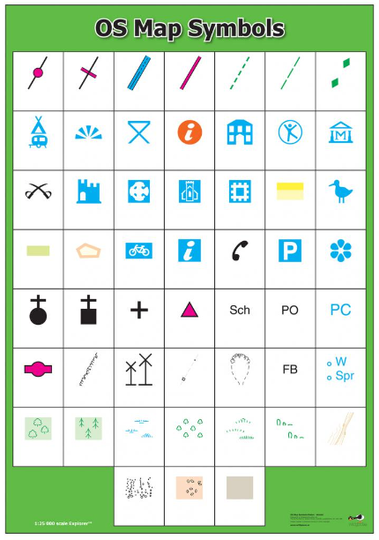



Sticky knowledge
Year group:4 | Topic: UK vs South America | Term: 5
Key vocabulary and definitions:
Settlements – a place where people move to, to live and use the land Urban - where many people live and work, resulting in very dense development of human structures: houses, commercial buildings, roads, bridges, etc. Rural – land often used for farming or agricultural shelter A place that protects us from weather or danger defence Resisting attack village A group of houses and buildings in a rural area, smaller than a town town A built up area smaller than a city and bigger than a village city A large human settlement agricultural Farming land retail Land with shops or other profitable buildings business Land used for business or offices residential Land used for housing industrial Land used for factories or warehouses leisure Land used for fun or non-essentials key Helps the reader understand map symbols OS symbols Symbols to label features on a map.
Substantive knowledge:
There are two main types of settlement; urban/rural. People need: shelter, food and water as a priority. Other needs: raw materials, transportation, healthcare, friends, entertainment and shops. Settlers build their settlements in places based on their needs. Many of the places people live in today are thousands of years old and were created by early settlers such as the Romans, Vikings and Anglo-Saxons. OS symbols will help us identify what is in each settlement. 6 main uses of land: agricultural, industrial, business (commercial), residential, leisure (recreational), and transportation. London is one of the largest urban areas in Western Europe. The human features include the government buildings, Buckingham Palace, museums and the underground transport systems Argentina is in South America and is one of the most urbanised countries in the world. Human features include monuments, theatres and cemeteries

