Slide 1


Year 5
Geography

Slide 2
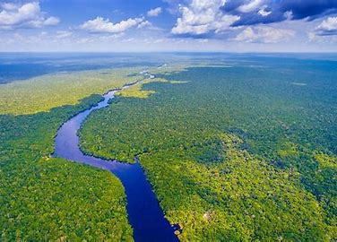




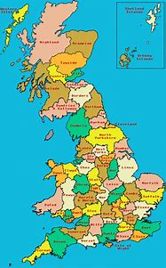
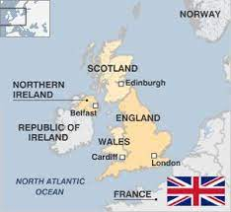


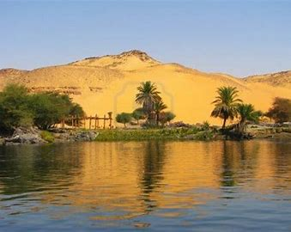
Sticky knowledge
Year group: 5 | Topic: Location, Location, Location | Term: Spring 1
Key vocabulary and definitions:
Landmarks- features or structures around the world that are easily recognised or unique Contour lines - show elevation and the shape of the terrain. grid references- tells you were something is on a map Latitudes- distance north or south of the equator Longitude- lines that run the length of the Earth from North pole to South Pole Human feature- something man made Physical feature - something that is naturally on the earth Settlement- where people live and work Natural resources- something found in nature that can be used Residential- where people live Agricultural – farming Recreation- things people do for entertainment Transportation- means of people getting around Commercial- ways of making money
Substantive knowledge and geographical concepts:
Rivers carry water and nutrients to areas all around the earth. They play a very important part in the water cycle, acting as drainage channels for surface water. Rivers drain nearly 75% of the earth's land surface. Rivers provide excellent habitat and food for many of the earth's organisms. The river Nile is the largest in the world and is located in Africa. The second largest river is the Amazon, and it runs through South America. There are 4 parts to United Kingdom – England, Scotland Northern Ireland and Wales. Each country within the United Kingdom has a capital city: Northern Ireland: Belfast, Wales: Cardiff, Scotland: Edinburgh, England: London. Each county and city has its own landmarks which are distinctive to the area- including human and physical features A settlement influences the amount of natural land that is converted into human habitation, the demand for non-renewable natural resources and the production of pollution and waste. About 55-56% of the world's population live in urban areas, which mean built up areas of housing in towns and cities. There are 5 most common uses of land; residential, agricultural, recreation, transportation and commercial- this has changed and developed over time.

Slide 3
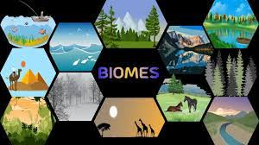

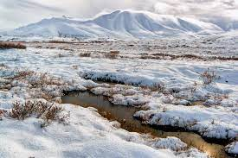
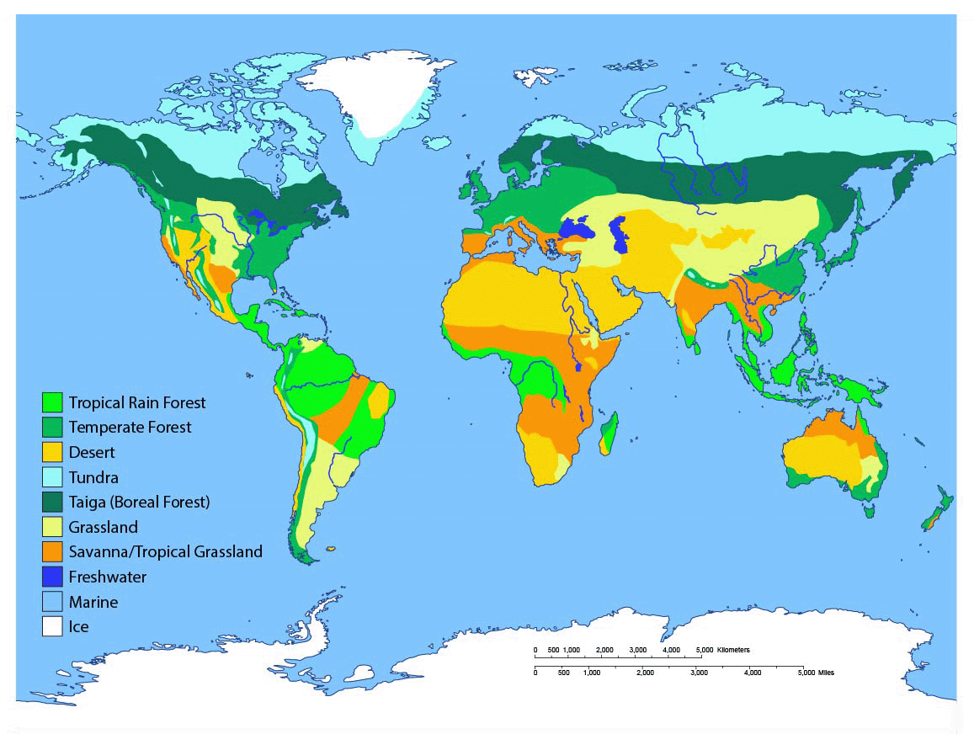
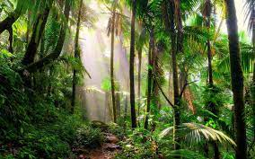
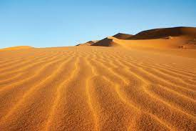
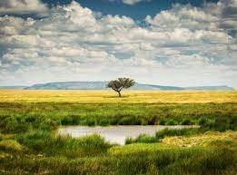
Sticky knowledge
Year group: 5 | Topic: Brilliant Biomes | Term: Spring 2
Key vocabulary and definitions:
Climate zones- areas with distinct climates Biomes- is an area classified according to the species that live in that location, temperature range, soil type, and the amount of light and water. Vegetation belt- an area with distinct plant types- determined by climate, soil, drainage and elevation Permafrost- any ground that remains permanently frozen Desert- a place where almost no rain falls Polar –areas round the North and South Poles Tropical- places near the equator Equator- an imaginary line running round the middle of the earth Adversely –unfavourable
Substantive knowledge and geographical concepts:
There are five major types of biomes: aquatic, grassland, forest, desert, and tundra. Despite only covering 5% of the Earth, over half of the world's plant and animal species are found in the rainforest biome. Much of the world's food and fibre comes from the plants and animals in the world grasslands. The largest biome on Earth is the aquatic biome - covering 75% of the planet. The permanently-frozen ground found in the tundra is known as permafrost. Deserts can be hot or cold. The world is spilt into four major climate zones they are temperate, desert, polar and tropical. Species adapt to different biomes and would struggle to survive without specific adaptable features. Humans have adversely affected many biomes throughout the world- e.g by cutting down trees, developing land, over hunting and burning fossil fuels.

Slide 4
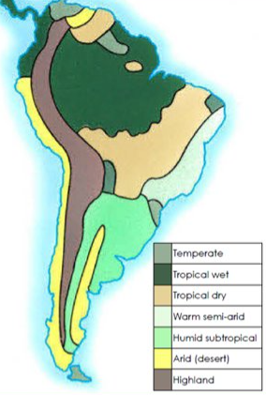
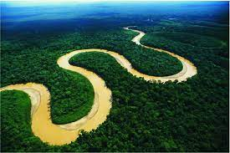
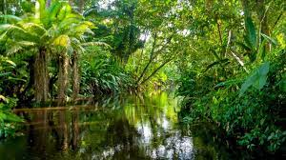
Sticky knowledge
Year group: 5 | Topic: UK vs South America | Term: Summer 1
Key vocabulary and definitions:
Island- a body of land surrounded by water Country- land controlled by single government Continent- a massive area of land that is separated from others by water or natural features Sothern Hemisphere- the area of the Earth that is south of the Equator Equator- an invisible line running round the centre of the earth Climate- the average weather conditions of a place
Substantive knowledge and concepts:
The UK's full name is the United Kingdom and is an island country in the Atlantic Ocean. The UK is situated off the north-western coast of mainland Europe. The country has land on two main islands (Great Britain and Ireland). South America is one of the seven continents in the southern hemisphere it is surrounded by the Pacific ocean and has a population of 440 million. South America is made up of 12 countries including: Chile, Argentina, Uruguay, Paraguay, Bolivia, Peru, Ecuador, Brazil, Colombia, Venezuela, Guyana, and Suriname—plus an overseas department of France called French Guiana. The Amazon river and rainforest are located within South America. The island of Great Britain contains England, Scotland, and Wales and has a population of 61 million. Due to its position over the Equator, most parts of South America are much warmer than the UK. The UK has a temperate (mild) climate, whilst many parts of Southern America do not have clear seasons.

