Slide 1


Year 6
Geography

Slide 2
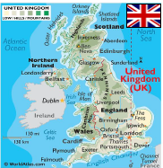
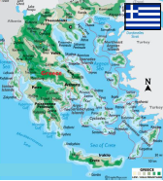


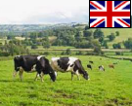
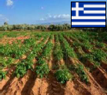




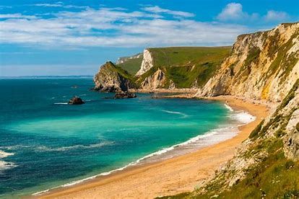
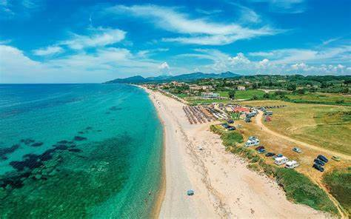

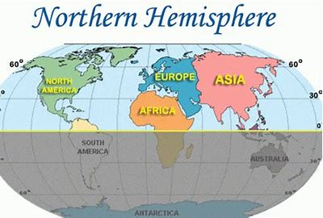
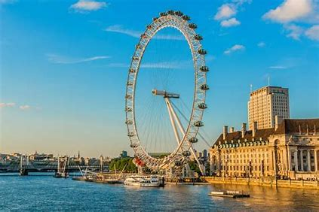
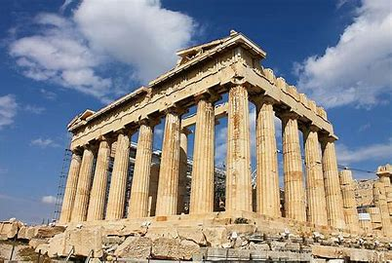

Sticky knowledge
Year group: 6 | Topic: UK vs Greece | Term: Aut 2
Key vocabulary and definitions:
Island- a body of land surrounded by water Country- land controlled by single government Northern Hemisphere- the section of earth North of the Equator Equator – an imaginary line running round the centre of the earth Population- number of people living in a certain place Agriculture- science of farming
Substantive knowledge and geographical concepts:
The UK's full name is the United Kingdom and is an island country in the Atlantic Ocean. The UK is situated off the north-western coast of mainland Europe. There are 50 countries in Europe, they include; Germany, Italy, Greece, France, Spain, UK and Sweden. The UK is in the Northern Hemisphere and has four seasons. The capital city of Greece is Athens. Greece is in southern Europe. Physical and human features define countries and cities within Europe. For example, Greece has longest coastline in Europe (physical feature) and Parthenon temple is a famous tourist attraction of Ancient Greece (Human feature). A similar percentage of land is used for agriculture. Greece has higher mountains than the UK. Mt Olympus is 2,917m high. The highest in the UK is Ben Nevis, at 1,345m. The UK has no active volcanoes, whereas Greece has three. Due to its position closer to the equator, Greece is warmer than the UK. On average, Athens is 5°C hotter than London. Greece is smaller than the UK. The UK has a bigger population compared to Greece. Tourism contributes to the UK and Greek economy. Features of Uk and Greece make it popular with tourists.

Slide 3

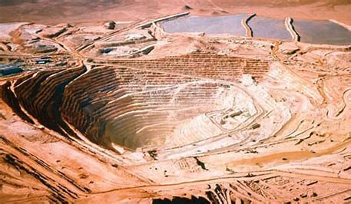
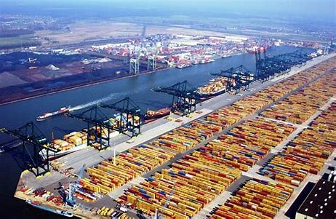
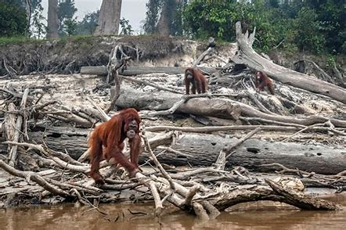
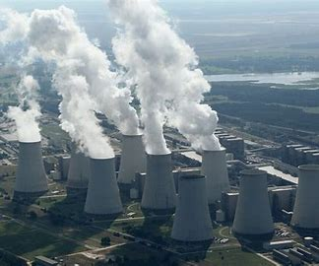
Sticky knowledge
Year group: 6 | Topic: Cataclysmic Climate Change | Term: Spring 2
Key vocabulary and definitions:
Natural resources- anything found in nature that can be used by living things Trade- buying and selling things Port – a place where boats come and go to load and unload their goods Settlement- places where people live and work Environmental degradation- the deterioration of the environment Human activity- something that people do or cause to happen Extinction- the dying out or disappearance of species from earth Deforestation- the clearing or cutting down of forests
Substantive knowledge and geographical concepts:
Key aspects of physical geography, include rivers, earthquakes, volcanoes, erosion and landslides Mountains form where two continental plates collide. Water is a major force of change in the environment- human activity that uses or alters its course will inevitably end up having an impact. Some natural resources are found everywhere, and some are unevenly distributed, for example oil, coal and natural gases are only found where conditions allow large quantities of animal or plant matter. Saudi Arabia, Russia and the USA produce the most oil. The USA, Russia and China have the largest coal reserves. Earth’s crust contains many minerals and other materials that are useful to people. To get these valuable natural resources, people must dig into the ground. The holes that they dig are called mines. Chile has the world's biggest mine. Human settlements require the availability of water to support agriculture, trade and transportation links which influences the expansion and development of cities e.g construction of ports. Trade is an important way of making money. Good area transported around the world in container ships from port to port and by aeroplane. Human activity is causing environmental degradation, which is the deterioration of the environment through depletion of resources such as air, water and soil; the destruction of ecosystems; habitat destruction; population; and the extinction of animals The main cause of climate change is burning fossil fuels such as oil, gas and coal. When burnt, they release carbon dioxide into the air causing the planet to heat up.

Slide 4

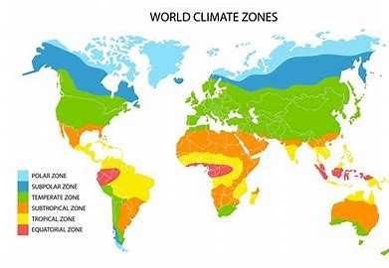
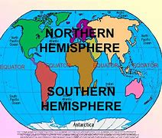
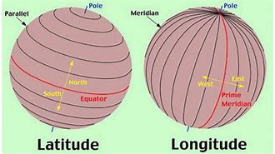
Sticky knowledge
Year group: 6 | Topic: Our Wonderful World | Term: Summer 1
Key vocabulary and definitions:
Longitude - Imaginary vertical lines used to show position on the Earth’s surface. Latitude - Imaginary horizontal lines use to show position on the Earth’s surface. Northern Hemisphere - One of two hemispheres. Area between the equator and the North Pole. Southern Hemisphere – One of two hemispheres. Area between the equator and the South Pole. Antarctic circle - The Antarctic Circle is the most southerly of the five major circles of latitude as shown on maps of the Earth. Arctic circle - The Arctic Circle is the most northerly of the five major circles of latitude as shown on maps of Earth. Tropic of Cancer- the parallel of latitude that 23.5 degrees north of the equator Tropic of Capricorn- an imaginary line of latitude going round the Earth at Approximately 23.5 degrees south of the equator
Substantive knowledge and geographical concepts:
There are 50 countries in Europe, they include, UK, Norway, Switzerland, Ukraine, Denmark and Romania America has two separate continents consisting of North America and South America. There are 23 countries in North America, they include Canada, Mexico, Cuba and Belize. There are 12 countries in South America, they include Chile, Argentine, Uruguay and Peru. Lines of latitude and longitude help locate countries on a map. The Americas cover a huge area of the globe, extending over several lines of latitude and longitude. The characteristics of different countries and regions vary significantly, including weather, land use and flora and fauna. There are four main climate zones determined by latitude (polar, temperate, sub-tropics, tropical) Places can be compared by looking at their physical geography (natural features) and their human geography (man-made features).

