Slide 1
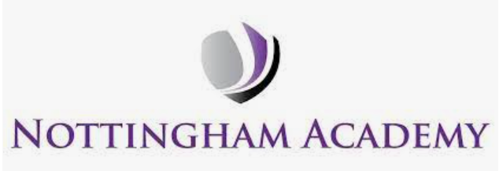

ART
Year 1

Slide 2
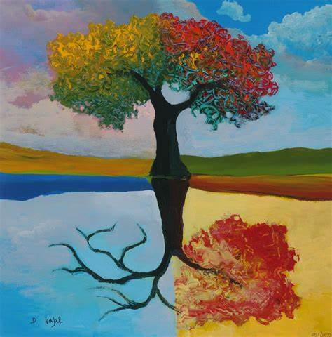
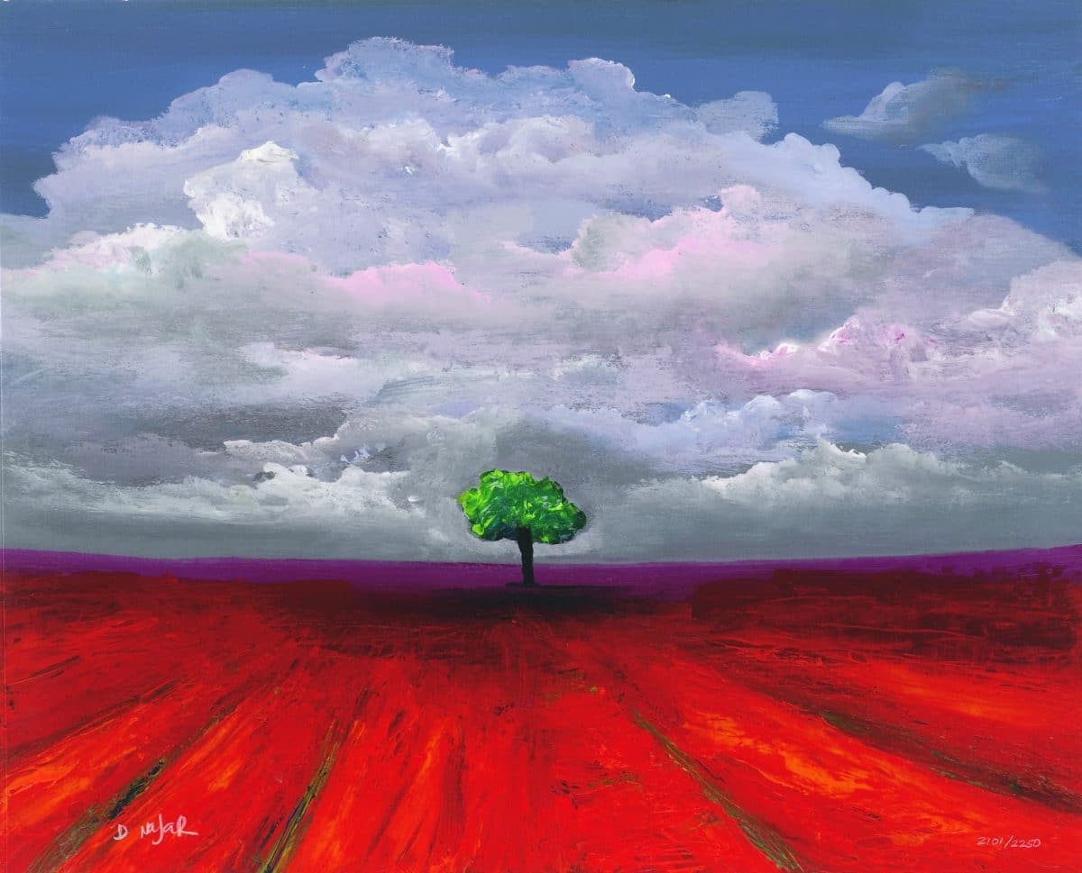
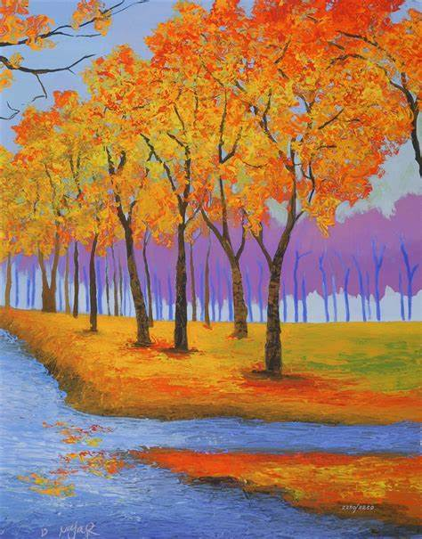
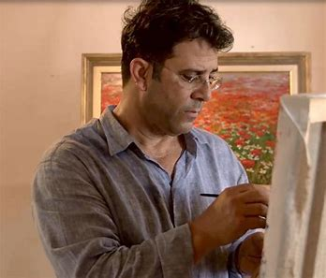
Sticky knowledge
Year group: 1 | Focus: Drawing/ Painting/ Printing Artist: David Najar | Term: 2
Elements of Art:
Line Space Shape Colour Texture
Knowledge of Artist:
David Najar was born in in 1962. He grew up near Israel. David's teachers knew he had artistic talents, but his family didn't support him. He visited an art museum and was inspired to learn how to paint. When he was 30 years old, he attended art lessons His artwork focuses on scenes of nature. He uses oil and acrylic paint. He uses bold colours to express his emotions.
Materials:
Paint, paper, objects to print with, tissue paper, pastels, crayons
Techniques and processes:
Colour mixing- Add white to change colour and shade. - Primary colours can be mixed to make secondary colours Collage- add a small amount of glue to an areas where the collage material will be added. Printing- Dip the printing object into paint and then press onto the paper. Lift it up without moving the object to create the desired pattern. Printing can be layered to create a desired effect Wash- Add lots of water to paint to dilute it. This can be used to paint over paper to a create a background for a picture. A large brush is good for covering large spaces with paint. A small brush is good for adding detail. Texture- Adding materials such as soap or sand can change the texture of paint.

Slide 3
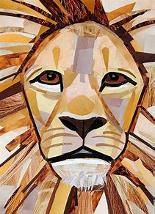
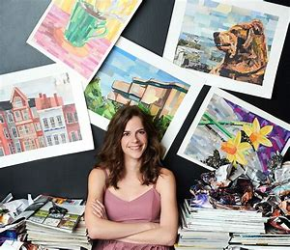
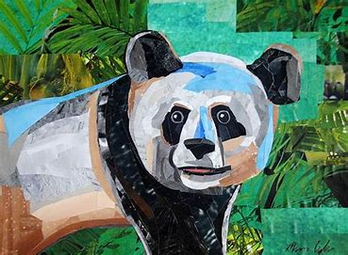
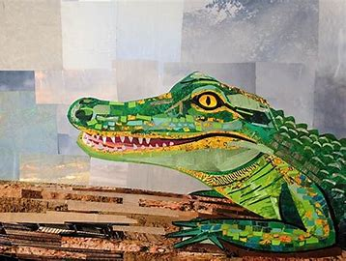
Year group: 1 | Focus: Collage Artist: Megan Coyle | Term: 5
Sticky knowledge
Artist knowledge:
Megan Coyle lives in New York, America. She creates collages through using pieces of magazine strips. As a child, she loved art and took part in lots of art classes. Megan calls her collage technique 'painting with paper' as the way she collages with magazine strips represent brush strokes. People that have seen Megan's artwork think they are created using paint, until they see up close that they are in fact layer of paper. Megan's work concentrates on animals, landscapes, cityscapes and still life.
Elements of Art:
Shape Colour Texture
Materials:
PVA glue Tissue paper Magazines
Techniques and processes:
Cutting- Carefully cut pieces of coloured paper to the shape and size needed. Collage- add a small amount of glue to an areas where the collage material will be added.

Slide 4
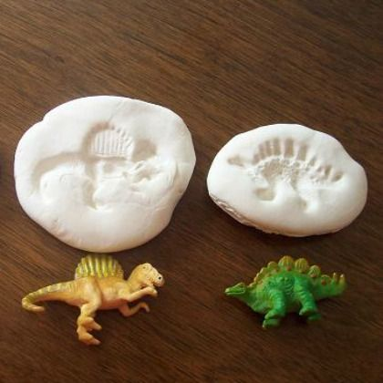
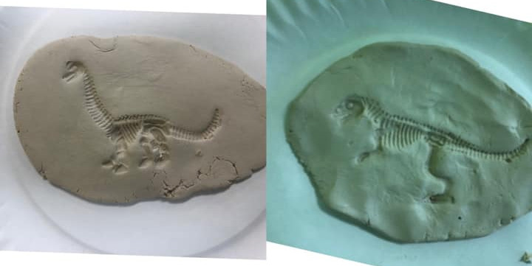
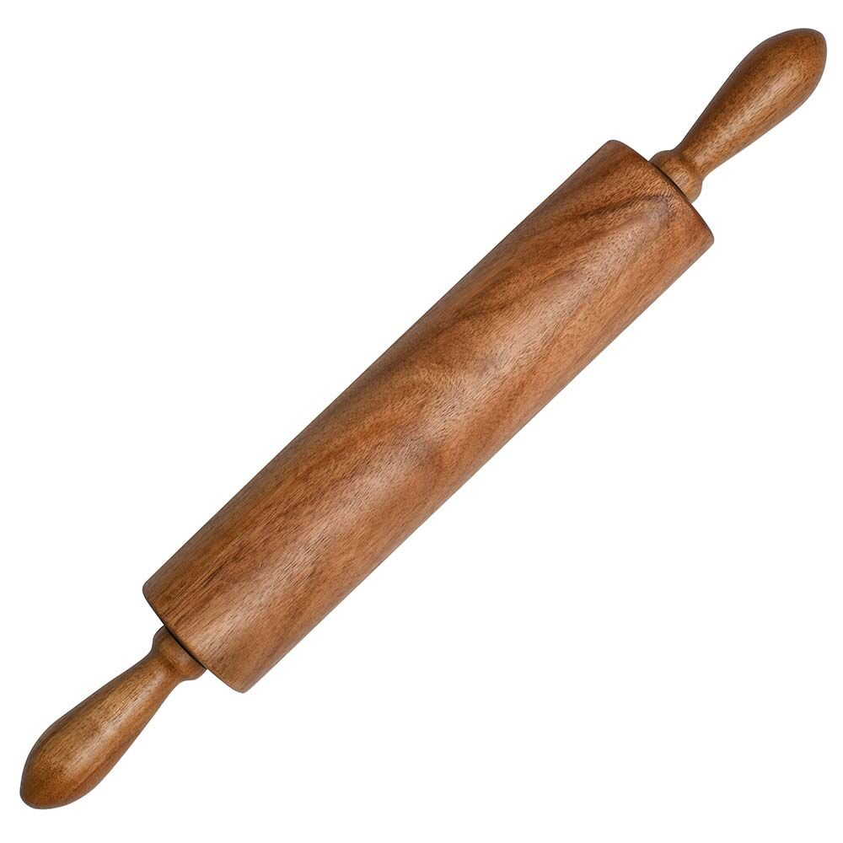
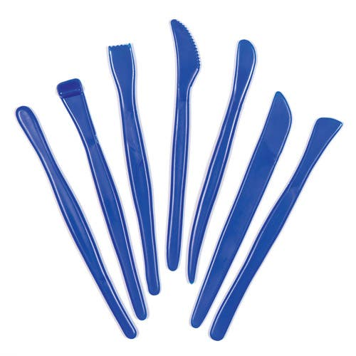
Year group: 1 | Focus- 3D Form/ Sculpture- creating fossils | Term: 6
Sticky knowledge
Elements of Art:
Form Shape
Materials:
Clay Salt dough
Techniques and processes:
Clay or salt dough dries out when it gets warm and dry. Clay and salt dough isn't very strong and can easily break so it is best to keep your work quite thick. A rolling pin can be used to make a flat piece Cutting tools can be used to make a neat edge You can add texture or marks to clay by pressing objects into the clay Press a dinosaur figure down hard into the clay/ salt dough and lift it up Clay/ salt dough will dry and turn hard once when it is left in a dry, warm place or put into an oven to harden quickly.

Slide 5
ART
Year 2

Slide 6
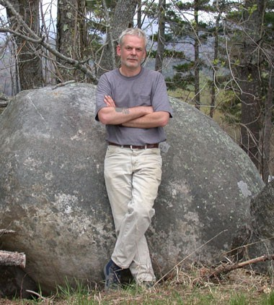
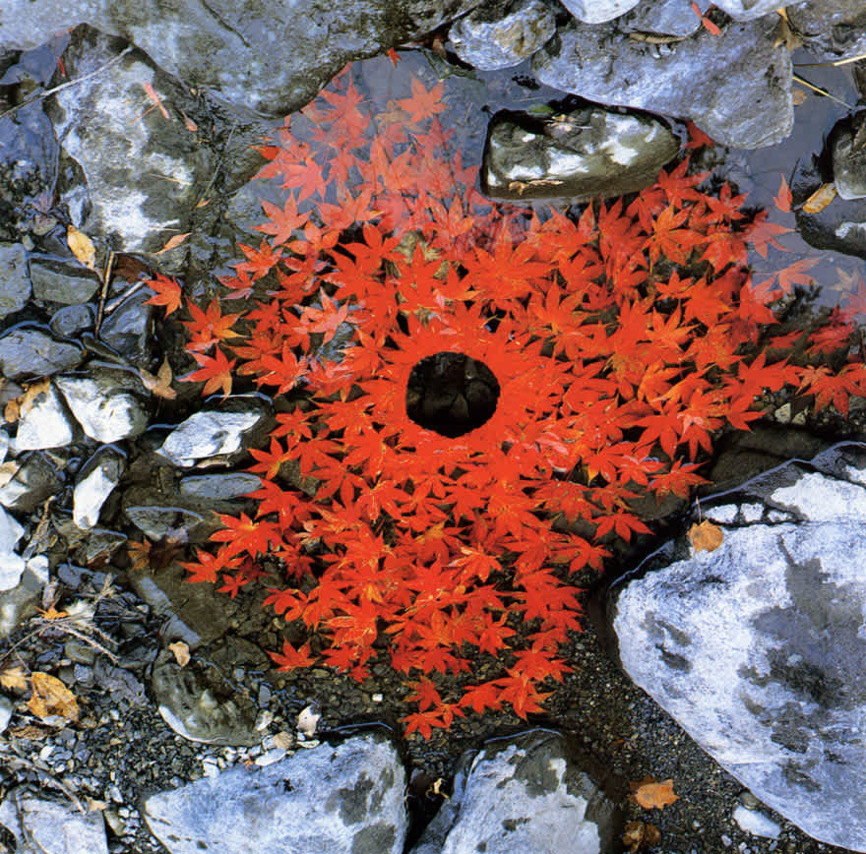
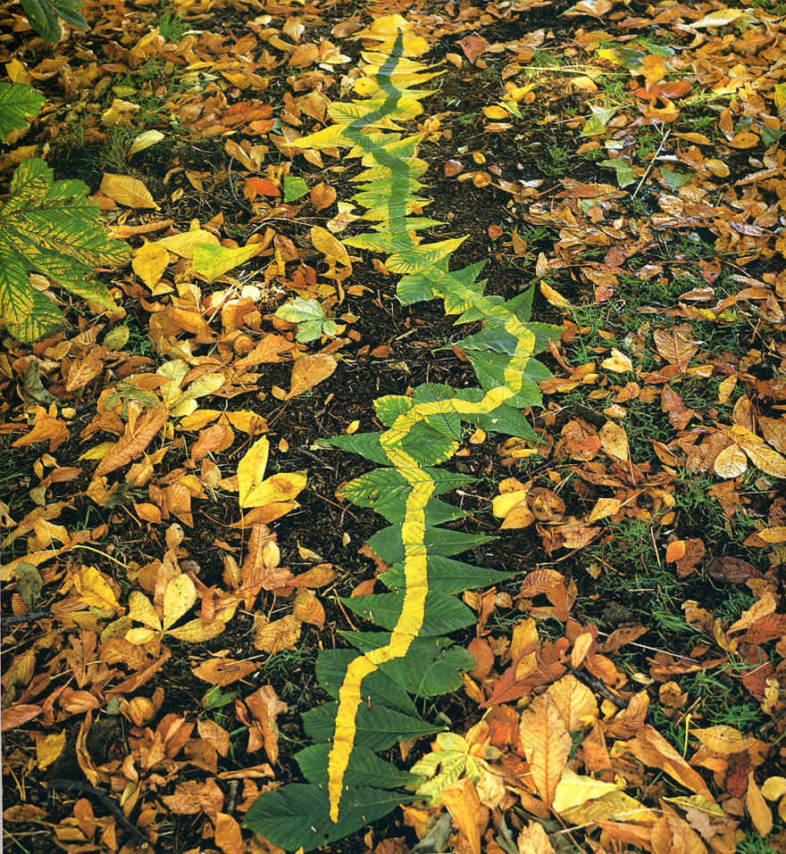
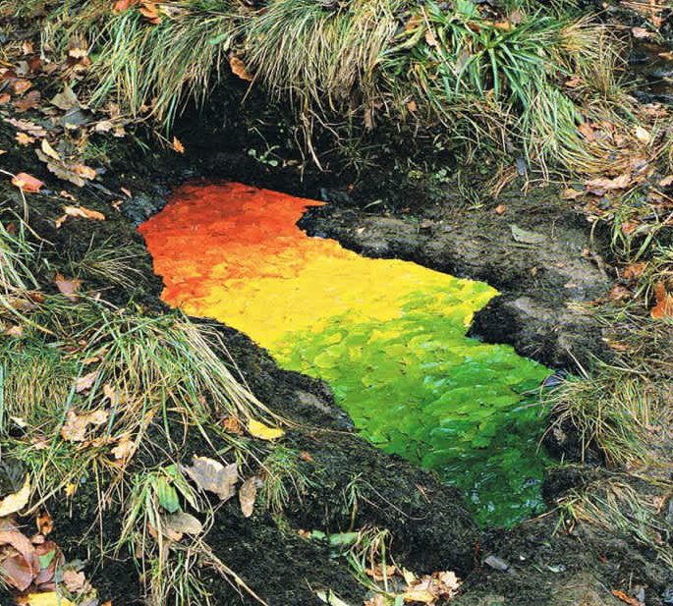
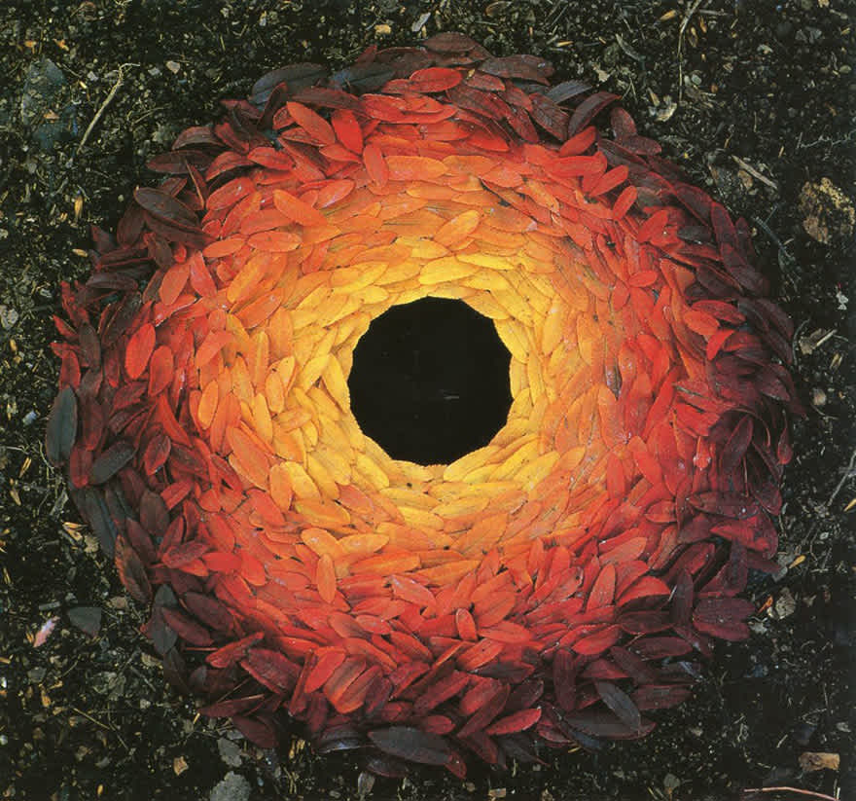
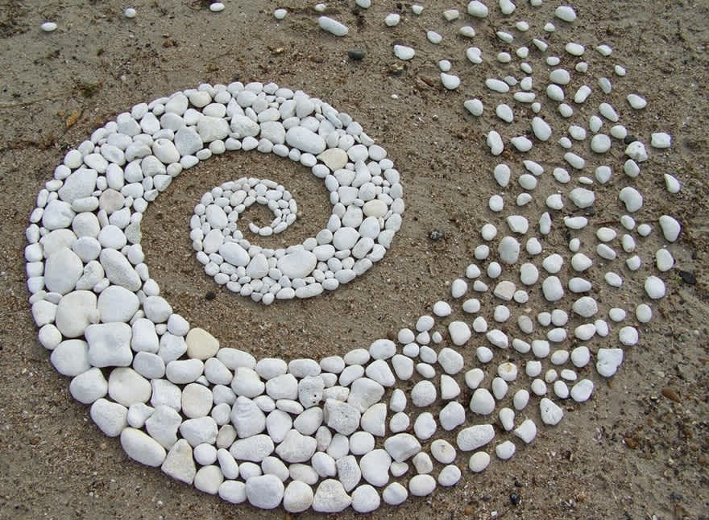
Year group: 2 | Focus: Collage Artist: Andy Goldsworthy | Term: 1
Sticky knowledge
Elements of Art:
Form line Colour Shape Space
Artist knowledge:
Andy Goldsworthy was born in 1956 in Cheshire. He lives in Scotland He uses objects he finds in nature to create his art, including leaves, flowers, sand, sticks, icicles and stones. Goldsworthy turns tree roots, puddles, and the ground itself, into pieces of art. Goldsworthy has produced more than 70 exhibitions and projects all over the world including those in the Canadian Arctic, the streets of London and Tochigi Prefecture, Japan. Goldsworthy will not carve into for break natural materials to use in his art, instead he will look for loose or unsettled materials.
Materials:
Natural material: Leaves Conkers Pine cones Stones Water Wood bark
Techniques and processes:
Collect loose natural materials Look closely at the colours (including shades) and shapes of the objects found. Natural objects can be arranged to make a picture, shape or pattern. Art can be 2D or 3D. Objects can be laid on top or next to each other to create shapes and space Natural materials can be folded, scrunched, torn or overlapped. Wind or rain may wash away the natural art

Slide 7
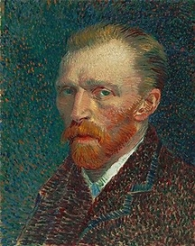
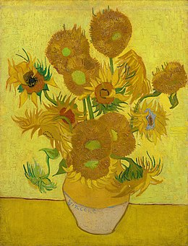
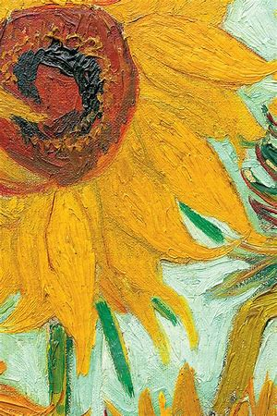
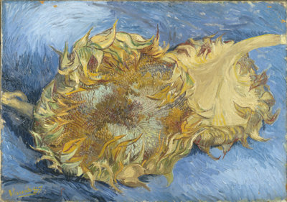
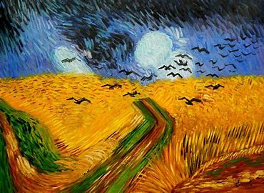
Year group: 2 | Artist: Vincent Van Gogh Focus: drawing/ painting | Term: 3
Sticky knowledge
Elements of Art:
Colour Texture Line
Artist knowledge:
Vincent Van Gogh was a Dutch painter. He was born on 30th March 1853 and died on 29th July 1890- aged 37 He is one of the most famous and influential artists in history. In just over 10 years he created 2100 pieces of art. His paintings include landscapes, still life, portraits and self-portraits. Van Gogh's paintings used bold, symbolic colours, and dramatic and expressive brushwork. Today, Van Gogh's works are among the world's most expensive paintings to have ever sold. The Van Gogh Museum in Amsterdam holds the world's largest collection of his paintings and drawings. Vincent wanted to be known as the sunflower painter He painted 5 different versions of 'sunflowers in a vase', which are now displayed around the world, including in London, Amsterdam and Tokyo.
Materials:
Paint Paper Drawing pencils
Techniques and processes:
Looking closely at sunflowers using magnifying glasses will help you see fine detail Pressing down hard with a pencil will create a dark line Pressing down gently will create a faint line Large brushes are good for painting large spaces. Small brushes are used to paint smaller details. A spatula can be used to add thick paint to a painting to make it look like it has more texture. A wash is thin paint- it is created by adding more water to paint. It can be used to create a background A short-bristled brush can be used to dab paint onto a picture- this adds texture to a painting. Primary colours can be mixed together to make secondary colours. Shades and tones can be changed by adding black or white paint

Slide 8
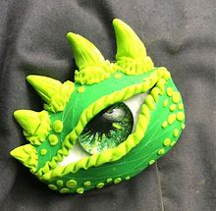
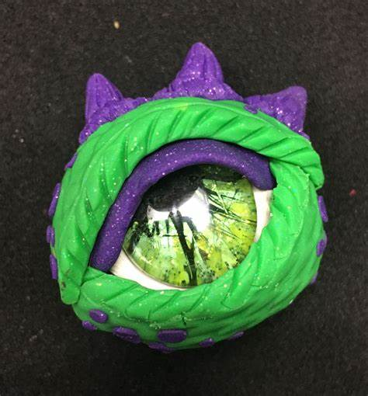
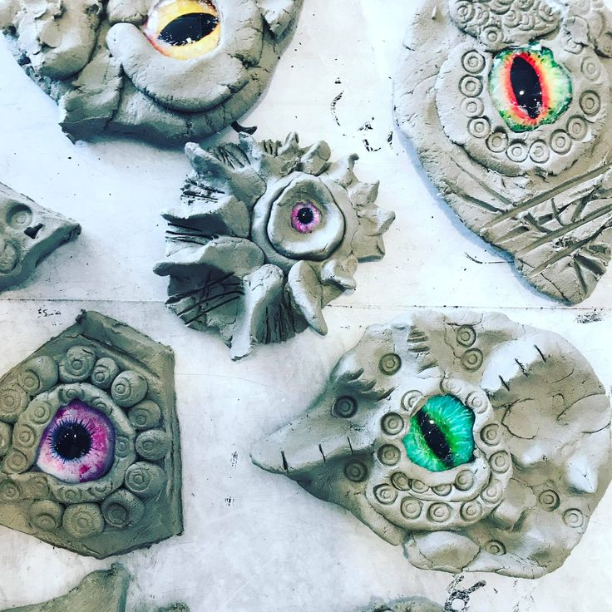
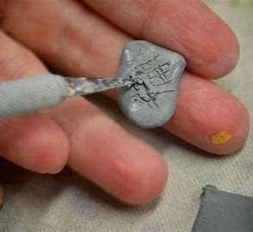
Sticky knowledge
Year group: 2 | Topic: Clay dragon eye | Term: 5
Elements of Art:
Form Shape
Materials:
Clay
Techniques and processes:
Clay dries out when it gets warm and dry so keep it cool and wet when you are working with it. Clay isn't very strong and can easily break so it is best to keep your work quite thick. A rolling pin can be used to make a flat piece Cutting tools can be used to make a neat edge You can add texture or marks to clay by pressing objects into the clay You can mold clay to make shapes using your hands (e.g pinch, stretch, press or twist) or tools You can join pieces of clay by scoring (making lines in the clay) and adding slip (watered down clay) which acts as glue. Clay will dry and turn hard once when it is left in a dry, warm place or put into an oven to harden quickly. Primary colours can be mixed together to make secondary colours. Shades and tones can be changed by adding black or white paint

Slide 9
ART
Year 3

Slide 10
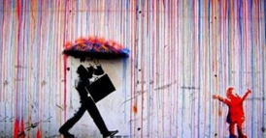
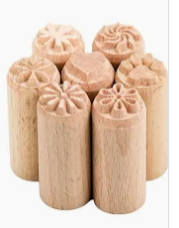
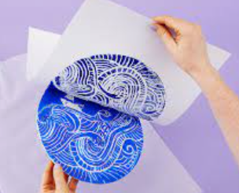
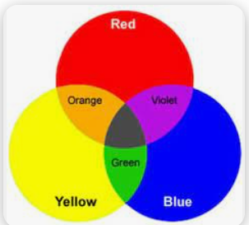
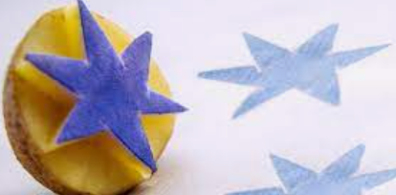
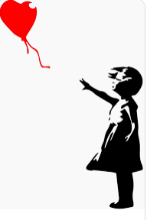
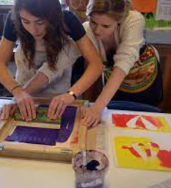
Sticky knowledge
Year group: 3 | Focus: Printing and Painting Artist: Banksy | Term: 1
Elements of Art:
Colour Line Texture Value
Artist knowledge:
Banksy is believed to have been born in 1974. Banksy is an anonymous graffiti artist. Being anonymous means he keeps his identity a secret. He became a freehand graffiti artist in 1993 He will not allow photos or copies of his artwork to be made and sold. Graffiti artists have a ‘tag’, which is like putting a signature on their work. One of Banksy’s most famous artworks was called Love is in the Bin. The image had just sold for £1.4 million. Banksy’s art sells for millions now. This means that sometimes people buy and remove the entire wall it was painted on! In 2005, Banksy published a best-selling book. It was called Wall and Piece.
Materials:
Paint, printing tools, paper, brushes
Techniques and processes:
Tools such as potato's, bubble wrap, sponges ink rollers and squeegees can be used for printing. Paint brushes can be used for mixing paint and applying it to the printing block. You can mix primary colours to make secondary colours. Mono printing is a form of printmaking where the image can only be made once. Block printing is a printing technique involving carving a pattern onto a large block, covering that design in ink or dye, and stamping it onto a background. Hard rollers will ink up less and can leave roller marks at the edges, soft rollers can roll ink more evenly but can deposit more ink in the grooves.

Slide 11
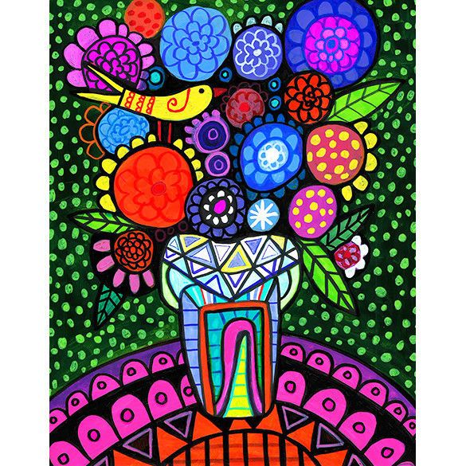
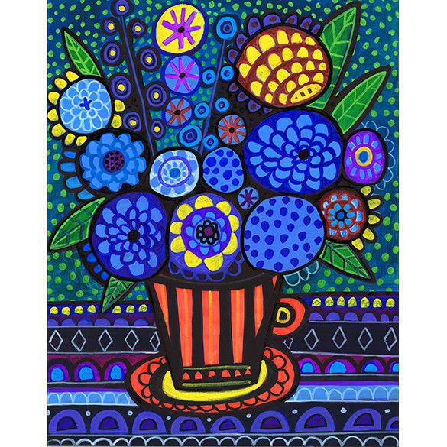
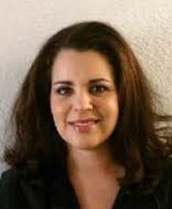
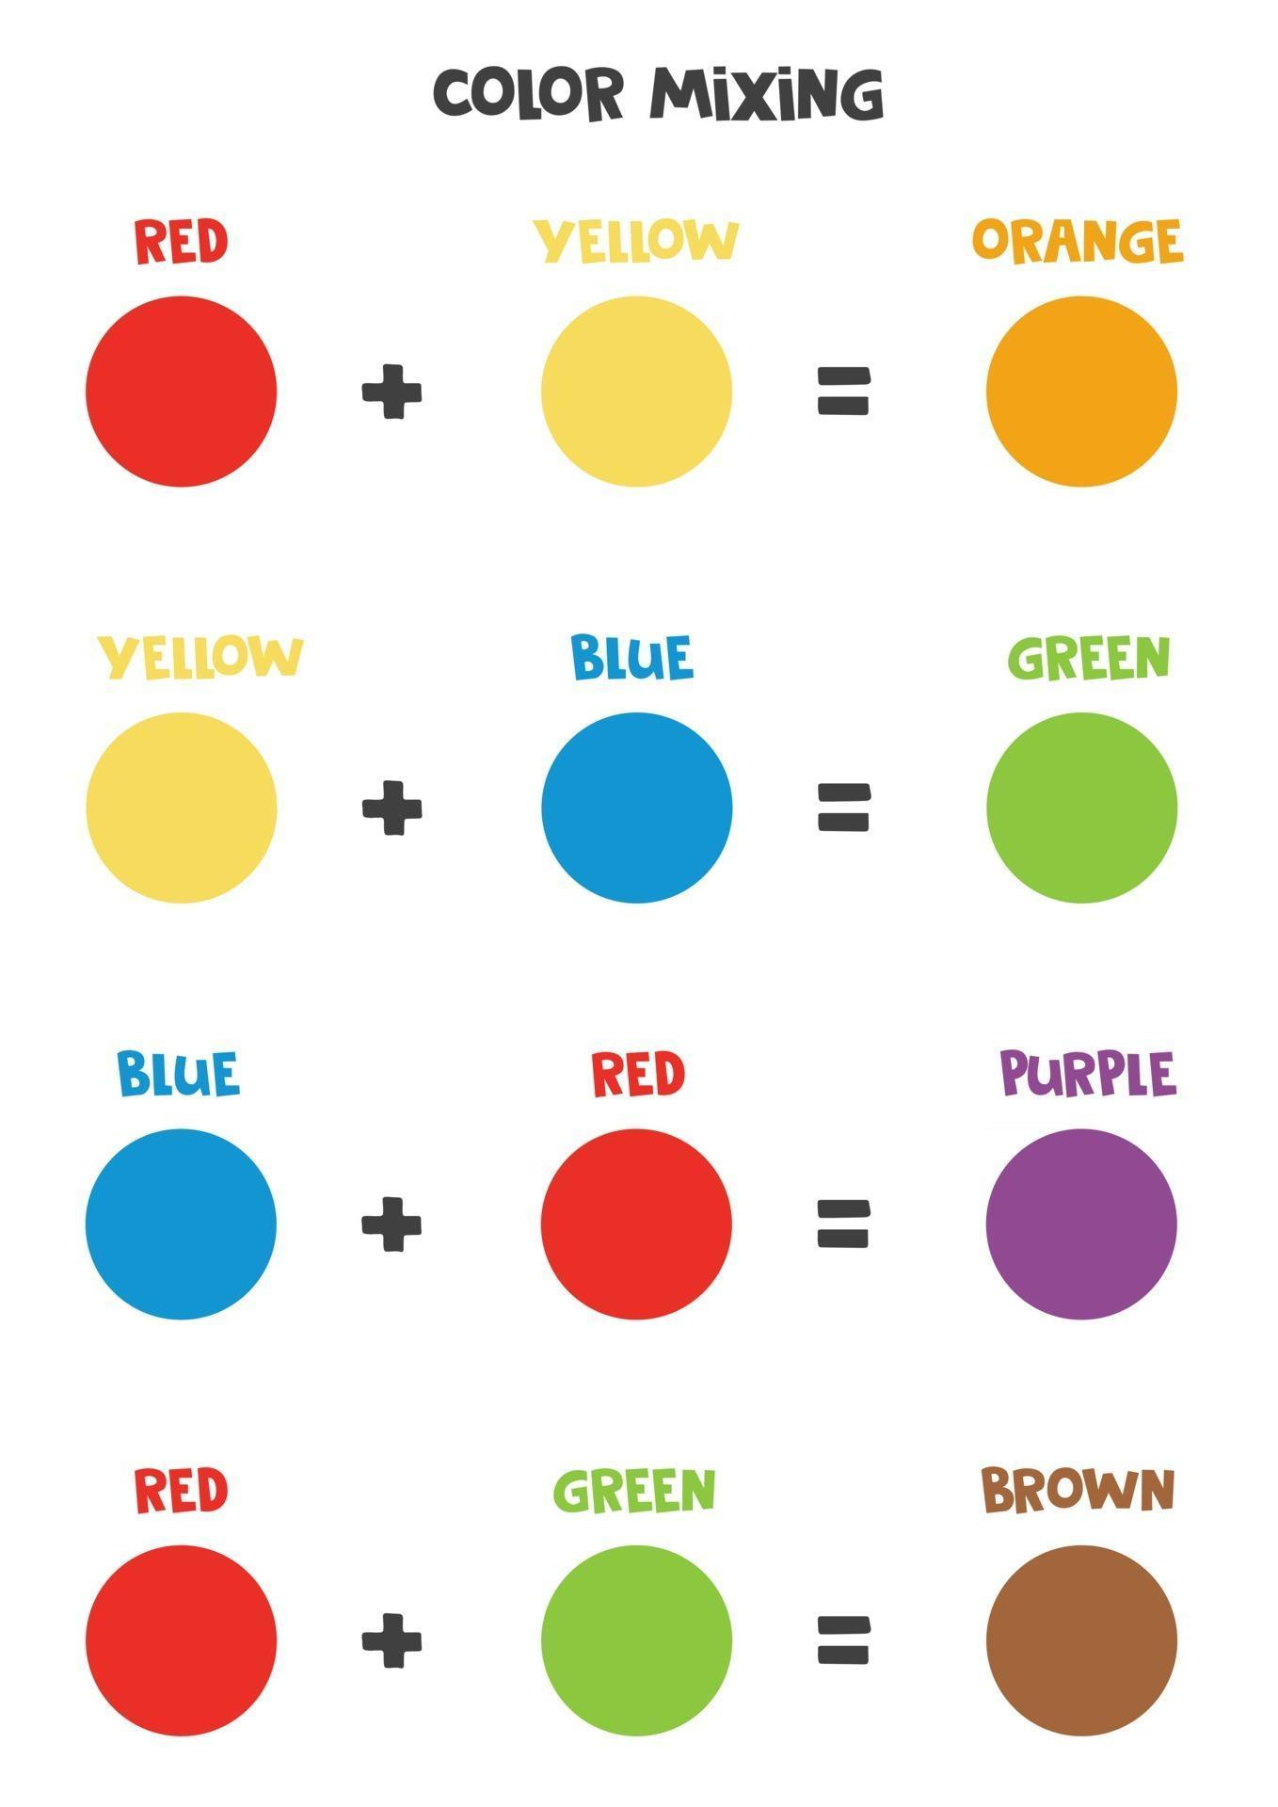
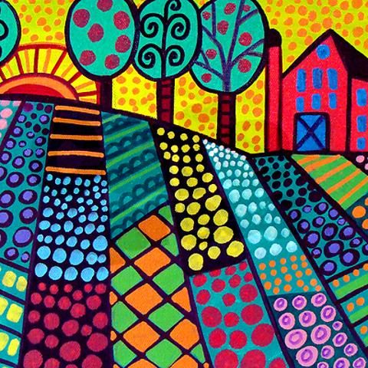
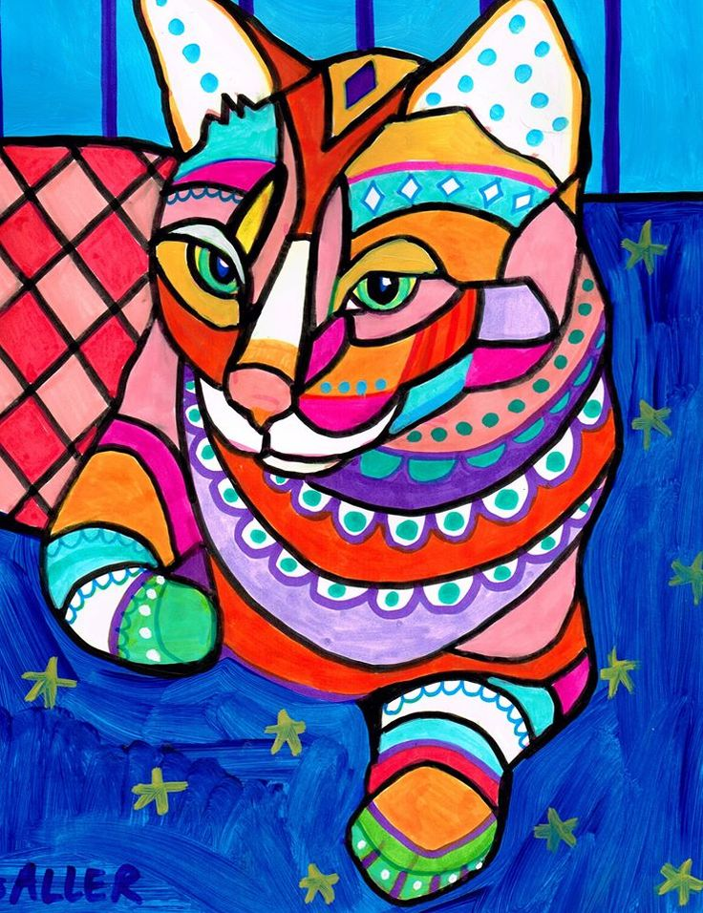
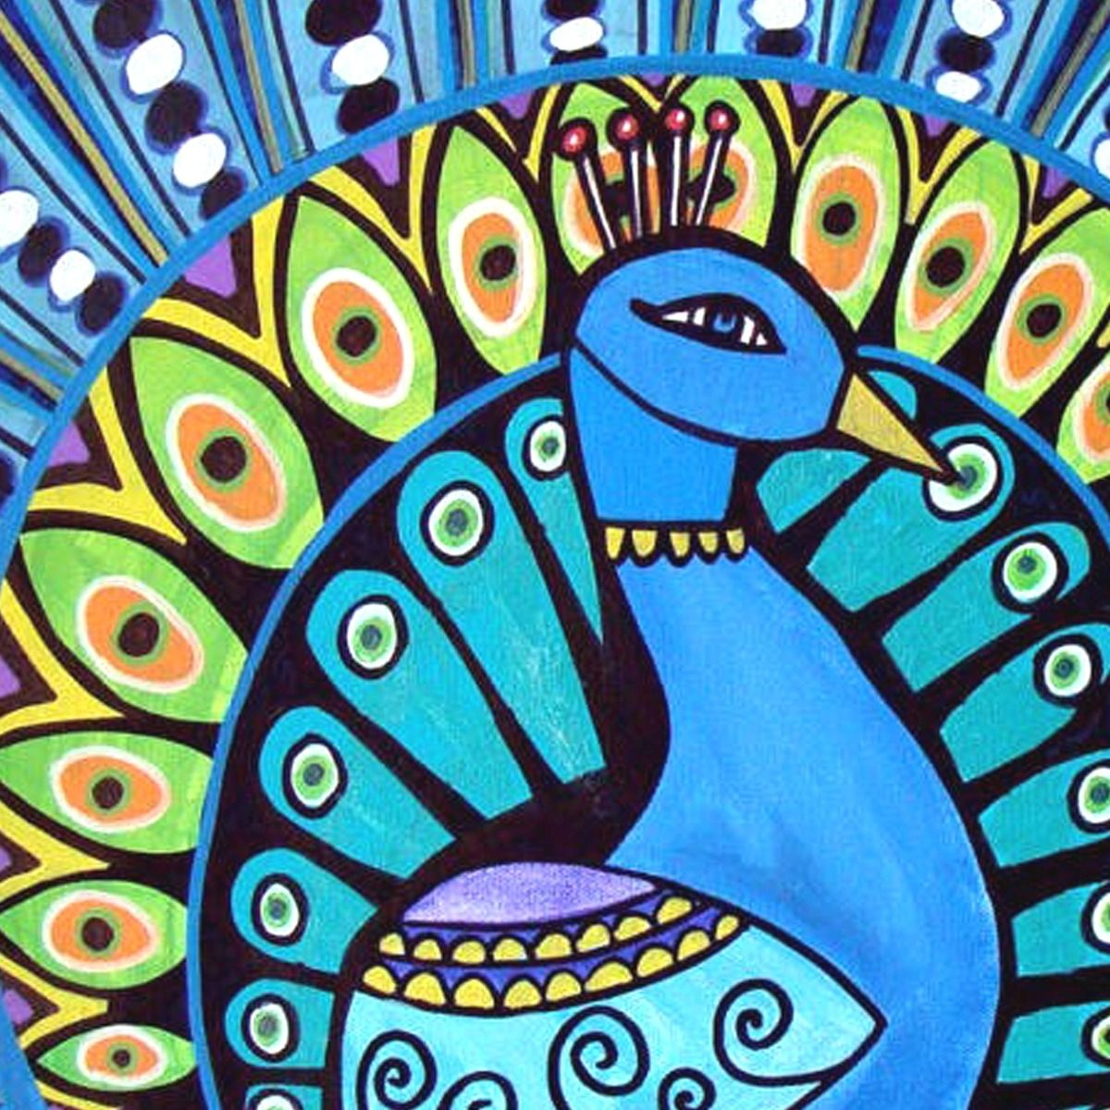
Year group:3 | Focus: Drawing and Painting Artist: Heather Galler | Term: 4
Sticky knowledge
Elements of Art:
Line Shape Colour
Artist knowledge:
Heather Galler is an American Folk artist She was born in New York in 1970 A folk artist is an artist that didn't get trained in an art school but creates art around what is important to them. Heather Galler likes to paint flowers, people, landscapes and pets. She has sold over 750 paintings in the last 5 years Her paintings use bold colours, energetic patterns and geometric shapes
Materials:
Paper, pencils, black marker, oil resistant crayons/ wax crayons, paint
Techniques and processes:
Drawing your flowers with pencil first allows you to design your picture with no pressure to get it right first time. A black outline makes the shapes and patterns stand out. Patterns and shapes can be created using bold colours- firstly using wax/ oil resistant crayons. Water colours can be used alongside wax/oil resistant crayons as the paint resists (won't go over) the crayon. A small brush should be used to add detail to small areas.

Slide 12
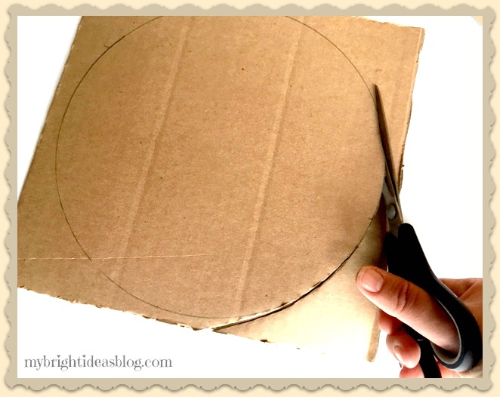
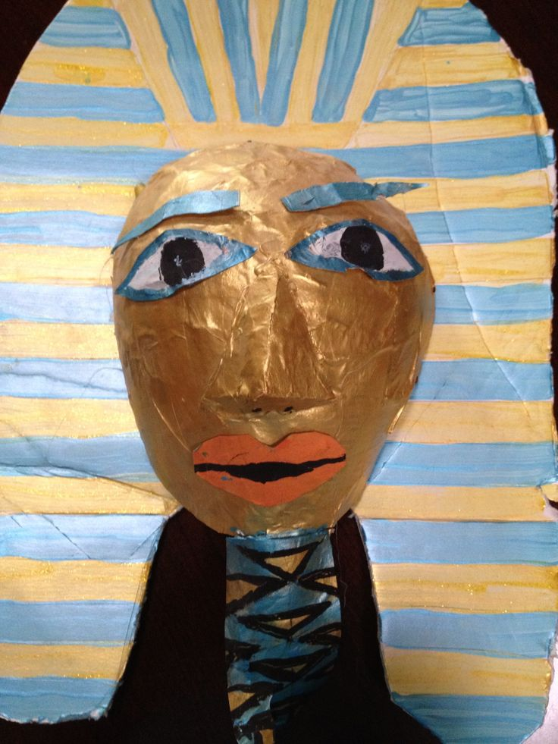
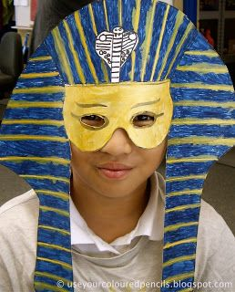
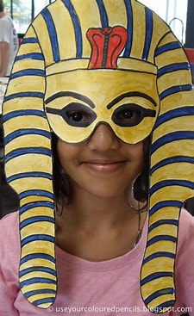
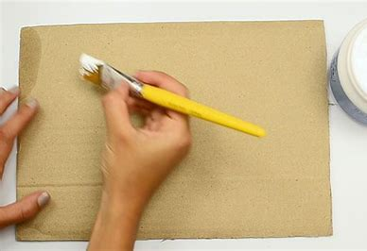
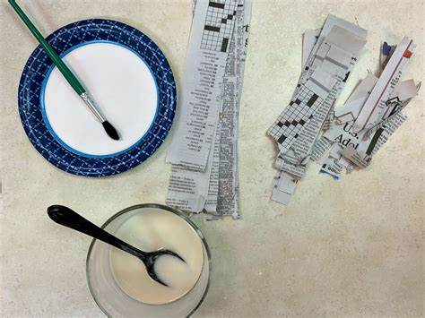
Year group: 3 | Focus: 3D form/ Sculpture Painting- Egyptian masks | Term: 6
Sticky knowledge
Elements of Art:
Form Shape Colour
Materials:
Card board Paint Collage materials Paper mache
Substantive knowledge:
The ancient Egyptians used paper mâché to make death masks using linen and plaster. Egyptians believed that death masks aided the soul's search of its human body after death. One of the most famous death masks is that of Tutankhamun. The term paper mâché means 'chewed paper' in French.
Techniques and processes:
It is important to draw out your mask design with pencil first. Scissors can be used to cut out the shape of your mask. Paper mâché is a popular crafting technique that uses paper and a paste to create a variety of objects. To paper mâché, you need to layer pieces of paper and with watered down adhesive (glue) onto a blank surface. Paper mâché can be used to thicken and strengthen a surface or add shape to a surface. As the paper dries, the outer shell hardens. The dried paper mâché can be painted and decorated.

Slide 13
ART
Year 4

Slide 14
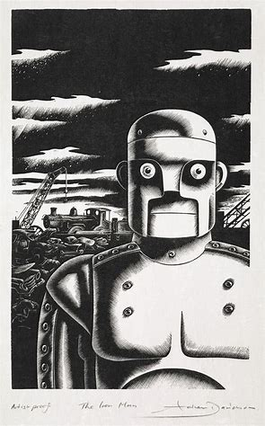
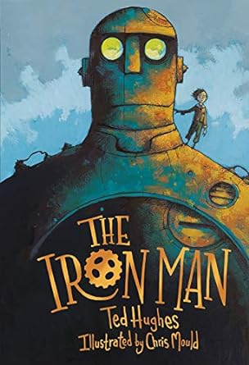


Year group: | Focus: Drawing Artist: Illustrator- Chris Mould | Term: 2
Sticky knowledge
Elements of Art:
Line, shape, value
Artist knowledge:
Chris Mould was born in Bradford in 1969 He is a British illustrator and occasional writer of children's books He exhibits his artwork regularly When he left school at the age of 16, the only skill he had was drawing. He decided to go to an art school to study graphic design. He then went to University in Leeds and received an honours degree in Graphic Design & Illustration. He has drawn the illustrations for many children's books, including Ironman, which was his favourite books as a child.
Materials:
Charcoal, paper charcoal pencils
Techniques and processes:
The simplest way to use a charcoal is to draw with the end, holding it as you would a pencil or pen. You can alter the thickness of the line by varying the pressure you’re applying to the charcoal. Press harder for darker and thicker lines. Press more gently for lighter and thinker lines. To create large blocks, use the side of a charcoal stick. You can create tonal variations with charcoal. Optical Blending: which is achieved by having lines or dots in close proximity (hatching or cross-hatching) Pressure Strokes: when the charcoal is applied on the paper with various pressure to create light and dark values Blending: when charcoal is blended with white on the paper to create a lighter values.

Slide 15




Year group: | Focus: Printing – Aztec patterns | Term: 3
Sticky knowledge
Elements of Art:
Line, shape, colour
Materials:
Paper or fabric, Polystyrene Sheets for printing, potato, ink, paint, cotton buds
Substantive knowledge:
Printing with stamps was popular with the Aztecs and remains today - all over the world. By Aztec times stamps were hugely popular, especially at festival times, for printing designs onto the human face/body (as well as onto items of clothing); some stamps were curved in shape to aid printing onto legs and thighs. Aztec body printing was like modern-day face-painting and the use of stick-on temporary tattoos at big events. Colour dyes were made from charcoal and pine (for black), chalk (white), cinnabar (bright scarlet mercury ore), cochineal, indigo and other materials. Popular designs included geometric patterns, flowers, animals, serpents and eagle heads.
Techniques and processes:
Relief printing is a printmaking technique that allows a design to be repeated multiple times. For this technique you created on a surface - known as a printing plate - which is then rolled or painted with ink and printed onto paper or fabric. Mono printing is a printing technique where the print can only be made once. For this you need to paint a thin layer of paint over a smooth clean surface. Then use a cotton bud to draw a pattern in the paint (removing the paint onto the bud). Then print with paper over the top. Rubbings are a reproduction of the texture of a surface. These are created by placing a piece of paper over the subject and then rubbing the paper with charcoal or crayons to take a print of the texture underneath Resist printing: is a methods of colouring cloth in a pattern by pretreating designed areas to resist penetration by the dye.

Slide 16




Year group: | Focus: Drawing and Painting- Portraits of Monarchs Artist- Holbein | Term: 6
Sticky knowledge
Elements of Art:
Value, line, colour, shape, colour, texture
Artist knowledge:
Hans Holbein was a German print maker and artist and one of the greatest 16th century portrait painters. He was born in Augsburg, Germany, in 1497 During the early 1530s, Hans Holbein moved to England and became King Henry Vlll's official portrait painter. He painted many paintings of Tudor royalty while employed as the King’s portrait painter. Hans Holbein was recognised for his skills of art and his life like quality of his paintings. He was also a skilled drawer, he could create incredibly detailed drawings more rapidly in front of the sitter (person being painted) Henry VIII asked Hans Holbein to paint Anne of Cleves so he could decide whether or not to marry her. Hans Holbein died of the plague in London in 1543 Hans Holbein's paintings are displayed in galleries around the world. The portrait of Henry VIII is now displayed in a museum in Madrid, Spain.
Materials:
Paper, drawing pencils, paint,
Techniques and processes:
Draw an outline of the shape of a head Start to draw on features, including eyes, nose and mouth. Add finer details such as eyebrows, eye lashes Drawing lightly allow you to be able to rub out any mistakes more easily. Looking and where light hits and object and where shadows are created helps to make portraits to look more realistic. Blending: which is achieved by having lines or dots in close proximity (hatching or cross-hatching) Pressure can be applied on the paper to create light and dark values Small, thin brushes can be used to add fine detail Larger brushes can be used to cover larger areas with a block of colour. Tools can be used to create paint effects

Slide 17
ART
Year 5

Slide 18







Year group: 5 | Focus: Layered Collage/ Printing/ Painting – Recycled Viking longboats | Term: 1
Sticky knowledge
Elements of Art:
Line Value Shape Texture
Materials:
Paper, paint, cardboard, recycled materials, drawing pencils, sponges, paint brushes
Techniques and processes:
A WASH is an even coverage of paint over all or part of the paper. A VARIEGATED WASH is a wash that changes in colour- perfect for a sunset sky. To paint a wash, load your large flat brush with a lot of water and dip it into the first colour- The more water you use, the lighter your sky will be – the less water you use, the more vibrant or bright the sky will be. Colour can change shade by adding white to lighten it and black to darken it When printing, it is important not to overload the printing object with paint, otherwise the pattern won't be clear. Relief printing is a printmaking technique that allows a design to be repeated multiple times. Mono printing is a printing technique where the print can only be made once. Resist printing: is a methods of colouring cloth in a pattern by pretreating designed areas to resist penetration by the dye. Torn paper art is a popular technique used to achieve rough edges- perfect for waves! Artists use layering approaches to add interest and depth to their art by layering a variety of media and textures.

Slide 19






Year group: 5 | Focus: Drawing/ Painting- Watercolours Artist: Henri Rousseau | Term: 4
Sticky knowledge
Elements of Art:
Line Shape Colour Texture Form
Materials:
Paper, drawing pencil, water colours, oil pastels/ wax crayons
Artist knowledge:
Henri Rousseau was born in 1844 and died in 1910. He was born in Lavel, France He worked a variety of jobs (including a saxophonist and tax collector) before beginning to paint at the age of 40. He was a self-taught painter and claimed he had "no teacher other than nature". His best-known paintings depict jungle scenes, even though he never left France or saw a jungle. His inspiration came from illustrations in children's books and the botanical gardens in Paris as well as tableaux of taxidermy wild animals. Many critics said he "painted like a child". A Rousseau painting was used as an inspiration for the 2005 children's animated film Madagascar. Rousseau's work can be found in several major world museums including Paris's Musée d'Orsay, the Kunsthaus Zürich and the Philadelphia Museum of Art.
Techniques and processes:
Lightly drawing detail in pencil is a crucial step. A wash can be created by adding water to the brush. The more water the lighter the colour- less water the more vibrant the colour. Wet paint on dry paper is called the wet on dry technique Wet paint on wet paper is called the wet on wet technique Layer oil pastels or wax crayons resist water colours. Layering is a wet on dry technique so that colours don't run into each other. Different brushstrokes and techniques can create interesting effects Layering can be used with one or more colours to increase intensity or darken tone.

Slide 20





Year group: 5 | Artist: William Morris Focus: Drawing/ Printing | Term: 6
Sticky knowledge
Elements of Art:
Space, shape, colour
Artist knowledge:
William Morris lived and worked during the Victorian era. He was born in 1834 and he died in 1896. He earned a degree from Exeter College, Oxford. After his graduation he started to work as an architect. After some influence form his painter friends, he stopped being an architect to become a painter When William got married, him and his wife brought a house which they decorated themselves. This led them to starting their own arts and crafts company. Their company made hand crafted furniture, tableware, soft furnishings and wallpaper. William Morris was famous for his wallpaper designs- they were inspired by the natural world. William also wrote poems and drew beautiful illustrations for his book. When William Morris died in 1896, his doctor said that Morris had carried out the work of ten men during his lifetime. His work was continued by his daughter, May Morris A famous William Morris quote is "Have nothing in your house that you do not know to be useful or believe to be beautiful".
Materials:
Material, printing block, paint
Techniques and processes:
Look closely and practice observational drawings of nature. Tools such as sharp or blunt pencils can be used to create a design on the printing block. A roller or paint brush can be used to cover the printing block evenly in paint. Prints can be repeated to create a larger design over a bigger space. Prints can be rotated to fit together to make designs symmetrical or a reflection of the original print. Printing blocks can be cut into different shapes so that they fit together. Prints can be layered to add more complex detail.

Slide 21
ART
Year 6

Slide 22







Year group: 6 | Focus: 3D form/ Scultpure Artist: Bridget Baker Alexander Calder Elizabeth Berrien | Term: 1
Sticky knowledge
Elements of Art:
Line Shape space Form
Artist knowledge:
Bridget Baker Bridget Baker studied Zoology at University but only started making wire animals after retirement. Each figure is made from galvanized wire which is then painted with enamel paints. Alexander Calder Alexander Calder was an American sculptor from Pennsylvania Alexander Calder is known for inventing wire sculptures and the mobiles His mobile structures rely on careful weighting to achieve balance and suspension in the air. Elizabeth Berrien Elizabeth Berrien, known as "Godmother of Wire" for inspiring the current generation of contemporary wire sculptors. Her works is displayed in hotels, restaurants, health care, airports, private and corporate setting worldwide. Her awards include Obie, Cannes Gold Each Berrien wire sculpture begins with the joining of two strands of wire. Then another, and another, until hundreds or even thousands of wires are involved.
Materials:
Wire
Techniques and processes:
Thicker wire is stiffer and is best for creating the framework around which the structure will be built. Thinner wire is easier to bend and can be used to add detail to a structure. A darker wire colour will give a structure a strong silhouette 3D wire structures are like drawing in 3D Wire can be wound around certain tools in order to achieve shapes for a design. Wire can be held in place on the sculpture by winding the end of the wire around another piece within the structure- connecting them all together.

Slide 23





Year group: 6 | Focus: Drawing and painting Animals linked to evolution | Term: 5
Sticky knowledge
Materials:
Drawing pencils, oil pastels, paint
Elements of Art:
Line Colour Texture Shape
Techniques and processes:
Drawing lightly allow you to be able to rub out any mistakes more easily. Looking and where light hits and object and where shadows are created helps to make portraits to look more realistic. Blending: which is achieved by having lines or dots in close proximity (hatching or cross-hatching) Pressure can be applied on the paper to create light and dark values. Different marks and lines create different effects Marks can be layered to give the appearance of texture Adding black or white paint to a colour will change the shade

Slide 24






Year group: 6 | Focus: Drawing/Painting - Optical illusion Artist: Bridget Riley | Term: 6
Sticky knowledge
Elements of Art:
Line Texture Shape Colour Value
Artist knowledge:
Bridget Riley was born in 1931 in London, but when World War II broke out she left the city and moved to Cornwall. Bridget liked to walk along the coastline in Cornwall and explore the caves where she would sit and watch the reflections in rock pools. She also liked looking at the sea and how the light made it change colour during the day. In 1960, Bridget Riley went to Venice where she saw sculptures by the Italian artist Umberto Boccioni. She wanted to make paintings that had curves like Boccioni’s sculptures. She started experimenting with colour, putting warm and cold colours together like red and blue to make the paintings vibrant. She travelled to many different countries, like Egypt and India, and looked closely at the way the artists in those countries used colour. She was interested in the way hot countries used very bright colours to stop them fading in the sun. When Bridget Riley first exhibited her black and white abstract paintings in the 1960s, people were amazed at how they seemed to move. It was like she was painting with electricity and the patterns were live wires! This style of painting is known as op art (optical art). Op artists put colours, shapes and patterns together in clever ways to create an optical illusion. This can make an image look like its moving!
Materials:
Paper, drawing pencils, paint, rubber, ruler
Techniques and processes:
Straight lines should be drawn with a ruler Straight or curved lines can be drawn to divide the paper Straight or curved lines can be drawn and crossed over to create an optical illusion Some designs start at a centre point with lines drawn from the middle to the edge of the paper Shapes can be drawn around to enhance the art Colour can be used in alternate sections to give an optical illusion 3D value can be created by pressing harder near the edges and softer in the middle of each section when using drawing materials.

