Slide 1
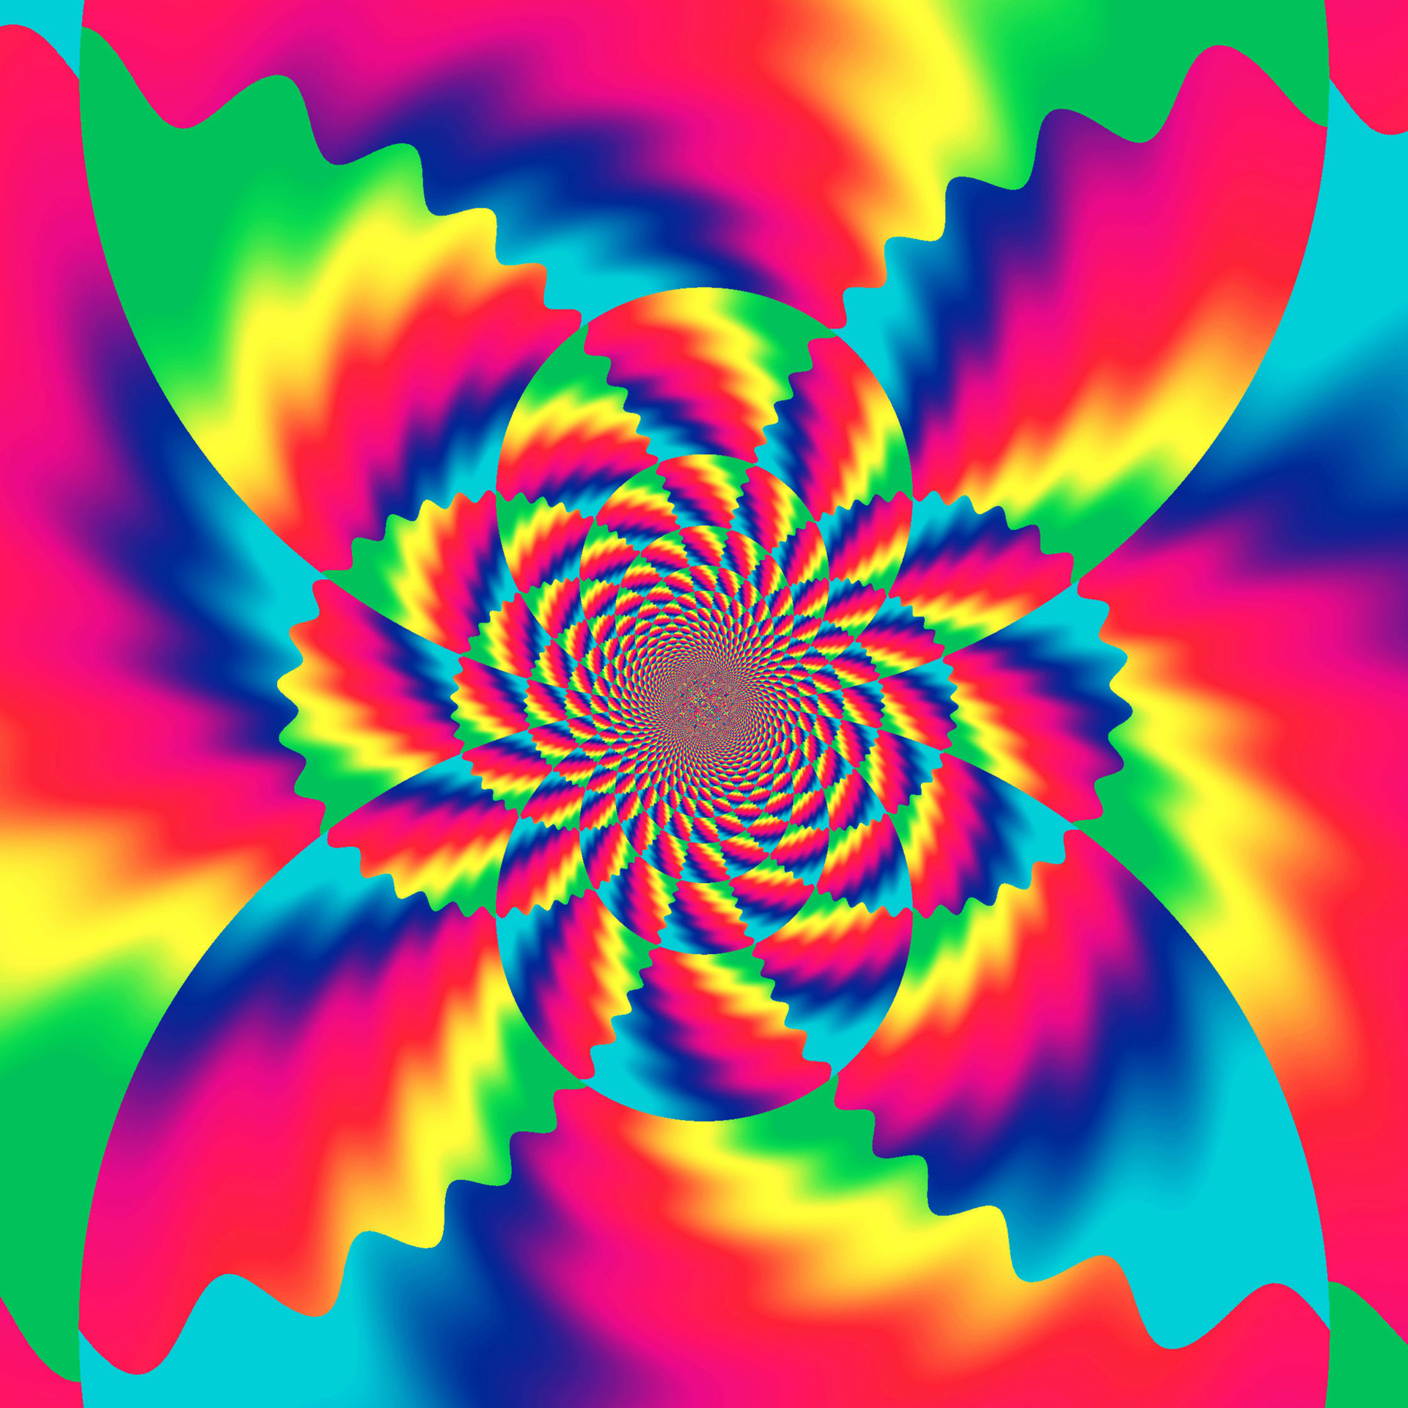
Progression Overview of Primary Art Strands
Nottingham Academy Primary

Slide 2
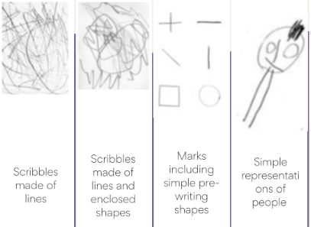
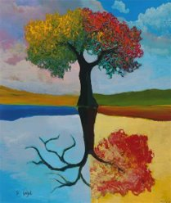
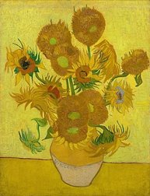
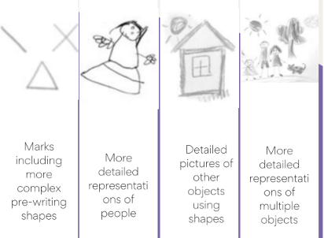
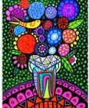
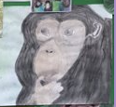
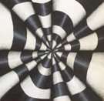
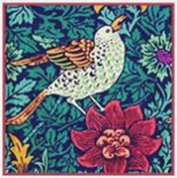
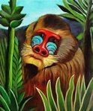
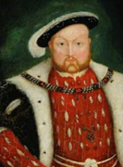

Through a range of CP and adult initiated tasks:
F1
Make marks
Draw circles and lines
Draw faces with features and give meaning to marks
Draw ‘potato people’
Draw things that they observe
Draw simple things from memory
F2
Draw people with increasing detail e.g limbs and features
Draw from memory in more detail
Begin to draw self-portraits landscapes and buildings
Artist study: David Najar
Experiment and use a variety of media: pencils, crayons, pastels, felt tips, chalk, charcoal
Through observation and imagination, begin to explore the use of line and shape, using different surfaces
Artist study: Vincent Van Gogh
Experiment with the visual elements: line, shape, pattern and colour through observation and the imagination
Layer different media e.g. crayons, felt-tips, pencils
Investigate tone by drawing light/dark lines, patterns and shapes
Year 1
Year 2
EYFS
Drawing
Artist Study: Heather Galler
Explore the relationship between line and tone, pattern and shape, line and texture
Select appropriate materials.
Year 6
Year 3
Linked to evolution study in Science
Artist study- Bridget Riley
Demonstrate a wide variety of ways to make different marks with wet and dry media
Develop ideas using mixed media Manipulate and experiment with the elements of art: line, shape
Create shades and tints using black and white
Develop ideas using different or mixed media, using a sketchbook.
Identify artists that have worked in a similar way
Year 5
Artist Study: Illustrator- Chris Mould
Artist study: Hans Holbein
Begin to use simple perspective (single focal point) and begin to develop an awareness of scale e.g. foreground, background
Explore the relationship between line and tone, pattern and shape, line and texture
Explore colour mixing and blending techniques with coloured pencils (shading, hatching).
Select appropriate resources ate material
Year 4
Artist study: Henri Rousseau
Artist study: William Morris
Using dry and wet media, explore the potential of the visual elements: line, shape, pattern, colour and texture
Through sustained and independent work, develop detailed drawings
Explore colour mixing and blending techniques with coloured pencils e.g. shading and hatching

Slide 3
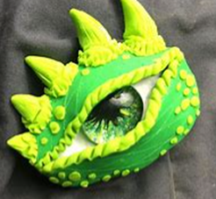
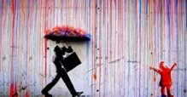


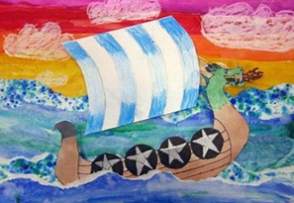
Through a range of CP and adult initiated tasks:
F1
Use pre-made paints
Can name primary colours.
Mix primary colours
Explore mixing primary colours to make secondary colours
Hold paint brush in palm of hand to make marks
Start to use thinner paint brush to add detail to painting
F2
Mix primary colours to make secondary
Add white or black paint to alter tint or shade
Colour matching to a specific colour and shade
Use a thin paint brush to add detail
Hold a paint brush with a tripod grip
Can select from a range of tools to improve painting e.g stampers, rollers
Artist study: David Najar
Use a variety of tools and techniques e.g brush sizes and techniques
Mix and match colours to artefacts and colours
Name and mix primary colours, shades and tones
Create different textures e.g. add sand, soap and use combs, sticks, fingers
Artist study: Vincent Van Gogh
Dragon eye Art
Experiment using a variety of tools and techniques e.g. layering, mixing media
Work on different scales e.g. large brushes on large paper
Mix a range of secondary colours, shades and tones
Year 1
Artist Study: Heather Galler
Artist Study: Banksy
Develop a painting from a drawing using a variety of sources e.g. poetry, music
Work in a range of scales e.g. thin brush on small paper Identify primary colours.
Make secondary colours and understand contrasting colours
Mix and match colours to create atmosphere and light effects
Year 2
EYFS
Painting
Year 6
Year 3
Linked to evolution study in Science
Artist study- Bridget Riley
Create shades and tints using black and white.
Choose appropriate paint, paper and implements to adapt and extend their work.
Carry out preliminary studies, test media and materials and mix appropriate colours.
Work from a variety of sources, inc. those researched independently.
Show an awareness of how paintings are created
Develop a painting from a drawing
Year 5
Year 4
Artist study: Hans Holbein
Demonstrate a secure knowledge of primary, secondary, warm and cold, complementary and contrasting colours
Create imaginative work from a variety of sources
Develop a painting from drawing by testing media and materials
Create different effects by using tools and techniques e.g. dots, scratches and dashes ate material
Artist study: Henri Rousseau
Viking longboat art
Experient using shades and tints using black and white.
Choose appropriate paint, paper and implements to adapt and extend their work.
Carry out preliminary studies, test media and materials and mix appropriate colours.
Work from a variety of sources, inc. those researched independently.

Slide 4

Artist study: David Najar
Design patterns of increasing complexity and repetition
Take simple prints e.g. mono printing
Create simple printing blocks for press print
Experiment with overprinting
Through a range of CP and adult initiated tasks:
F1
Print with large blocks and sponges
Print using a range of materials
F2
Can select from a range of tools to improve painting e.g stampers, rollers
Create patterns or meaningful pictures when printing
Year 1
Artist Study: Banksy
Create printing blocks using relief or impressed method
Create repeating patterns Develop print techniques e.g. mono printing, block printing
EYFS
Printing
Year 3
Year 5
Year 4
Artist study: William Morris
Viking longboat Art
Use techniques including: mono, relief, resist, poly-block, rubbings
Organise work in terms of pattern, repetition, symmetry or random style
Experiment with overprinting colour
Aztec printing- Linked to History topic
Use techniques including relief, mono, resist, poly-block, rubbings
Build up layers and overlays using colours and textures.
Experience marbling and resist printing
Organise work in terms of pattern
ate material

Slide 5
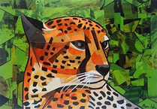
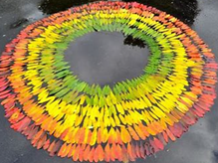
Through a range of CP and adult initiated tasks:
F1
Use glue sticks to join
Use glue and spatulas to join items with support
Explore different materials freely
Create a model with one texture
F2
Use glue sticks and glue spatula’s independently
Join items with masking tape
Join is a variety of ways independently
Animal art linked to Giraffes can't dance.
Artist study: Megan Coyle
Create images from imagination, experience and observation
Choose and use a wide range of media: fabric, tissue.
Apply decoration: beads, buttons & feathers
Artist study:
Andy Goldworthy (linked to habitats in science)
Arrange and/ or glue materials to different backgrounds
Create images from imagination, experience and observation
Fold, crumple, tear and overlap materials
Year 1
Year 2
EYFS
Textiles/ collage
Collage longboat Art- Linked to Vikings history topic
Extend their work within a specific technique.
Use a range of media to create collage.
Use fabric/ materials to create 3D structures
Join materials in different ways
Experiment overlapping and layering fabric/ materials to create texture
Add collage to a printed or painted background
Year 5

Slide 6
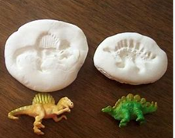
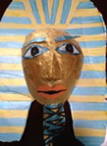
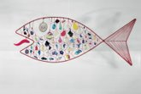
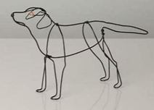
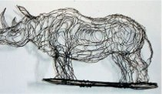
Through a range of CP and adult initiated tasks:
F1
Builds towers by stacking objects
Builds walls to create enclosing spaces.
Build simple models using a variety of resources
Explores clay/ playdoh using fingers
Makes marks in clay/ playdoh
Manipulates clay/playdoh- roll, cut, squash, pinch, twist
F2
Build simple models in a variety of ways
Builds models to replicate those in real life
Make a model using clay/playdoh
Fossil Art- Linked to Dinosaur topic
Use clay in a variety of ways: rolling, joining, kneading
Construct and join recycled, natural and man-made materials
Explore shape and form in sculpture with a range of malleable media
Dragon Eye Art
Use clay in a variety of ways: rolling, joining, kneading
Construct and join recycled, natural and man-made materials
Explore shape and form in sculpture with a range of malleable media
Year 1
Year 2
EYFS
3D form/ Sculpture
Year 6
Artist study: Bridge Baker
Alexander Calder
Elizabeth Berrien
Create and construct sculpture with increasing independence.
Produce patterns within a sculpture
Use recycled, natural and manmade materials within sculpture
Year 3
Create and Egyptian mask:
Construct and join recycled, natural and man-made materials
Use papier-mâché to create simple 3D effects

