Slide 1
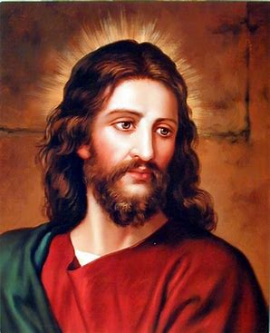
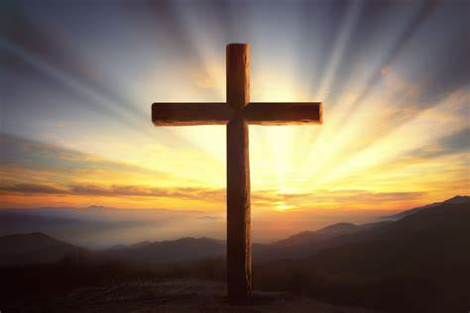

Christianity through NAP
Year 5
T1/2- Inspirational people today
Key learning:
Who is Martin Luther King?
Why is he an inspiration?
Who is William Booth?
Why is he an inspiration?
Enrichment
Visit to William Booth Museum
T2- What matters to Christians?
Key learning:
Meaning of Christmas, Easter, Pentecost and Eucharist
Christians can use the Bible to help guide them through challenges.
Being a Christian involves living a good life- generosity towards God and others.
The Trinity is the belief that God is three separate persons but is still s single God- The Father, the Son and the Holy Spirit.
T6- Beliefs in action in the world
Explore the architecture of Peter’s Basilica (largest church in the world) and Southwell Minster (local)
Year 1
T1 Myself and caring for others
Religious Stories:
The lost sheep
Key learning:
Explore good characteristics- care and kindness
What is a Christian?
T2 Beliefs and teaching
Religious Stories:
Nativity story
Calming the storm on lake Galilee
The lost coin
Feeding the 5000
Healing the ten leapers
Key learning:
Christian belief that God comes to Earth to help people.
T3/4 Celebrations and Festivals
Religious Stories:
Easter story
Key learning:
How Christians celebrate Easter and Christmas
Christian place of worship
Christian symbols
T5/6 Symbols in Religious worship and practice
Key learning:
Visit to church
Key religious symbols and artefacts, bible
Practice of worship in a church
Enrichment
Visit to Church (Summer term)
Year 3
T1/2- Beliefs and questions
Religious stories:
Creation story (Build on Y2)
Jesus born in Bethlehem (Build on Y1)
Bible texts linked to Pentecost
Bible texts linked to Harvest
Fruit of the Spirit (Galatians 5:22)
Key learning:
Practices linked to Easter, Christmas, Pentecost and Harvest.
Christians ideas- incarnation, trinity, crucifixion, resurrection and Holy Spirit.
T3/4- Inspirational people
Religious stories:
Christian Gospels – Matthew and Mark
Bible texts on Abraham and Moses.
Stories of Jesus as the Messiah.
Inspirational people from Jewish/ Christian bible:
Moses, Jacob, Abraham,
T5- Religious, family and community: Prayer
Key learning:
Meaning of the Lords Prayer
How Christians pray in Church
Christians belief in God
T6- Worship and sacred places
Key learning
Churches- representing belief and worship
Features of a church- ie alter, crucifix
Year 2
T1/2- Leaders
Religious stories:
Jesus and St Peter
Jesus calls Peter to follow him Peter recognises Jesus as the Messiah​
Jesus washes Peter’s feet​
Peter denies Jesus​
Peter becomes the first leader of the Christians
Key learning:
St Peter was the earliest leader of the Christian Church
St Peter was a disciple of Jesus.
St Peter performed miracles like healing the blind.
Explore what makes a good leader- behaviour, wisdom, rules for harmonious living
Comparisons to non religious leaders
T3/4 Belonging
Key learning:
Explore own feelings of belonging- family, school etc
Belonging in Christianity – through Christening and Baptism.
T5/6- Stories
Religious stories:
Noah and the Ark
Abraham and Sarah
King David
Year 4
Term 2- Spiritual expressions
Key learning:
Music of Christian community i.e Carols, Hymns, contemporary worship music
May comparisons to other spiritual music
T3/4- Symbols and Religious Expression
Key learning:
Journey to Holy Land – practice and rituals
Local places of pilgrimage- i.e Southwell Minster
T6- Journey of life and death
Key learning:
How Christians see life as a journey
Key life milestones Christians- Christenings, marriages, funerals
Christians believe in Heaven.
Year 6
T1- Beliefs in action in the world
Learn about the work of the charity ‘Christian Aid’.
T3/4- Wisdom and Authority
Religious Stories:
Stories with morals:
David and Goliath
Loaves and fishes
Key learning:
Explore the life and values of Denzel Washington (using position to spread God’s messages)
Explore the life and values of JK Rowling (moral themes within books)
T5/6- Religion, Worldviews, Family and Community
Key learning:
Explore % of Christians in Nottingham City, Nottinghamshire, England and worldwide.
Explore Interfaith networks

Slide 2
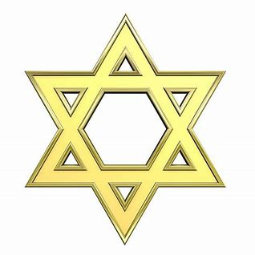
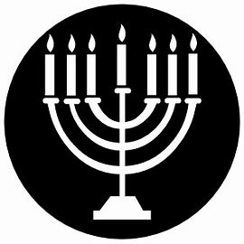
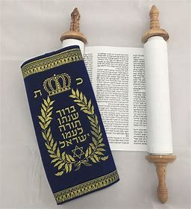
Judaism through NAP
Year 2
T1- Leaders
Religious stories:
The baby in the bulrushes
Parting the red sea
The burning bush
The ten Plagues
Key learning:
Moses led Jews out of slavery in Egypt.
Explore what makes a good leader- behaviour, wisdom, rules for harmonious living
Comparisons to nonreligious leaders.
T3- Believing
Religious stories:
Story of creation
Key learning:
Jews ideas on the story of creation
The importance of Shabbat (Jewish day of rest)
Story of creation- God created the world in 6 days and rested on the 7^{th.}
How Rabbi teaches Jewish law.
T5/6- Stories
Religious stories:
Noah and the Ark
Abraham and Sarah
King David
Key learning:
Torah the holy book- The teachings of Moses
Use of Torah in Synagogue
Enrichment
Visit to Synagogue (Summer term)
Year 1:
T1 Myself and caring for others
Religious stories:
Jewish Palm 23
T3/4 Celebrations and Festivals
Religious stories:
Story of creation
Key learning:
How Jews celebrate Hanukkah and Shabbat.
Jewish artefacts
Jewish celebrations- including food, songs
Place of worship
T5/6 Symbols in Religious worship and practice
Key learning:
Key religious symbols and artefacts, Torah Scroll
Practice of worship in a synagogue
Year 3
T3/4- Inspirational people
Inspirational people from the past
Religious stories:
Stories of Moses as the servant of God. ​
Stories of Moses as a law-giver. ​
Exodus and the 10 Commandments
Key learning:
Abraham and Moses- inspirational people from Jewish Bible
Qualities of a good leader
Who is Abraham, what does he stand for?
Religious terminology of leaders
Year 6
T1- Beliefs in action in the world
Explore pre-war Jewish life.
Learn about persecution and discrimination of Jewish people
Explore Kinder transport and why it was important.
Explore the work of National Holocaust Museum.

Slide 3

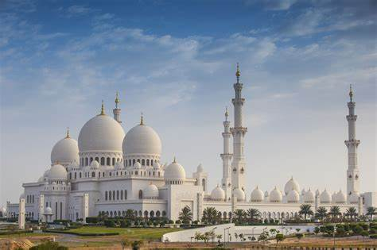
Islam through NAP
Year 1
T3/4 Celebrations and Festivals
Key learning:
How Muslims celebrate Eid.
Year 6
T1- Beliefs in action in the world
Learn about the work of the charity ‘Islamic relief’.
Enrichment:
Speaker from Islamic relief
T3- Wisdom and Authority
Religious Stories:
The crying camel
The Prophet and the ants.
Key learning:
Explore the life and values of Amir Khan
Explore the life and values of James Caan
T5/6- Religion, Worldviews, Family and Community
Key learning:
Explore % of Islam followers in Nottingham City, Nottinghamshire, England and worldwide.
Explore Interfaith networks
Year 3
T3/4- Inspirational people
Religious stories:
Islamic stories from the life of the Prophet Muhammad [PBUH] and his companions.
Stories from the Qu’ran and Hadith.
T5- Religious, family and community: Prayer
Key learning:
Importance of 5 daily Islamic prayers
Practice of prayer in a Mosque.
Belief in Allah.
T6- Worship and sacred places
Key learning
Mosque- representing belief and worship
Features of a Mosque- i.e Ablutions fountain, qiblah wall
Enrichment:
Visit to Mosque
Year 5
T1/2- Inspirational people today
Key learning:
Who is Dr Hany El Banna?
Why is he an inspiration?
T3- Beliefs and questions
Key learning:
Explore Muslims belief in Allah.
Explore 5 Pillars of Islam
Explore belief in Muhammed.
Explore how to become a Muslim.
How Muslims practice their faith.
How Muslims use the Qran.
Explore examples of Islamic art- found on prayer mats ornaments and Mosques.
T6- Beliefs in action in the world
Explore the architecture of Masjid al-Haram (Mecca) and Jamia Masjid (Sneinton)
Year 4
T3/4- Symbols and Religious Expression
Key learning:
Pilgrimage to Makkah- practice and rituals
T6- Journey of life and death
Key learning:
How Muslims see life as a journey
Key life milestones Muslims- birth (Aqiqah ceremony) marriages, funerals
Muslims belief around death.

Slide 4

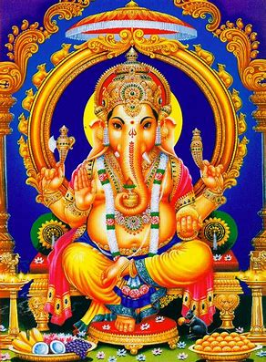
Hinduism through NAP
Year 1
T3/4 Celebrations and Festivals
Key learning
How Hindus celebrate Diwali.
Year 5
T1/2- Inspirational people today
Key learning:
Who is Ghandi?
Why is he an inspiration?
Who is Pandurang Shastri?
Why is he an inspiration?
T3- Beliefs and questions
Key learning:
Explore understanding of Brahman and the forms.
Explore Hindus belief in birth, death and rebirth.
How Hindus practice their faith.
Explore Hindus holy book.
Explore examples of Hindu art- including art of Gods.
Explore temple designs.
T6- Beliefs in action in the world
Key learning:
Explore the architecture of Srirangam Ranganathaswamy temple and Hindu temple (Sneinton)
Year 4
T1- Religion, family, community, worship, celebration, ways of living
Religious stories:
Rama and Sita
Key learning:
How Hindu’s worship
Celebration of Diwali
Celebration of Holi
Hindu’s ideas of Gods/ Godesses
Worshipping practices in the home and in Mandir
Hindu community life
T3/4- Symbols and Religious Expression
Key learning:
Journey to Varanasi- practice and rituals
T6- Journey of life and death
Key learning:
How Hindus see life as a journey.
Key life milestones for Hindu- birth marriages, funerals
Hindus belief around death.
Enrichment:
Visit to Hindu temple- Aut term
Year 3
T6- Worship and sacred places
Key learning
Mandir- representing belief and worship
Features of a Mandir- i.e Murtis, shrines for deities

Slide 5

Non-Religious studies through NAP
Year 4
T4- Symbols and Religious Expression
Key learning:
Spiritual journey- may reflect a religious pilgrimage
T6- Journey of life and death
Key learning:
Non-religious views on life and death i.e- committing to the life we have.
Year 6
T1- Beliefs in action in the world
Explore spiritual concepts of justice, fairness, compassion and responsibility
Learn about the work of the charity ‘Save the Children’
Year 5
T6- Beliefs in action in the world
Explore the work of ‘Love thy neighbour’ (network of charities, churches, businesses) working to support issues in UK and beyond.

