Slide 1


Year 1
Music - Charanga

Slide 2
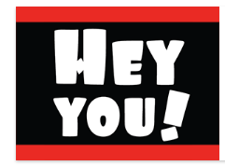
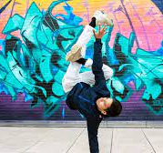
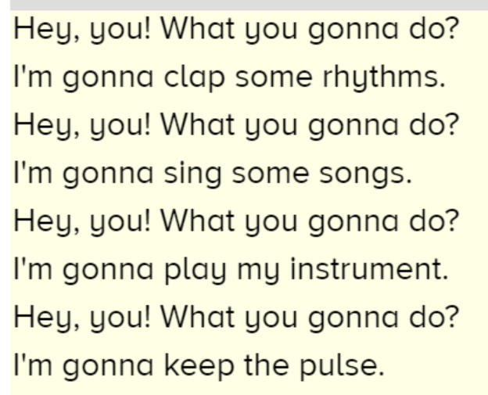
Sticky knowledge
Year group: 1 | Topic: Hey You! (Hip-Hop) | Term: Autumn
Key vocabulary and definitions:
Structure – the form of the music made up of verses and choruses . Pulse – the regular heartbeat of the music; its steady beat. Rhythm – long and short sounds or patterns that happen over the pulse. Pitch - high and low sounds Tempo – the speed of the music; fast or slow or in-between. Texture – layers of sound working together. Dynamics - how loud or quiet the music is. Timbre – the different sound quality of each instrument. Dynamics – the volume of the music, either loud or quiet. Hip-hop – the backing music used for rap featuring heavy rhythm and bass sounds Rap – an artistic form of vocal delivery and emotive expression that incorporates rhyme, rhythmic speech, and street vernacular.
Substantive Knowledge
Hip-hop is a style of music with lots of strong sounds that is often used with rap. Rapping is a form of fast singing with lots of strong rhythms and speech. Hey You is written in a hip-hop style. The instruments in the song are drums and electronic sounds. The song has quite a fast tempo.

Slide 3
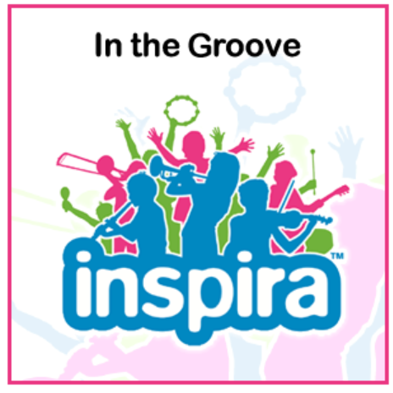
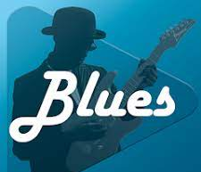
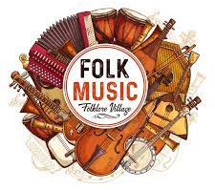
Sticky knowledge
Year group: 1 | Topic: In The Groove | Term: Spring
Key vocabulary and definitions:
Rock – a form of music with a powerful rhythm and beat. Structure – the form of the music made up of verses and choruses . Pulse – the regular heartbeat of the music; its steady beat. Rhythm – long and short sounds or patterns that happen over the pulse. Pitch - high and low sounds Tempo – the speed of the music; fast or slow or in-between. Texture – layers of sound working together. Dynamics - how loud or quiet the music is. Timbre – the different sound quality of each instrument. Dynamics – the volume of the music, either loud or quiet. Band – a group of instruments that play music together.
Substantive Knowledge
In The Groove is a song written in different styles of music. There are 6 styles of the song, to listen to each week; Blues, Baroque, Latin, Bhangra, Folk and Funk. There are different musical styles from throughout history and around the world. Different musical styles use different tempo (speed), different rhythms and different instruments. Songs can make us feel happy or sad depending on what style they are in. Blues or Funk music can be quite sad. Latin and Folk music can be quite happy.

Slide 4
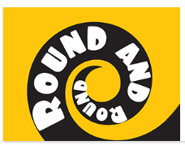
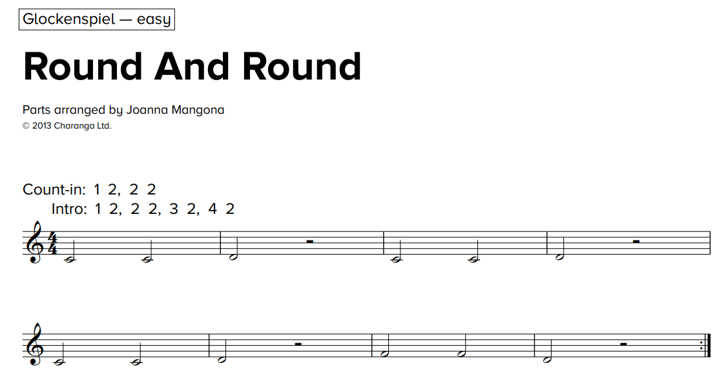
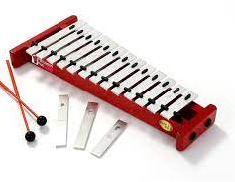
Sticky knowledge
Year group: 1 | Topic: Round and Round (Bossa Nova) | Term: Summer
Key vocabulary and definitions:
Structure – the form of the music made up of verses and choruses . Pulse – the regular heartbeat of the music; its steady beat. Rhythm – long and short sounds or patterns that happen over the pulse. Pitch - high and low sounds Tempo – the speed of the music; fast or slow or in-between. Texture – layers of sound working together. Dynamics - how loud or quiet the music is. Timbre – the different sound quality of each instrument. Dynamics – the volume of the music, either loud or quiet. Bossa Nova – a relaxed style of music from South America.
Substantive Knowledge
Round and Round is written in a Bossa Nova style Bossa Nova is a relaxed style of music that comes from South America. The instruments in the song are keyboard, bass, guitar, drums, percussion, trumpet, trombone and saxophone. The texture is thick, there are lots of layers of instruments and sound. The tempo is medium, it is not fast or slow.

