Slide 1


Year 2
Music - Charanga

Slide 2
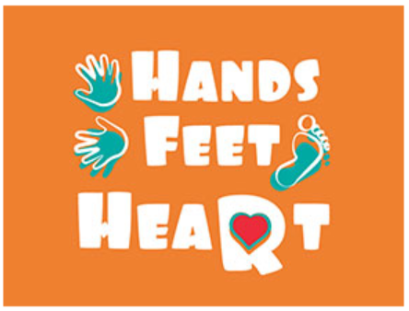

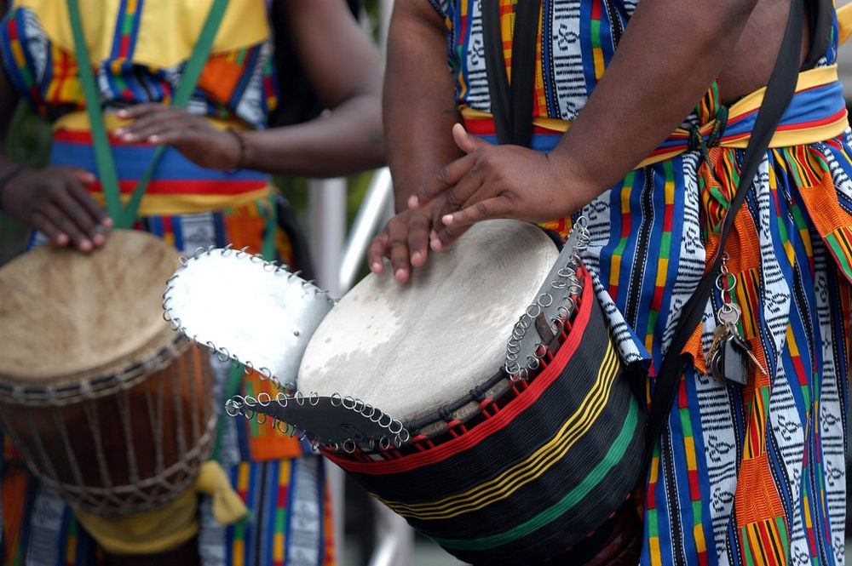
Sticky knowledge
Year group: 2 | Topic: Hands, Feet, Heart (Afro-Pop) | Term: Autumn
Key vocabulary and definitions:
Structure – the form of the music made up of verses and choruses . Pulse – the regular heartbeat of the music; its steady beat. Rhythm – long and short sounds or patterns that happen over the pulse. Pitch - high and low sounds Tempo – the speed of the music; fast or slow or in-between. Texture – layers of sound working together. Dynamics - how loud or quiet the music is. Timbre – the different sound quality of each instrument. Dynamics – the volume of the music, either loud or quiet. Afro-Pop – a mix of traditional African music and modern pop music
Substantive Knowledge
The song Hands, Feet, Heart is in the style of South African Afro-Pop. Afro-Pop is a mix of traditional African music and modern pop music. Traditional African music generally uses voices and drums. Generally South African music has a strong dance beat and is full of energy. The speed of a piece of music is called the tempo.

Slide 3
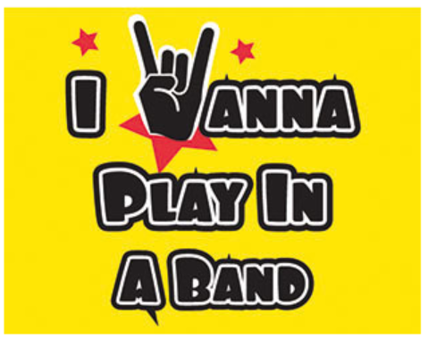
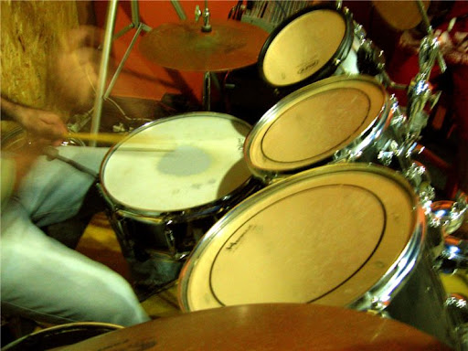
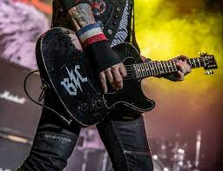
Sticky knowledge
Year group: 2 | Topic: I Wanna Play In A Band (Rock) | Term: Spring
Key vocabulary and definitions:
Rock – a form of music with a powerful rhythm and beat. Structure – the form of the music made up of verses and choruses . Pulse – the regular heartbeat of the music; its steady beat. Rhythm – long and short sounds or patterns that happen over the pulse. Pitch - high and low sounds Tempo – the speed of the music; fast or slow or in-between. Texture – layers of sound working together. Dynamics - how loud or quiet the music is. Timbre – the different sound quality of each instrument. Dynamics – the volume of the music, either loud or quiet. Band – a group of instruments that play music together.
Substantive Knowledge
I Wanna Play In A Band is a song written in a rock style. The song has a male and a female singer. The instruments in the song are electric guitar, bass, drums and keyboard. The texture is thick and stays the same throughout the song. The tempo is moderate and is not fast or slow. The dynamics are loud throughout. Rock music has heavy sounds, with lots of drums and guitar solos.

Slide 4
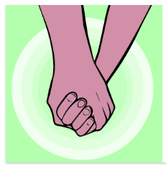
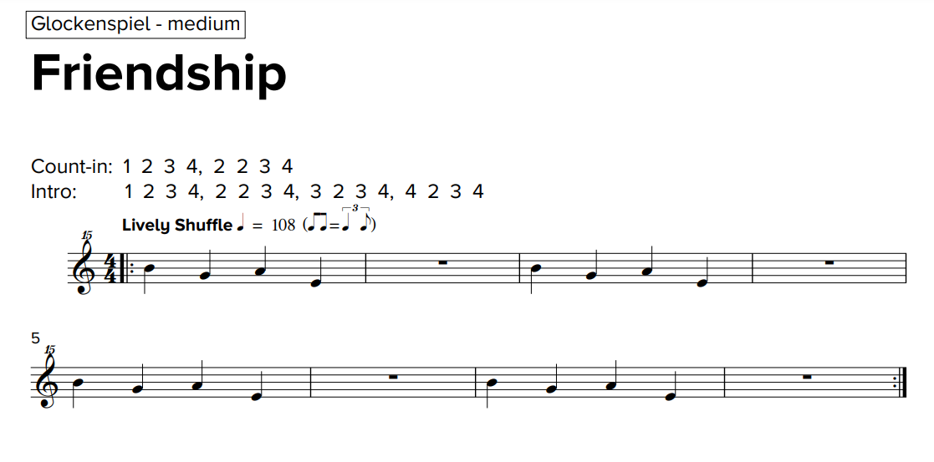
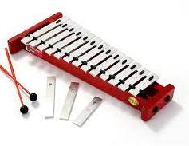
Sticky knowledge
Year group: 2 | Topic: Friendship Song | Term: Summer
Key vocabulary and definitions:
Structure – the form of the music made up of verses and choruses . Pulse – the regular heartbeat of the music; its steady beat. Rhythm – long and short sounds or patterns that happen over the pulse. Pitch - high and low sounds Tempo – the speed of the music; fast or slow or in-between. Texture – layers of sound working together. Dynamics - how loud or quiet the music is. Timbre – the different sound quality of each instrument. Dynamics – the volume of the music, either loud or quiet.
Substantive Knowledge
The song Friendship Song tells a story about being friend. Songs often tell stories or carry important messages. The instruments in the song are drums, keyboard, bass, female vocal with backing vocals and glockenspiel. The music is light and upbeat. It is designed to make us feel happy. Music can make us feel different emotions.

