Slide 1


Year 3
Music - Charanga

Slide 2
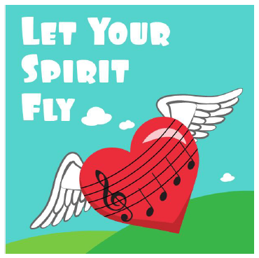
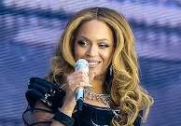
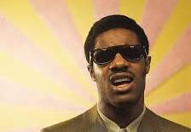
Sticky knowledge
Year group: 3 | Topic: Let Your Spirit Fly (RnB) | Term: Autumn
Key vocabulary and definitions:
Structure – the form of the music made up of verses and choruses . Pulse – the regular heartbeat of the music; its steady beat. Rhythm – long and short sounds or patterns that happen over the pulse. Pitch - high and low sounds Tempo – the speed of the music; fast or slow or in-between. Texture – layers of sound working together. Dynamics - how loud or quiet the music is. Timbre – the different sound quality of each instrument. Chorus – a repeating main theme of the song in-between each verse Verse – the main sections of a song Hip-hop – the backing music used for rap featuring heavy rhythm and bass sounds Rap – an artistic form of vocal delivery and emotive expression that incorporates rhyme, rhythmic speech, and street vernacular. Soul – a kind of pop music incorporating elements of rhythm and blues and gospel Gospel – a spiritual style of singing music Synthesizer – electronic music like on a keyboard
Substantive Knowledge
Let Your Spirit Fly is written in the style of RnB. The instruments in the song are male and female voice, bass, drums, guitar, keyboard, synthesizer. RnB is a mix of musical styles including soul, hip-hop and gospel music. Famous RnB singers include Beyoncé, Usher, Rihanna and Stevie Wonder. Soul music is a popular music genre that originated in the African American community in America in the late 1950s and early 1960s. It has its roots in African-American gospel music and rhythm and blues. African American Gospel music is a form of euphoric, rhythmic, spiritual music rooted in the solo and responsive church singing of the African American South.

Slide 3
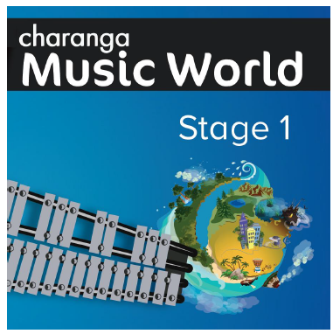
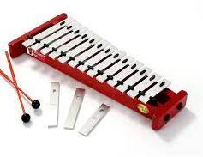
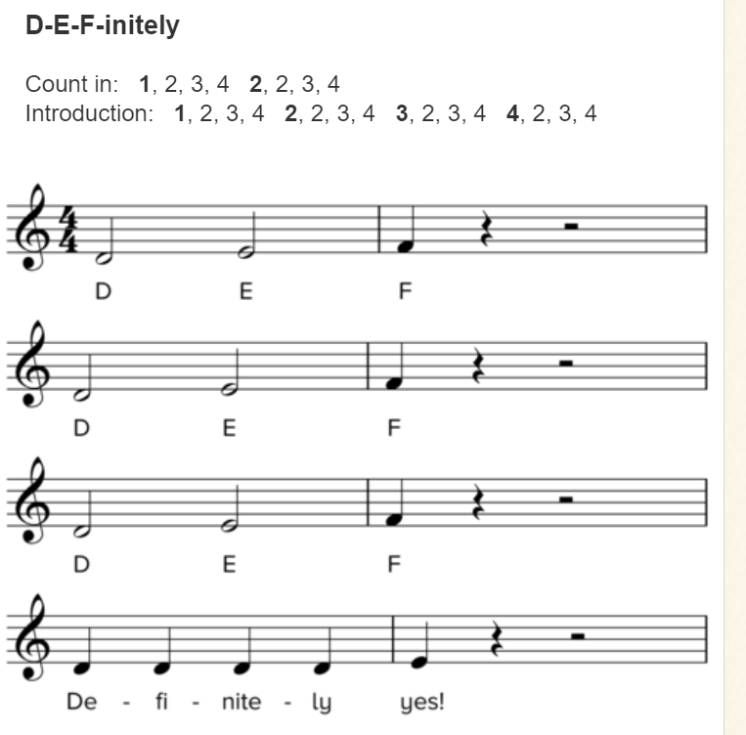
Sticky knowledge
Year group: 3 | Topic: Glockenspiel Performance (Unit 1) | Term: Spring
Key vocabulary and definitions:
Structure – the form of the music made up of verses and choruses . Pulse – the regular heartbeat of the music; its steady beat. Rhythm – long and short sounds or patterns that happen over the pulse. Pitch - high and low sounds Tempo – the speed of the music; fast or slow or in-between. Texture – layers of sound working together. Dynamics - how loud or quiet the music is. Compose – to write a piece of music. Improvise – where a melody line is made up to fit the chords of the song. Notation – the notes on the page that tell the musician what to play.
Substantive Knowledge
The glockenspiel is a tuned percussion instrument. The glockenspiel uses beaters to play individual notes. The glockenspiel follows treble clef music. Treble clef music has a B on the middle line. Treble clef notes go up and down following an 8-note scale starting and finishing on the same note. This is called a heptatonic scale, as it has 7 different notes. The glockenspiel can be played loud or soft by hitting it harder or softer.

Slide 4
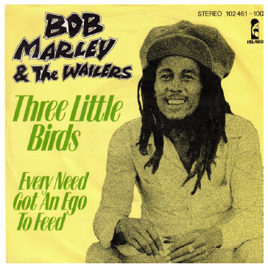
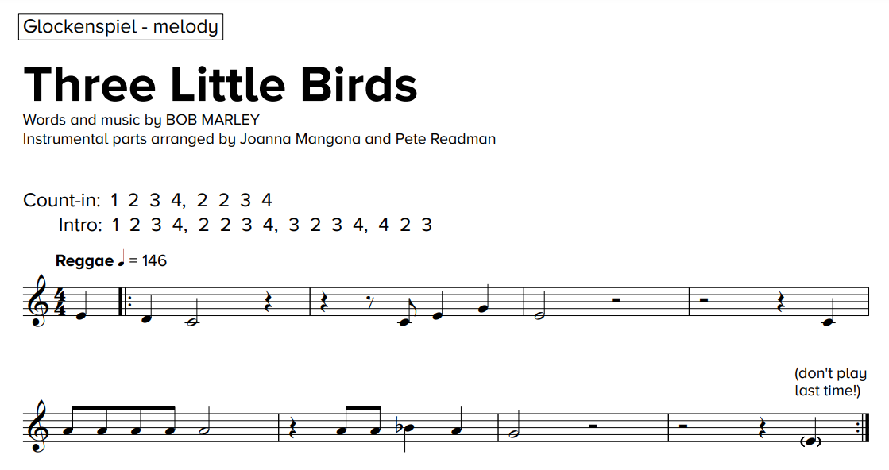
Sticky knowledge
Year group: 3 | Topic: Three Little Birds (Reggae) | Term: Summer
Key vocabulary and definitions:
Rock – a form of music with a powerful rhythm and beat. Structure – the form of the music made up of verses and choruses . Pulse – the regular heartbeat of the music; its steady beat. Rhythm – long and short sounds or patterns that happen over the pulse. Pitch - high and low sounds Bridge – a fill section in-between the verse and chorus Tempo – the speed of the music; fast or slow or in-between. Texture – layers of sound working together. Dynamics - how loud or quiet the music is. Chorus – a repeating main theme of the song in-between each verse Verse – the main sections of the song with lyrics Improvise – where a melody line is made up to fit the chords of the song. Compose – to write a piece of music. Melody – The main musical pattern of a piece of music. Reggae – a Jamaican musical style from the 1960s.
Substantive Knowledge
Three Little Birds is a Reggae song written by Bob Marley in 1977. Bob Marley is one of the most famous Reggae musicians and has helped make it famous world-wide. The instruments in the song are vocals, backing vocals, bass, guitar, drums, keyboard and organ. Reggae is a style of popular music that originated in Jamaica in the late 1960s and quickly emerged as the country's dominant music. Other famous Reggae songs include Jamming by Bob Marley, Small People by Ziggy Marley, 54-46 Was My Number by Toots and The Maytals and Ram Goat Liver by Pluto Shervington.
To be taught over half the term

Slide 5

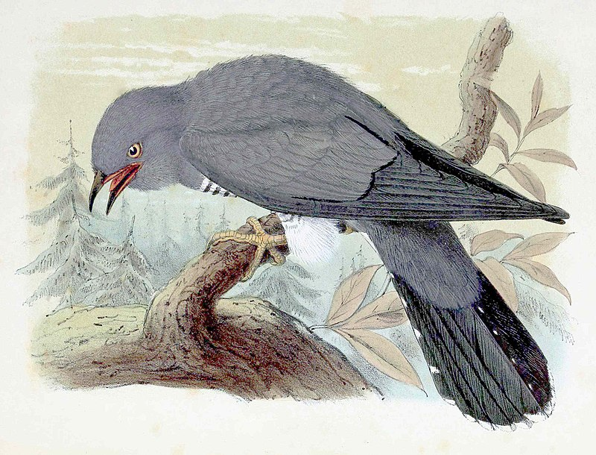
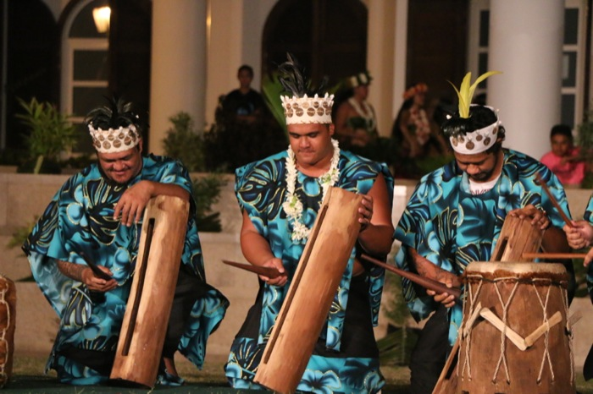
Sticky knowledge
Year group: 3 | Topic: The Dragon Song | Term: Summer
Key vocabulary and definitions:
Structure – the form of the music made up of verses and choruses . Pulse – the regular heartbeat of the music; its steady beat. Rhythm – long and short sounds or patterns that happen over the pulse. Pitch - high and low sounds Tempo – the speed of the music; fast or slow or in-between. Texture – layers of sound working together. Dynamics - how loud or quiet the music is. Timbre – the different sound quality of each instrument. Appraising – listening to and understanding styles of music. Traditional songs – songs that were created a long time ago and are popular in a certain culture Folk songs – traditional songs from different cultures Acceptance – where you treat everyone equally Respect – where you treat others as you would like to be treated yourself
Substantive Knowledge
The Dragon Song is about themes of kindness, respect, friendship, acceptance and happiness. Traditional Folk tunes are songs that come from different culture around the world. Folk songs help us celebrate our differences and learn about different cultures. 5 folk songs from around the world: - Birdsong – Chinese folk music - Vaishnava Java – A Hindu Song - A Turkish Traditional Tune - Aitutaki Drum Dance from Polynesia - Zebaidir Song from Sudan
To be taught over half the term

