Slide 1


Year 4
Music - Charanga

Slide 2
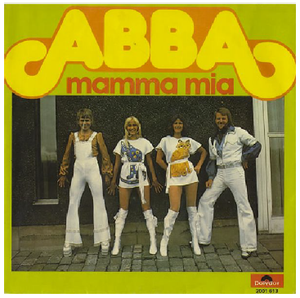
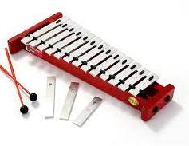
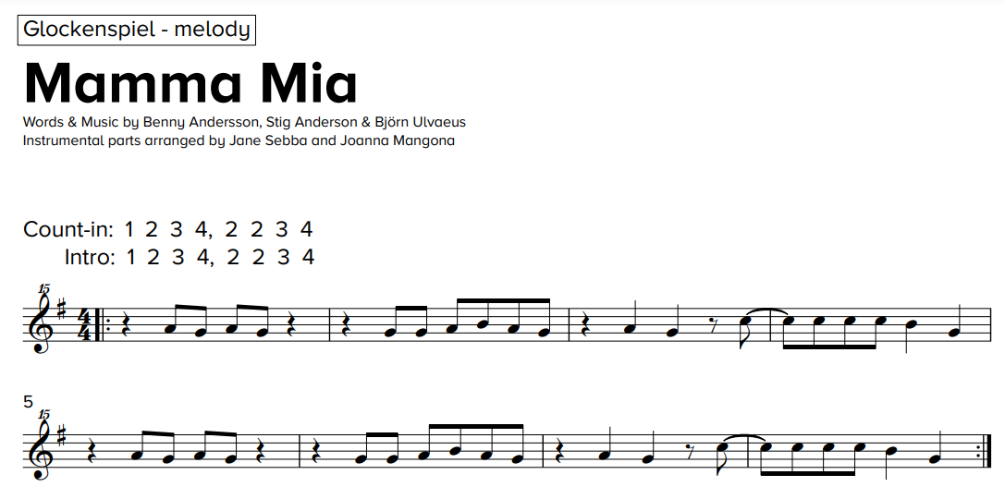
Sticky knowledge
Year group: 4 | Topic: Mamma Mia (Pop) | Term: Autumn
Key vocabulary and definitions:
Rock – a form of music with a powerful rhythm and beat. Structure – the form of the music made up of verses and choruses . Pulse – the regular heartbeat of the music; its steady beat. Rhythm – long and short sounds or patterns that happen over the pulse. Pitch - high and low sounds Bridge – a fill section in-between the verse and chorus Tempo – the speed of the music; fast or slow or in-between. Texture – layers of sound working together. Dynamics - how loud or quiet the music is. Chorus – a repeating main theme of the song in-between each verse Verse – the main sections of the song with lyrics Improvise – where a melody line is made up to fit the chords of the song Melody – The main musical pattern of a piece of music. Pentatonic Scale – a 5 note scale Unison – when different parts play the same thing together
Substantive Knowledge
Mamma Mia is a pop song written by the Swedish pop group ABBA formed in 1972. Abba songs feature lots of singing in unison. Other famous ABBA songs include Dancing Queen, The Winner Takes It All, Waterloo, Thank You For The Music. The instruments used are voices, keyboard, electronic strings, glockenspiel, guitar, bass and drums Pop songs are made up of a series of verses and choruses and linking sections called bridges. The structure of the song is intro, verse, bridge, chorus, intro, verse, bridge, chorus.

Slide 3
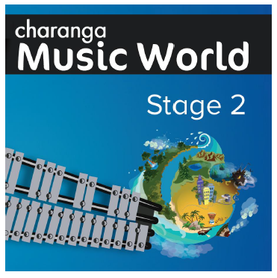
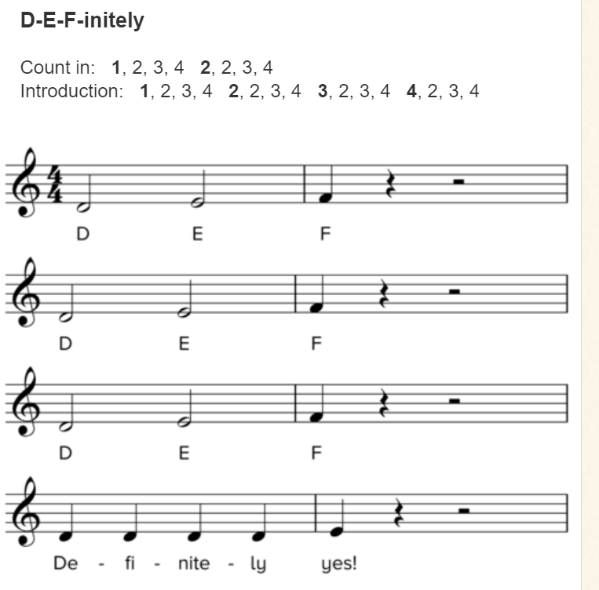
Sticky knowledge
Year group: 4 | Topic: Glockenspiel Performance (Unit 2) | Term: Spring
Key vocabulary and definitions:
Structure – the form of the music made up of verses and choruses . Pulse – the regular heartbeat of the music; its steady beat. Rhythm – long and short sounds or patterns that happen over the pulse. Pitch - high and low sounds Tempo – the speed of the music; fast or slow or in-between. Texture – layers of sound working together. Dynamics - how loud or quiet the music is. Improvise – where a melody line is made up to fit the chords of the song. Notation – the notes on the page that tell the musician what to play.
Substantive Knowledge
The glockenspiel is a tuned percussion instrument. The glockenspiel uses beaters to play individual notes. The glockenspiel follows treble clef music. Treble clef music has a B on the middle line. Treble clef notes go up and down following an 8-note scale starting and finishing on the same note. This is called a heptatonic scale, as it has 7 different notes. The glockenspiel can be played loud or soft by hitting it harder or softer.

Slide 4
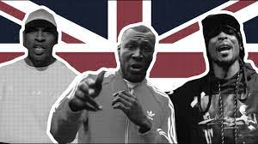


Sticky knowledge
Year group: 4 | Topic: Stop! (Grime) | Term: Summer
Key vocabulary and definitions:
Structure – the form of the music made up of verses and choruses . Pulse – the regular heartbeat of the music; its steady beat. Rhythm – long and short sounds or patterns that happen over the pulse. Pitch - high and low sounds Tempo – the speed of the music; fast or slow or in-between. Texture – layers of sound working together. Dynamics - how loud or quiet the music is. Timbre – the different sound quality of each instrument. Chorus – a repeating main theme of the song in-between each verse Verse – the main sections of a song Hip-hop – the backing music used for rap featuring heavy rhythm and bass sounds Rap – an artistic form of vocal delivery and emotive expression that incorporates rhyme, rhythmic speech, and street vernacular. Riff – a short repeated phrase used as an introduction Grime – a form of electronic dance music Synthesizer – electronic music like on a keyboard
Substantive Knowledge
Stop! is a song/rap written in a Grime style. Grime is a genre of electronic dance music that emerged in London in the early 2000s. It developed out of the earlier UK dance style UK garage, and draws influences from jungle, dancehall, and hip hop Hip-hop also known as rap, and formerly known as disco rap, is a genre of popular music that originated in the early 1970s in African American and Caribbean cultures. Rapping is an artistic form of vocal delivery and emotive expression that incorporates rhyme, rhythmic speech, and street vernacular or slang. Another hip-hop piece is Gotta Be Me by Secret Agent 23 Skidoo. Justin Timerlake’s Can’t Stop The Feeling also uses funk and disco influences that come from hip-hop and rap.
To be taught over half the term

Slide 5

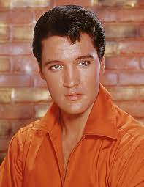
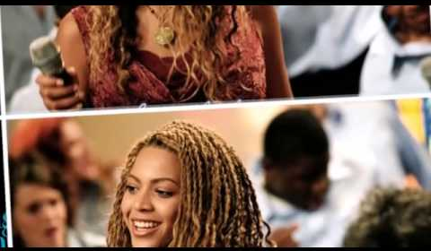
Sticky knowledge
Year group: 4 | Topic: Lean On Me (Soul/Gospel) | Term: Summer
Key vocabulary and definitions:
Structure – the form of the music made up of verses and choruses . Pulse – the regular heartbeat of the music; its steady beat. Rhythm – long and short sounds or patterns that happen over the pulse. Pitch - high and low sounds Tempo – the speed of the music; fast or slow or in-between. Texture – layers of sound working together. Dynamics - how loud or quiet the music is. Timbre – the different sound quality of each instrument. Improvise – where a melody line is made up to fit the chords of the song. Appraising – listening to and understanding styles of music. Soul – a kind of pop music incorporating elements of rhythm and blues and gospel Gospel – a spiritual style of singing music Riff – a short repeated phrase used as an introduction
Substantive Knowledge
Lean On Me is a soul song written by Bill Withers in 1972. It has also been covered and interpreted as a gospel song because of its powerful and moving lyrics. Soul music is a popular music genre that originated in the African American community in America in the late 1950s and early 1960s. It has its roots in African-American gospel music and rhythm and blues. African American Gospel music is a form of euphoric, rhythmic, spiritual music rooted in the solo and responsive church singing of the African American South. Other soul/gospel songs include, He Still Love Me by Walter Williams and Beyoncé, Shackles by Mary Mary and Amazing Grace by Elvis Presley
To be taught over half the term

