Slide 1


Year 5
Music - Charanga

Slide 2
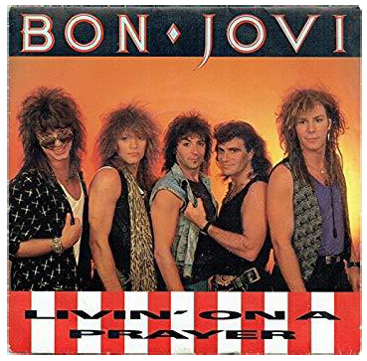
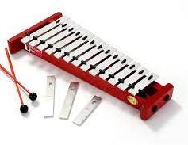
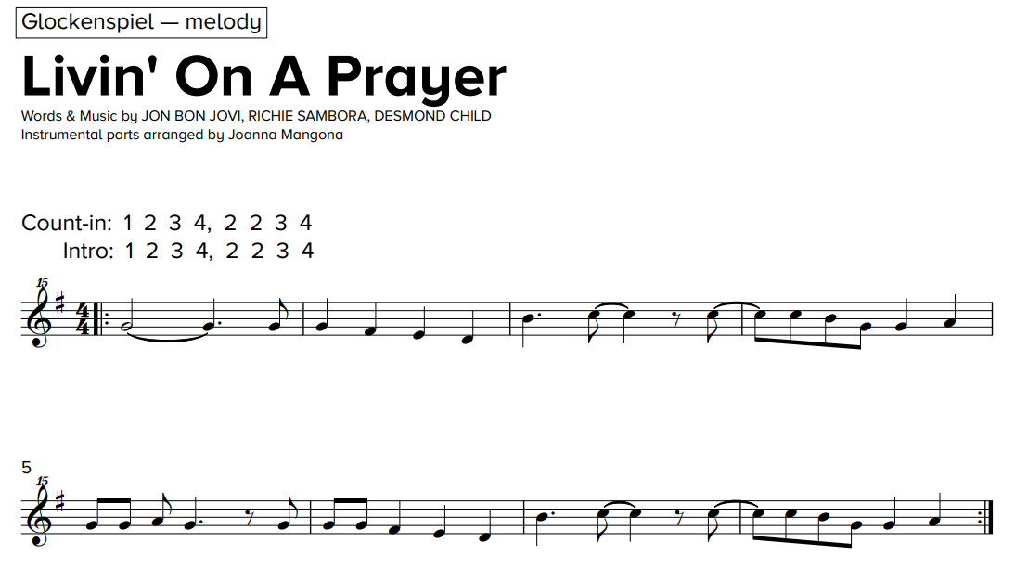
Sticky knowledge
Year group: 5 | Topic: Livin’ On A Prayer (Rock) | Term: Autumn
Key vocabulary and definitions:
Rock – a form of music with a powerful rhythm and beat. Structure – the form of the music made up of verses and choruses . Pulse – the regular heartbeat of the music; its steady beat. Rhythm – long and short sounds or patterns that happen over the pulse. Pitch - high and low sounds Bridge – a fill section in-between the verse and chorus Tempo – the speed of the music; fast or slow or in-between. Texture – layers of sound working together. Dynamics - how loud or quiet the music is. Chorus – a repeating main theme of the song in-between each verse Verse – the main sections of the song with lyrics Improvise – where a melody line is made up to fit the chords of the song
Substantive Knowledge
A rock anthem is a bold, powerful song with a driving rhythm, often with a strong, catchy chorus that the audience can sing along to. Livin’ on a Prayer is a Rock song that was released in 1986. The words tell us about life in America in the 1980’s. The structure of the song follows a typical rock pattern: Intro, verse 1, bridge, chorus, intro, verse 2, bridge, chorus, guitar solo, bridge, chorus. The instruments in the song are lead vocal, electric guitar, bass guitar, drums, keyboard. Rock songs can be used to express feelings about societal issues. Other rock songs include We Will Rock You by Queen, Smoke On The Water by Deep Purple, Rockin’ All Over The World by Status Quo
To be taught over half the term

Slide 3
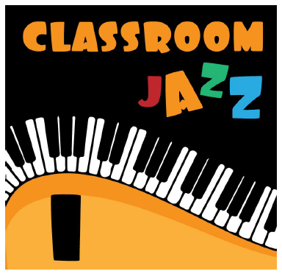
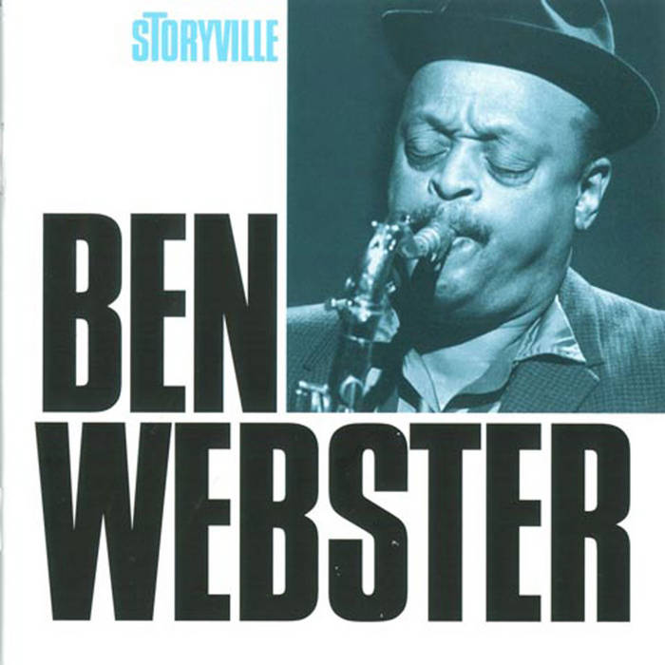
Sticky knowledge
Year group: 5 | Topic: Classroom Jazz (Unit 1) | Term: Autumn
Key vocabulary and definitions:
Structure – the form of the music made up of verses and choruses . Pulse – the regular heartbeat of the music; its steady beat. Rhythm – long and short sounds or patterns that happen over the pulse. Pitch - high and low sounds Tempo – the speed of the music; fast or slow or in-between. Texture – layers of sound working together. Dynamics - how loud or quiet the music is. Improvise – where a melody line is made up to fit the chords of the song. Bossa Nova – a style of Brazilian music with more emphasis on melody over percussion. Appraising – listening to and understanding styles of music. Syncopation – a type of rhythm with an emphasis on the ‘off-beat’. Swing – a type of American jazz from the 1930s and 1940s Big Band – typically a 17-piece band used in swing and jazz music
Substantive Knowledge
Swing is a type of jazz music that comes from America in the 1930s and 1940s. Bossa Nova is a type of jazz that comes from Brazil. The Three Note Bossa and Five Note Swing are famous pieces of swing and bossa nova music and demonstrate the different musical styles. Both pieces use piano, bass, drums, glockenspiel. Jazz music uses improvisation, which is where musicians make up a melody on the spot to match the chords of the music. Other famous swing and bossa nova pieces include Desafinado by Stan Getz, Cotton Tail by Ben Webster, 5 Note Swing by Ian Gray and Perdido by Woody Herman Big Bands were used in the swing era, featuring guitar, bass, piano, drums, saxophones, trumpets and trombones.
To be taught over half the term

Slide 4
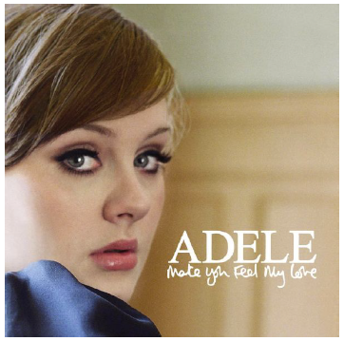
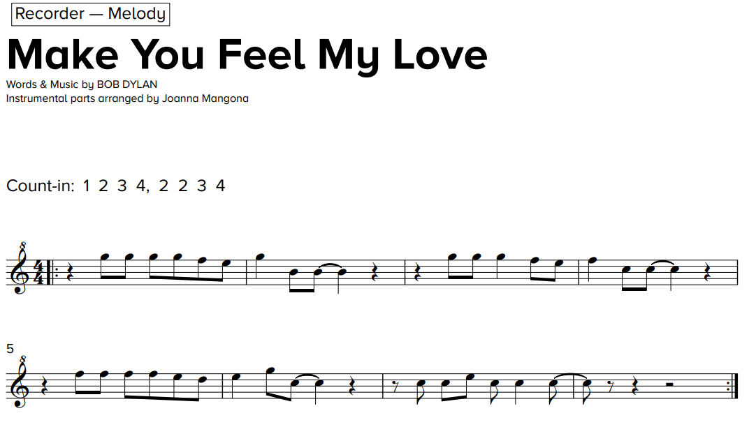
Sticky knowledge
Year group: 5 | Topic: Make You Feel My Love | Term: Spring
Key vocabulary and definitions:
Structure – the form of the music made up of verses and choruses . Pulse – the regular heartbeat of the music; its steady beat. Rhythm – long and short sounds or patterns that happen over the pulse. Pitch - high and low sounds Tempo – the speed of the music; fast or slow or in-between. Texture – layers of sound working together. Dynamics - how loud or quiet the music is. Timbre – the different sound quality of each instrument. Improvise – where a melody line is made up to fit the chords of the song. Appraising – listening to and understanding styles of music. Chorus – a repeating main theme of the song in-between each verse Verse – the main sections of the song with lyrics Interlude – a fill section in-between the verse and chorus Ballad – a slow, sentimental or romantic song
Substantive Knowledge
A pop ballad is a type of slow love song Make You Feel My Love is a pop ballad covered by Adele in 2008 It was originally written by Bob Dylan in 1997 Other pop ballads include Hello by Lionel Ritchie, The Way You Look Tonight by Tony Bennett, Love Me Tender by Elvis Presley. The instruments in the song are voice, piano, guitar, bass and drums. The structure of the song is intro, verse 1, verse 2, chorus, verse 3, interlude, chorus, verse 4 and ending.

Slide 5
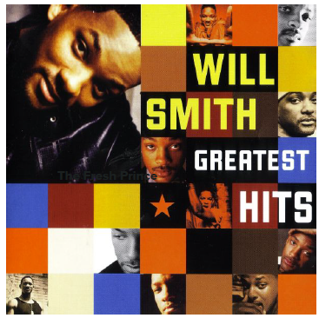
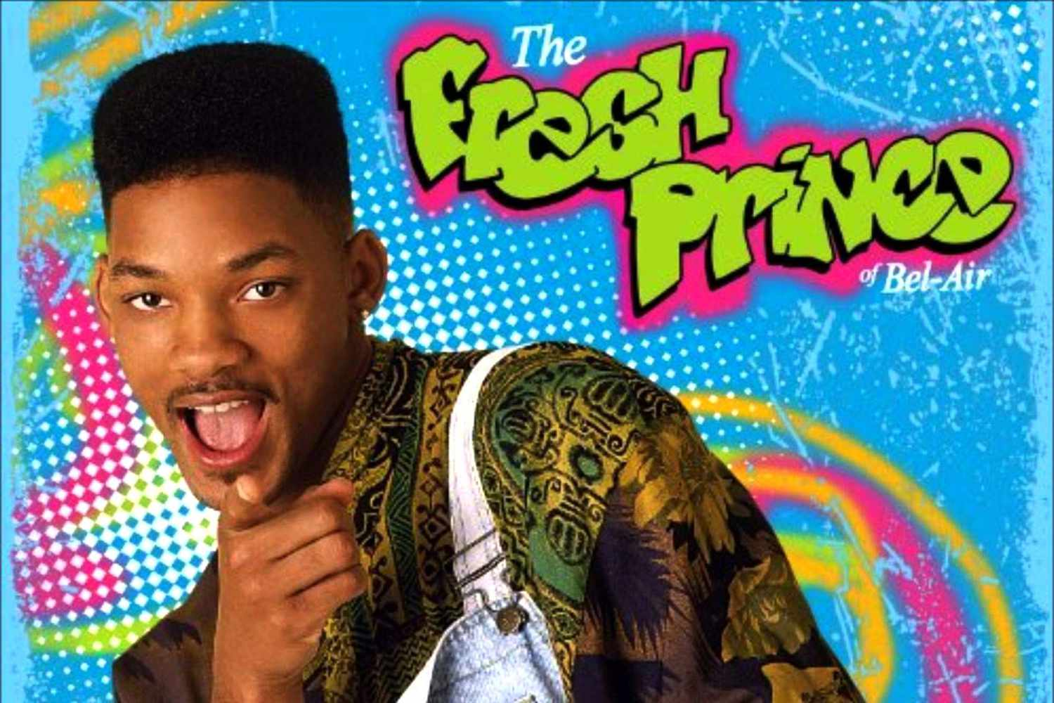
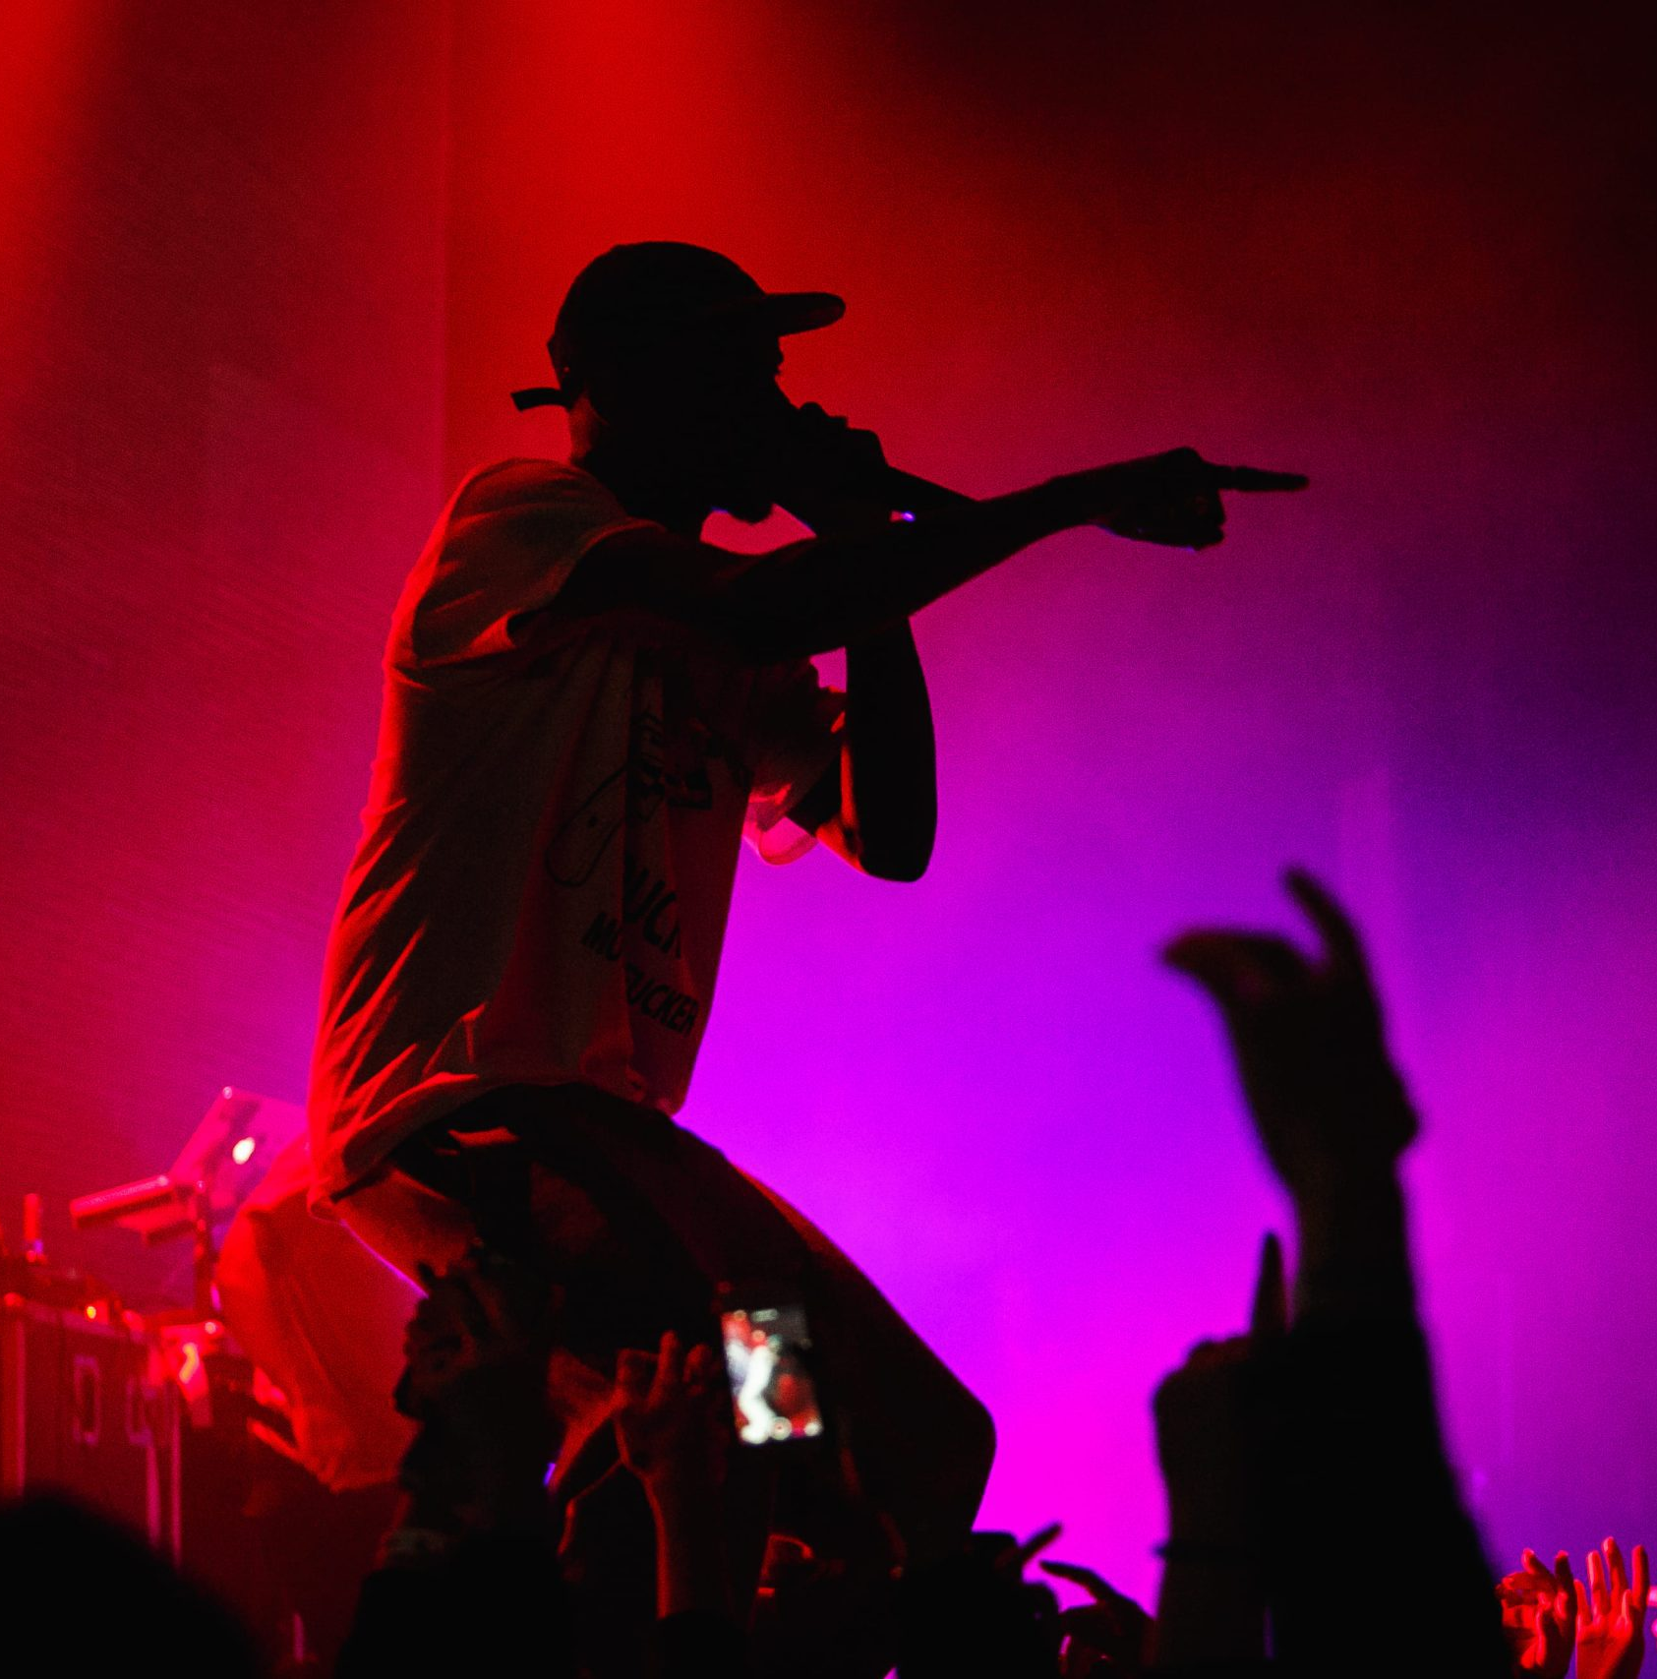
Sticky knowledge
Year group: 5 | Topic: The Fresh Prince Of Bel-Air | Term: Summer
Key vocabulary and definitions:
Structure – the form of the music made up of verses and choruses . Pulse – the regular heartbeat of the music; its steady beat. Rhythm – long and short sounds or patterns that happen over the pulse. Pitch - high and low sounds Tempo – the speed of the music; fast or slow or in-between. Texture – layers of sound working together. Dynamics - how loud or quiet the music is. Timbre – the different sound quality of each instrument. Compose – writing your own structured piece of music Chorus – a repeating main theme of the song in-between each verse Verse – the main sections of the song with lyrics Hip-hop – the backing music used for rap featuring heavy rhythm and bass sounds Rap – an artistic form of vocal delivery and emotive expression that incorporates rhyme, rhythmic speech, and street vernacular. Riff – a short repeated phrase used as an introduction
Substantive Knowledge
Hip-hop also known as rap, and formerly known as disco rap, is a genre of popular music that originated in the early 1970s in African American and Caribbean cultures. Rapping is an artistic form of vocal delivery and emotive expression that incorporates rhyme, rhythmic speech, and street vernacular or slang. The Fresh Prince of Bel-Air was written and performed by Will Smith in 1990 for a television series. The music was written by Quincy Jones. The instruments and sounds used are piano, loops, samples, decks, scratching, drums, bass, synthesizer and rapper Other hip hop songs include Me Myself and I by De La Soul, Ready or Not by Fugees, Rapper’s Delight by The Sugarhill Gang, U Can’t Touch This by MC

