Slide 1


Year 6
Music - Charanga

Slide 2
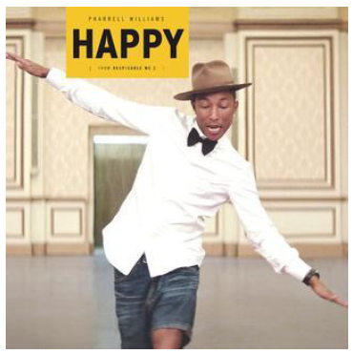

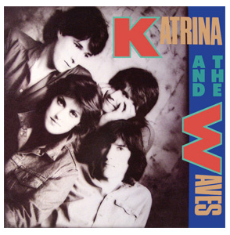
Sticky knowledge
Year group: 6 | Topic: Happy (Pop/Neo-Soul) | Term: Autumn
Key vocabulary and definitions:
Structure – the form of the music made up of verses and choruses . Pulse – the regular heartbeat of the music; its steady beat. Rhythm – long and short sounds or patterns that happen over the pulse. Pitch - high and low sounds Bridge – a fill section in-between the verse and chorus Tempo – the speed of the music; fast or slow or in-between. Texture – layers of sound working together. Dynamics - how loud or quiet the music is. Improvise – where a melody line is made up to fit the chords of the song Cover – when a song is rewritten and performed by another musician Pop music – a mix of rock and roll and other popular music from the 1950s Neo-soul – a form of pop music that incorporates styles of soul music Motown - music characterized by a thumping backbeat that made dancing easy for everyone
Substantive Knowledge
Happy is a neo-soul style of song, that is a form of pop music that incorporates styles of soul music Motown music is popular music characterized by a thumping backbeat that made dancing easy for everyone Happy is a song written, produced and performed by the American singer and producer Pharrell Williams. It is also featured in the film, Despicable Me 2. Happy is from Pharrell's second album, Girl (2014). Happy is a Pop song that has a Soul music sound and groove from the 1960s, very much like a Motown song. Happy was the most successful song of 2014. Other famous pop song include Top Of The World sung by The Carpenters, Don’t Worry, Be Happy sung by Bobby McFerrin and Walking On Sunshine sung by Katrina And The Waves.

Slide 3
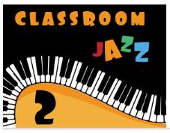
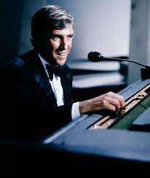
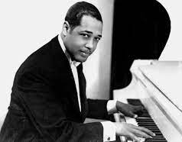
Sticky knowledge
Year group: 6 | Topic: Classroom Jazz (Unit 2) | Term: Spring
Key vocabulary and definitions:
Structure – the form of the music made up of verses and choruses . Pulse – the regular heartbeat of the music; its steady beat. Rhythm – long and short sounds or patterns that happen over the pulse. Pitch - high and low sounds Tempo – the speed of the music; fast or slow or in-between. Texture – layers of sound working together. Dynamics - how loud or quiet the music is. Improvise – where a melody line is made up to fit the chords of the song. Bossa Nova – a style of Brazilian music with more emphasis on melody over percussion. Appraising – listening to and understanding styles of music. Syncopation – a type of rhythm with an emphasis on the ‘off-beat’. Swing – a type of American jazz from the 1930s and 1940s Big Band – typically a 17-piece band used in swing and jazz music Blues – an early type of jazz which featured deep and emotional songs
Substantive Knowledge
Blues and swing are different types of jazz music that come from America in the 1920s, 1930s and 1940s. Blues is a style of music originating in the deep south of America and is considered an ancestor of Jazz. Jazz music uses improvisation, which is where musicians make up a melody on the spot to match the chords of the music. Big Bands were used in the swing era, featuring guitar, bass, piano, drums, saxophones, trumpets and trombones. Bacharach Anorak has a Latin American groove feel to it. The music is based on the style of Burt Bacharach. Burt Bacharach is one of the most influential American musicians of the 1950s and blended early pop and jazz styles together. Other famous jazz pieces include Take The ‘A’ Train by Duke Ellington, Back ‘O’Town Blues by Earl Hines and One ‘O’ Clock Jump by Count Basie.

Slide 4
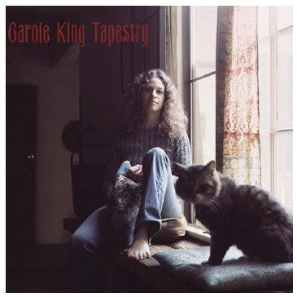
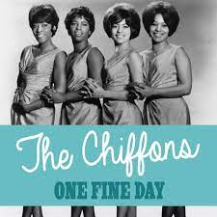
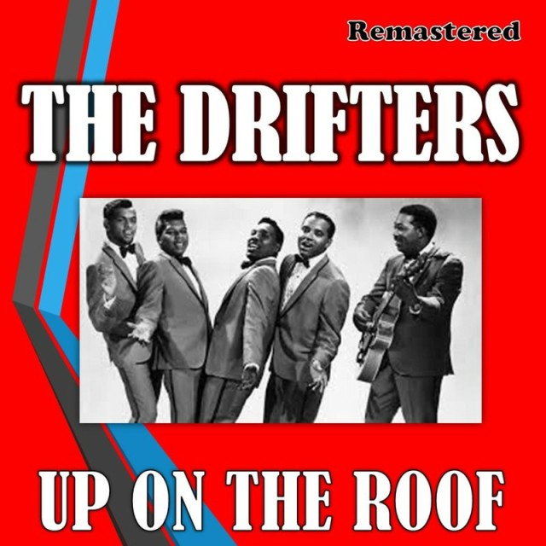
Sticky knowledge
Year group: 6 | Topic: The Music Of Carole King | Term: Summer
Key vocabulary and definitions:
Structure – the form of the music made up of verses and choruses . Pulse – the regular heartbeat of the music; its steady beat. Rhythm – long and short sounds or patterns that happen over the pulse. Pitch - high and low sounds Tempo – the speed of the music; fast or slow or in-between. Texture – layers of sound working together. Dynamics - how loud or quiet the music is. Timbre – the different sound quality of each instrument. Harmony – the sound of two notes heard together. Compose – writing your own structured piece of music Improvise – where a melody line is made up to fit the chords of the song. Solo – performing music by yourself Civil Rights – a movement to support people’s rights Gender equality – the equal treatment of men and women
Substantive Knowledge
You've Got A Friend is a pop song written by Carole King in 1971. It was first featured on her famous album, Tapestry. In the 1960s, Carole King was employed to write pop songs for artists to perform. Carole King did a lot to support civil rights and promote gender equality. Other songs by Carole King include The Loco-Motion sung by Little Eva, One Fine Day sung by The Chiffons and Up On The Roof sung by The Drifters.

