Slide 1
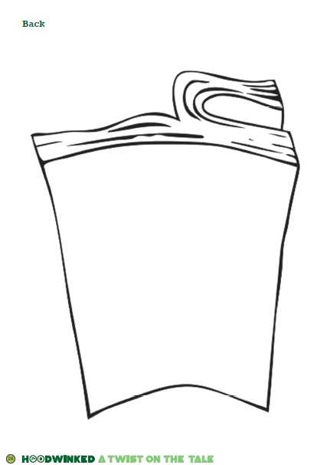
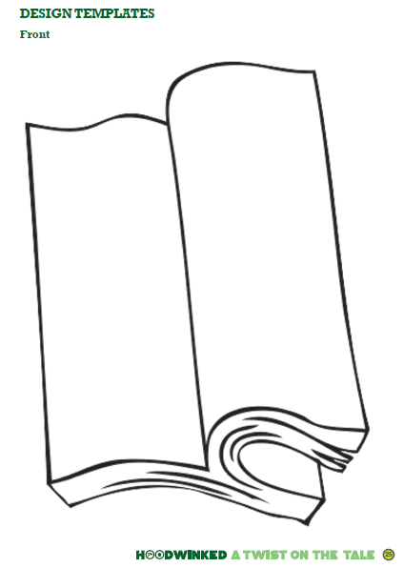


Along with fifty-two schools across Nottingham City, Year 5 are involved in a project to decorate a bench (which has been designed in the shape of an open book.) When completed, this will be taken to one of our local neighbourhood community spaces for everyone to enjoy as part of Nottingham City’s Hoodwinked trail. The trail, which begins in July, will see huge decorated sculptures of robins, placed in key places across Nottingham.
Year 5 need your help! As a school, we need to come up with a design to decorate our bookbench. Your design could be inspired by any book or author – fiction or non-fiction. All you need to do is design your bench on the form and hand it in to your teacher by Friday 11th May. There will be lots of prizes – so get designing!
Design a bench
competition
Name
Class

