Slide 1
Nottingham
Academy
Primary
Sit –a- SAT
Meeting
Monday 11th March 2019

Slide 2
SATs Timetable
It is imperative that your child attends school for the full week of SATs. Please ensure that holidays and other absences are arranged after these dates.
Monday 13th May 2019 | Tuesday 14th May 2019 | Wednesday 15th 2019 | Thursday 16th May 2019
Paper 1 - English grammar, punctuation and spelling. Paper 2- Spelling | English Reading Test | Maths Paper 1 – Arithmetic Maths Paper 2 – Reasoning | Maths Paper 2 Reasoning

Slide 3
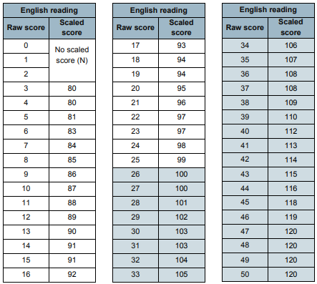
Scaled scores
To calculate a child's scaled score, their raw score – in other words, the actual number of marks they achieved – will be converted into a scaled score.
The scaled score needed to achieve Expected Standard and Higher Standard has fluctuated each year. It is only calculated once all of the papers have been marked across the country and a mean can be worked out. Schools are not told how many marks the children need before the tests.
Year | Reading | Maths | SPAG
2016 | 21 | 60 | 43
2017 | 26 | 57 | 36
2018 | 28 | 61 | 38
Each child will be told their raw score, their scaled score, and confirmation of whether or not they achieved the national standard.

Slide 4
Reading Test
In an average paper ,the children will have 3 different texts to read, e.g. a story, a report, a set of instructions and an advert.
As with previous years, the questions will broadly assess a child's ability to fully understand the structure, meaning and purpose of a passage of text. The questions will test a variety of reading comprehension skills including:
Fact retrieval e.g. "Name the four types of building detailed within the piece.“
Structure or presentation e.g. "Why do you think the author choose to present a table alongside the text?“
Inference e.g. "Why do you think the author has used the word "frozen" to describe the character?“
Open-ended questions e.g. "Explain how and why the author has chosen to end the story. Use two examples from the text.“

Slide 5


Slide 6
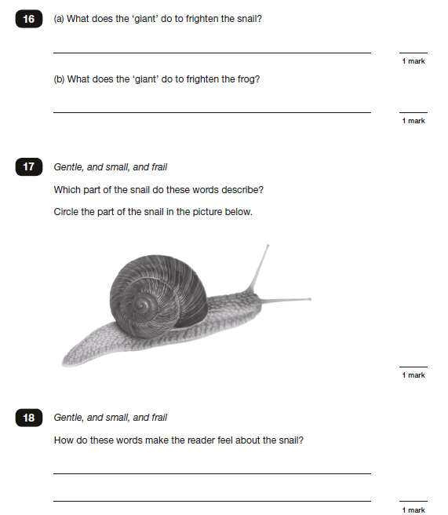

Slide 7
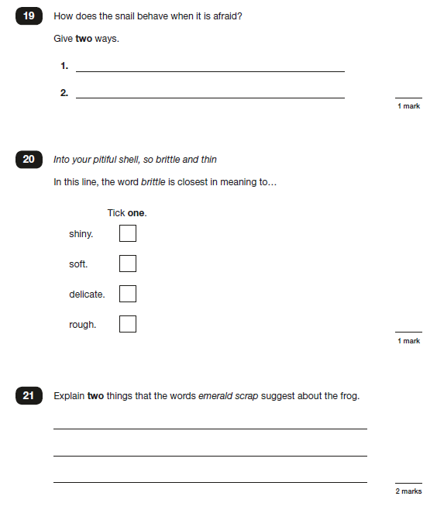

Slide 8
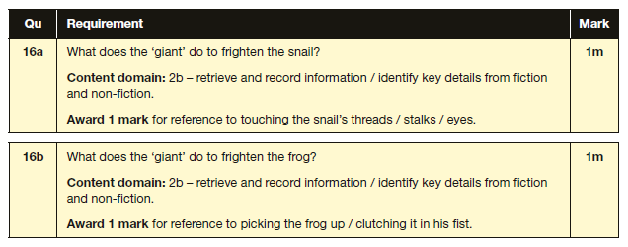
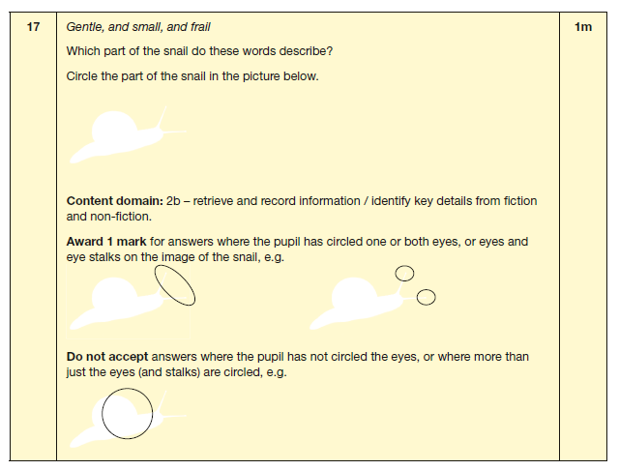

Slide 9
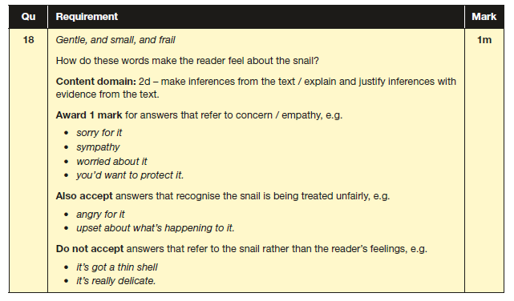
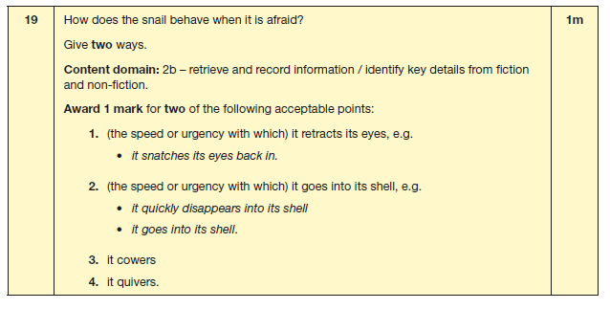

Slide 10
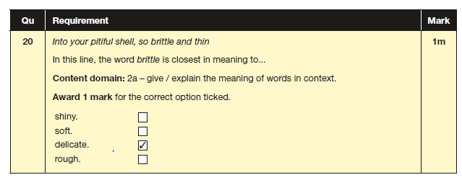
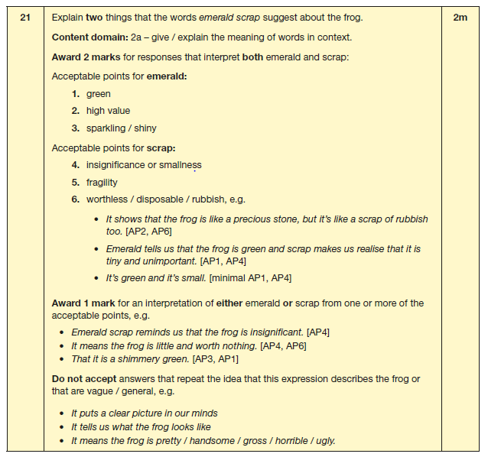

Slide 11
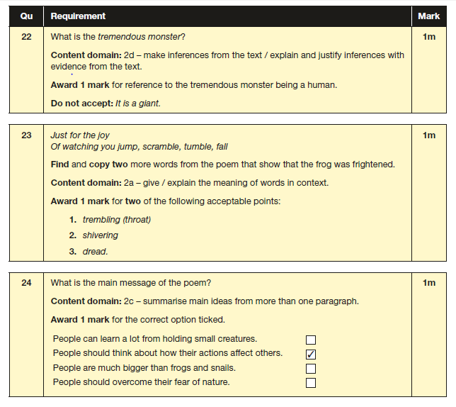

Slide 12
SPaG Test
Children will take two KS2 SPaG tests:
Part 1 (Punctuation & Grammar Questions) : 50 marks, 45 minutes.
Part 2 (Spelling Test) : 20 marks, 15-20 minutes.
The refreshed Part 1 (Punctuation & Grammar Questions)
Nouns, verbs, pronouns, adjectives, adverbs, determiners, conjunctions, clauses etc.
Subjunctive verbs, passive and active voices, subordinate clauses etc.
(The use of) capital letters, commas, inverted commas, apostrophes, colons, semi-colons, hyphens etc.
Suffixes, homophones, synonyms and antonyms.
Part 2 (Spelling Test) is essentially unchanged from previous years and involves your child's teacher reading 20 sentences from a script. Your child then fills in the blank on their answer sheet by correctly spelling the missing word.

Slide 13
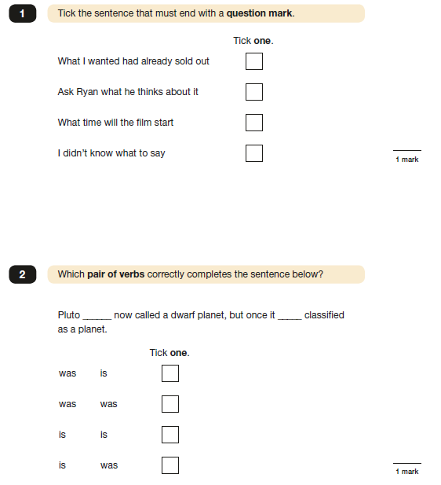
Example of SPaG questions

Slide 14
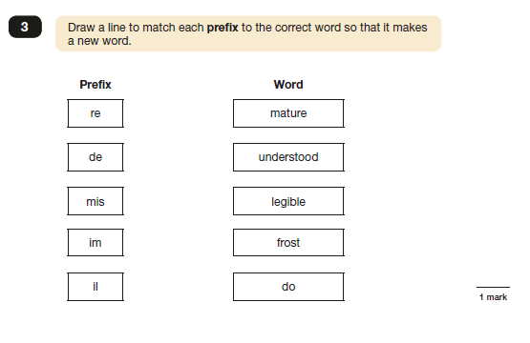
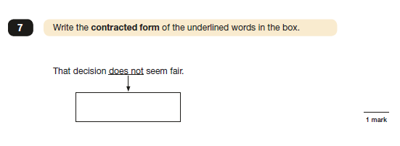
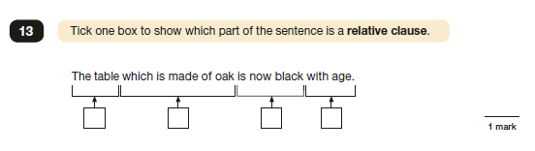

Slide 15
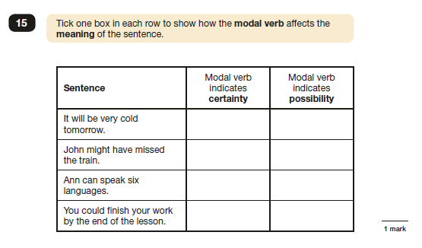
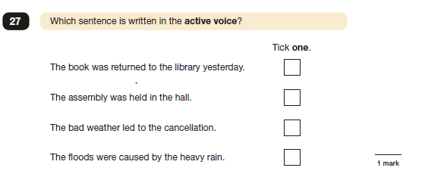
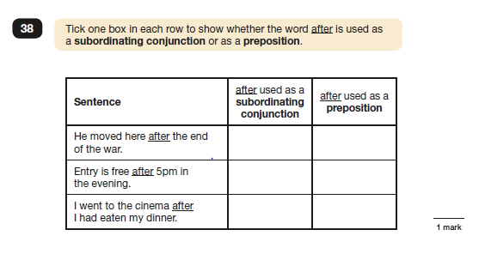

Slide 16
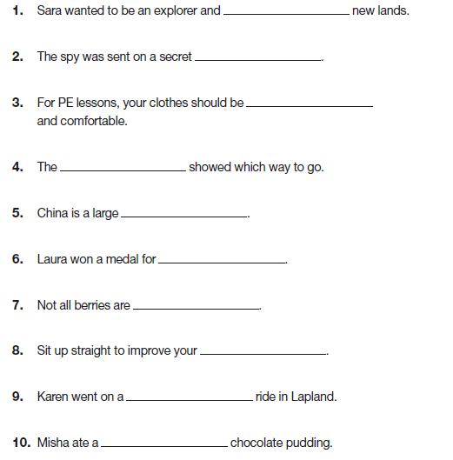
Spelling test

Slide 17
Maths Tests
Children will now take three separate KS2 Maths tests:
Paper 1 (Arithmetic) : 40 marks, 30 minutes.
Paper 2 (Reasoning) : 35 marks, 40 minutes.
Paper 3 (Reasoning) : 35 marks, 40 minutes.
Paper 1, now known as the "Arithmetic" paper, contains 40 marks worth of calculation-based questions. For this paper it's essential that your child is comfortable with the following topics:
Fractions (including mixed numbers).
Decimals (including converting fractions into decimals).
Percentages (and how they relate to fractions).
Square numbers.
Rounding.
Applying Addition, subtraction, multiplication (long and short) and division (long and short) to ALL of the above. This includes how to apply these operations in order when required (i.e. BODMAS).
KS2 Maths Paper 2 and Paper 3 are now known as the "Reasoning" papers and each contain 35 marks worth of more problem-solving based Maths. Children will need to apply their KS2 Maths skills (as used in Paper 1) to a variety of topics including:
Geometry (including coordinates, rotation, reflection, symmetry etc).
Ratios (and how to interpret them from fractions, percentages etc).
Charts and tables.
Units and measures (including time, temperature, money, weight, volume etc).
Shapes and their properties (including triangles, hexagons and their angles).
Roman numerals.
Mean, median and mode.

Slide 18
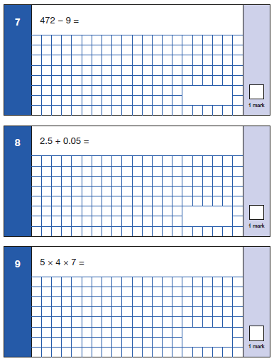
Arithmetic Paper

Slide 19
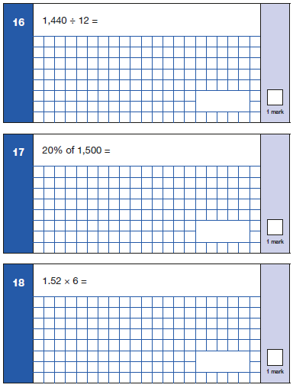
Arithmetic Paper

Slide 20
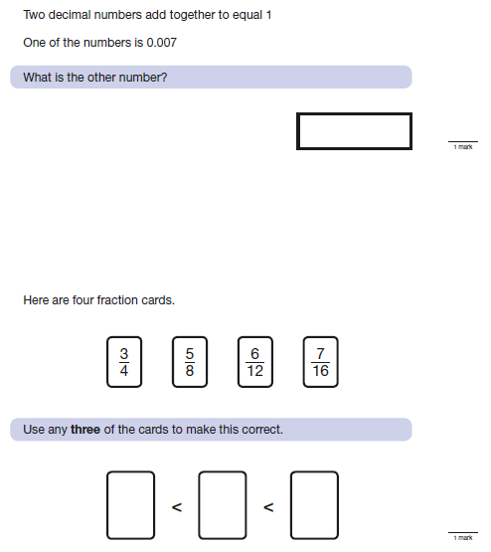
Reasoning Paper

Slide 21
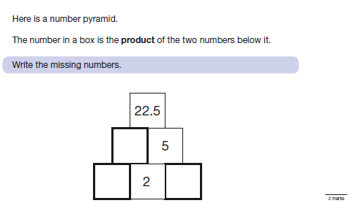
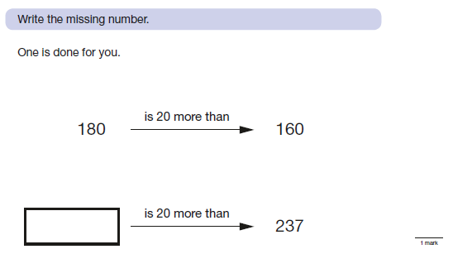
Reasoning Paper

Slide 22
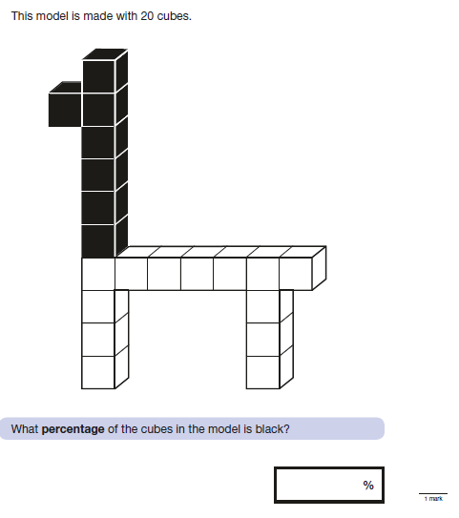
Reasoning Paper

Slide 23
What we’re doing in school already.
Target SPaG groups
Daily Guided Reading
Tuesday afternoon focussed SATs reading support – 5 groups
Extra maths sessions – focussing on Arithmetic and to focus on gaps in learning, as well as times tables.
Social, emotional and behaviour mentoring
Studying past SATs papers
Targeted homework clubs at lunchtime
After-school maths boosting
Morning Maths boosters for Higher Standard
Technical writing groups with Learning Mentors.
Speed reading – 100 words per minute to build stamina and fluency
Fast spelling
Weekly Arithmetic and mental maths strategies at the start of Maths lessons
RIC activities at the start of Guided Reading, Literacy, Topic and Computing
Daily Routines for English and Maths during Daily Dash
Streamlined homework to focus on reading, maths and physical activity/ reflection
Notes:
Samina

Slide 24
What else you can do to help
-Make sure your child is here that week –(no holidays booked during the week commencing 13th May).
-Set a routine to allow children to have enough sleep and are up in plenty of time
-Ensure your child completes their homework every week
-Encourage them to use the internet sites they use at school to revise
-Ask them mental maths questions on a daily basis
-Ensure they read every night (for at least 10 minutes) including a range of text types
Notes:
Rose

