Slide 1


Year 1 - History

Slide 2
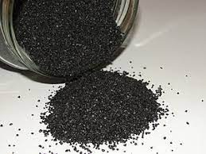

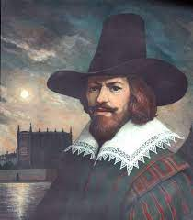

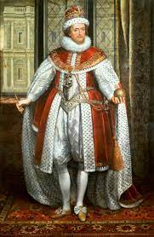

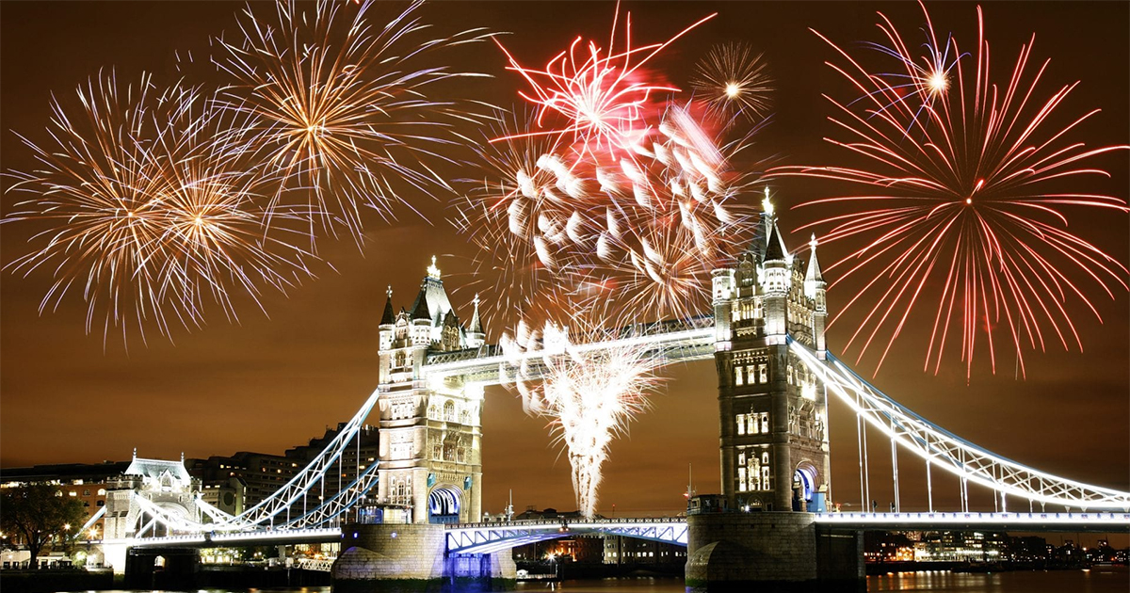

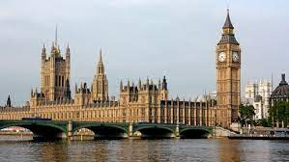
Sticky knowledge
Year group: 1 | Topic: Significant individual- Guy Fawkes | Term: 1
Key vocabulary and definitions:
Timeline- a line that shows the time and the order in which events have happened. Before- the time prior to a particular event or time. After- the time following an event. Guy Fawkes- The man responsible for lighting the fuse to the barrels of the gunpowder Gun Powder – an explosive powder Plot-. A plan made in secret by a group of people. King- the ruler of the state/ country Parliament- the people who make the laws Historical concepts
Substantive knowledge:
The Gunpowder Plot was a significant event in British history. Guy Fawkes, Robert Catesby and Thomas Percy were significant individuals involved in the plot. Guy Fawkes was born on 13th April 1570, in York. Guy Fawkes was involved in devising the Gun Powder plot which was a plan to blow up the Houses of Parliament when the king was inside using many barrels of gunpowder. The Catholic religion was very important to Guy Fawkes. King James I was a protestant and did not like people being Catholic in England. The gunpowder plot was going to blow up the houses of parliament, but it was discovered in time. Guy Fawkes was arrested and ordered to be executed By King James. King James decided that on the 5th of November every year, from that day, we would remember the Gunpowder Plot and how Guy Fawkes’s plan failed by having bonfires and firework displays.
Guy Fawks
King James I

Slide 3
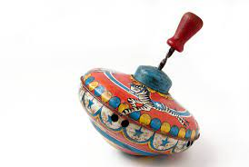

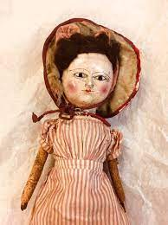
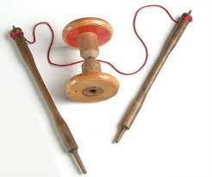

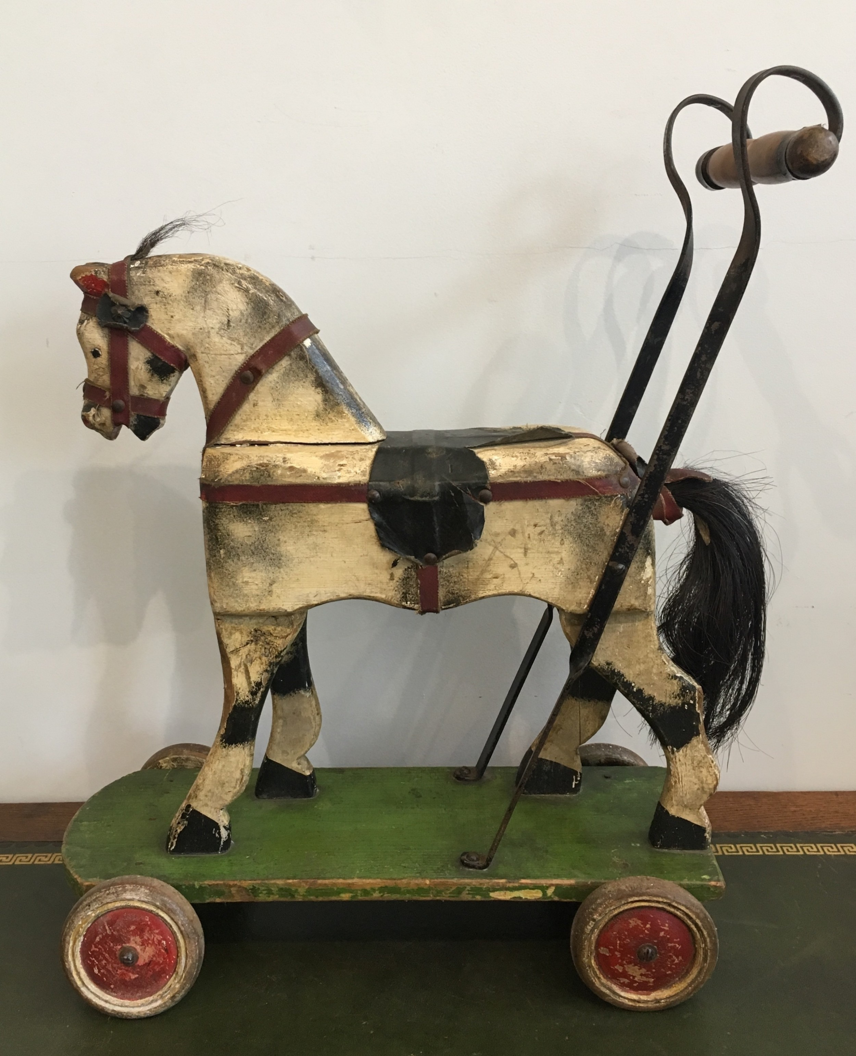
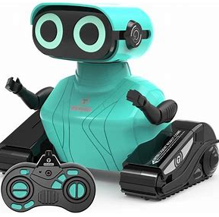
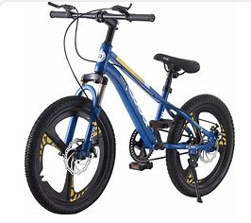


Sticky knowledge
Year group: 1 | Topic: Old toys vs new toys | Term: 2
Key vocabulary and definitions:
Timeline - a line that shows the time and the order in which events have happened. Present – now, at the present time. Past – a time before now. Century – a hundred years Victorian – from the time when Queen Victoria reigned. Living memory – a period of time that is remembered by people still alive. Similar – having some qualities that are the same but not identical. Different – not the same Materials – what something is made from. Toy – Something a child plays with.
Substantive knowledge:
Children have always had toys to play with. Many Victorians lived in cramped conditions, and there wasn’t the space for the children to play indoors. So many popular Victorian toys were designed to be played with outside. The materials that toys are made from has changed over time. Many toys in the Victorian time were made from wood, metal, paper or fabric. Many toys now are made from plastic and have electrics. Victorian toys were mainly handmade Modern day toys are usually made in factories Some toys that we play with now are the same or similar to those played with by children in the past.
Old toys
New toys

Slide 4
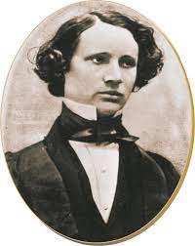
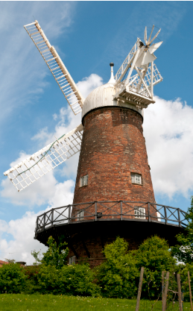



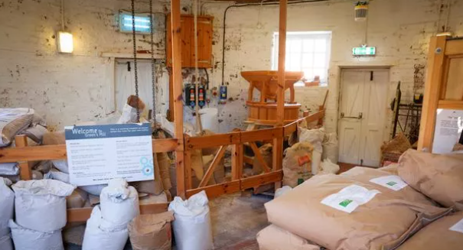
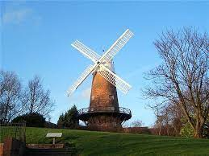
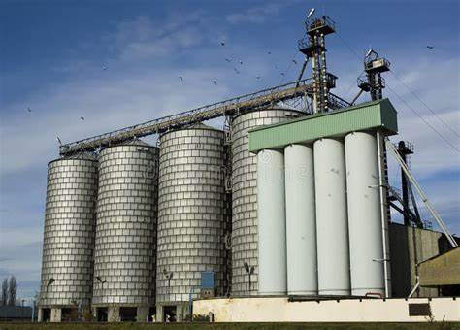
Sticky knowledge
Year group: 1 | Topic: Studying locality –. George Green- Green’s Windmill | Term: 4
Key vocabulary and definitions:
Year- the time taken by the earth to make one trip around the sun- 365 days Decade- ten years Timeline-a line that shows the time and the order in which events have happened. Mathematician – someone who is very good at maths. Windmill – a building with sails/vanes that turn in the wind to generate power to grind corn into flour. Artefacts- an object made by a human being, typically one of cultural or historical interest. Significant- an important place, person or object
Substantive knowledge:
George Green was born in 1793 in Sneinton. His family ran the windmill and at a young age George helped at the windmill. When he was 14, he started his apprenticeship at the bakery. In 1823, Green met his partner, Jane. They had 7 children together. In 1829, his dad died, and he took over the mill. In 1833, when he was 40 years old, he went to the University of Cambridge to study maths. He was a mathematician. He died on 31st March 1841. A windmill grinds grain and makes flour used for baking and cooking. Today electronic machines in factories are used to make flour.
George Green’s Windmill still
stands in Sneinton today.
Modern flour mill
Inside the mill.

Slide 5
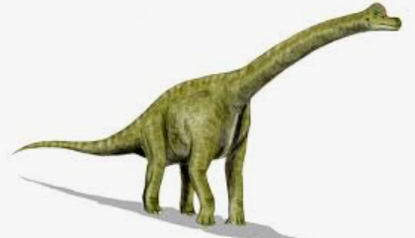
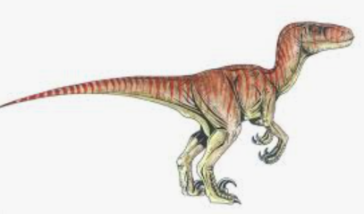
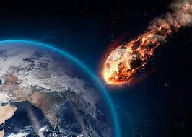
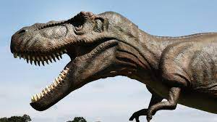

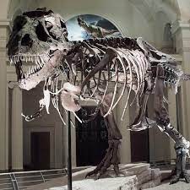
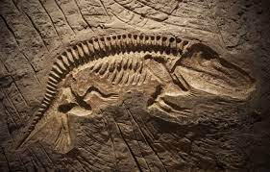

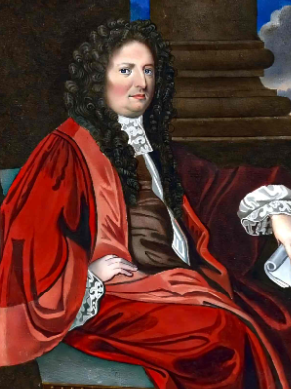
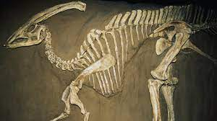

Sticky knowledge
Year group: 1 | Topic: Dinosaurs | Term: 6
Substantive knowledge:
The word dinosaur means terrible lizard. There were more than 700 species of dinosaur. Some were big, some were small, and some could fly. Some dinosaurs were herbivores and only ate plants, some were carnivores and ate other dinosaurs, some were omnivores and ate both plants and other dinosaurs - this is much like animals and humans today
Key vocabulary and definitions:
Herbivore : an animal that eats plants Carnivore :an animal that eats meat Omnivore: an animal that eats both plants and meat Palaeontologist: a scientist that studies fossils. Fossil: The remains of plants or animals that have been preserved in rock. Excavation: Digging to uncover buried objects. Extinction: The death of an entire species of plants or animals. Prey: an animal that is hunted by others for food. Predator: an animal that kills another for food.
Scientists believe that about 65million years ago a large asteroid hit the earth and killed all the dinosaurs, this caused extinction.
Dinosaurs are now extinct.
Dinosaurs lived millions of years ago, before people. The landscape looked very different. There were gigantic land masses that aren’t here today, enormous mountains, forests and deserts.
Dinosaurs lived on earth for 65 million years when the earth looked very different. There were no human features such as buildings, roads and bridges.
Initially the climate was dry and hot, and the earth was like a desert, but later during the Jurassic period, the climate was humid and tropical where forests could grow.
A Palaeontologist studies fossils.
Dr Robert Plot found the first dinosaur bone in 1677.
The first dinosaur bone found in England was discovered in Oxford.
Bones and fossils

