Slide 1


Year 2- History

Slide 2
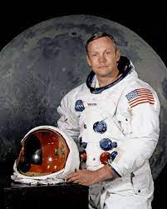
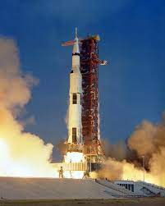

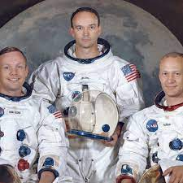
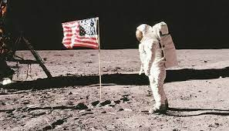


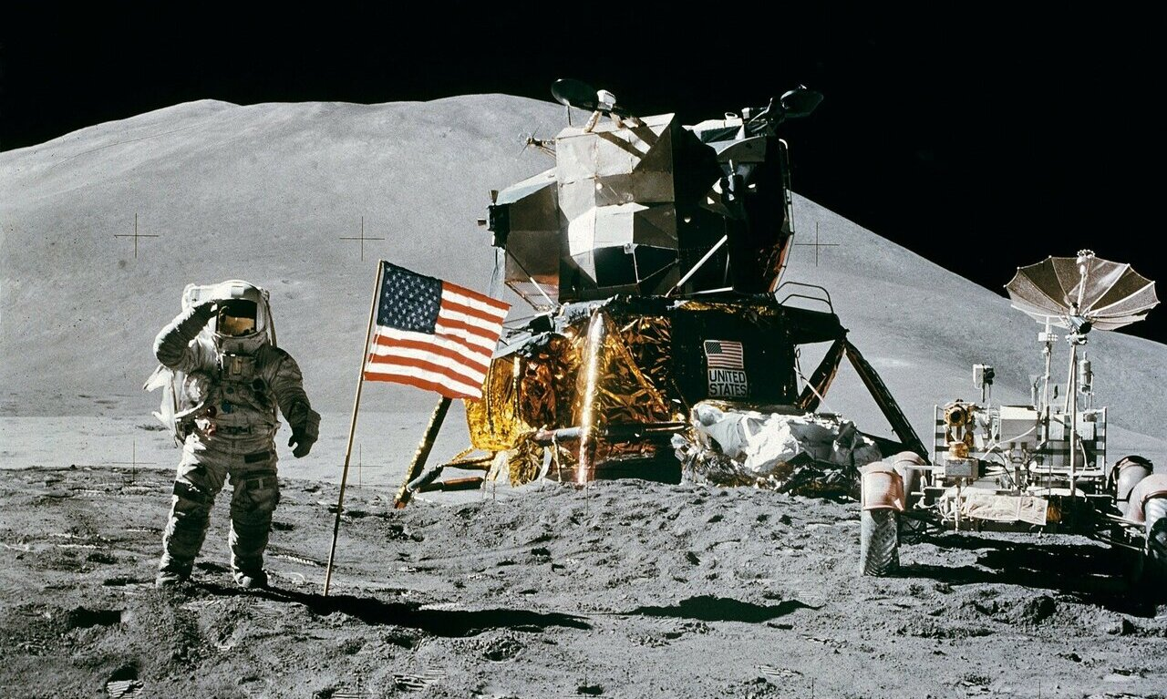
Sticky knowledge
Year group: 2 | Topic: Significant Individuals (Neil Armstrong) | Term: 2
Key vocabulary and definitions:
Astronaut: a person trained to travel in a spacecraft. Outerspace: the universe beyond earth. Moon: a large round object that circles the Earth and shines at night. Apollo 11: the first spacecraft that landed on the moon. Significant: of importance to be worthy of attention Achievements: a thing done successfully with effort, skill and courage Timeline: a line that shows the time and order in which events have happened
Substantive knowledge:
Neil Armstrong is a famous American astronaut; he was born in 1930 Neil Armstrong went to the moon in 1969 on the Apollo 11. He is the first man to land and walk on the moon and was joined by Buzz Aldrin- a fellow astronaut. They explored the moon together and collected moon rocks Armstrong and Aldrin took photographs and sent live television pictures back to earth. As Neil Armstrong stepped onto the Moon, he said, “That’s one small step for man, one giant leap for mankind.” Neil Armstrong died in 2012. Neil Armstrong studied Aeronautical engineering and Science in Aerospace engineering at University Neil Armstrong loved flying; he flew planes for the American Navy before he started space travel. He made his first trip to space as an Astronaut in 1966.

Slide 3
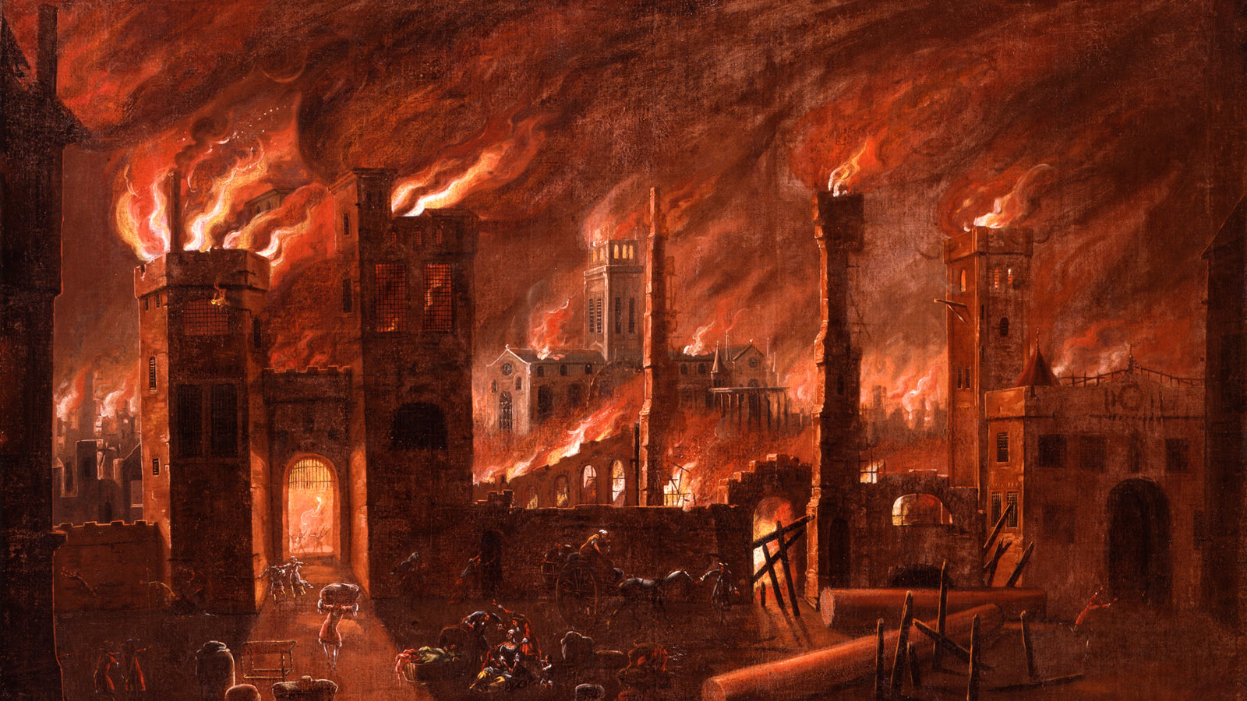

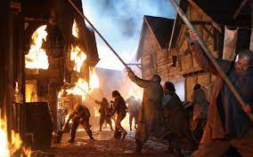

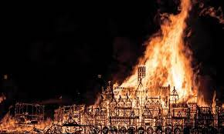


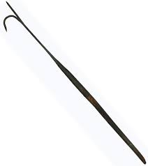
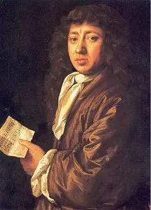

Sticky knowledge
Year group: | Topic: The Great Fire of London | Term: 4
Substantive knowledge:
The Great Fire of London started on the 2nd of September 1666. The fire started on Pudding Lane The fire started because Thomas Farriner forgot to turn off the oven in his bakery. There were around 350,000 people living in London at this time- it was a busy city. People didn’t know about the dangers of fire- houses were made form wood and straw. Samuel Pepys lived at the time of the fire, and he wrote a diary about the Great Fire of London. His diary was well preserved so historians can use it to find out about the event. The fire lasted five days. The fire spread because the houses were made from wood and were built close together. Sir Christopher Wren redesigned much of the city of London after the fires. London was rebuilt in a safer and more organised way after the fire. King Charles ll ordered that houses and shops be pulled down to stop the fire from spreading
Key vocabulary and definitions:
Timeline: a line that shows the time and the order in which events have happened. Chronological order: arranged according to the order of time. Firebreak: When a building was torn down to make a gap so that the fire could not continue. Fire hooks: a long pole used in firefighting for tearing down burning buildings Diary: a book in which people write a daily record of events King Charles ll- The king of England at the time of the Great fire of London.
Samuel
Pepys
1633-1703

Slide 4
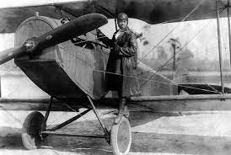
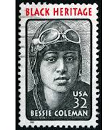

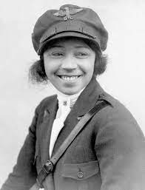


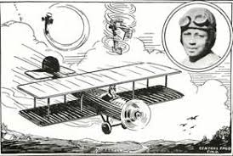


Sticky knowledge
Year group: 2 | Topic: Bessie Coleman | Term: 6
Key vocabulary and definitions:
Aviator/pilot: a person who flies an aeroplane. Plane: a vehicle with wings and engine(s) that can fly. Propellor: a device with blades that turns rapidly to make an aeroplane move forward. Biplane: an early type of plane with two wings above each other University- where people go to get a higher level education Licence- to be permitted to own or do something Racism – where someone is not treated fairly because of the colour of their skin Impact: something that makes and influence.
Substantive knowledge:
Bessie Coleman was born in 1892 in Texas, USA Bessie Coleman was the first African – American woman and first native American to hold a pilot licence She inspired African Americans to follow their dreams She also used her fame to fight racism and segregation, refusing to fly in shows that forced Black and white spectators to enter through separate gates. She worked in cotton fields at a young age She had an interest in flying- but African Americans and woman could not train to be pilots in America She went to France to earn her pilot licence She performed dangerous stunts in air shows in the US She died in 1926 in a plane crash while practicing for an airshow Most early planes were made of canvas and wood Bessie learnt to fly planes that had no brakes or steering wheels
Bessie Coleman
1892-1926

