Slide 1


Year 3- History

Slide 2
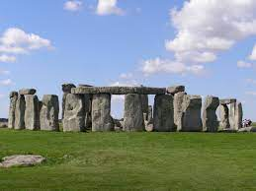



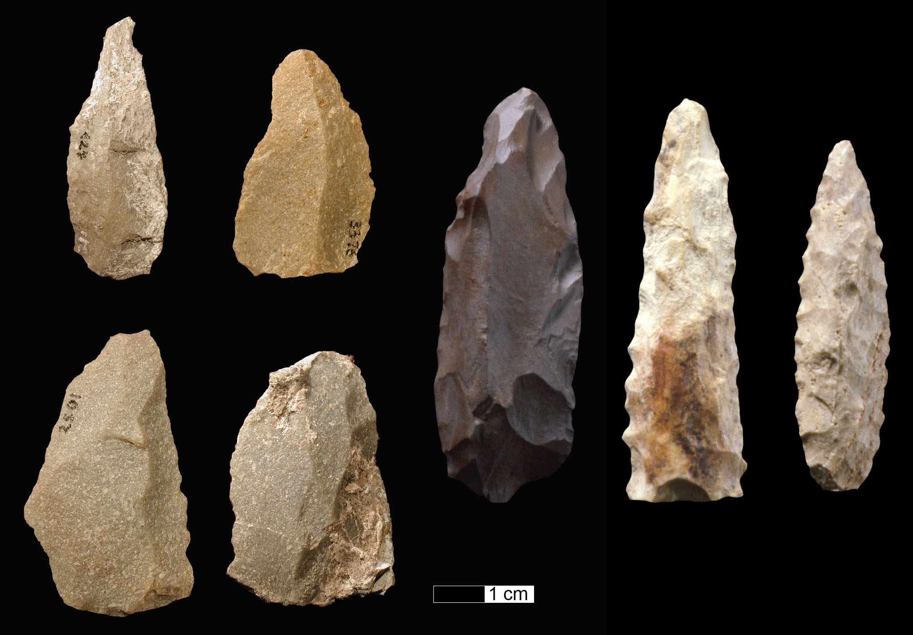

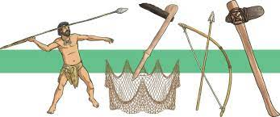
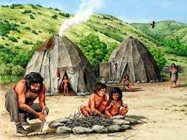

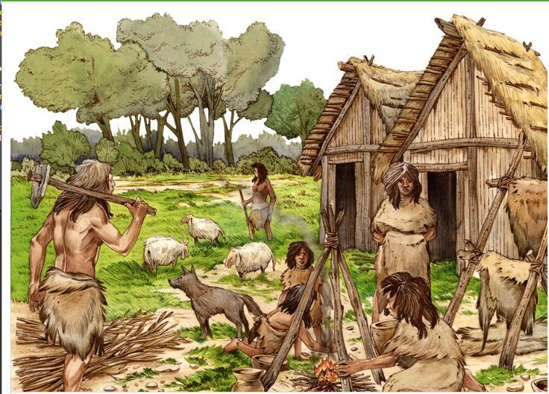
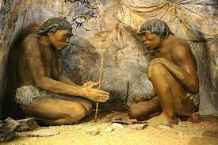
Sticky knowledge
Year group: 3 | Topic: The Stone Age to the Iron Age | Term: 2
Key vocabulary and definitions:
BC – Before Christ AD – Anno Domini Palaeolithic – Start of the Stone Age Mesolithic – Middle of the Stone Age Neolithic – Last part of the Stone Age Bronze Age – starting the use of metal Iron Age – use of iron for making tools Hunter- a person who hunts animals for food Gatherer- someone who collects or forages Civilisation- a group of people with their own language and way of life Settlement- places where people live and work Agriculture- the science of farming- how to grow crops and rear animals.
Substantive knowledge:
Stone Age was 2.6 million years ago Bronze Age was 3300BC to 1200BC- tools and weapons were made of bronze Palaeolithic period people lived in caves. Mesolithic period people built huts to live in. Neolithic people had settled communities, they domesticated animals and farmed They formed civilisations along rivers, so they had water for their settlements. In the Iron age people lived in clans and belonged to tribes. They were led by Warrior Kings. Stone and bone was used to make tools during the Stone Age Iron Age began in 1200BC and ended in 600BC- iron was the most popular material to use when making tools and weapons. Stone Age people were hunter-gatherers, they hunted animals for food. Early humans in the Stone Age ate raw meat, fish, nuts, seeds and berries Farming was what most people did as a job in the Iron age. Other jobs were carpenters and metal workers.
Stone age tools and weapons

Slide 3

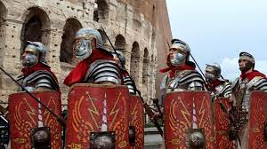
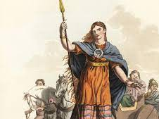



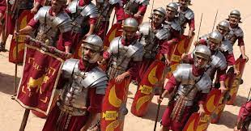
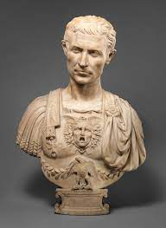


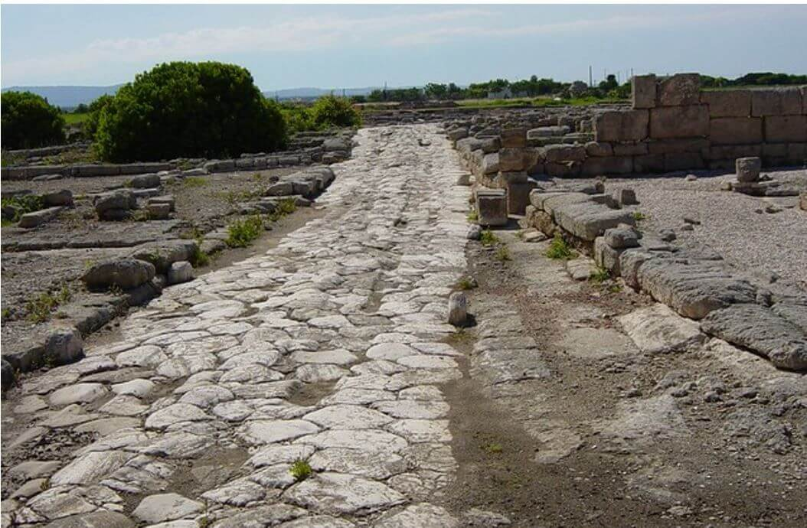
Year group: 3 | Topic: Romans and the Impact of Britain | Term: 3
Sticky knowledge
Substantive knowledge:
The Romans originated in the city of Rome The romans ruled countries across the globe- including Great Britain (The Roman Empire) The Romans acquired lots of land by fighting battles. Its army was the most powerful in the world. As it conquered more countries, the city of Rome grew from a town into an enormous capital. People were punished for crimes depended on who you were and your position in Roman society. Whipping and fines were the most common punishments. Wealthy people lived in houses called domus which had plenty of space. They had rooms like the triclinium, where people would eat together, while lying down. Or the atrium, where the family would entertain guests. Less wealthy/ poorer people lived in an insulae, where lots of families lived in a building with multiple floors. The Romans built baths, roads and sewage systems; they are still used today. Julius Caesar attempted to invade Britain in 55 and 54BC but failed. He was a Roman leader; he was in the military and was very brave in battles. He was popular with the people of Rome. He made significant changes to the government, helping the poor. Augustus, was Julius Caesar's great nephew, he was the first Roman Emperor. He brought peace and began to build roads, building and bridges. Emperor Claudius successfully invaded Britain in 43CE Boudicca was a Warrior Queen and led a rebellion against the invasion. She was defeated by Claudius.
Key vocabulary and definitions:
Romans – Civilisation of Ancient Rome Emperor – Ruler of an empire Conquer – To take control Invasion – Taking over another place Empire- a group of countries that are controlled by one ruler Governance- authority to manage a country Rebellion- armed resistance to government or ruler

Slide 4
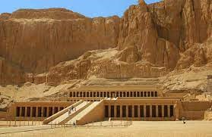
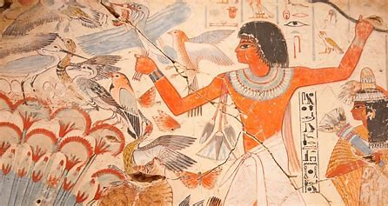


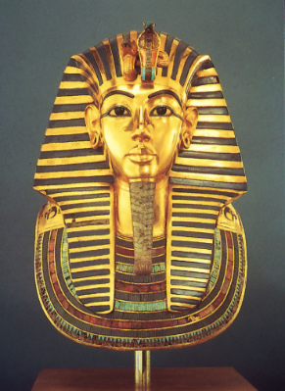
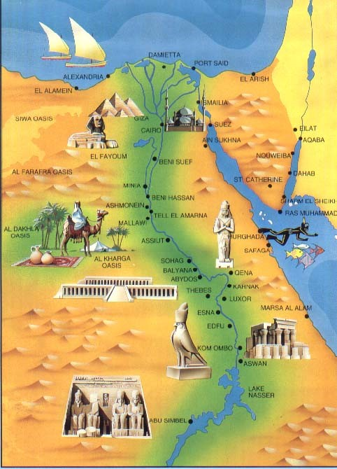




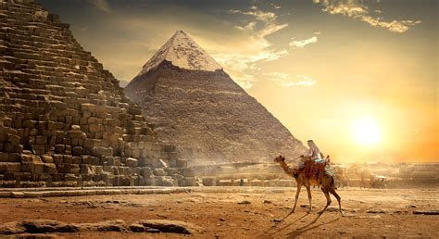




Sticky knowledge
Year group: 3 | Topic: Ancient Egypt | Term: 5
Key vocabulary and definitions:
Civilisation – Group of people with their own language and way of life Pharaoh – Ruler of Egypt Ancient Egypt – Civilisation of Egypt Pyramids – Royal tombs built from stone Hierarchy- a ranking of people Tomb- a large underground vault for burying a dead person
Substantive knowledge:
The River Nile was used for transport, washing clothes and drinking water The River Nile had 3 seasons – Akhet (flooding season), Peret (growing seasons) and Shemu (harvesting season) Tutankhamun was a Pharaoh at the age of 9, he ruled the country at a time of conflict, when there were battles over land. Tutankhamun died aged 18 Ancient Egypt was one of the longest lasting civilisations (over 3000 years) The Pharaoh was the top of the Egyptian hierarchy, followed by Vizier, Nobles and Priests, Soldiers and Scribes, craftsmen and slaves. The Ancient Egyptians built pyramids as giant burial tombs for the most important people in their society, the pharaohs. The largest pyramids were made with over 2 000 000 blocks of rough yellow limestone that were taken from the ground on site. Most of the blocks were cut in the ground and then prized out using wooden levers. To move the heavy stone they used large wooden sleds which they pulled over wet sand. Children in Ancient Egypt went to school to learn reading , writing, maths and religious instruction. Girls were educated at home. Egyptians used papyrus to make paper and hieroglyphics for writing and numbers Everyone worked hard in Ancient Egypt, everyone had a job. Jobs included bakers, priests, farmers, artist, fisherman
The ancient Egyptians had many gods and goddesses.
Some gods were stars, others were humans and animals.
The gods stood for things like weather, fire and death, that were part of life.
People believed the Pharaohs were picked by the gods.
In Ancient Egypt, when someone important died, their body was mummified to prepare them for burial.
Ancient Egyptians believed they would be judged by their gods and goddesses to see if they could move on to the afterlife.
Mummification was just one step in preparing for the afterlife.

