Slide 1


Year 4- History

Slide 2
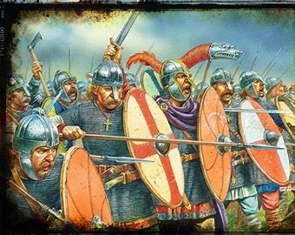


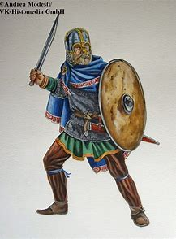


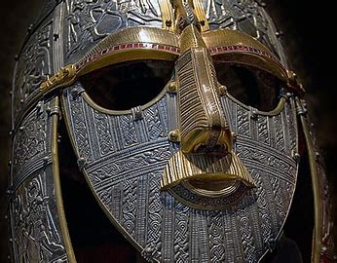
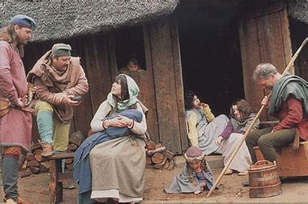


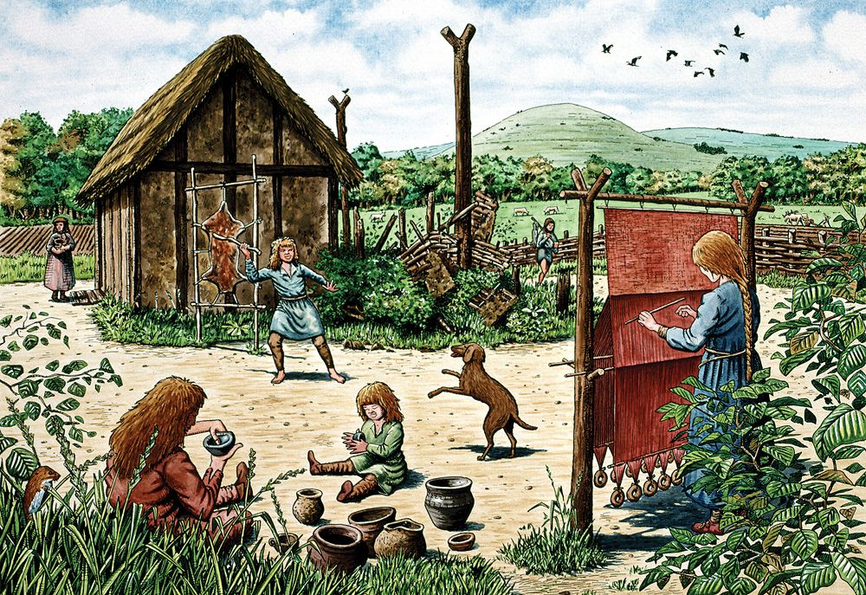
Sticky knowledge
Year group: 4 | Topic: Anglo- Saxons | Term: 1
Key vocabulary and definitions:
BC – Before Christ AD – Anno Domini Chronological order- ordering events in which they occurred Archaeologist-a person who studies human history and prehistory Invasion- taking over a country with armed force Conquer- take control of a place by military force Kingdoms- a territory ruled by a king or queen Warrior- someone brave, strong and intelligent. Someone willing to fight to the death
Substantive knowledge:
Anglo-Saxon farming was widespread throughout Britain, and almost everybody worked on a farm. They raised chickens, goats, sheep, pigs and cows and grew a range of crops and vegetables. Most Anglo-Saxon farms and villages were built close to a source of fresh water. As well as raising animals for their meat, milk and eggs, the Saxons also used animals for other products important for daily living. These included wool and leather, cooking fat, and tallow for making candles. Near the end of Roman rule, Britain was being attacked by the Picts and Scots from the north, and the Anglo-Saxons from the sea. The Romans built forts to defend the coast and Hadrian's wall defended the north. Saxon warriors were invited to Britain in around AD380 to help the Romans fight the Picts. The last Roman soldiers were ordered to leave in around AD410. Britain no longer had the strong Roman army to defend it from the invaders. There were many battles between Anglo-Saxons and Britons. Over time, the Anglo-Saxons took control of most of Britain. The Pics, Scots and Anglo-Saxons were constantly trying to get land and power. The Pics, Scots and Anglo-Saxons all had similar Kingdoms, and they all farmed and hunted. But had their own language, arts and traditions. Anglo-Saxons believed in lucky charms. They thought that rhymes, potions, stones and jewels would protect them from evil spirits or sickness. Over time their beliefs changed and many Anglo-Saxons were converted to Christianity.

Slide 3
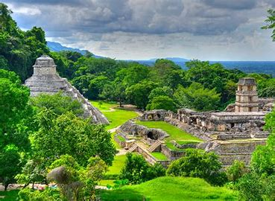



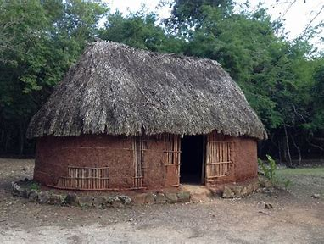





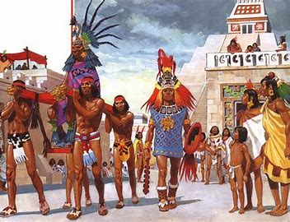
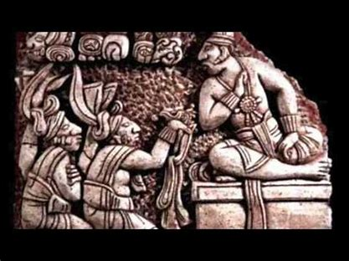
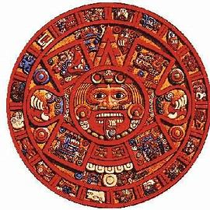


Sticky knowledge
Year group: 4 | Topic: The Mayan and Aztecs | Term: Spring 1 and 2
Substantive knowledge:
The Mayan, or Maya, peoples made their home in an area known as Mesoamerica (modern day Mexico and Central America). Maya houses were made of wooden poles, clay and mud, they had thatched rooves, one room and little furniture Mayan culture spanned a large time frame (established by 1000 BC, and it lasted until 1697) Maya were deeply religious and worshipped various gods related to nature. They built jungle pyramids to worship their gods. They worshipped gods which influenced their daily lives and left behind temples as evidence. The Maya first developed their civilisation in around 2000 BC. The Aztecs were the next civilisation after the Maya. Maya society was very complex with hundreds of cities, commoners, a middle class, nobles and the king and his royal court. The Maya built amazing cities like Tikal and Palenque. Even though they lived in different cities, ruled by different kings and queens, the Maya shared a lot of common beliefs and traditions. Warfare and trade were important aspects of Maya society and so was art and architecture. Top of Maya society were the Kings who claimed to be related to gods Maya people were able to do complex calculations, which allowed them to create very detailed and accurate calendars. They used these calendars for farming. The Aztecs were famous for their agriculture and introducing irrigation. The Maya ate (Maize, squash, beans, root vegetables, tortillas, a sweet drink and porridge) If farmers grew more than they could eat, they traded the leftovers in markets.
Key vocabulary and definitions:
Culture: ideas, customs, and social behaviour of a particular people or society Invasion: invading a country or region with an armed force Civilisation: the society, culture, and way of life of a particular area Agriculture- The art and science of growing crops and raising livestock Society- a group of people associated together for religion, cultural, political views Worship- an expression of obedience, praise and adoration to a god

Slide 4
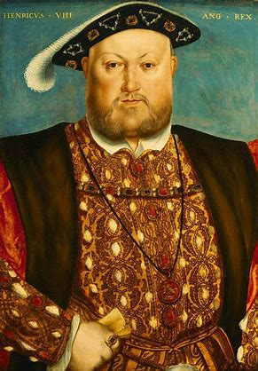


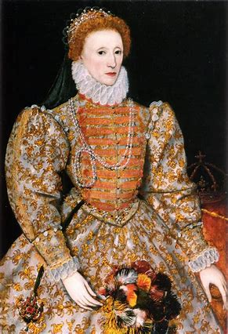


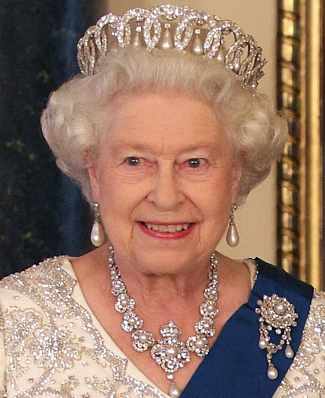
Sticky knowledge
Year group: 4 | Topic: Change in power of the Monarchs | Term: 6
Substantive knowledge:
Henry VIII was King of England and Ireland from 1509-1547 (Tudor era) He was 18 years old when he became King. Henry VIII wanted to divorce his first wife because she didn't give him a male heir (a son). Henry VIII had six wives- they were all either divorced, died or were beheaded. Elizabeth I was Henry VIII daughter. She reigned for 45 years Elizabeth I created a compromise between Catholics and Protestants Elizabeth II was the longest reigning monarch. She was queen for 70 years. When the pope wouldn't allow Henry VIII to divorce his wife, he broke away from the Catholic Church and created his own Church of England (followers of the Church of England were called the Protestants). Catholics and Protestants were against each other. Henry VIII had six wives- they were all either divorced, died or were beheaded. Elizabeth I was Henry VIII daughter. She reigned for 45 years Elizabeth I created a compromise between Catholics and Protestants The monarchy has changed over the years and so has the role they play in society.
Key vocabulary and definitions:
Monarch- a sovereign head of state: king, queen or emperor Heir- a person who inherits and continues the work of a predecessor reign- control of a company, government or organisation Throne- a ceremonial chair for a sovereign Catholic- belonging to part of the Christian Church that the pope is the leader of Protestant - a Christian who belongs to the branch of the Christian church
Henry VIII
1509-1547
Elizabeth I
1558- 1603
Elizabeth II
1952-2022

