Slide 1


Year 5- History

Slide 2
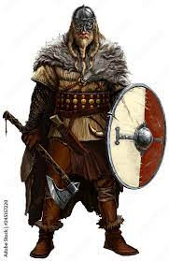



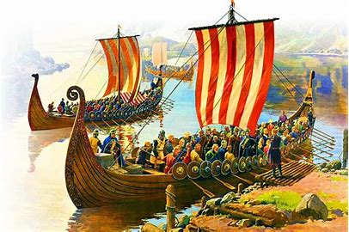


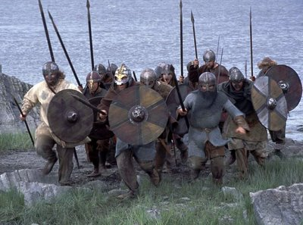
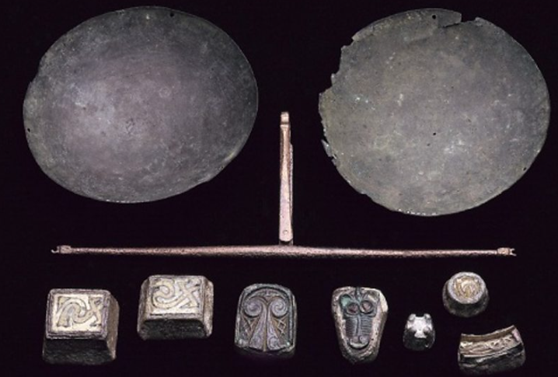
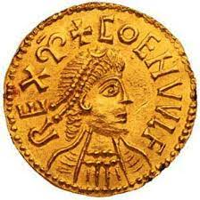
Sticky knowledge
Year group: 5 | Topic: The Viking struggle for the Kingdom of England | Term: 1
Key vocabulary and definitions:
Hostile – Having or showing unfriendly feelings. Status - a position of power or rank. Armour – a metal covering to protect the body in battle Invasion – the movement of an army into a region, usually in a hostile attack that is part of a war or conflict Warriors- a person experienced at war Society- a group of people who lived in a community and share the same culture King- the most powerful person in the land Jarls- ich land owners Karls- Everyday people such like farmers and craft workers Thralls- enslaved people who were the bottom of society
Key Dates:
AD793 The Vikings invaded Lindisfarne.
AD410 the Romans left England the Anglo-Saxons came into power.
AD801 – AD900 Battles with the Vikings before peace was found.
AD871 the Vikings fought with King Alfred’s army.
AD954 Vikings left England.
AD899 King Alfred dies from poor health conditions.
Substantive knowledge:
The Viking age was from about AD700-1100. They came from Scandinavia and travelled in longboat to other countries like Britain and Ireland. The Vikings wanted to invade Britain because they were looking for lucrative items to steal and trade. King Alfred of Wessex (Alfred The Great) fought and defeated the Vikings. He reigned from rom 886 until 899. Viking warriors were fierce. They raided and attacked other societies across Europe. Viking society was organised into the King, Jarls, Karls and Thralls. Vikings wore layers of clothes to protect them from the elements in the colder months. Women wore dresses whilst men wore tunics with over garments which were made from thick and hardwearing material. They wore lots of different colours and patterns which related to their status and power. Warriors were not afraid of dying as they believed they would go to Valhalla (Viking Heaven). Viking children helped at home with cooking, weaving and spinning, working in fields, workshops metal working and woodworking. Viking children were seen as adults when they were 10 years old. They had to work as hard as any adult and would be punished as adults if they stole or broke the law. Vikings were famers, handmen, carpenters, blacksmiths, animal doctors and bone-carvers. By the middle of the Viking age blacksmiths were making weapons and armour. They diversified into jewellery making, carpenters, bead makers, potters, weavers, slave traders and amber dealers. Many Vikings worked as farmers. Everything had to be done by hand on a Viking farm, so life was tough The Vikings bought goods and materials such as silver, silk, spices, wine, jewellery, glass and pottery. They sold items like honey, tin, wheat, wool, wood, iron, fur, leather, fish and walrus ivory. They used scales to weigh coins and get a fair deal.

Slide 3
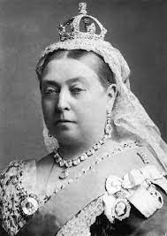
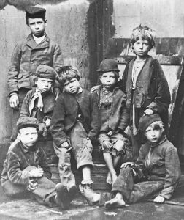


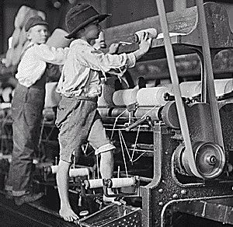




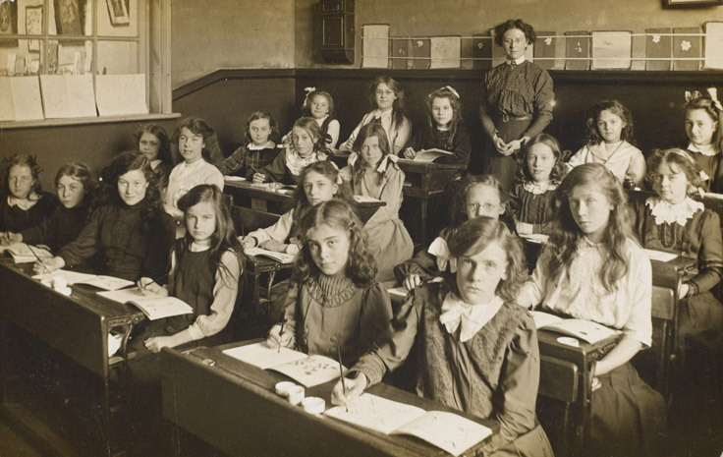

Sticky knowledge
Year group: 5 | Topic: Victorians | Term:2
Key vocabulary and definitions:
Monarch - a sovereign head of state, especially a king, queen, or emperor. Reign - the period of rule of a monarch. Ruler – Leader of a country. Poverty - extremely poor. Workhouse - a place where poor families were sent to live/work. Vulnerable - capable of being damaged, hurt or attacked. Neglected - pay no attention and disregarded
Substantive knowledge:
The Victorian era was named after Queen Victoria because she was the main ruler of this time. Queen Victoria was the monarch of Great Britain and she reigned from 1837 – 1901 (for a total of 64 years). The Victorians were famous for inventing different thing, some of which still exist today, such as; photographs, telephone, electric bulb, petrol car, x-rays. Some families were sent to the Workhouse if they were poor, here they would be provided with food and shelter in return for their labour. The workhouses were very dangerous. The children had to work long hours and had little food and water. The children were beaten regularly and were neglected. Various Christmas traditions were invented during the Victorian era such as the Christmas tree, holidays, cards, gifts, traditional Christmas dinner, carols and crackers. Children of rich families went to school, yet children of poor families had to work to provide for their families. In school the children wrote on slates instead of paper and the school system had very cruel punishments. The Poor Law Amendment Act (1834) ensured that the children sent to the workhouse would receive basic schooling in return for their labour. Victorian children were sent out to work at a young age (5 years old) and would carry out jobs such as, chimney sweeps, domestic servants, mill workers, factory workers, farm hands, working on coal mines.
Victorian workhouse

Slide 4
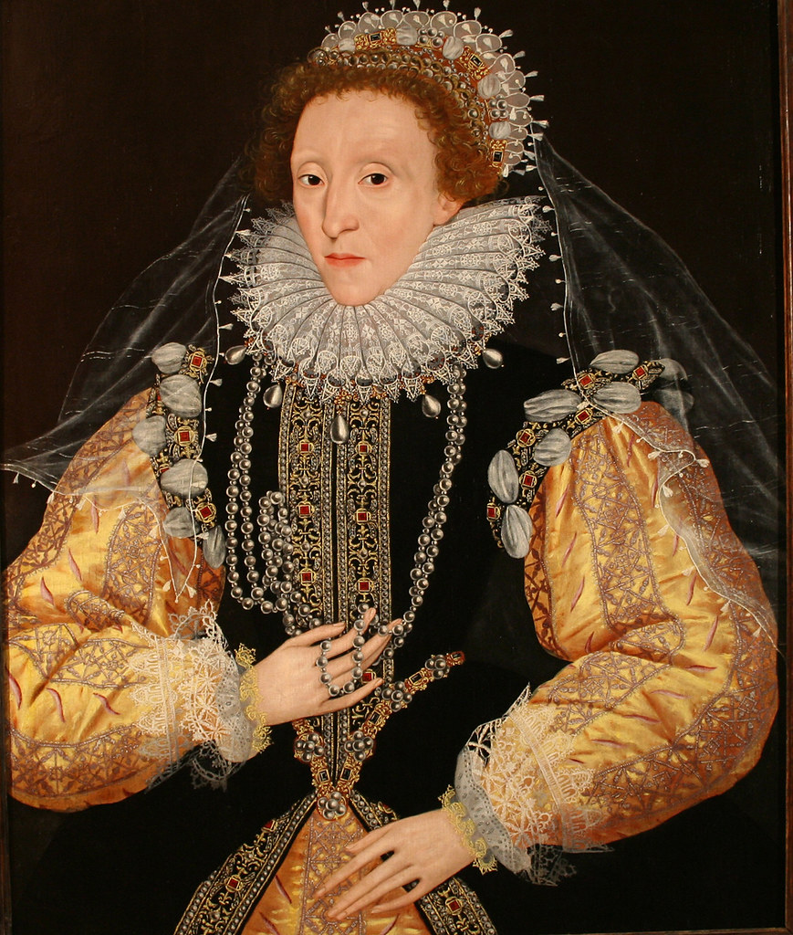


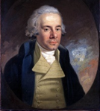

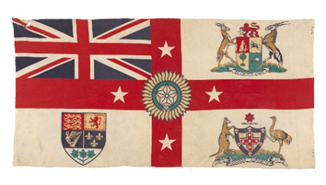

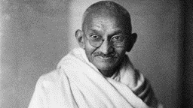
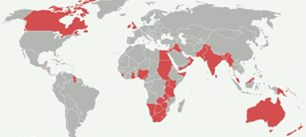
Sticky knowledge
Year group: 5 | Topic: The Rise and Fall of the British Empire | Term: 6
Key vocabulary and definitions:
Empire: A group of states or nations ruled over by a single government or monarch. Settlement: The building of a village or town in an area not lived in before. Maritime trade: The buying and selling of products around the world by ships. Rule Britannia: The idea of Britain ruling the world through the power of its navy. Industrial Revolution: The rapid development of factories and industry that saw a birth of many new technologies in Britain, principally due to the rise of the steam engine. Workshop of the world: A phrase that captures the extent to which Victorian Britain produced and sold goods all around the world. Independence: When a country is no longer controlled by an Empire and governs itself. Abolition: The act of abolishing or ending the practice of something. Commonwealth: The association of 56 countries that used to be part of the British Empire.
Substantive knowledge:
The British Empire began in the late 1500s under Queen Elizabeth I. Mahatma Gandhi led the movement for Indian independence. Gandhi believed in peaceful, non-violent protest and forced Britain to accept Indian independence without any fighting. William Wilberforce led the campaign to abolish slavery in the Empire in 1807. By 1913 the empire had grown to rule over 400 million people, making it the largest empire in history. The height of the British Empire was during the Victorian era. The Empire spread education, law, technology and the English language around the world. Australia became part of the British Empire in 1770 when it was ‘discovered’ by Captain Cook. America was part of the British Empire until 1776 when it declared independence during a war with Britain. In the 19th Century, India was the most important part of the British Empire. India became independent in 1947, when it was partitioned into India and Pakistan. British government and society benefitted economically from the empire. The people colonised by the British had British laws and customs imposed upon them, lost their ability to govern themselves and were, in many cases, violently oppressed. The Empire controlled people, often with armed force and did not treat everyone equally. For people living in the colonies, British rule often meant that their traditional languages, religions and ways of living were replaced with the English language, Christianity and British systems of government and education. English remains the official language of many ex-colonies to this day.
Queen Elizabeth I
William Wilberforce
1759-1833
Mahatma
Gandhi

