Slide 1


Year 6- History

Slide 2
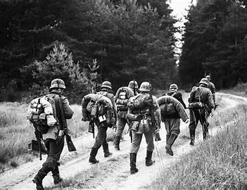
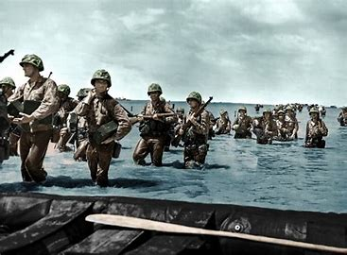

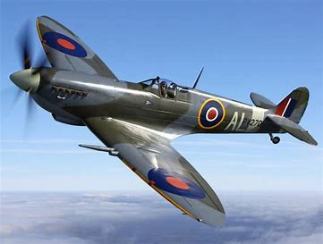


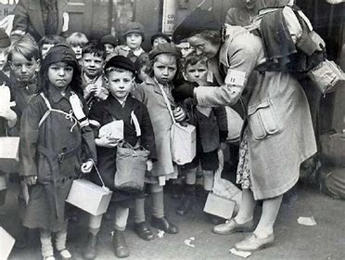

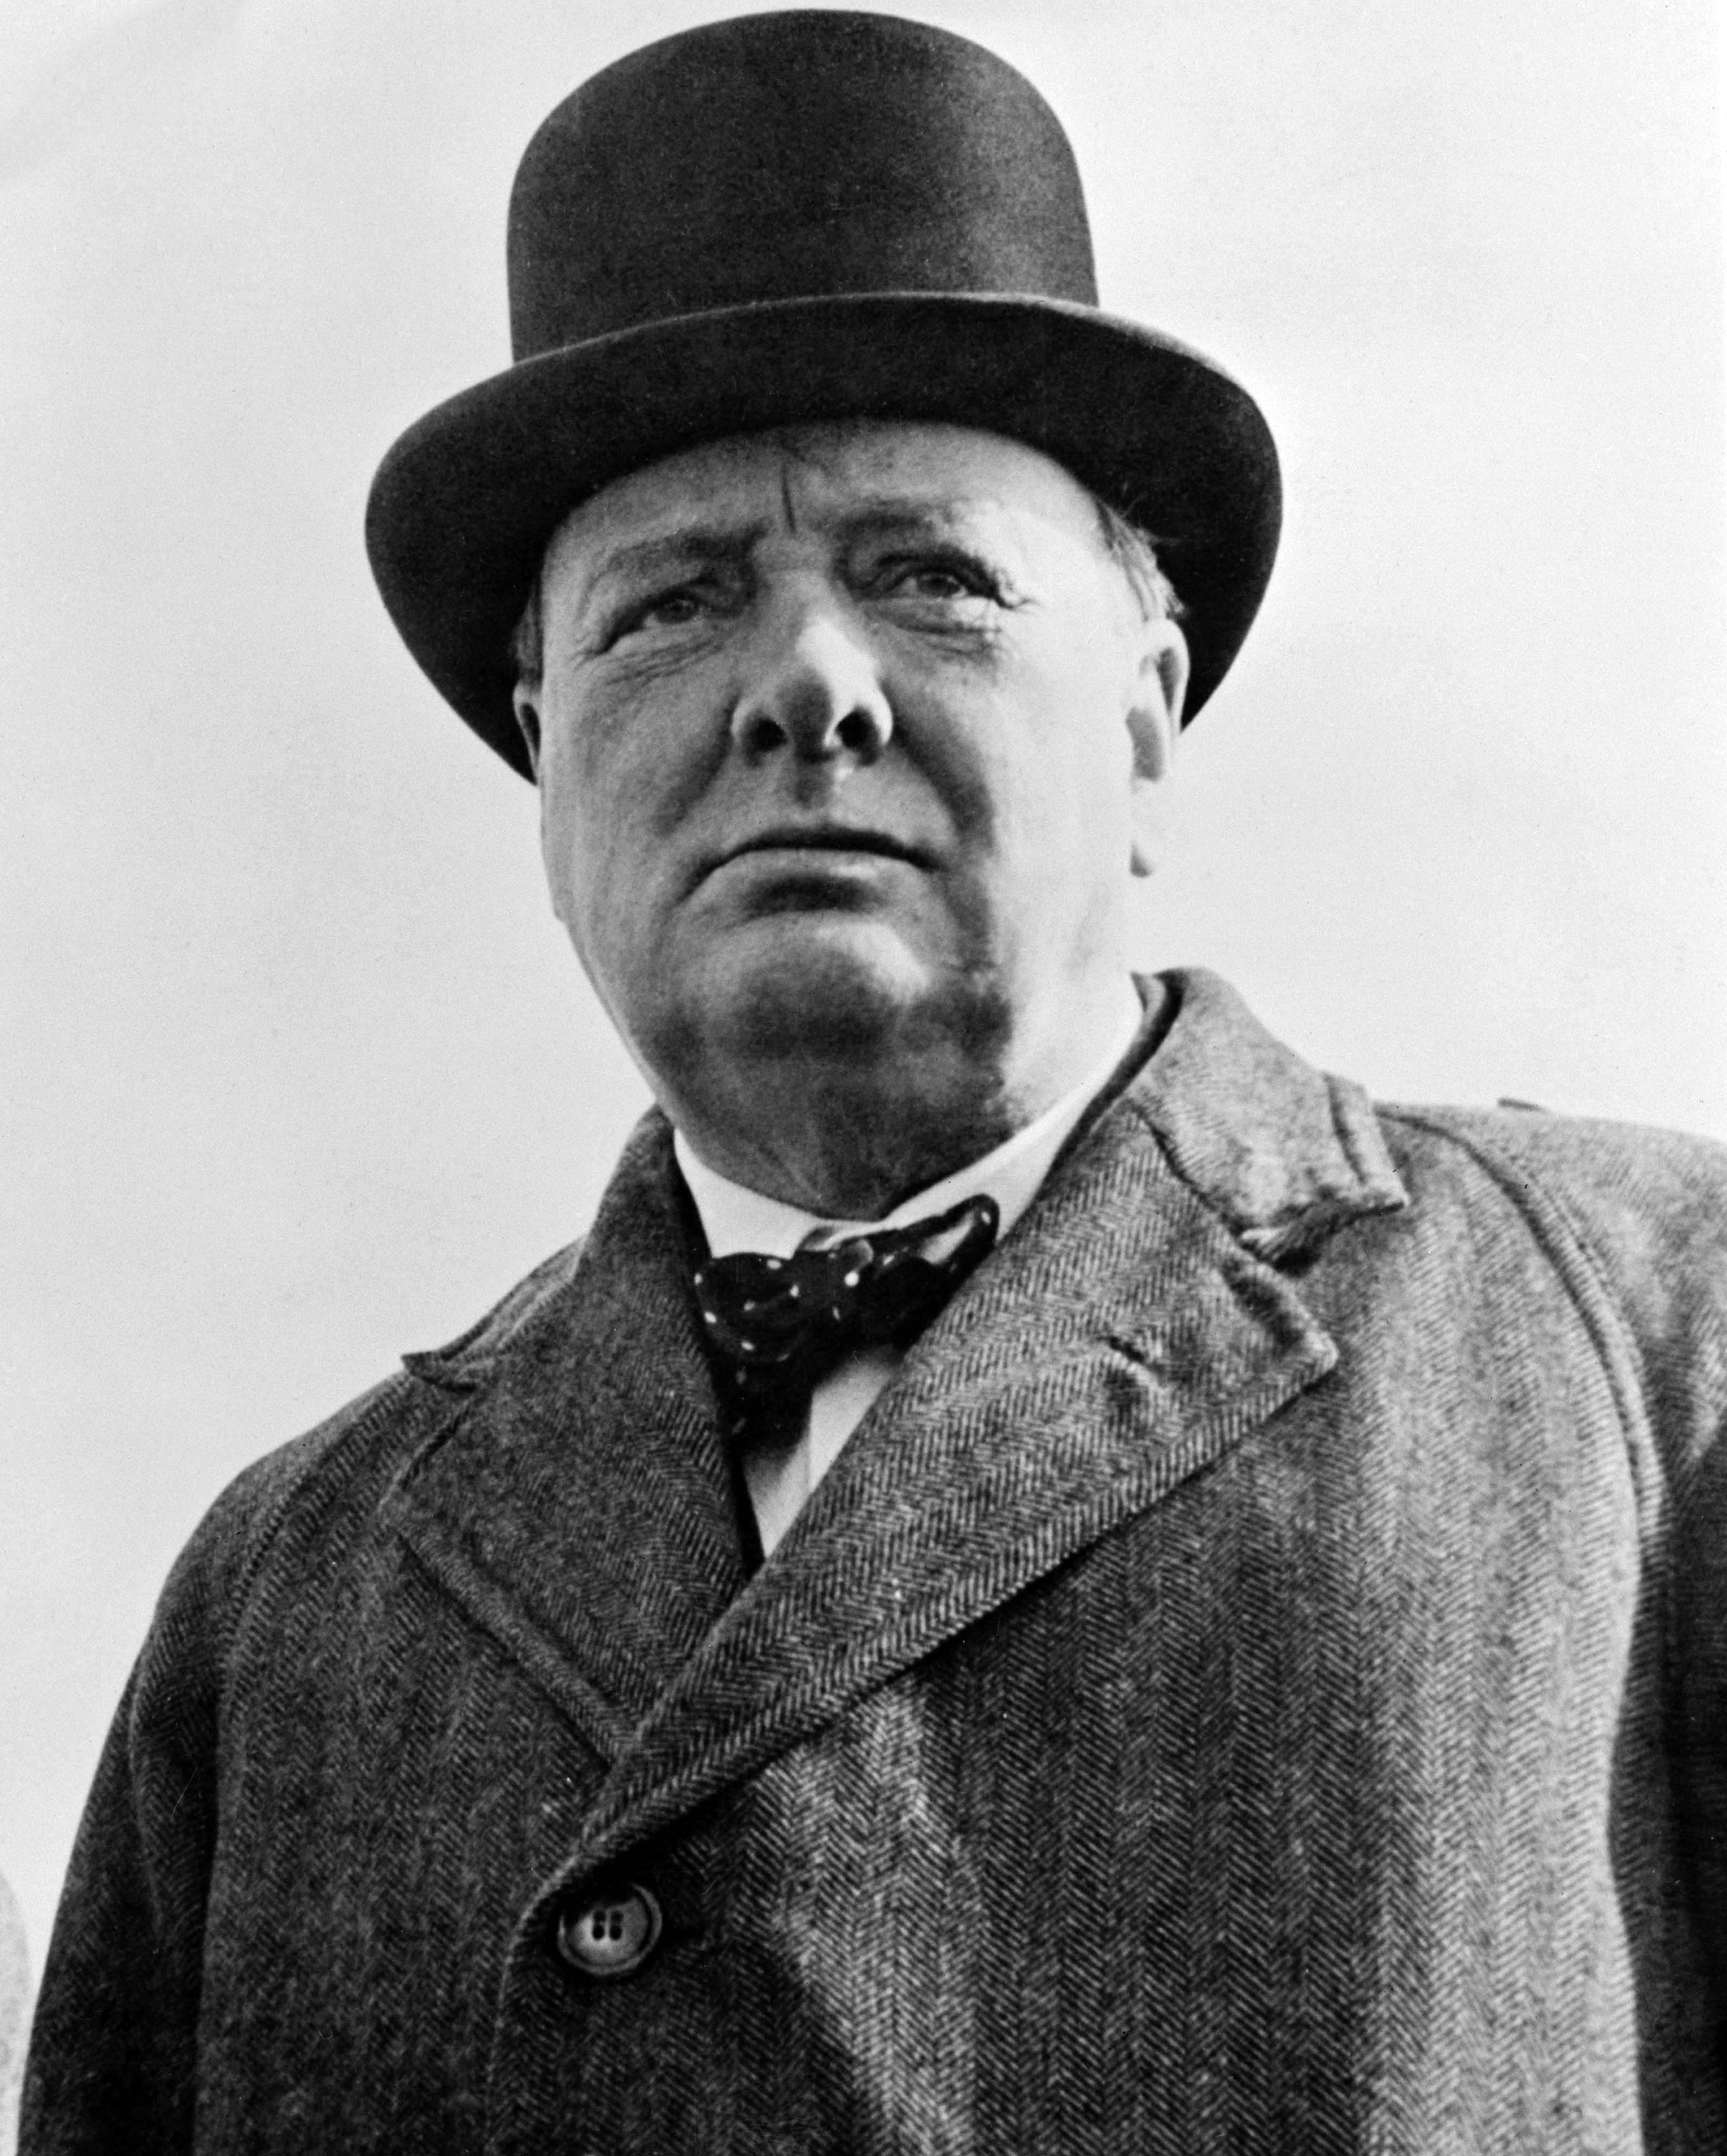

Sticky knowledge
Year group: 6 | Topic: Word War II | Term: 1
Key vocabulary and definitions:
War- state of armed conflict between different countries or groups within a country Invaded- to enter a country or region with the aim to occupy it Empire- a group of states or countries ruled by a single monarch Evacuation- the process of moving people from a dangerous place to somewhere safe Bomb shelter- an enclosed space designed to protect people from explosive weapons such as bombs or missiles Rations- a fixed amount of something officially allowed for each person during a shortage Frontline- the military line or part of an army that is closest to the enemy
Substantive knowledge:
World War II began in 1939 and ended in 1945 World War II began in Europe on Sept 1st 1939 when Germany invaded Poland. Great Britain and France responded by declaring War on Germany on Sept 3rd. German represented a threat to British security of its empire. Letting Germany dominate Europe had grave implications for British status and survival. Britain went to War to defend the balance of power and safeguard Britain's position in the world. Winston Churchill was the Prime Minster of the country during WW2 During the war, Churchill led the country in the fight against Hitler. Adolf Hitler ruled Germany from 1933 to 1945. Evacuation of civilians during WW2 was designed to protect people, especially children from the risks of bombing in cities and moved them to areas less at risk. 1.5 million people were relocated. Some evacuees flourished in their new surroundings while others endured a miserable life. Children experienced a restricted diet due to rationing and were crammed into classrooms at school. During WW2 woman worked in factories, built ships, aeroplanes, worked as air raid wardens, nurses, fire officers and evacuation officers. Soldiers working in the trenches had a difficult and dangerous role through the risk of disease and shellfire.
Winston Churchill
UK Prime Minister

Slide 3
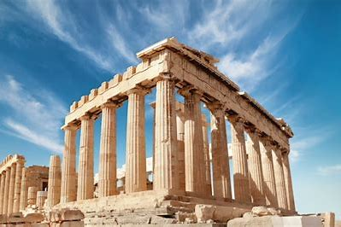


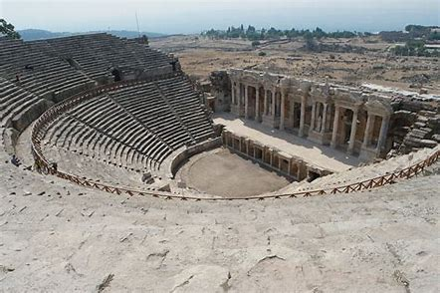

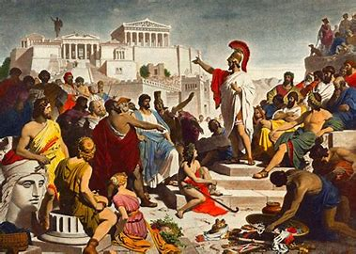


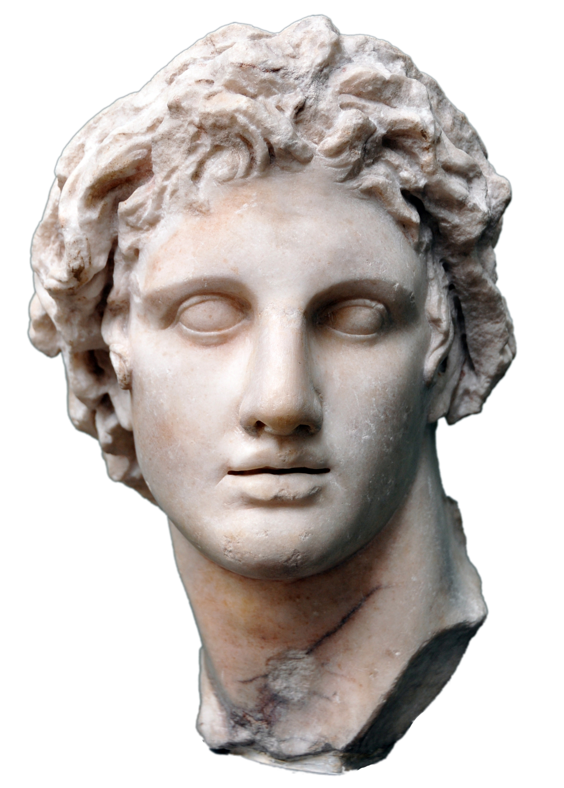

Sticky knowledge
Year group: 6 | Topic: Ancient Greece | Term: 3
Key vocabulary and definitions:
Society- the groups of people that share the same laws, rights, resources and live under the same flag Architecture- the science and art of designing buildings Kingdom- a country whose ruler is a king or queen Military campaigns- a connected series of operations designed to bring about a particular result Empire – a group of territories ruled by one single ruler or state Democracy- a government run by the people. Each citizen has a say about how the government is run
Substantive knowledge:
Alexander the Great was a king of the ancient Greek Kingdom of Macedon. He became king in 336 BC at the age of 20. He led his army to take over Greece, Persia, Egypt and even part of India. He ruled so much of the world they called him ‘Alexander the Great’. Wherever he went, Alexander took Greek ideas. Alexander the Great spent most of his time as a ruler conducting military campaigns through Western Asia and Egypt By the age of 30 he had created one of the largest empires in history. He was undefeated in battle Democracy is one of the most famous legacies of Ancient Greeks Greek architecture is known for tall columns, intricate detail, symmetry, harmony and balance – Doric Order, Iconic Order and Corinthian order Ancient Greece architecture is best known for its temples- including the temple of Zeus , Hera and Parthenon In ancient Greece, athletics emerged as a way of connecting people, elevating position in society, training for combat, and earning respect. Ancient Greece introduced contests including long jump, Diskos and javelin throwing, wrestling, boxing, horse raced and chariot races. Ancient Greek religion was based on the belief that there were 13 gods and goddesses that ruled the universe in Greece.
Alexander the
Great

