Slide 1


Year 2 Geography

Slide 2
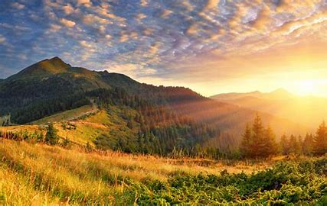
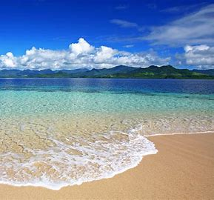


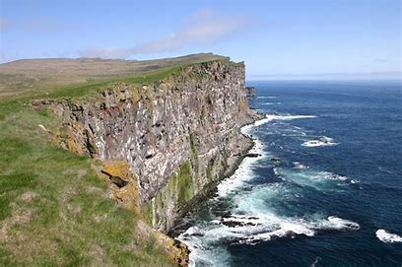
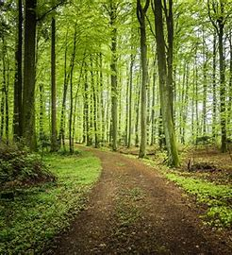


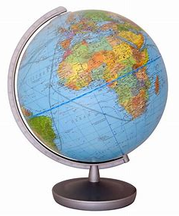
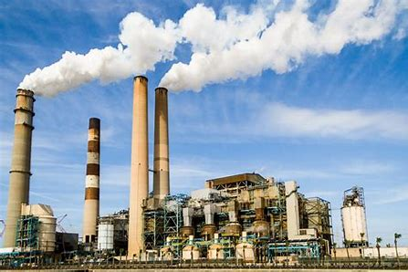
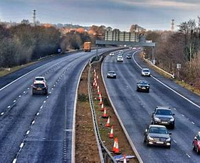
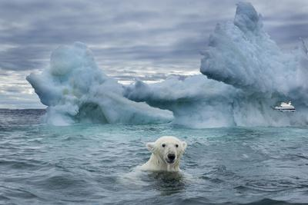

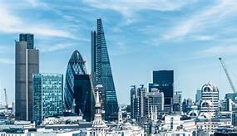
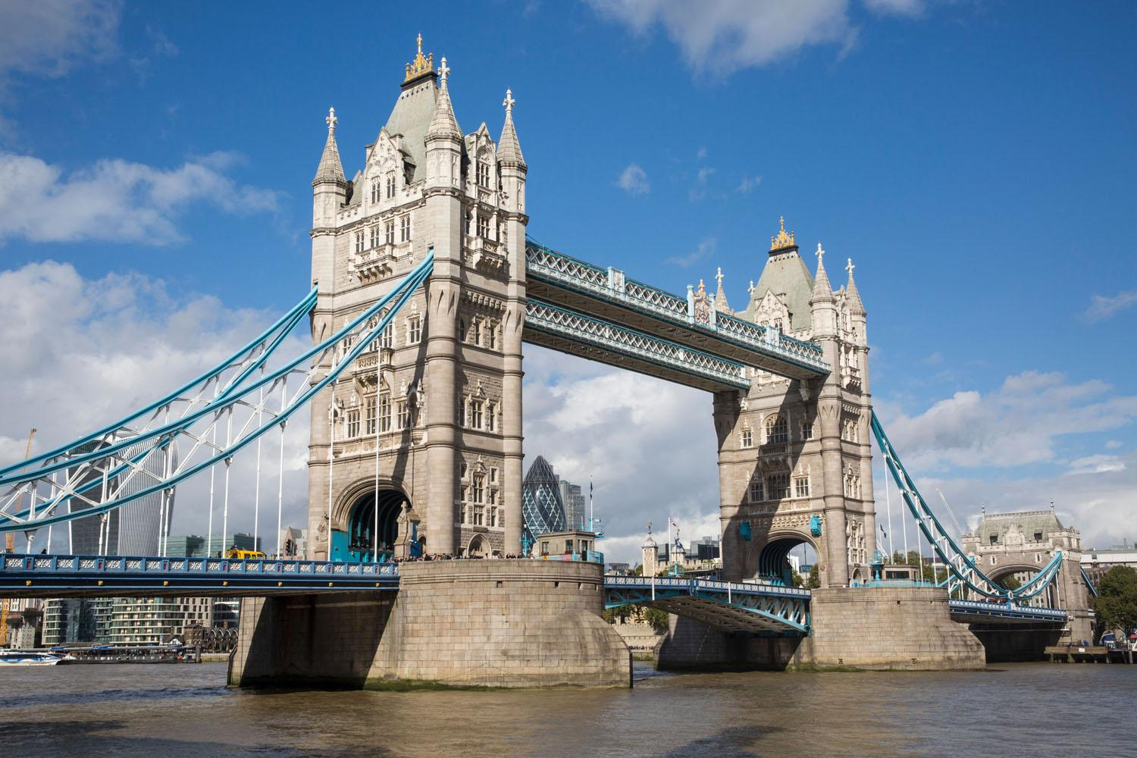
Sticky knowledge
Year group:2 | Topic: Human and physical features. | Term: 1
Key vocabulary and definitions:
Human feature: things that are made or built by humans Physical feature: natural features of the environment Landscape: the features of an area of land. Town: a place with many buildings such as shops and houses, where people live and work. City: a very large settlement with many human features. Ocean: a very large area of sea. Sea: a large amount of salty water. Arctic: the region around the North pole Antarctica: the region around the South pole Equator: imaginary line around the middle of the earth. Global warming: the gradual increase of the earth’s temperature.
Physical features
Substantive knowledge and geographical concepts:
Physical features would be here even if there were no people around- they include the seas, mountains, cliffs, forests and rivers. Human features have been built by people- they include buildings, bridges, roads, stadiums, shops and ports. Landscapes are made up of both physical and human features which together shape the way people live and interact with their environment. Antarctica and the Arctic are the coldest places on earth as they are furthest from the Equator- these can be located on a globe. The Equator is an invisible line around the centre of the earth. Due to global warming, the Earth is warming up meaning that the ice is melting in the Antarctic and Arctic. Our world has been getting hotter due to things humans are doing, like the way we make energy, farm and cut down trees. This is dangerous for humans, wildlife and the planet.
natural
Human features
Man-made

Slide 3
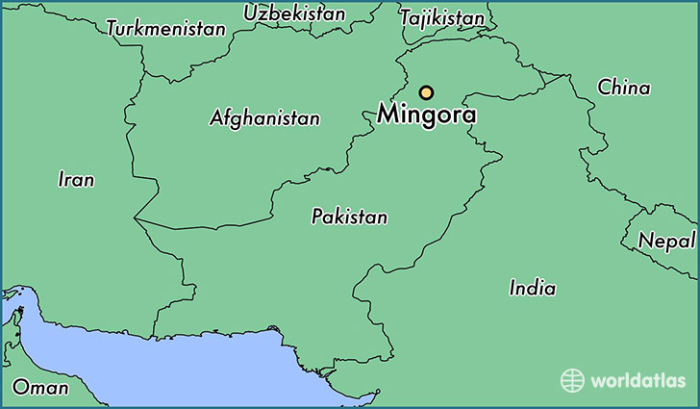
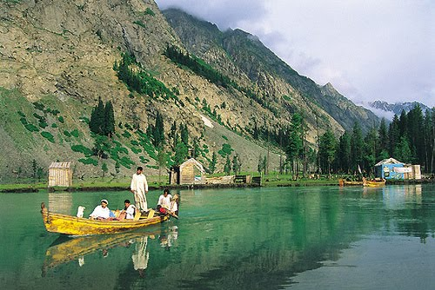
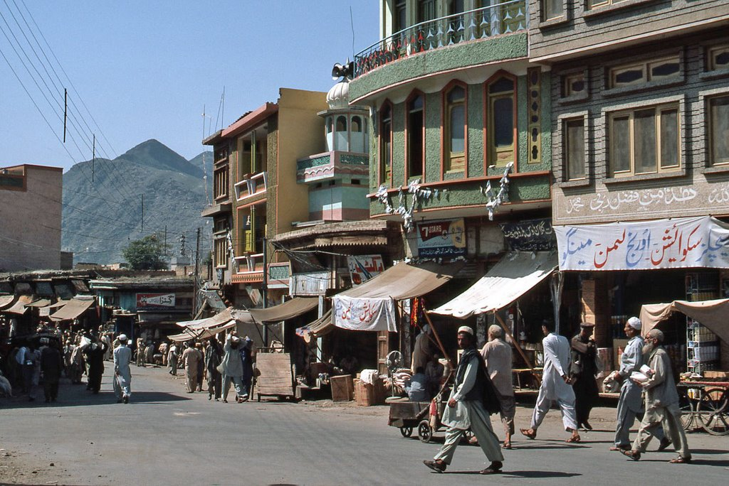



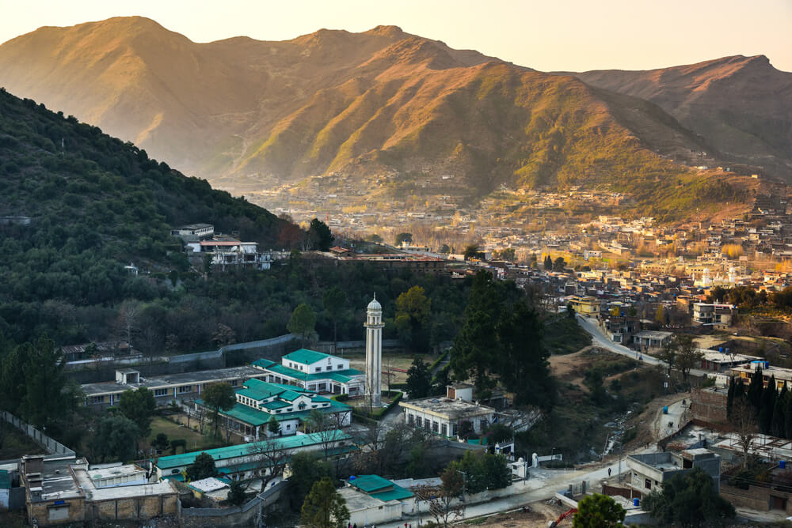
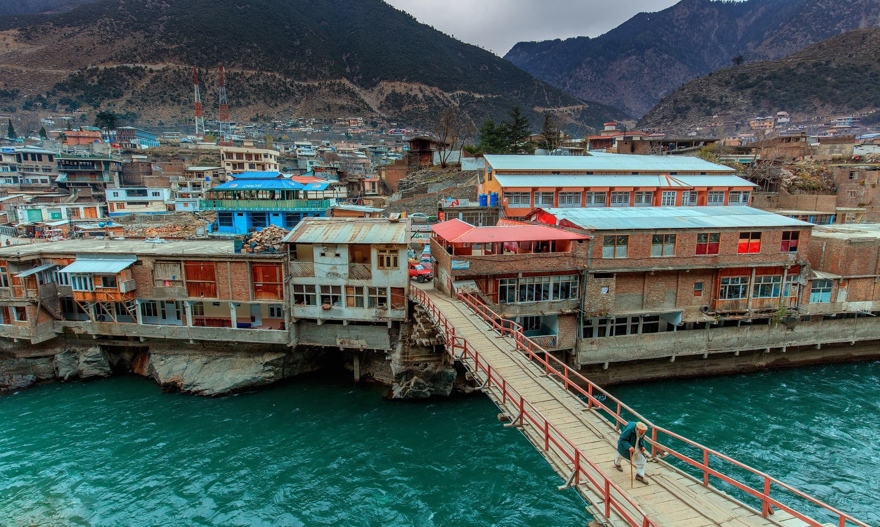
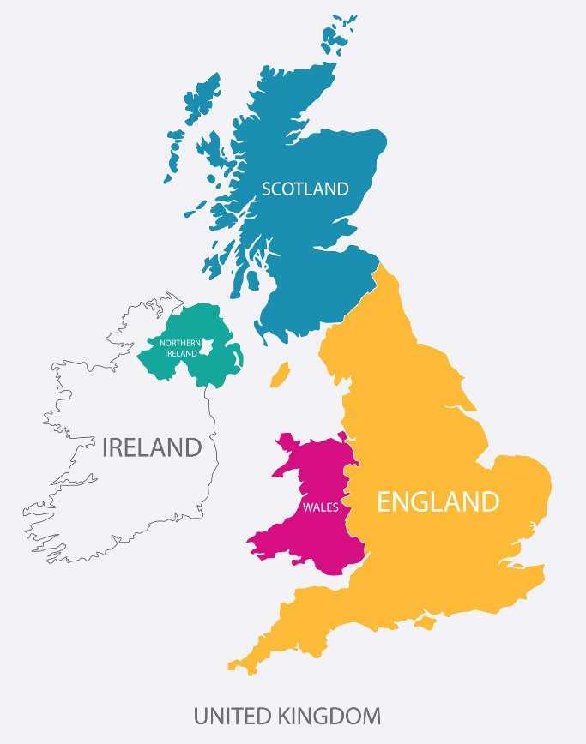
Sticky knowledge
Year group: 2 | Topic: Marvelous Mingora | Term: 3
Key vocabulary and definitions:
Continents: A continuous mass of land Ocean: A continuous body of water Country: an area of land controlled by its own government Location: a particular place or location City: a very large settlement Map: a representation of an area of land or sea showing physical features Features: a distinct attribute of something Human features: features built by people (houses, roads, bridges) Physical features: features that would be there even if no people were around (mountains, seas and rivers) Cultural geography: cultural values, practices, diversity. Related to human geography.
Mingora
Substantive knowledge and geographical concepts :
The countries in the UK are England, Scotland, Ireland and Wales The capital cities in UK are London (England) Edinburgh (Scotland) Cardiff (Wales) Belfast (Ireland) There are 7 continents- Africa, Antarctica, Asia, Australia/Oceania, Europe, North America, and South America There are 5 oceans: Atlantic Ocean, Pacific Ocean Indian Ocean, Southern Ocean and Arctic Ocean. Mingora is a city in Pakistan (Asia) Nottingham is a city in England (Europe) Both Nottingham and Mingora have rivers flowing through them. Nottingham is located on the River Trent while Mingora is on the Swat River. Both cities have a mix of urban and rural areas. Nottingham is a large city with surrounding countryside. Mingora is a small city surrounded by the Hindu Kush mountain range. Nottingham has a larger population than Mingora. Nottingham is located on flat terrain while Mingora is surrounded by mountains. Nottingham has a diverse population with different cultures and background. Mingora is home to Pashtun people. Malala Yousafsai is from Mingora.
Physical
Human
Nottingham

Slide 4
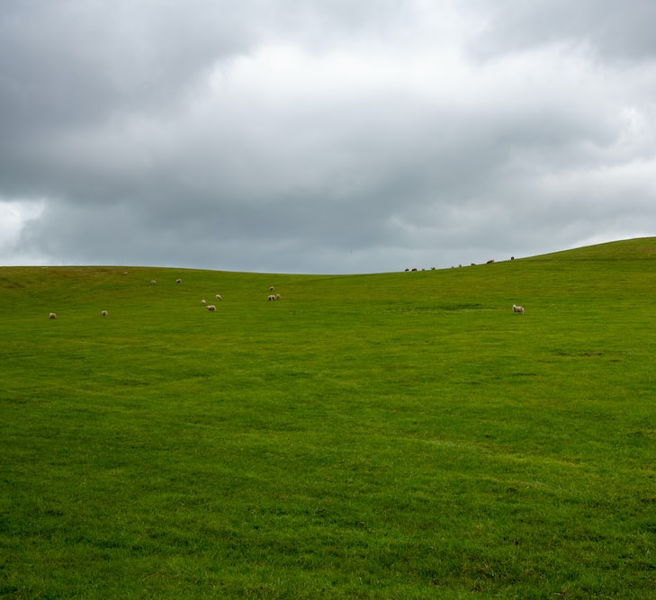
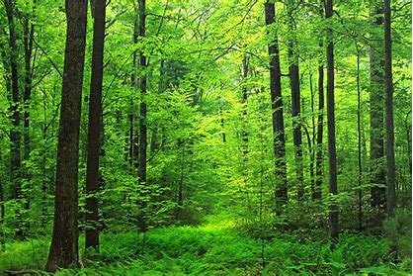
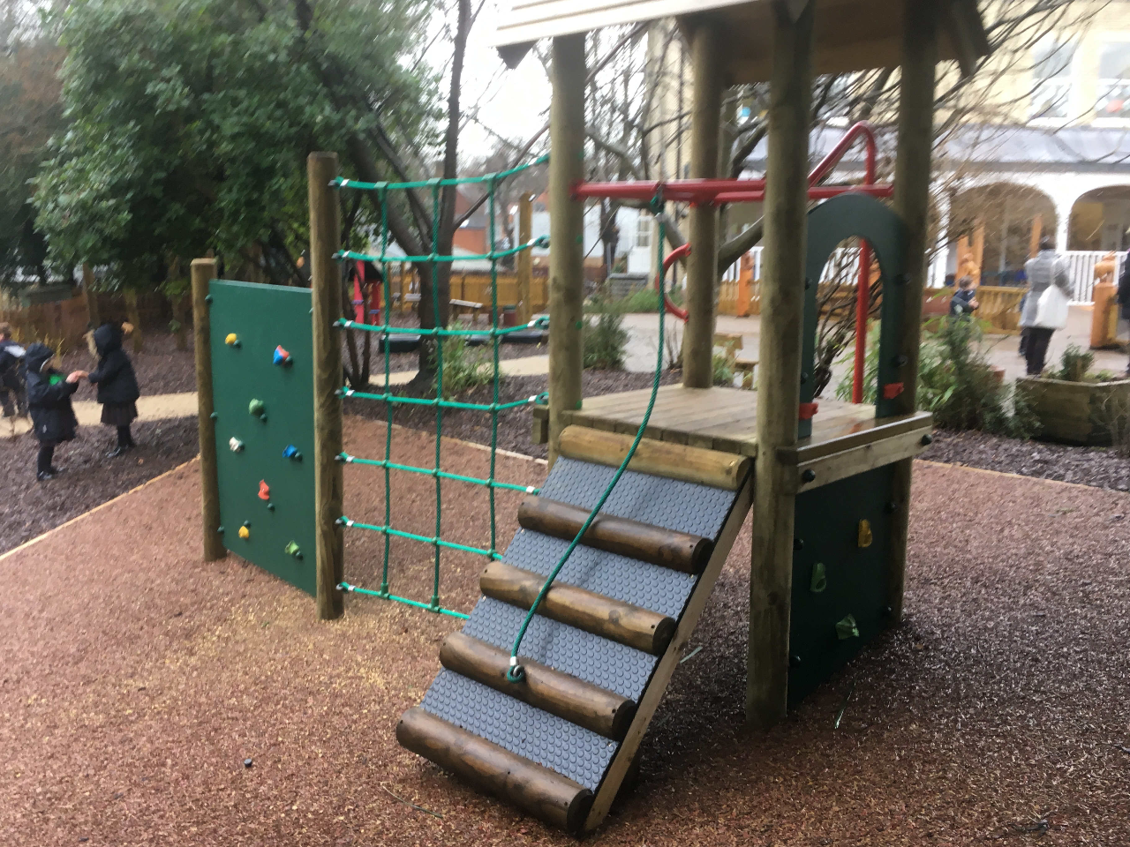
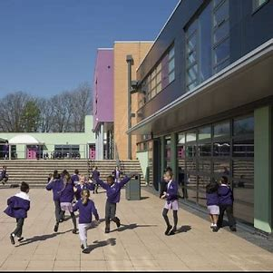
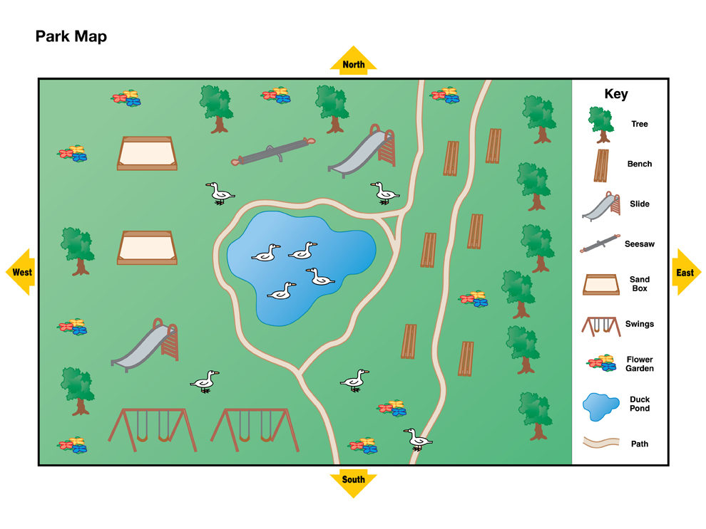
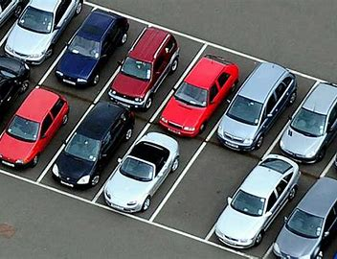
Sticky knowledge
Year group: 2 | Topic: Mega maps | Term: 5
Key vocabulary and definitions:
Map: representation of land showing physical and human features. Key: symbols to give information to find features on a map Human features: features made by people like houses, roads and bridges. Physical features: natural features like seas, mountains and rivers. Aerial view: a bird's eye view that focuses on landscapes and objects Plan perspective: viewpoint or outlook of the landscape
Substantive knowledge and geographical concepts:
Human features around the school include the building, playgrounds, paths and carpark. Physical features around the school include the field and F2 woods. Keys are used to tell you where something is on a map. An aerial view helps you see and locate places on a map. Maps help us locate physical and human features. Compass points are used to support direction.
Physical
key
Human
map

