Slide 1
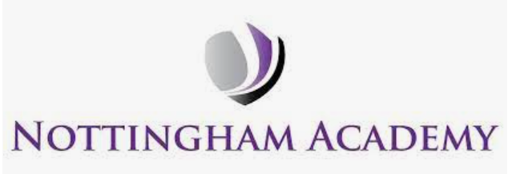

Year 1 - RE

Slide 2
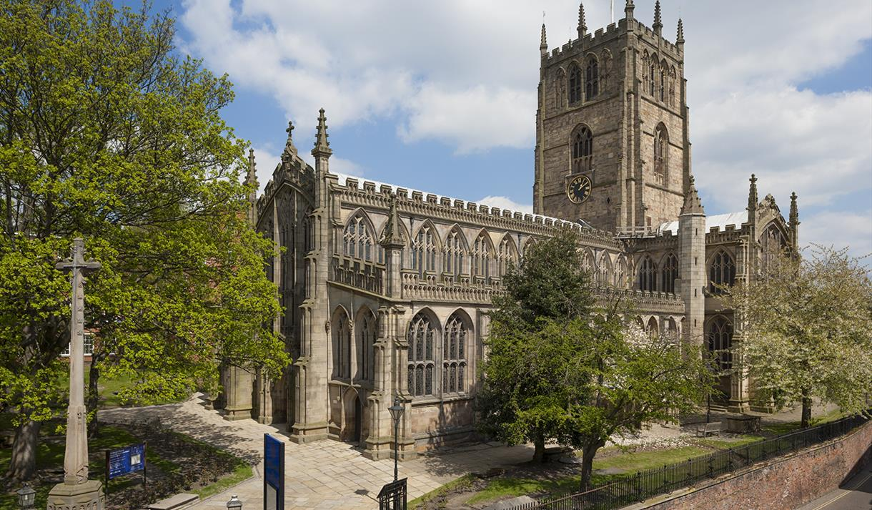
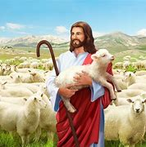
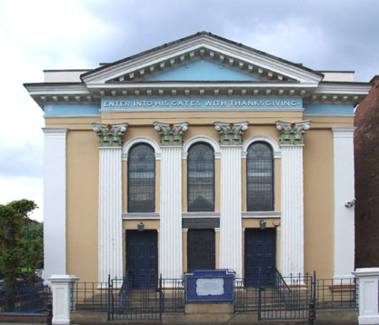
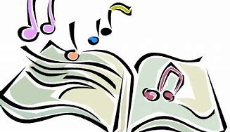
Sticky knowledge
Year group: 1 | Topic: Myself and Caring for Others How do we show we care for others? Why does it matter? | Term: 1
Key vocabulary and definitions:
Celebration - to do something special for an important event Festival - when people join together to celebrate something Religion – guide for what someone believes Christian - a person who follows the Christian religion Jewish – a person who follows the Jewish religion Hanukkah – Jewish celebration Synagogue – the building where Jews worship Church - the building where Christians worship Jesus - the son of God
Substantive knowledge:
Religion Focus: Christianity and Judaism People are unique and belong in different ways Some people belong to different religions, others not at all. Some religious stories talk about how we should behave. Different religions all have different beliefs. What happens when people are cheerful, honest, kind, thankful, fair or generous? What happens when people are unkind, ungrateful, untruthful, unfair or mean? Christians worship in a church. Jesus is the main character in many Christian stories. Jewish people worship in a Synagogue. Songs help spread important messages to others.
St Mary’s Church,
Nottingham City Centre
The lost sheep
Religious stories/songs:
Christianity: The Lost sheep Jewish Palm 23 | Judaism: The Song of David 23
Nottingham Synagogue

Slide 3
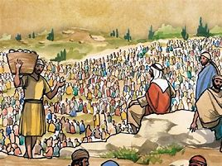
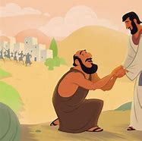
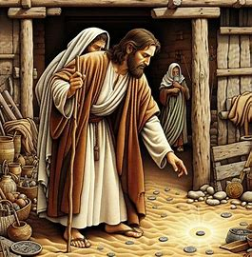
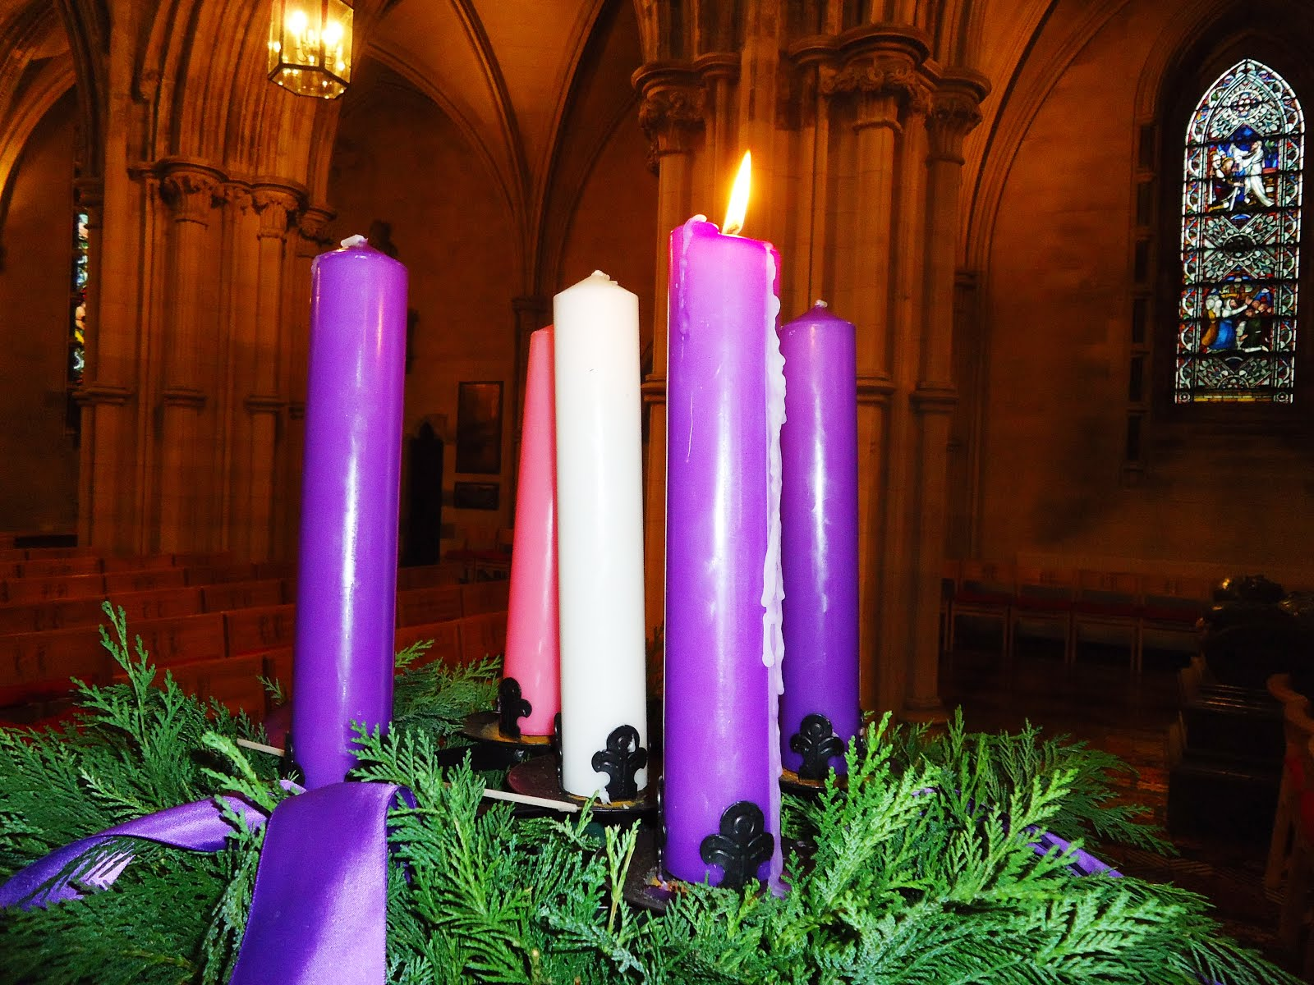
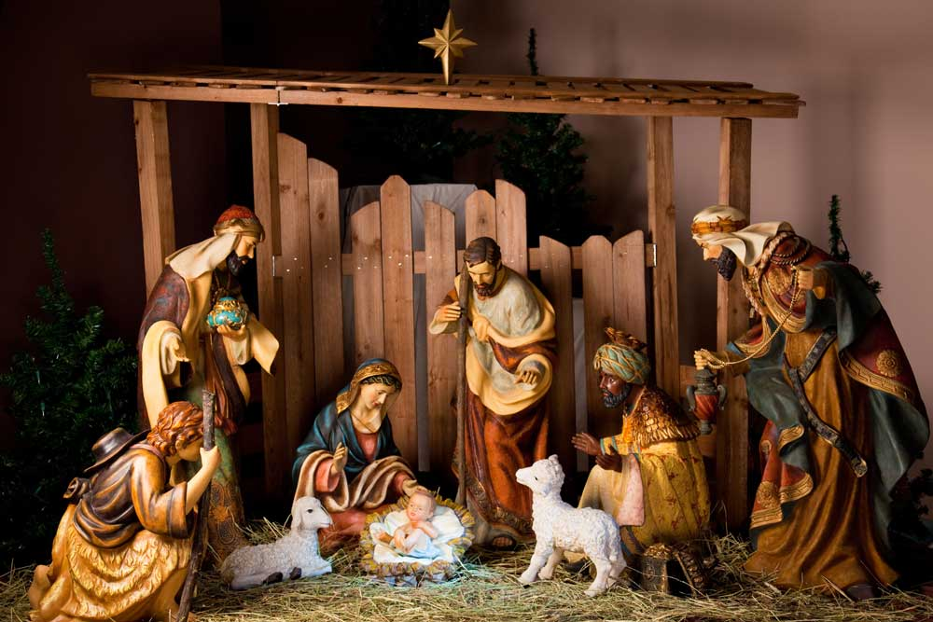
Sticky knowledge
Year group: 1 | Topic: Beliefs and Teachings What can we learn from them? How do religious stories make a difference to people’s lives? | Term: 2
Key vocabulary and definitions:
Religion – guide for what someone believes Christian - a person who follows the Christian religion Church - the building where Christians worship Symbol – something that has a meaning God – the creator of the universe Bible – Holy book of Christians
Substantive knowledge:
Religion Focus: Christianity The bible is a special book which is made up of the Old and New Testament. Christians believe that Jesus was the son of God. The bible contains many stories about Jesus. The New Testament teaches Christians about the life of Jesus. A parable is a story with a moral. Christians believe God came to earth to help people. Many of the stories tell of Jesus’ miracles. Christians believe Christmas is celebrated to remember the birth of Jesus Christ. Christmas is celebrated by people around the world, whether they are Christians or not. Advent is when Christians prepare for Jesus’ arrival. Advent traditions include wreaths, candles, calendars and making a crib scene.
Religious Stories:
Christianity: The Nativity story Healing the Blind Man Feeding the 5000 The lost coin
Feeding the 5000
Healing the blind man
The lost coin
Advent candles
in church
Nativity scene

Slide 4
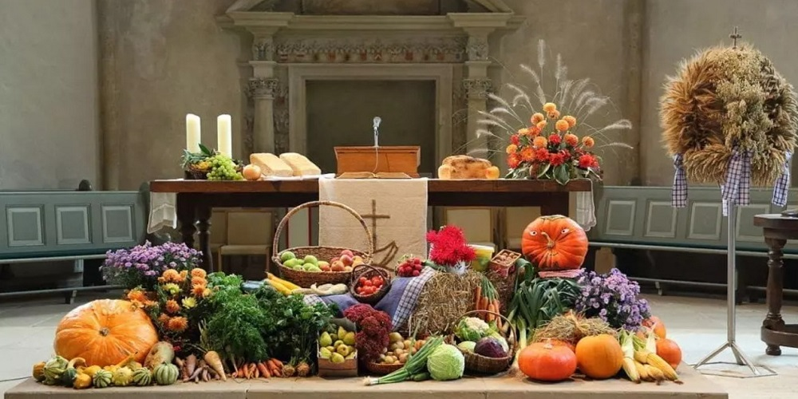
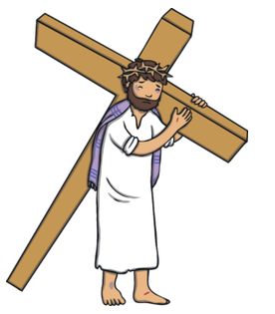
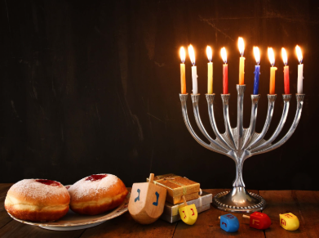
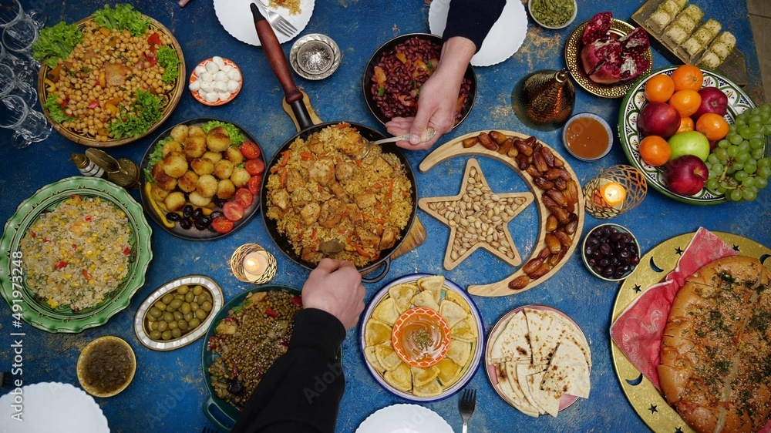
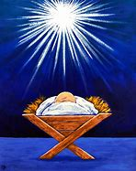
Sticky knowledge
Year group: 1 | Topic: Celebrations and Festivals Who celebrates what and why? | Term: 3&4
Key vocabulary and definitions:
Religion – guide for what someone believes Christian - a person who follows the Christian religion Church - the building where Christians worship Symbol – something that has a meaning Thankful – wanting to thank someone Faith - a belief and trust in God Belief – a feeling that someone or something exists or is true Christmas- A Christian festival celebrating the birth of Jesus Worship –giving thanks and praise to God/Gods through prayer and singing Synagogue- The building where Jewish people worship
Substantive knowledge:
Religion Focus: Christianity and Judaism A festival is a celebration where people may remember stories, have special food, give gifts and gather together. Christian and Jewish people hold weekly celebrations. Christians worship in a Church Jews worship in a Synagogue. Christians celebrate the Harvest Festival to give thanks to God for all the good things he gives them. Christian celebrations include Advent, Christmas and Easter. Easter is the most important Christian festival. The cross is an important symbol for Christians. Hanukah is an important festival which Jewish people celebrate each year. Hanukah is known as The Festival of Lights. Jews light oil lamps as part of the celebration. Other religions to explore: Islam Muslims celebrate Eid. Eid is a time to thank Allah. Muslims celebrate with prayers and a big meal.
Harvest festival
Religious stories:
Christianity: Easter Story Judaism: Story of Hanukah
The Easter
story
Hanukah
Eid
Church
Synagogue

Slide 5
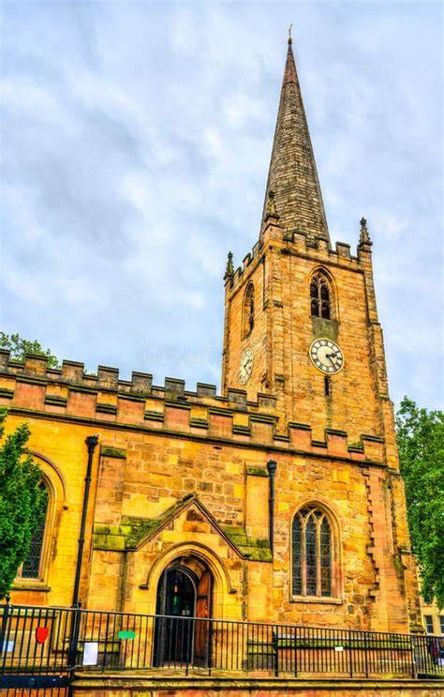
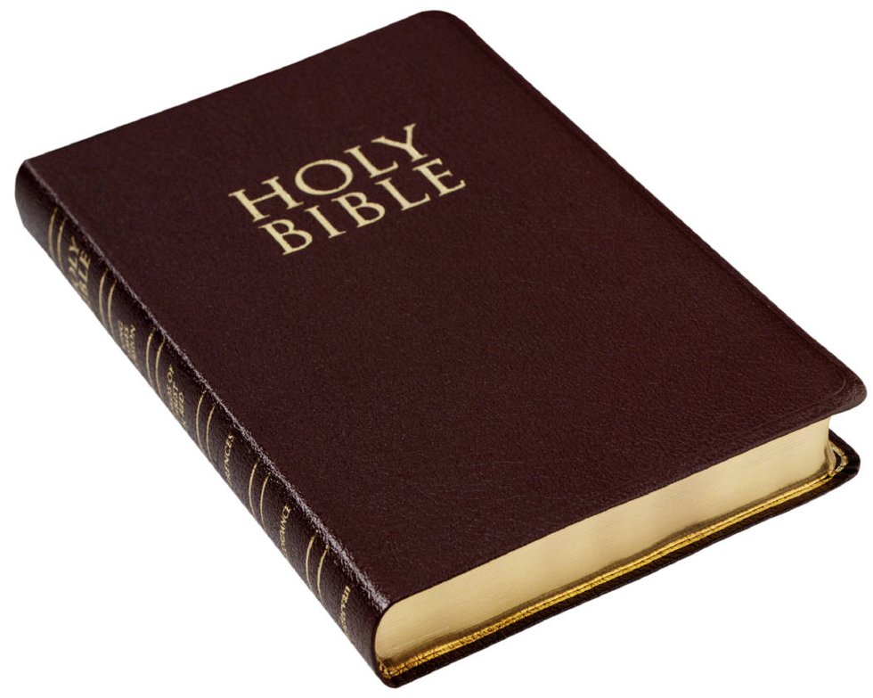
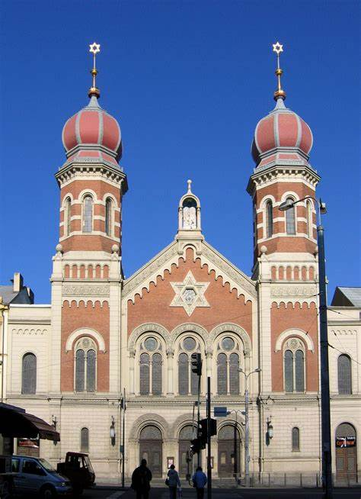
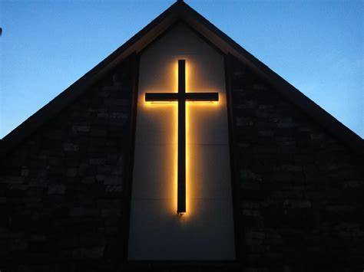
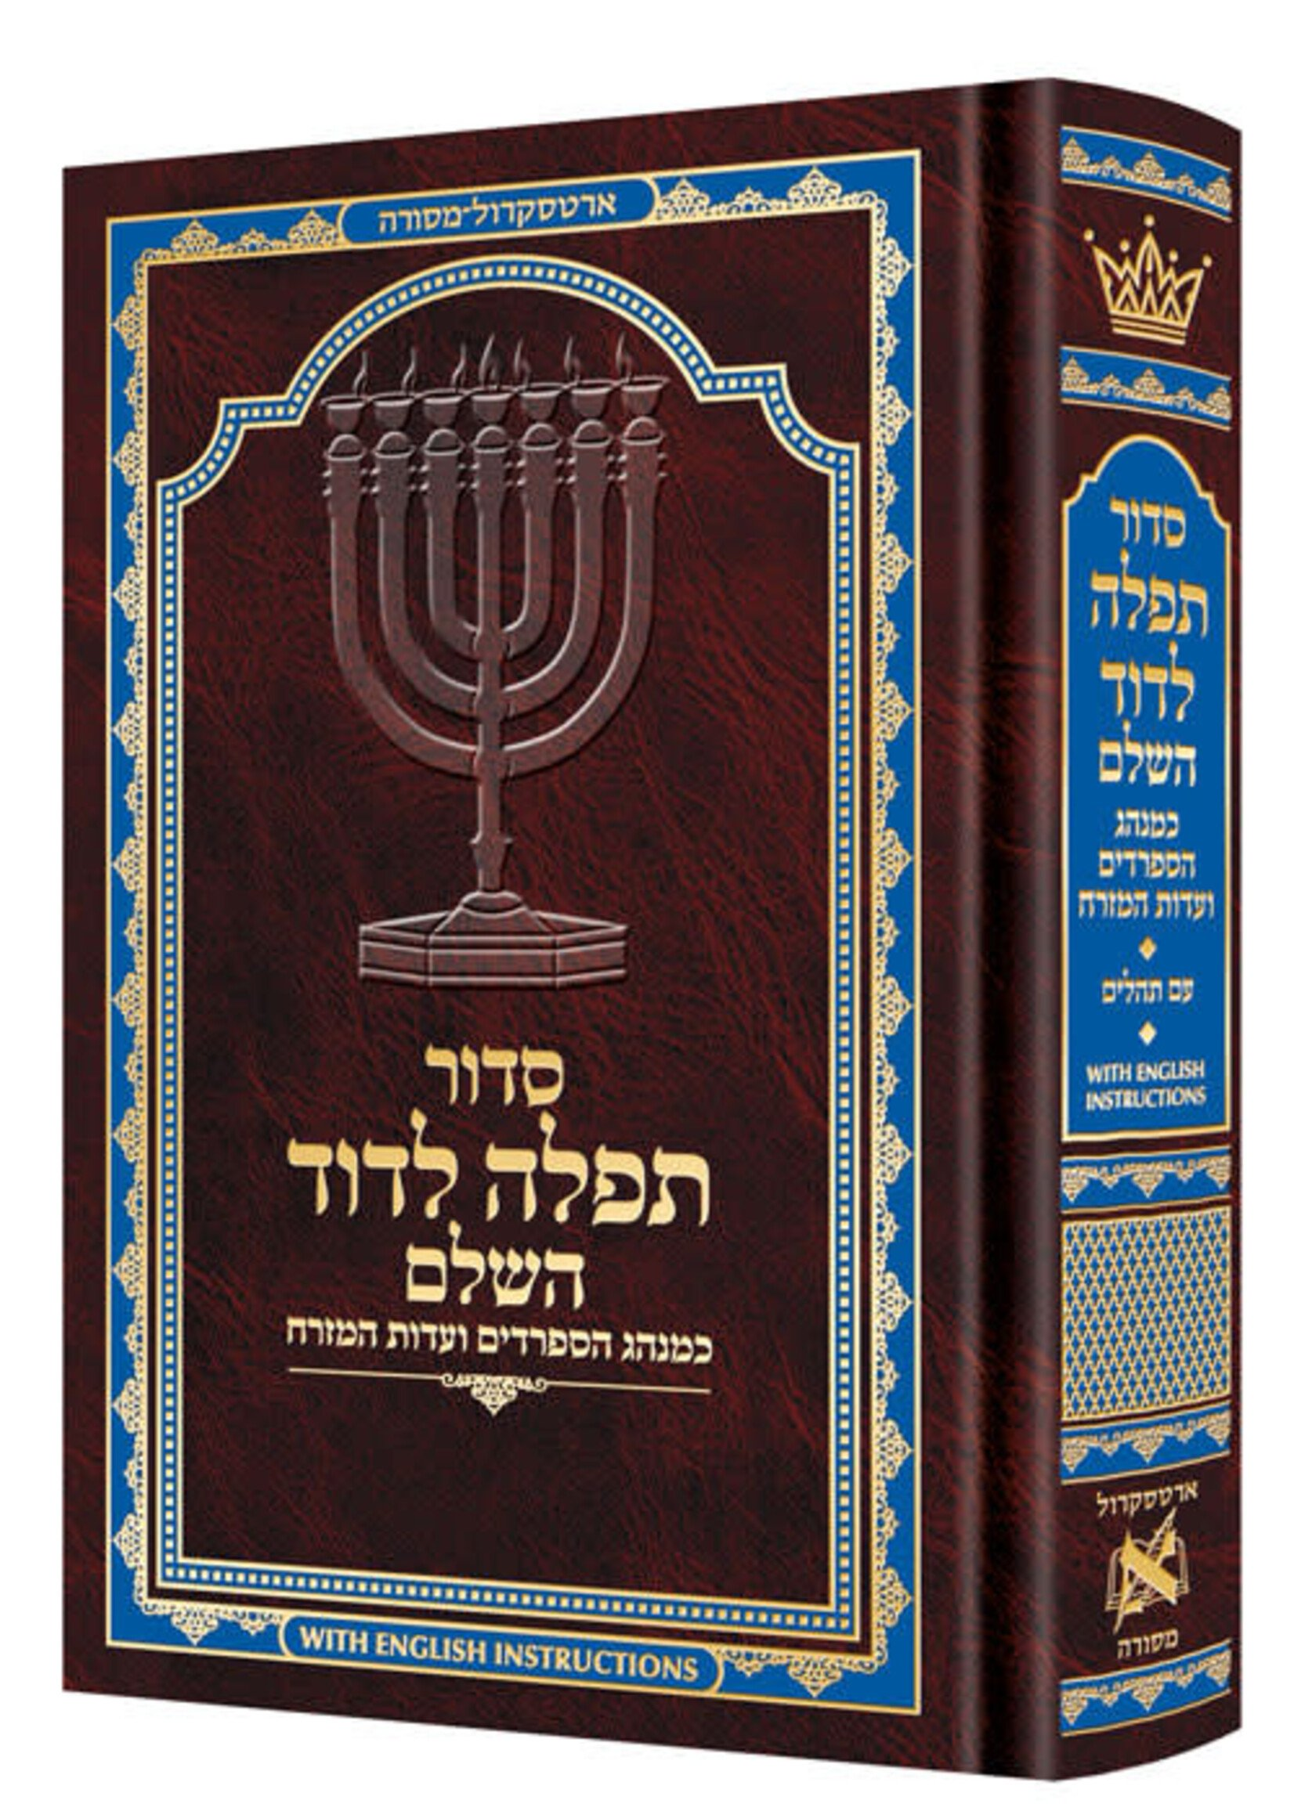
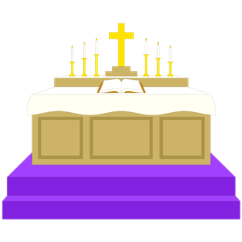
Sticky knowledge
Year group: 1 | Topic: Symbols in religious worship and practice In what ways are churches/synagogues important to believers? | Term: 5&6
Key vocabulary and definitions:
Torah – contains the words of the Jewish bible Bimah – a raised platform in the synagogue where the Torah is read Altar – a raised area in a church where people can honour God with offerings. Font – Holds sacred water Worship – Showing you follow a belief by your actions Holiness – Trying to be like God in your behaviour and actions Sacred – special religious meaning
Substantive knowledge:
Religion Focus: Christianity and Judaism The Bible is a special book used by Christians. Christians believe the Bible tells them how they should live. The church is a holy building for Christians to worship God. A cross reminds Christians that Jesus died on a cross. . Candles are lit in church to represent God’s love. The synagogue is a holy building for Jews to worship God. Men and women sit separately in a synagogue. In a synagogue, everyone must wear a hat, apart from unmarried women. The Siddur is the main prayer book. A rabbi is a spiritual leader of a synagogue. The Torah is a Jewish scroll and it is written in Hebrew. The Ark is a cupboard in which the Torah scrolls are kept. Holy buildings are often used to pray, sing, worship, learn. Weddings, baptisms and funerals are often held in holy buildings.
St Peter’s Church, Nottingham
The Bible is a holy
book read by Christians
A synagogue is where jews go to worship
A cross is symbol that reminds Christians that Jesus died on a cross
Siddur- a Jewish book of prayer

