Slide 1


Year 3 - RE

Slide 2
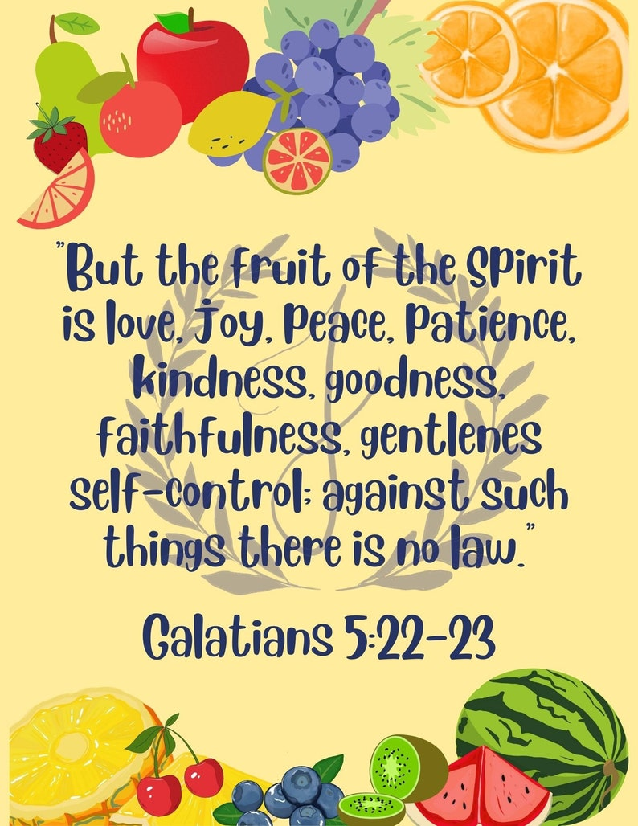
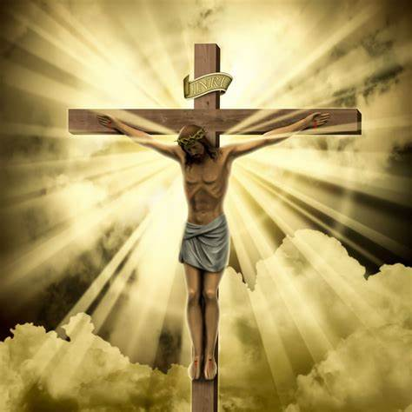
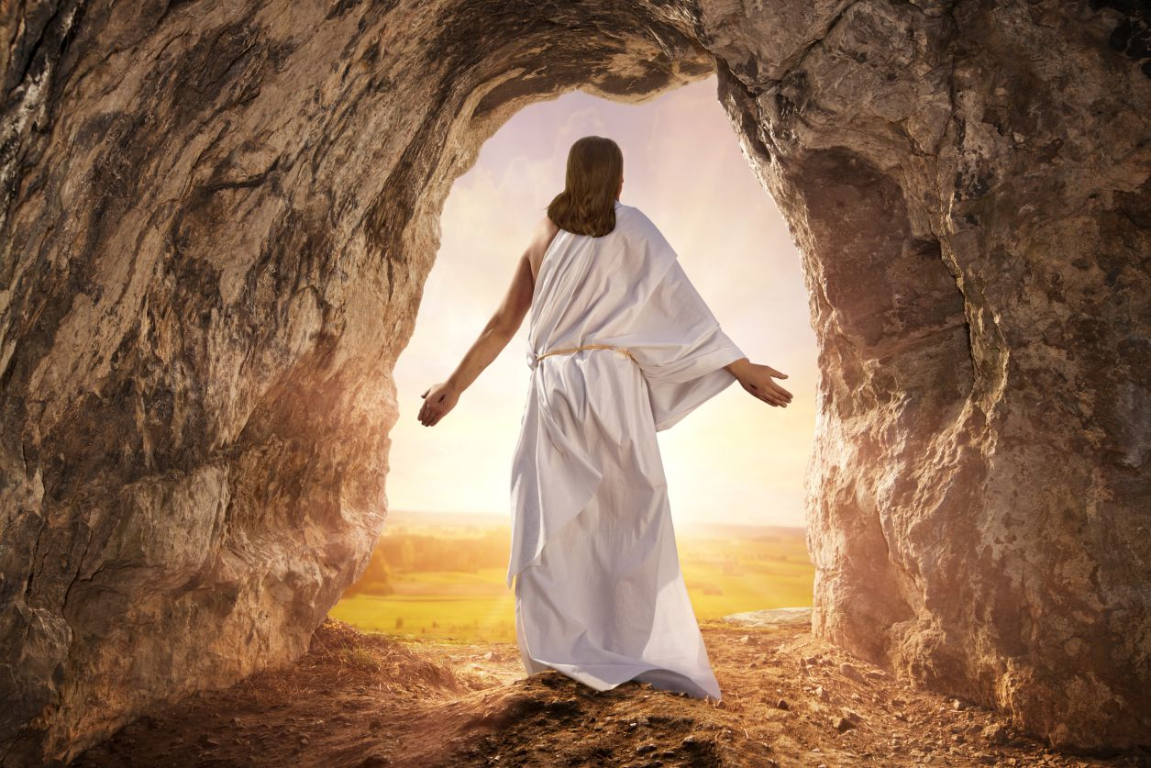
Sticky knowledge
Year group: 3 | Topic: Beliefs and questions (Christmas, Easter, Pentecost and Harvest) What difference does it make to be a Christian? How do Christian people’s beliefs about God, Jesus and the world and others have impact on their lives? | Term: 1&2
Key vocabulary and definitions:
Religion – guide for what someone believes Christian - a person who follows the Christian religion Spiritual – Believing in a spirit or soul Christmas – celebration of the birth of Jesus Easter – celebration of Jesus’ resurrection Pentecost – the birthday of the Christian church Harvest festival – saying thanks to God for all that he provides Commitment – being dedicated to something Values – the standards by which someone lives their life
Substantive knowledge:
Religion Focus: Christianity Christians believe it is still important to remember God as a creator and thank Him for the good things He provides. Many churches hold a Harvest Thanksgiving service where the community brings flowers to decorate the church building as a sign of their thanks to God. Gifts of food are taken to the needy or elderly people in the neighbourhood. Easter is important to Christians as it is a time to remember the sacrifice of God’s son for forgiveness. Pentecost is the festival when Christians celebrate the gift of the Holy Spirit. Pentecost is seen as the birthday of the Christian church. The Holy Spirit is God’s power and love inside people. Trinity means God as the Father, Son and Holy Spirit. The symbols of Pentecost include flames, wind, the breath of God and a dove. The Incarnation is the Christian belief that Jesus Christ is the God of Israel in a human body. Jesus was crucified on the cross (Good Friday) The resurrection of Jesus is the Christian belief that he returned to life by a miracle.
Religious stories:
Christianity: Creation story (Build on Y2) Jesus born in Bethlehem (Build on Y1) Bible texts linked to Pentecost Bible texts linked to Harvest (Leviticus 23:22 ) Fruit of the Spirit (Galatians 5:22)
Crucifixion
Fruits of the spirit
Resurrection

Slide 3
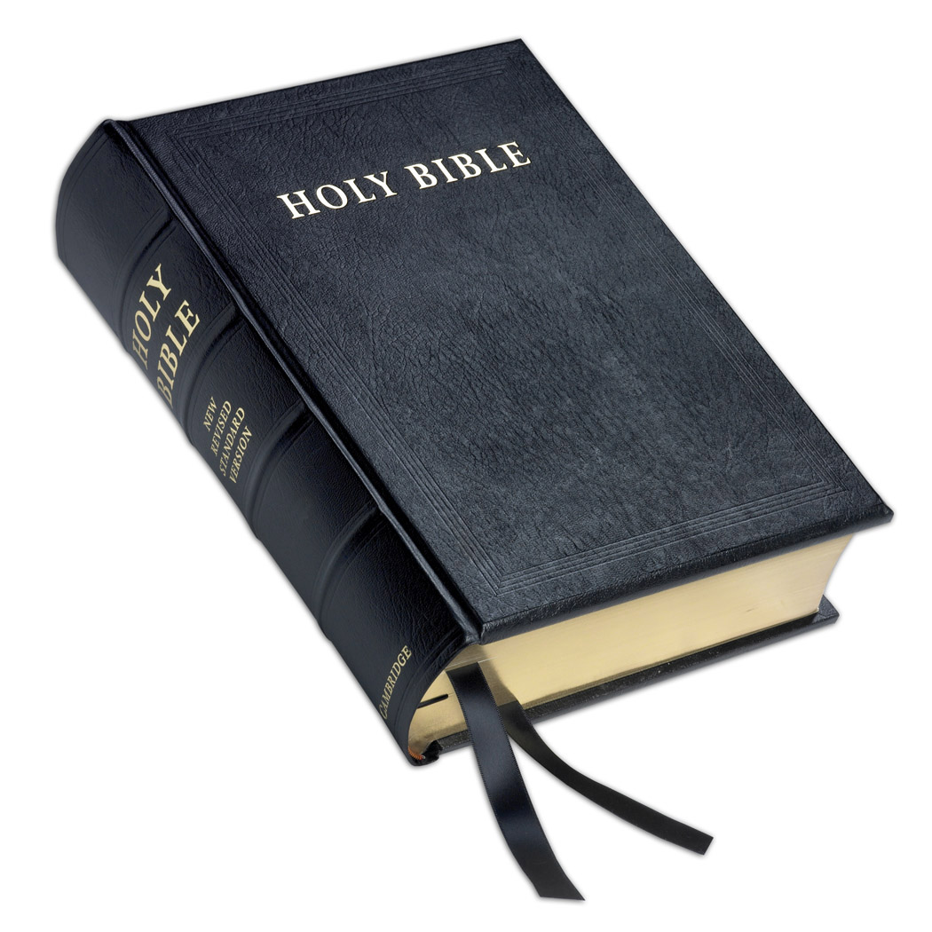
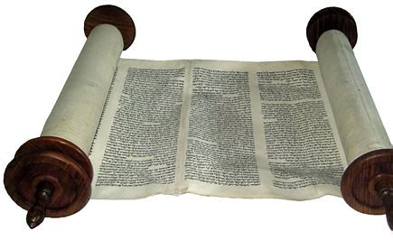
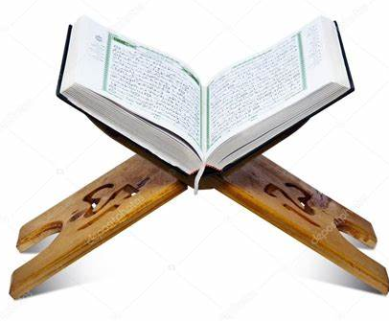
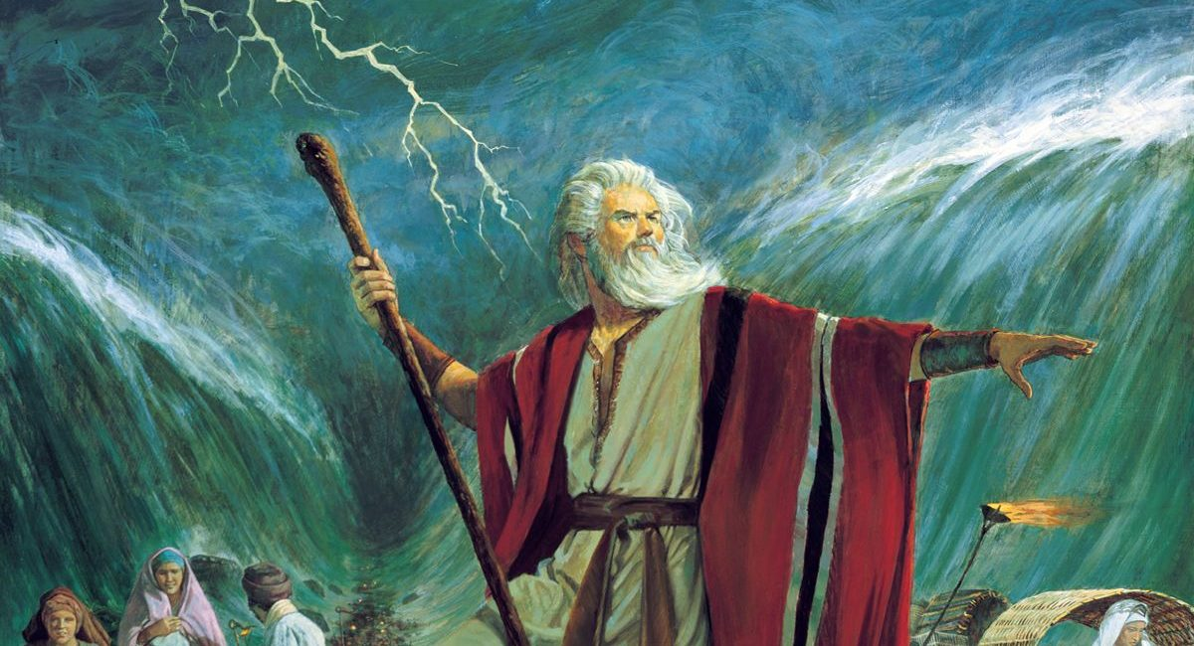
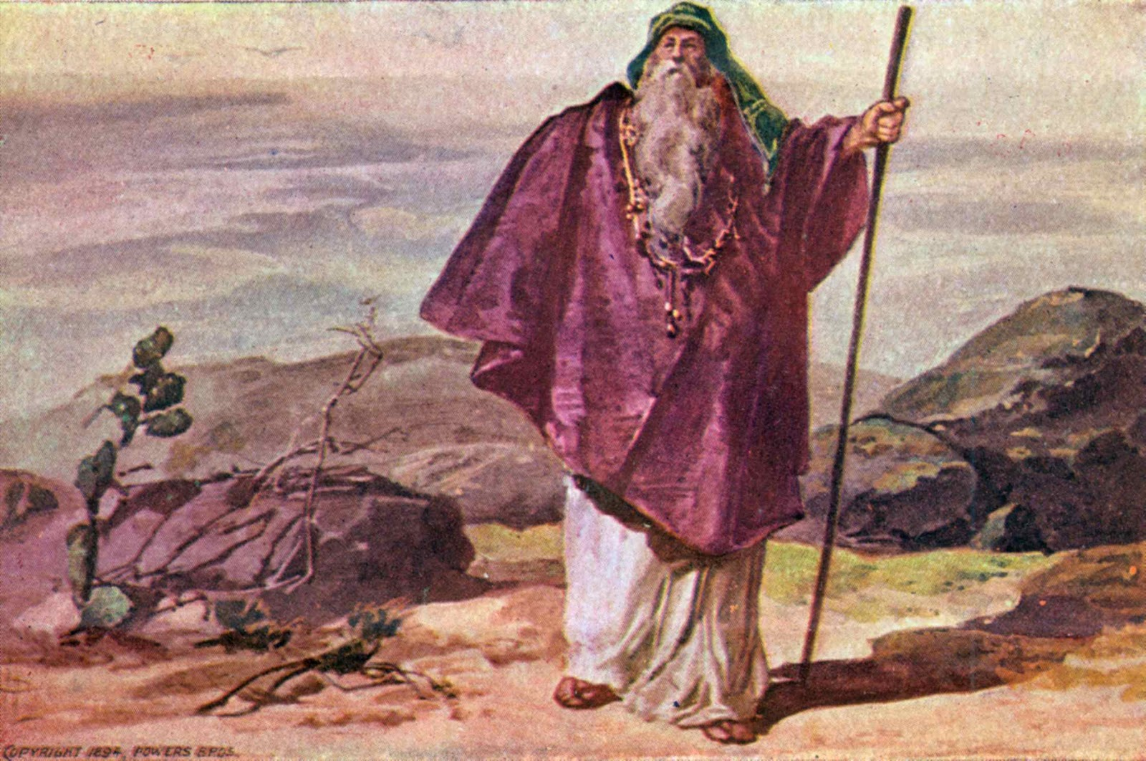
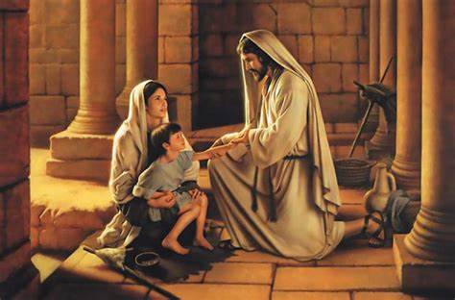
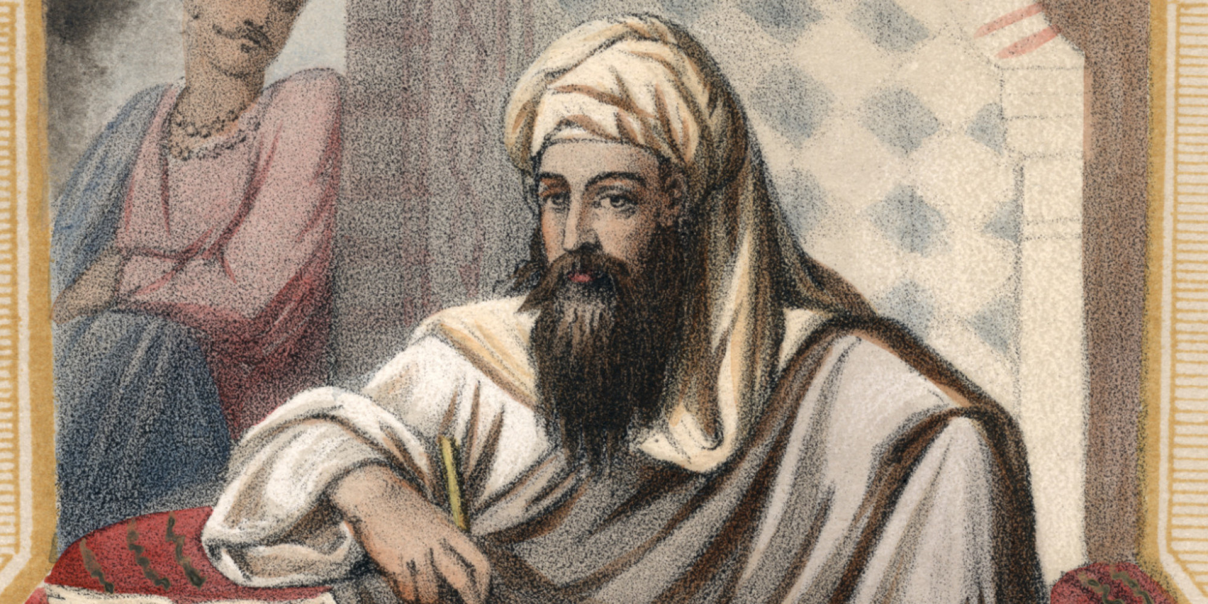
Sticky knowledge
Year group: 3 | Topic: Inspirational people from the past What can we learn from inspiring people in sacred texts and in the history of religions? | Term: 3&4
Key vocabulary and definitions:
Muslim – A follower of the religion of Islam Islam – The belief that Allah is the one true God Mosque – A place of prayer for Muslims Quran – The scared writings of Islam Prophet – A teacher of the lessons of God Spiritual – Believing in a spirit or soul Ritual – Actions that are done in a certain order for religious reasons Liturgy – a script for a religious service Prayer – Asking for help or giving thanks to God Commitment – Being dedicated to something Values - The standards by which someone lives their life Patriarch – Father or founder
Substantive knowledge:
Religion Focus: Christianity, Islam and Judaism Christians follow the teachings of Jesus, the Son of God. Jesus told parables, which were stories with a moral message. Abraham and Moses are examples of inspirational people from the Jewish and Christian Bible. The Prophet Muhammad [PBUH] is an inspirational figure within the teachings of Islam. Inspirational leaders set an example for their followers to live by. Abraham is seen as a patriarch for Christianity, Judaism and Islam. Abraham, Isaac, Jacob and Jacob’s twelve sons are seen as the patriarchs of Christianity. ‘Patriarch’, ‘prophet’ and ‘messiah’ are terms used in different religions to refer to its founder or leader.
Bible
Torah
Quran
Religious stories:
Christianity: Christian Gospels – Matthew and Mark Bible texts on Abraham and Moses. Stories of Jesus as the Messiah. | Judaism: Stories of Moses as the servant of God. Stories of Moses as a law-giver. Exodus and the 10 Commandments | Islam: Islamic stories from the life of the Prophet Muhammad [PBUH] and his companions. Stories from the Quran and Hadith
Moses
Abraham
Jesus
Prophet Muhammad

Slide 4
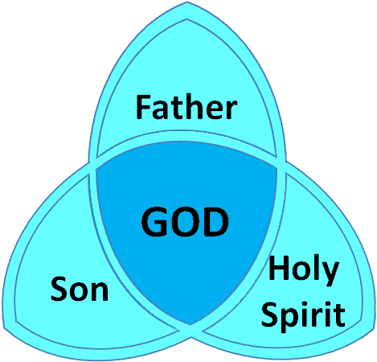
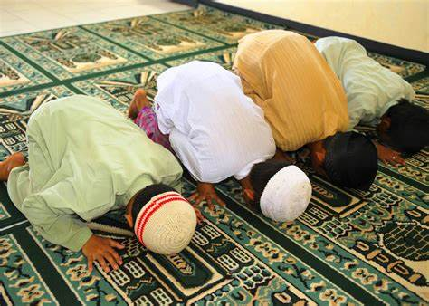
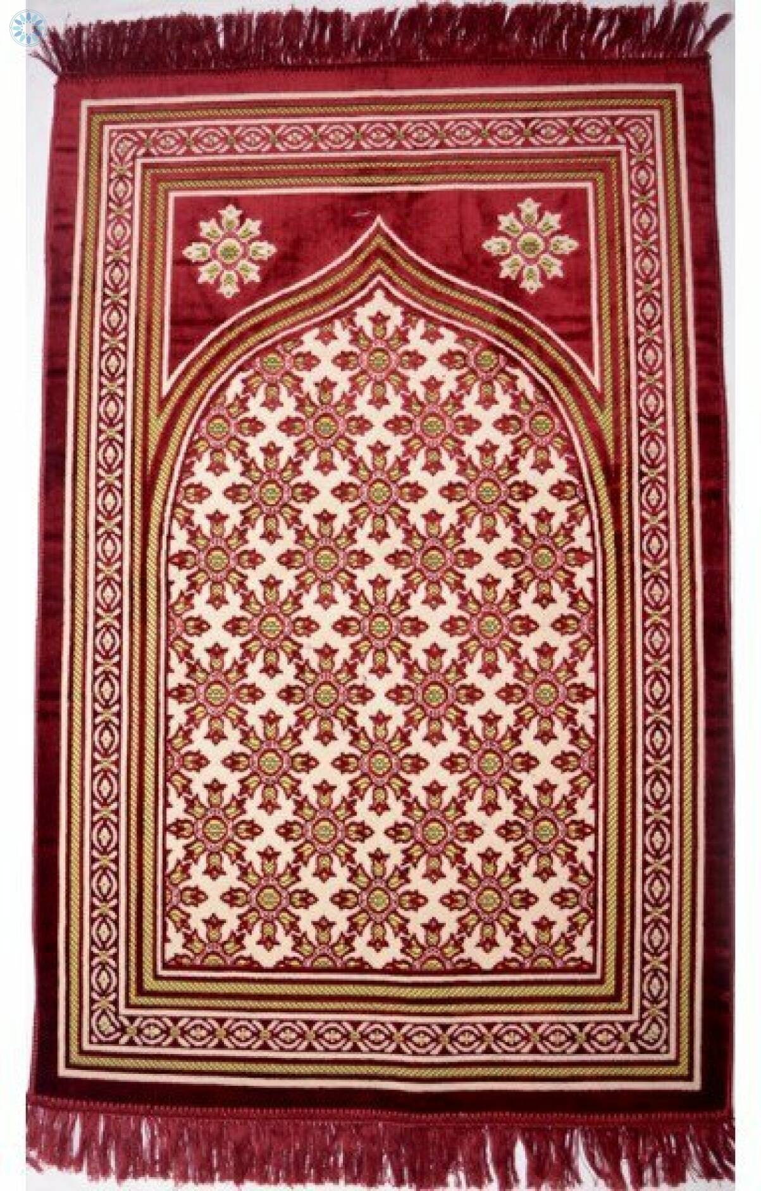
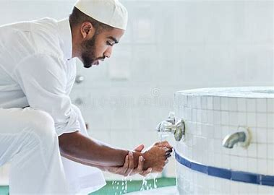
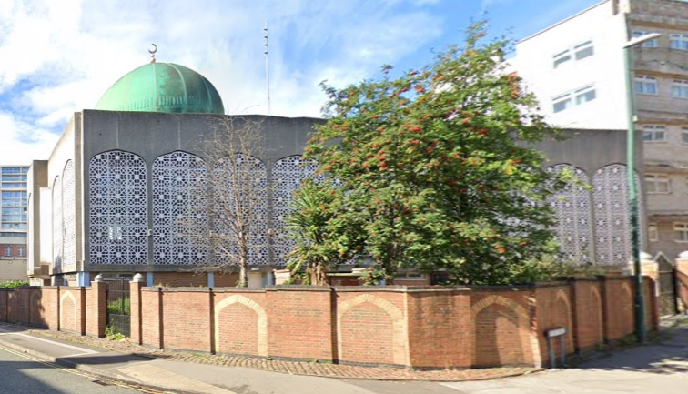
Sticky knowledge
Year group: 3 | Topic: Religion, family and community: Prayer How do religious families and communities practice their faith? The example of prayer. | Term: 5
Key vocabulary and definitions:
Hindu – A follower of Hinduism Muslim – A follower of the religion of Islam Islam – The belief that Allah is the one true God Mosque – A place of prayer for Muslims Mandir – A Hindu temple Trinity – The three persons of the Christian Godhead; Father, Son, and Holy Spirit Allah – The name of God among Muslims Ritual – Actions that are done in a certain order for religious reasons
Substantive knowledge:
Religion Focus: Christianity and Islam The Lord’s Prayer is a Christian prayer which Jesus taught his disciples to say. Christians believe they should live by God’s will. The Arabic word for prayer is ‘Salah.’ Prayer is the second pillar of Islam. There are 5 daily Islamic prayers at different times of the day. Muslims always face in the direction of Mecca when they pray. Muslims wash themselves before prayer. Christians and Muslims use prayer as a way of asking for forgiveness when they have done wrong. People pray in different ways e.g. together, on their own, saying a known prayer or praying with their own words. For Christians and Muslim people, prayer can bring the community together at church or a mosque.
Muslims pray in the
direction of Mecca
Muslims wash before they pray
Prayer mat
Mosque in Nottingham
The Trinity

Slide 5
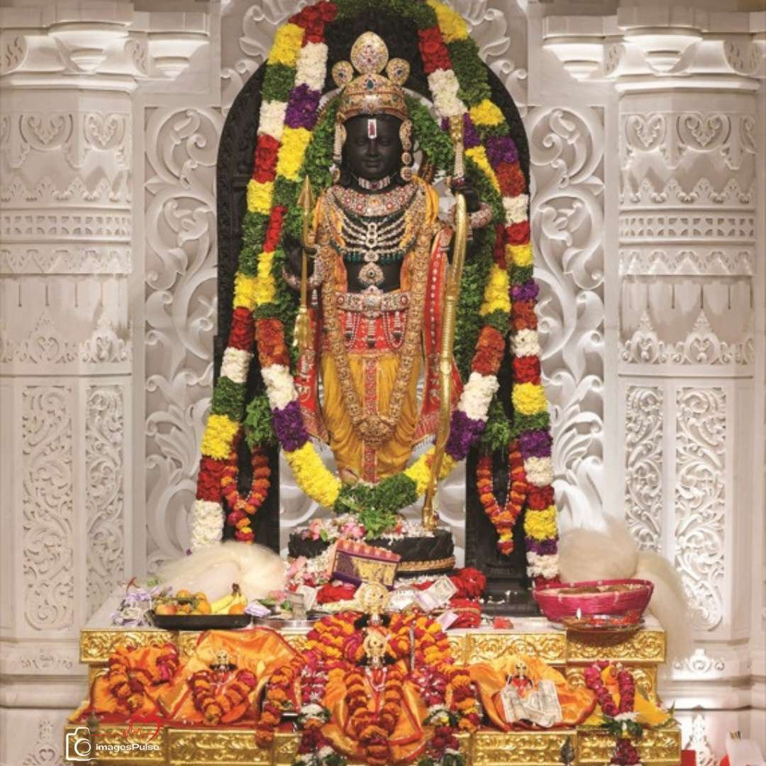
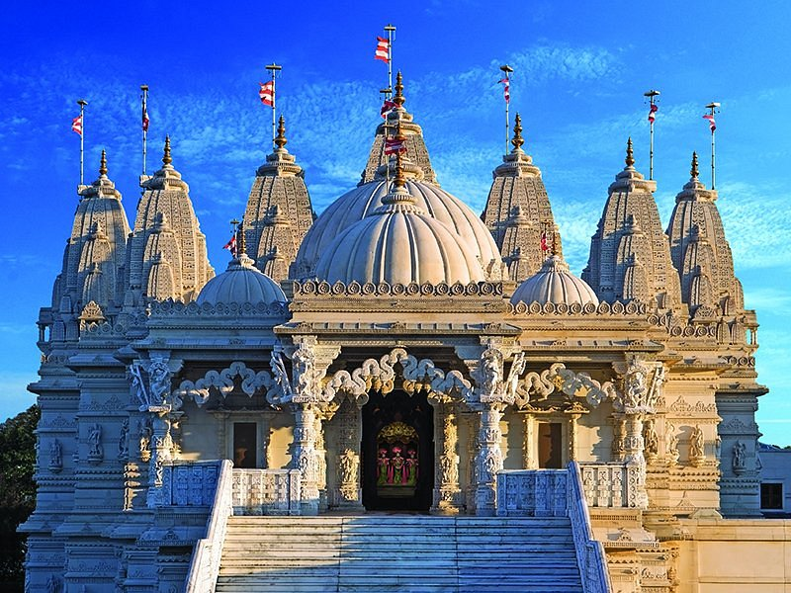
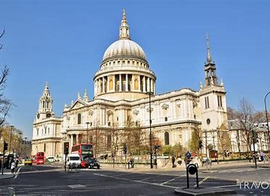
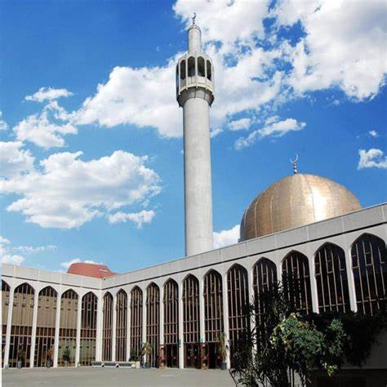
Sticky knowledge
Year group: 3 | Topic: worship and sacred places Where and how and why do people worship? | Term: 6
Key vocabulary and definitions:
Hindu- a follower of Hinduism Muslim- a follower of Islam Christian- a follower of Christianity Worship- to show love, respect and adoration for something Ritual- a ceremony or action Sacred- something worthy of awe and respect
Substantive knowledge:
Religion Focus: Islam, Hinduism and Christianity A Mandir is a place where Hindus go to worship. Some mandirs are very tall, Hindus believe this brings them closer to heaven. At a mandir, there are shrines for different Hindu gods and goddesses. Murti is a statue of a deity or goddess. Murtis are kept in a shrine, usually decorated with fruit, flowers and incense. Puja is a workshop ritual which Hindus carry out. Hindus ring a bell at the start of Puja to tell the gods that they are there. Many churches have a bell tower which is rung to remind people it is time to go to church. A mosque can be any clean place set aside for prayer. Muslims also believe that the dome reminds them that the universe belongs to God. Features of religious buildings connect many religious beliefs, teachings, practices and ways of life. Religious artefacts are treated with respect by believers.
Mandir, London
Mosque, London
Murti
Murti puja is the Hindu
practice of worshipping
sacred images of God
and dive personalities.
St Paul’s Cathedral, London

