Slide 1


Year 2 - RE

Slide 2
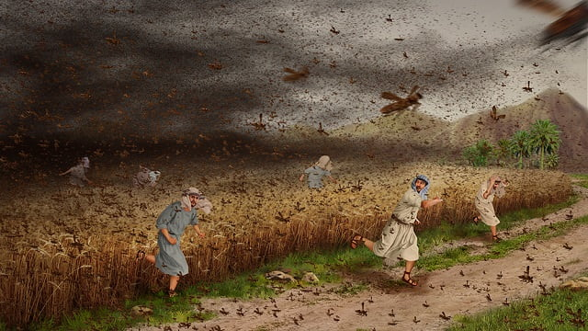
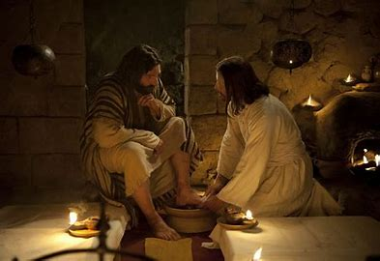
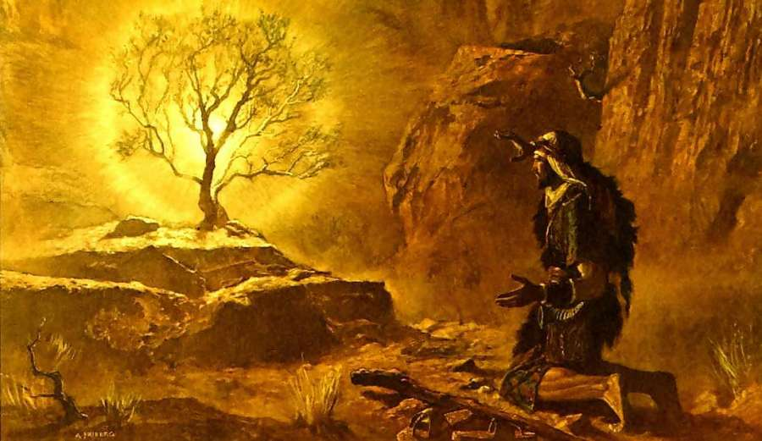
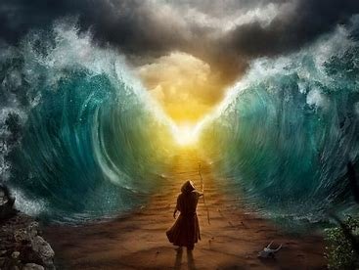
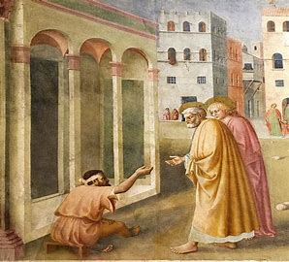
Sticky knowledge
Year group: 2 | Topic: Leaders What makes some people inspiring to others? Moses and Saint Peter. | Term: 1
Key vocabulary and definitions:
Religion – guide for what someone believes Christian - a person who follows the Christian religion Jewish – a person who follows the Jewish religion Leader- someone that guides and inspires others Torah – contains the words of the Jewish bible Bible – Christian holy book Wise sayings – offer advice about how to live Rules for living – how someone should live their life Co-operation –working together towards the same goal
Substantive knowledge:
Religion Focus: Christianity and Judaism A leader is someone who can inspire or motivate you. It is someone who others will listen to. Christians believe Jesus was a leader. Peter was a fisherman who Jesus chose to be one of his disciples. Saint Peter helped spread the word of God after Jesus’ death. Christians believe that Jesus and Saint Peter were guided by God. St Peter performed miracles, including healing the sick. Jewish people believe Moses was a great leader. Moses was born into slavery. Moses ended up leading the Israelites out of their slavery in Egypt and to a new homeland.
Jesus washes
Peter’s feet
Moses parting
the red sea
What makes a good leader?
The ten plagues
Religious stories:
Christianity: (Jesus and St Peter) Jesus washes Peter’s feet | Judaism- stories of Moses: The burning bush The ten plagues Parting the red sea
Confidence
Communication
Empathy
Integrity
Courage
Respect
The burning bush

Slide 3
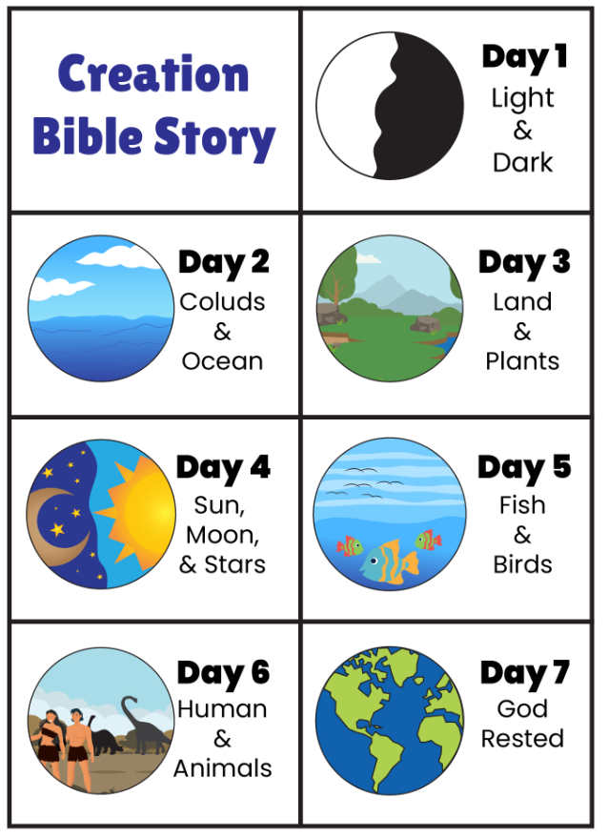
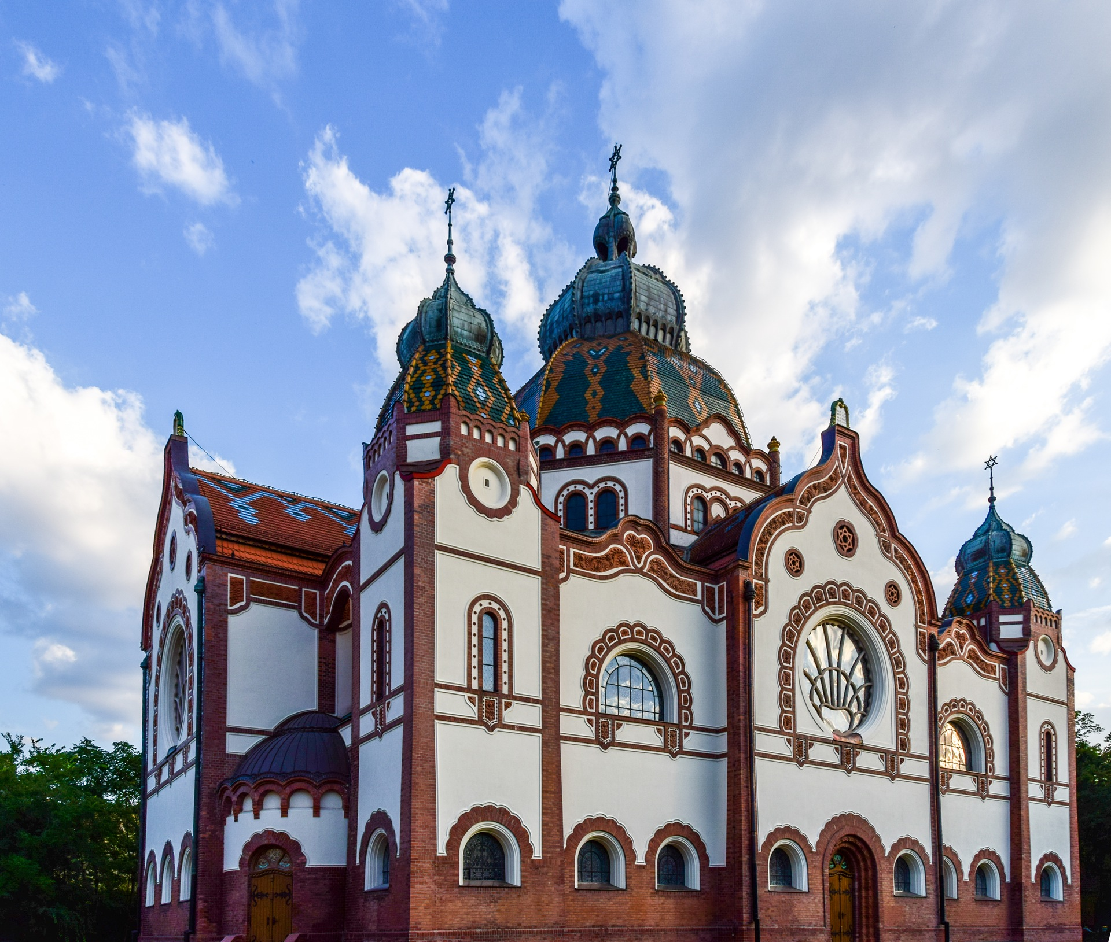
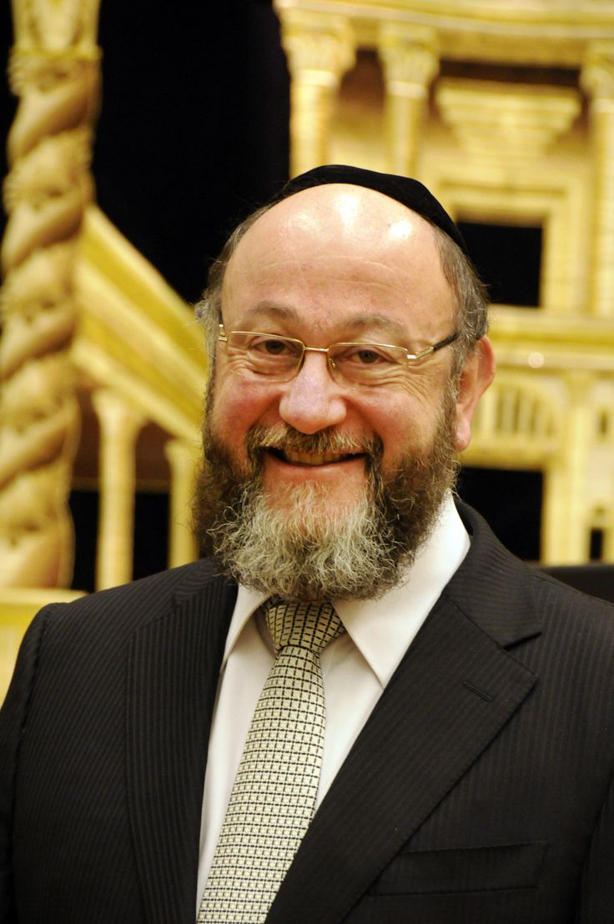
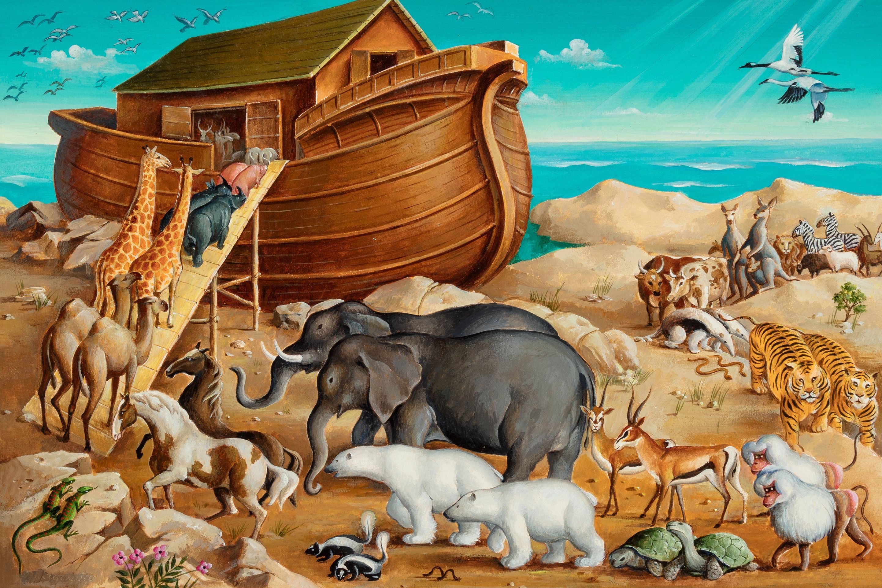
Sticky knowledge
Year group: 2 | Topic: Believing What do Jewish people believe about God, creation, humanity and the natural world? What are some ways Jewish people show their beliefs and how they belong? | Term: 2
Key vocabulary and definitions:
Judaism – the religion of the Jewish people Synagogue – the building where Jews worship Symbol – something that has a meaning Ark – a large wooden boat built by Noah to save his family and two of every animal one Earth Torah – contains the words of the Jewish bible Bimah – a raised platform in the synagogue where the Torah is read Shabbat – the day of the week set aside for worship and rest Creation story – the belief that God created the universe in seven days Holiness – Trying to be like God in your behaviour and actions Sacred – special religious meaning
Substantive knowledge:
Religion Focus: Judaism A Rabbi is a Jewish leader and religious teacher Jewish people write G-d to avoid being disrespectful. God is known by different names such as Almighty, Eternal and The Creator. Jewish people believe God created the world in six days and rested on the seventh day. Jewish people rest on the 7th day known as Shabbat. Shabbat starts each week on a Friday evening and ends on a Saturday evening.
A synagogue is where
Jews go to worship
Religious stories:
Judaism: The story of creation (Genesis)
Noah’s Ark – book of
Genesis
A Rabbi is a Jewish leader

Slide 4
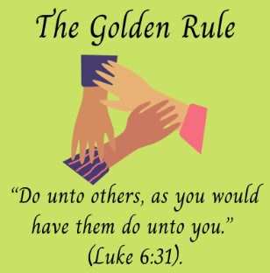
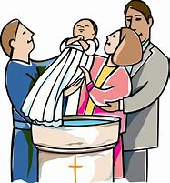
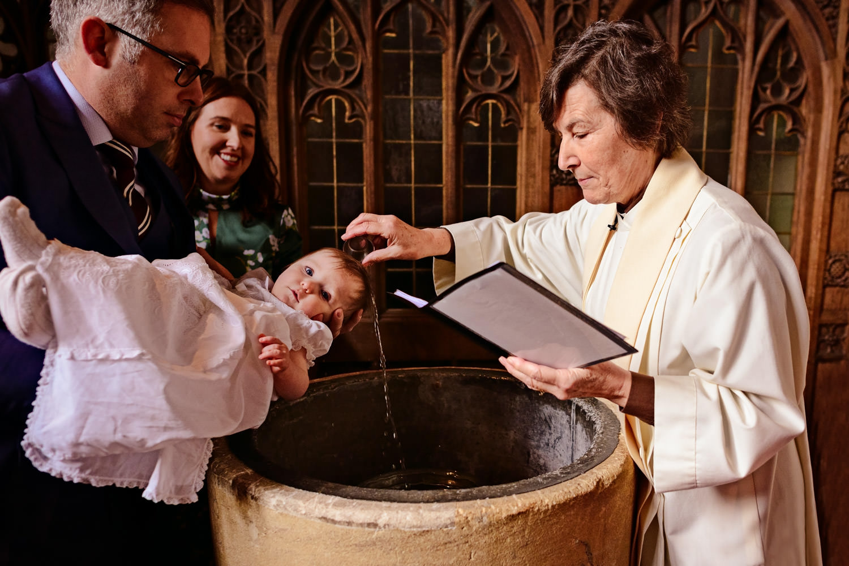
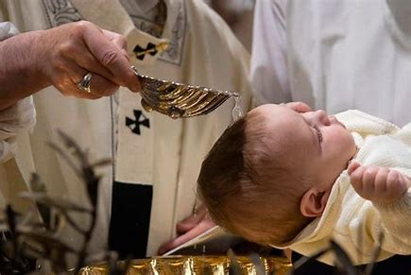
Sticky knowledge
Year group: 2 | Topic: Belonging What does it mean to belong? What is it like to belong to the Christian religion in Nottinghamshire today? | Term: 3&4
Key vocabulary and definitions:
Belonging – Being part of something Church - the building where Christian's worship Symbol – something that has a meaning Bible – the Christian holy book Golden Rule – In everything, do to others what you would have them do to you Worship – Showing you follow a belief by your actions Holiness – Trying to be like God in your behaviour and actions Sacred – special religious meaning Community – A group of people who share common attitudes or interests
Substantive knowledge:
Religion Focus: Christianity Belonging means feeling included in a group, such as family, school, friendship or club You may belong to other parts of the community such as clubs, school, church, synagogue etc. Christian people often show they belong by having their baby christened. A christening is a ceremony in which a baby or young child is given a Christian name and baptised. A Believer’s baptism is a way of welcoming new members into the Christian community. People who believe in God belong to a religious family. They share the same beliefs as that religion.
Religious stories:
Christianity: John the Baptist – River Jordan
A christening or baptism
involves pouring or wiping
water on a child's head
The Golden rules tell
Christians to treat
others as they would
wish to be treated.

Slide 5
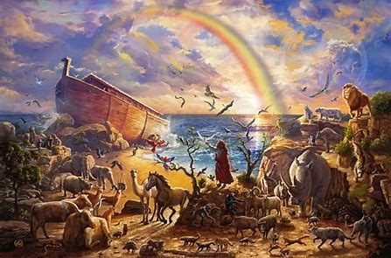
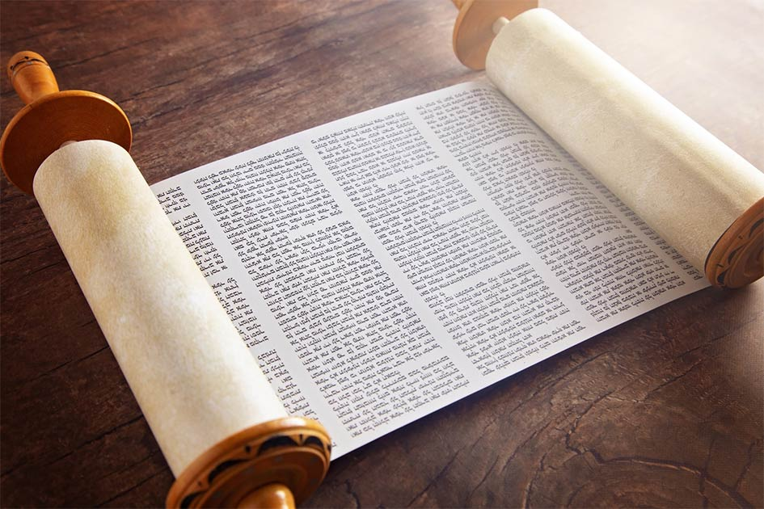
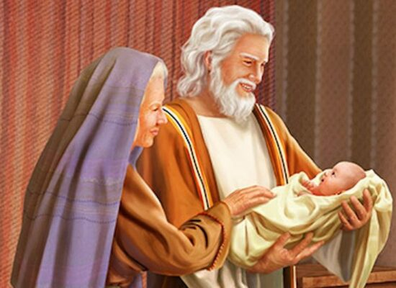
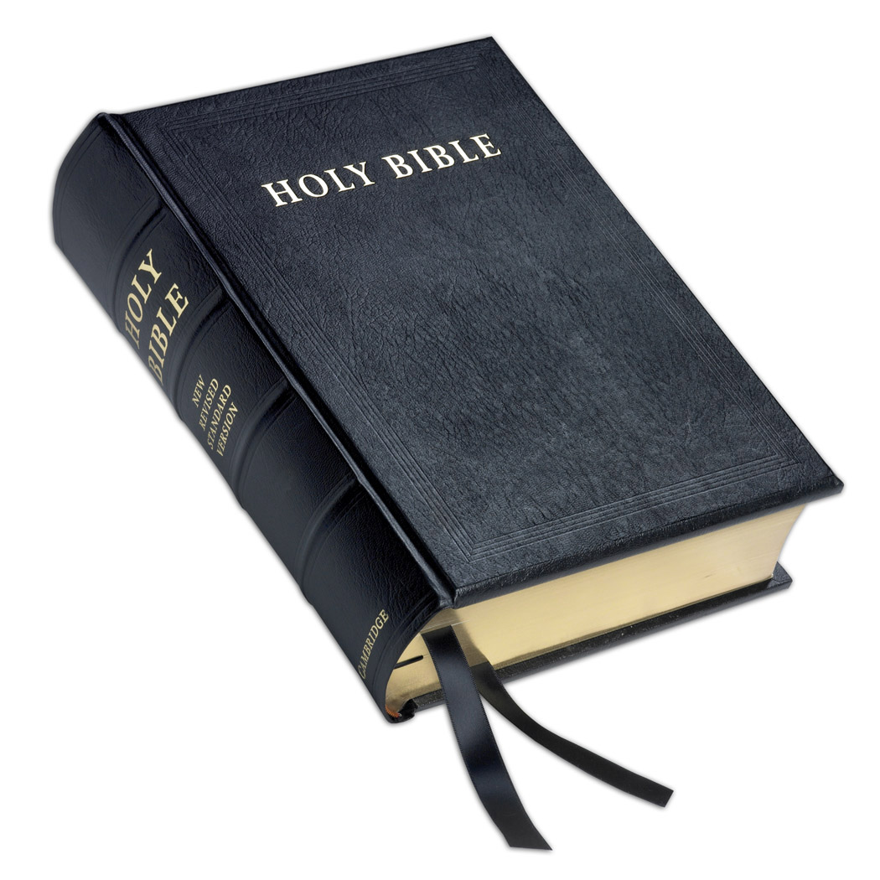
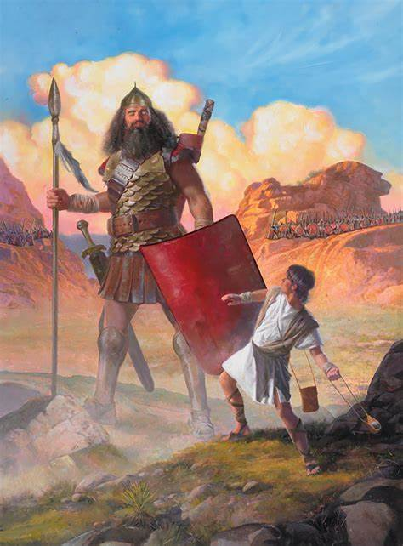
Sticky knowledge
Year group: 2 | Topic: Story How and why are some stories important in religions? What can we learn from these stories from the Torah and the Bible? | Term: 5&6
Key vocabulary and definitions:
Humanist – a person who does not believe in a god Torah – contains the words of the Jewish bible Bible – the Christian holy book Courage – to do something that may be frightening Persistence – continuing without giving up Forgiving – ready and willing to forgive God – the creator of the universe Creator – a person or thing that brings something into existence
Substantive knowledge:
Religion Focus: Christians and Judaism Stories help spread key messages to the followers of a religion Jewish stories can be found in the Torah, the Old Testament to the Bible and the Qur’an. The Bible is split into the Old Testament and New Testament. The New Testament is made up of books called Gospels. The Gospels tells stories about Jesus meeting and being kind to people. Many of the stories give guidance to Jewish and Christian people on how to live. The Jewish holy text, the Torah begins with the story of the creation of the world. All Jewish synagogues, or places of worship, keep a copy of the Torah. During most synagogue services, the Torah is read from to pass on teachings to the Jewish people.
Religious stories:
Christianity and Judaism: Noah and the Ark Abraham and Sarah King David- David and Goliath
Torah- the Jewish holy book
David and Goliath
Noah and the Ark
Abraham and Sarah
Bible- the Christian holy book

