Slide 1


Year 4 - RE

Slide 2
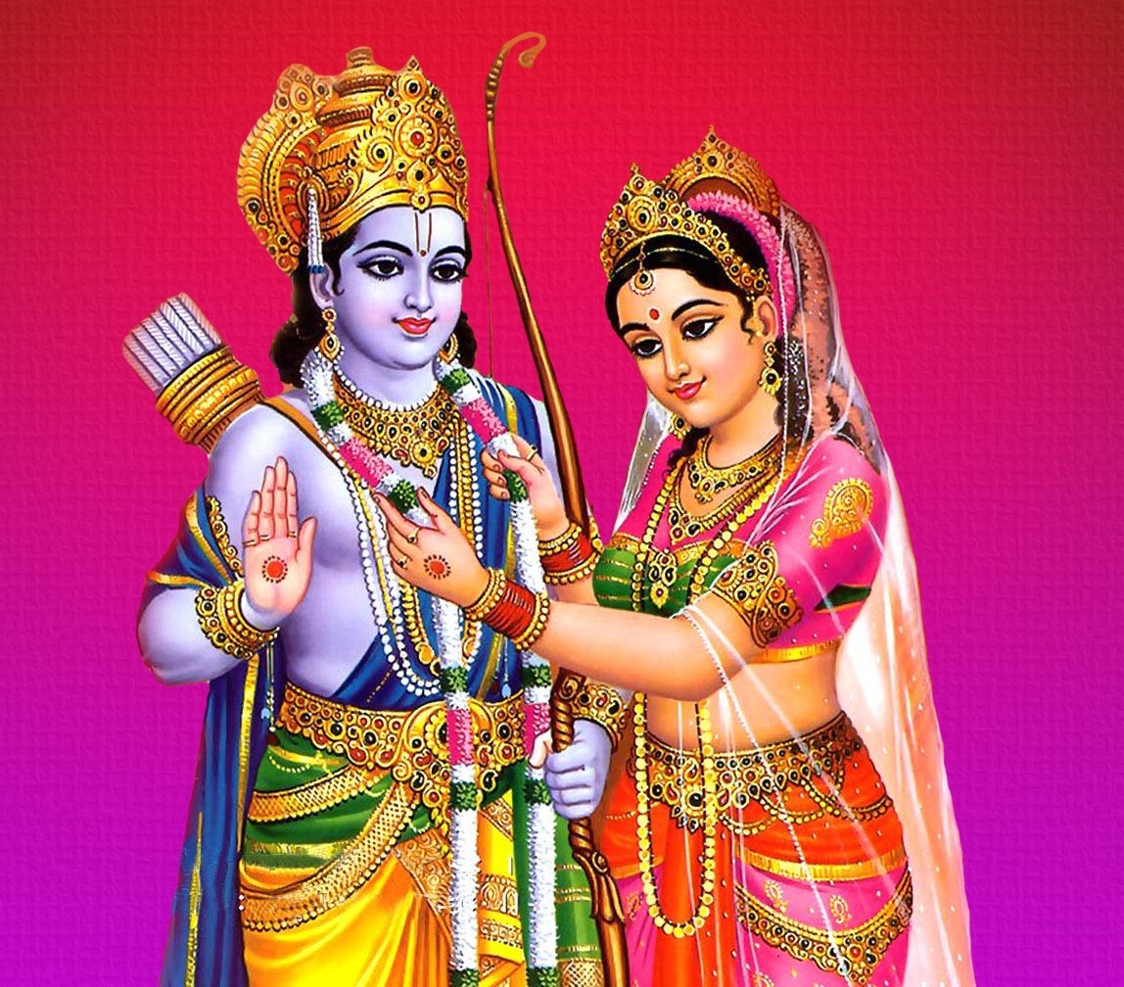
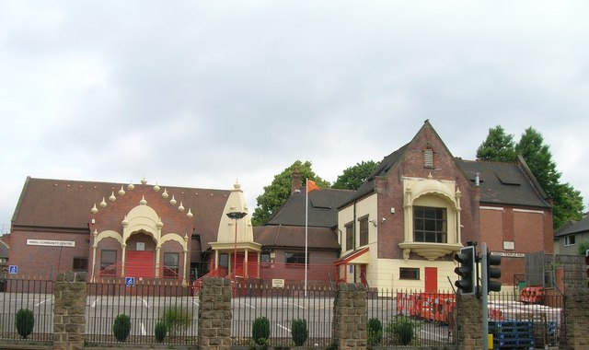
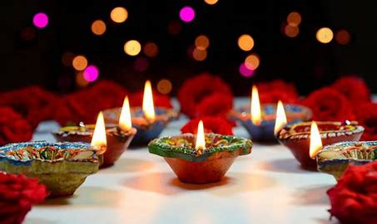
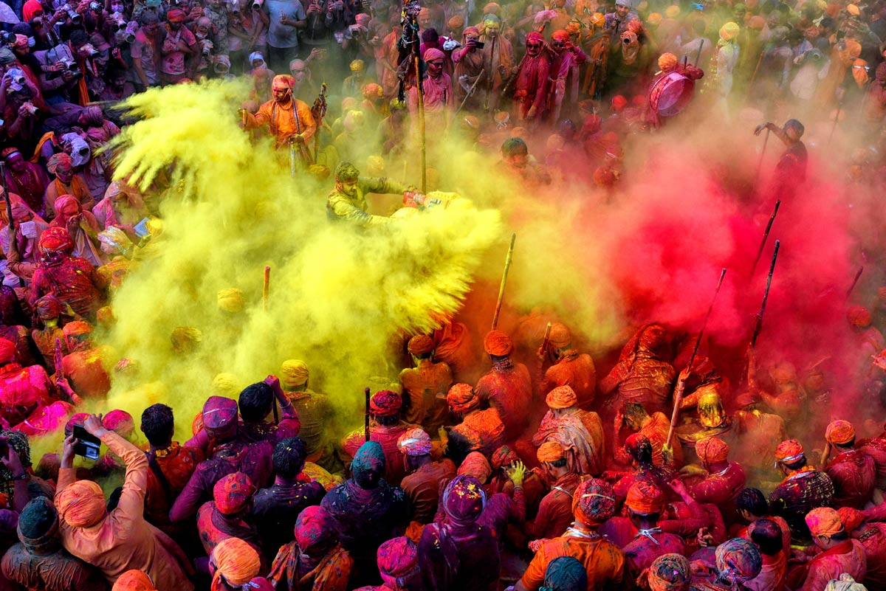
Year group: 4 | Topic: Religion, family, community, worship, celebration, ways of living How do Hindu families practice their faith? What are the deeper meanings of some Hindu festivals? | Term: 1
Sticky knowledge
Key vocabulary and definitions:
Religion – guide for what someone believes Hindu - A follower of the religion of Islam Murtis – A devotional image, statue or icon, of a deity or saint used during ceremony Deities – A god or goddess Karma – The sum of a person’s actions in this and previous states of existence, viewed as deciding their fate Dharma – A cosmic law underlying right behaviour Spiritual – Believing in a spirit or soul Ritual – Actions that are done in a certain order for religious reasons Festivals – when people join together to celebrate something Community – A group of people who share common attitudes or interests Commitment – Being dedicated to something Values - The standards by which someone lives their life
Substantive knowledge:
Religious Focus: Hinduism: Holi is a festival celebrated by Hindus. It is a festival of colour and marks the beginning of spring with bonfires and lots of singing and dancing. Old rubbish is burnt to mark a fresh start and colour is thrown on people. Diwali is the ‘festival of light’ and is celebrated in late autumn by Hindus. Diwali celebrates good’s victory over evil with lots of lights around homes. Fireworks, presents, new clothes are used to celebrate. Hindu temples always have an orange flag outside them. Many gods are worshipped in Hinduism. Each Hindu god is said to be a different part of the supreme God ‘Brahman’. Hindus believe that God can be seen in a person or an animal. They believe that God is in everybody. Hindus believe in karma which refers to the law that every action has an equal reaction either immediately or at some point in the future. Dharma is the spiritual law for human beings. It is the way of goodness, truth and duty. A child’s dharma is to be a good student. A parents dharma is to raise and support their family. Each age brings a new responsibility. Aum is the name given to the Hindu symbol. It is the sound heard in deepest meditation and is said to be the name most suited for God. Hinduism has no founder, single teacher nor any prophets. Hinduism is not a Single religion.
Religious stories:
Rama and Sita
Rama and Sita
Diwali-
Festival of light
Holi-
Festival of colour
Hindi temple, Nottingham

Slide 3
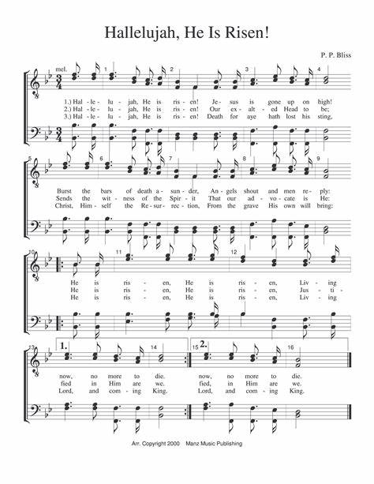
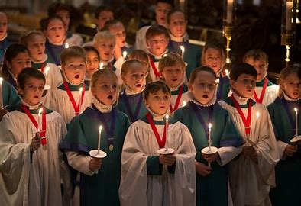
Sticky knowledge
Year group: 4 | Topic: Spiritual Expression What can we learn? | Term: 2
Key vocabulary and definitions:
Religion – guide for what someone believes Christian - a person who follows the Christian religion Spiritual – Believing in a spirit or soul Worship – Show reverence and adoration Devotion – Love, loyalty or enthusiasm for a person or activity Belief – An acceptance that something exists or is true Self-expression – The expression of one’s feelings, thoughts, or ideas Hymn – A religious song or poem of praise to God or a god Carol – A religious fold song or popular hymn, particularly associated with Christmas
Substantive knowledge:
Religious Focus: Christianity Religious music is a way of bringing a religious community together. It makes worshippers feel closer to each other and to God. Christians sing hymns in church and there are special hymns for religious festivals, such as carols to celebrate Christmas. Spiritual music has meanings.
Carol singing in
Church
Hymns:
Christmas Carols Hallelujah chorus Contemporary worship music Christmas songs for children

Slide 4
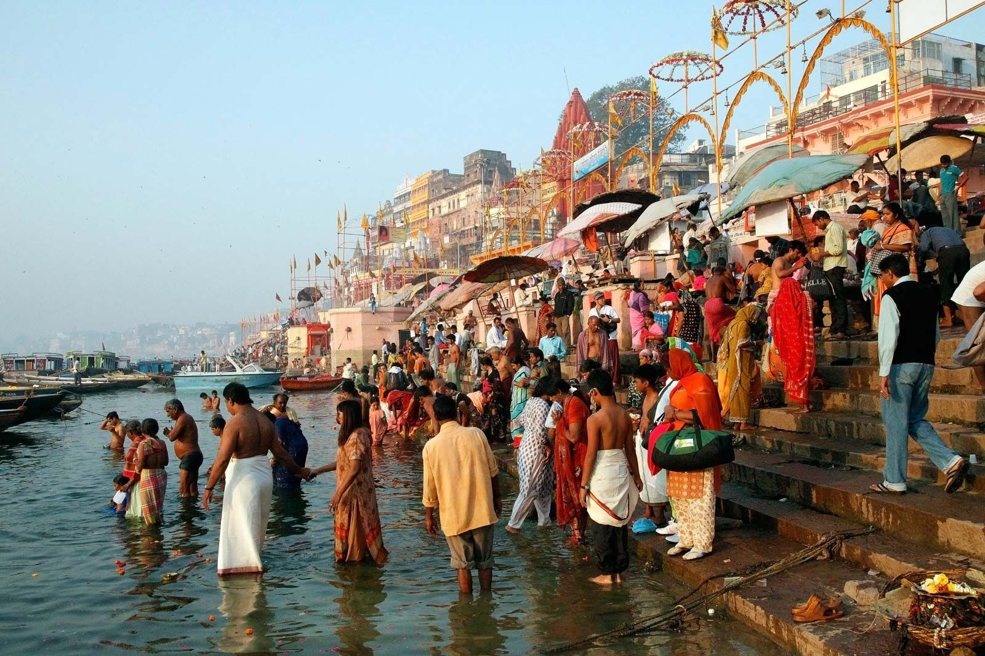
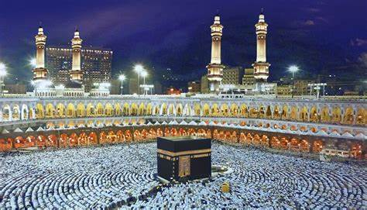

Sticky knowledge
Year group: 4 | Topic: Symbols and religious expression How do people express their religious and spiritual ideas on pilgrimages? | Term: 3&4
Key vocabulary and definitions:
Religion - guide for what someone believes Hindu – A follower of Hinduism Muslim – A follower of the religion of Islam Christian – a person who follows the Christian religion Pilgrim – A person who journeys to a sacred place for religious reasons Pilgrimage – A pilgrim’s journey Spiritual – Believing in a spirit or soul Ritual – Actions that are done in a certain order for religious reasons Community – Symbol - something that has a meaning Commitment – Being dedicated to something Values - The standards by which someone lives their life
Substantive knowledge:
Religion Focus: Islam, Hinduism and Christianity A pilgrimage is a sacred journey with a spiritual purpose. Pilgrims travel for spiritual reasons, not just to relax or for fun. The pilgrimage to Varanasi in India is an important spiritual journey for Hindus. Mecca (Makkah) is an important spiritual destination for Muslims. This pilgrimage is known as Haj and is one of the Five Pillars of Islam. Pilgrimages to Lourdes, Iona and ‘The Holy Land’ are important spiritual journeys for Christians. It is possible to take a short (6mile) pilgrimage to Southwell Minster in Nottinghamshire.
Varanasi- sacred place for Hindus
on the banks of River Ganga
Hajj is a pilgrimage made to
the Kaaba, the "House of Allah",
in the sacred city of Mecca in
Saudi Arabia.
Lourdes is a spiritual location
for Christians in the South of
France.

Slide 5
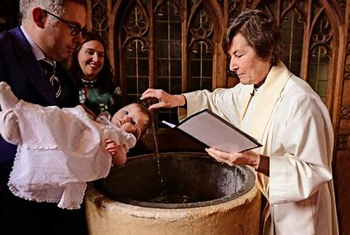
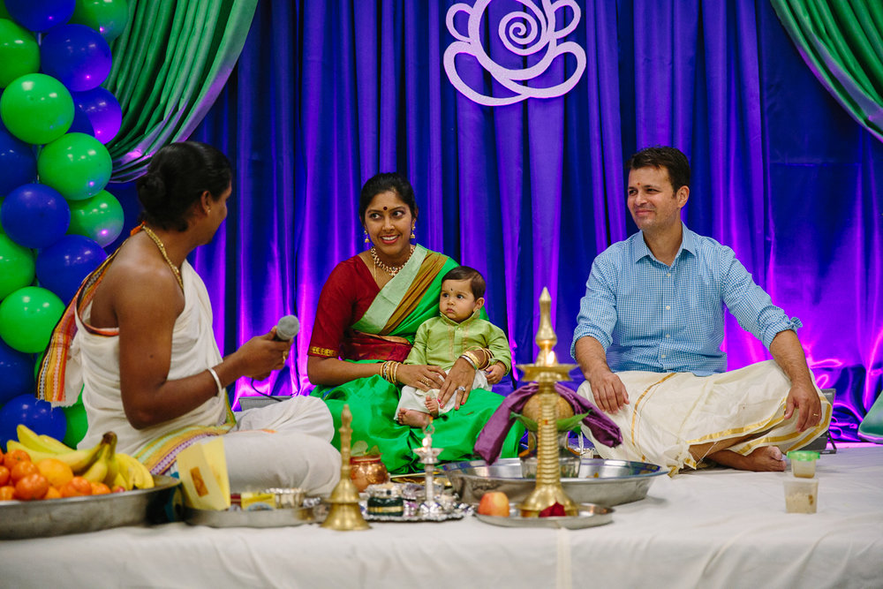
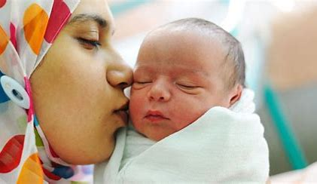
Year group: 4 | Topic: The journey of life and death Why do some people think life is like a journey? Where do we go? What do different people think about life after death? | Term: 5&6
Sticky knowledge
Key vocabulary and definitions:
Religion - guide for what someone believes Hindu – A follower of Hinduism Muslim – A follower of the religion of Islam Humanist – An advocate or follower of the principles of humanism Christian – a person who follows the Christian religion Beliefs – An acceptance that something exists or is true Destiny – The events that will necessarily happen to a particular person or thing in the future Soul – The spiritual part of a human being or animal, regarded as immortal Spiritual – Believing in a spirit or soul Ritual – Actions that are done in a certain order for religious reasons Symbol - something that has a meaning Heaven – A place regarded in various religions as the abode of God and of the good after death
Substantive knowledge:
Religious Focus: Christianity, Hinduism and Islam In some Hindu families, 40 days after birth, the baby is taken to the community mandir for a naming ceremony. In some Hindu communities, relatives wash the body after death and clothe it in white garments to help purify them. During the funeral ceremony for Hindus, the priest and the mourners may recite verses from scripture. Most Hindu grieve for the person they knew, not the spirit, which they believe the will be reincarnated. At the moment of birth, many Muslims make a call to prayer in the ear of the baby so that the call to serve Allah is present from the start of the child’s life. On the seventh day after birth, the child’s head is shaved as part of a naming ceremony and to symbolise cleansing the baby from impurities. The baby is often named after one of the prophets of early Islam. Islam teaches that there is life after death, and this is known as Akhirah. In Islam, it is Allah who decides when a person dies and most Muslims believe that when they die, they will stay in their graves until the Day of Judgement. Those who have performed more good deeds than bad will enter Jannah, or Paradise. In Christianity, baptism is a symbolic way of joining the Church. Water is used in baptism as a symbol of washing away sin and the start of a new life. During the baptism service, godparents are sometimes given a lighted candle to represent the light of Jesus that has come into the baby’s life. When a Christian dies, it is seen as the end of his/her life on earth. A funeral is held for friends and family to grieve for the person who has died and give thanks for their life.
Muslims make a call to
Prayer in the ear of newborn
baby
Water is poured or
wiped on baby’s
head during a baptism
Hindu naming
ceremony

