Slide 1


Year 5 - RE

Slide 2
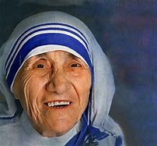
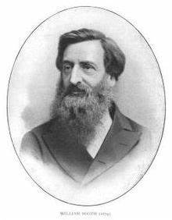
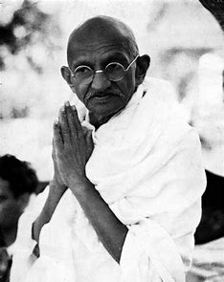
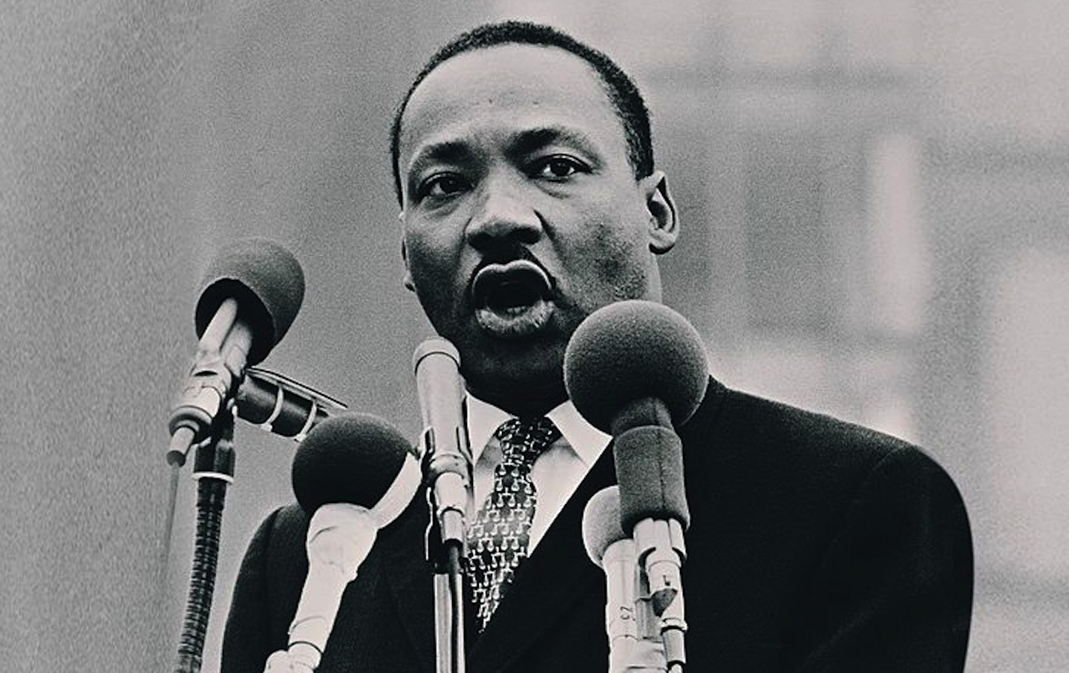
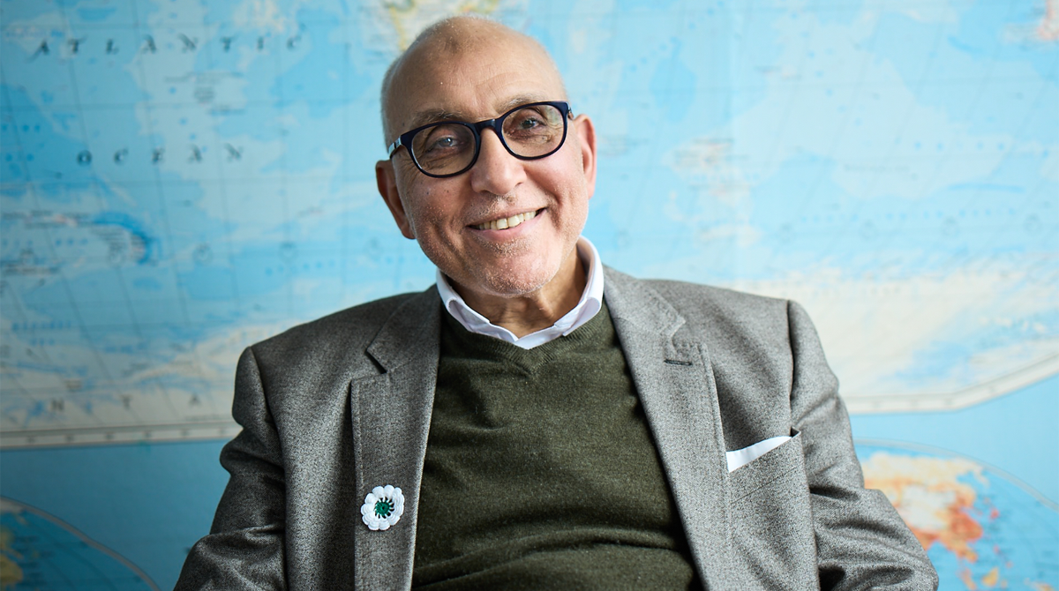
Sticky knowledge
Year group: 5 | Topic: Inspirational people in today’s world What can we learn from great leaders and inspiring examples in today’s world? | Term: 1&2
Key vocabulary and definitions:
Prophet – A teacher of the lessons of God Mahatma – Mahatma Gandhi Holiness – The state of being holy Spiritual – Believing in a spirit or soul Inspirational – Providing or showing creative or spiritual inspiration Vision – Imagine Symbol – something that has a meaning Compassion – Sympathetic pity and concern for the sufferings or misfortunes of others Devotion – Religious worship or observance Civil rights – The rights of citizens to political and social freedom and equality
Substantive knowledge:
Religious Focus: Islam, Hinduism and Christianity A religious leader is a person whose actions, wisdom or spiritual beliefs inspire others. Great leaders are usually people who have faced challenge during their lives and prove their commitment by the way they live or have lived. William Booth of Sneinton was the founder of the Salvation Army. Mother Teresa founded the Missionaries of Charity. She received a number of honours including the 1979 Nobel Peace Prize. Gandhi was one of the greatest political and social leaders in the 20th century. He was an Indian lawyer who employed non-violent resistance to lead the successful campaign for India’s independence from British Rule. He inspired movements for civil rights and freedom across the world. Dr Martin Luther King was a black American Christian minister and activist. Marin Luther King was a great believer in peaceful protests. His protests were non-violent, even when the protesters themselves were met with violence from the police. In 1963 Martin gave a speech called “I have a Dream”. It became one of the most famous speeches in history and focuses on Martin’s dream of society where black people and white people live together in harmony. He was assassinated in 1968. *Dr Hany El Banna is the co-founder of Islamic Relief, the largest Western based International Muslim relief, promoting understanding between Global Cultures and Faiths within the UK. Desmond Tutu, Pandurang Shastri Athavali and Nelson Mandela are other great leaders known for their beliefs, wisdom and inspiration.
Mother Teresa
William Booth
Gandhi
Martin Luther King
Dr Hany El Banna

Slide 3
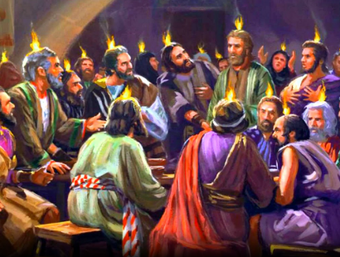
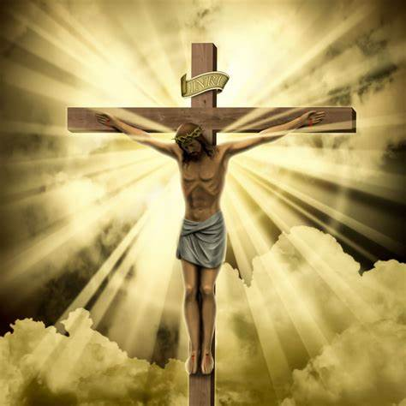
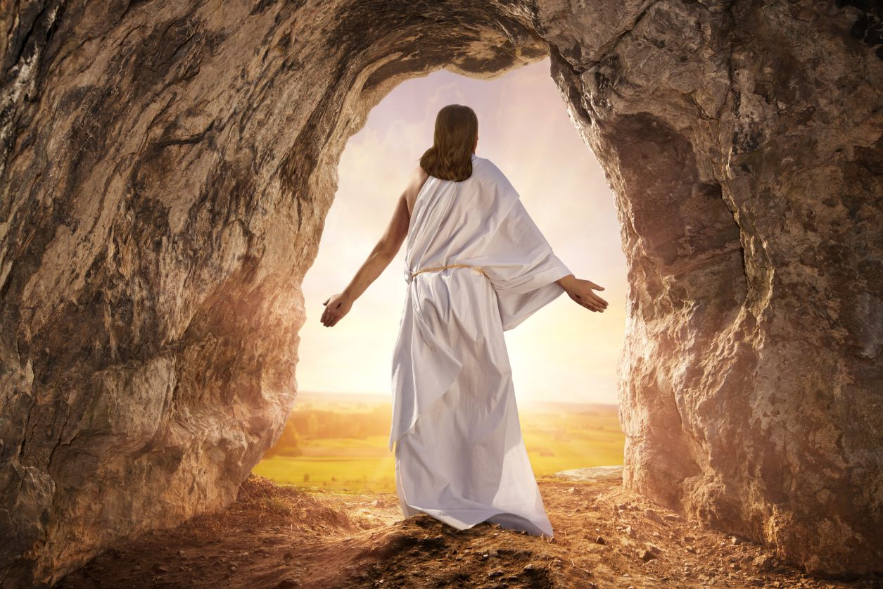
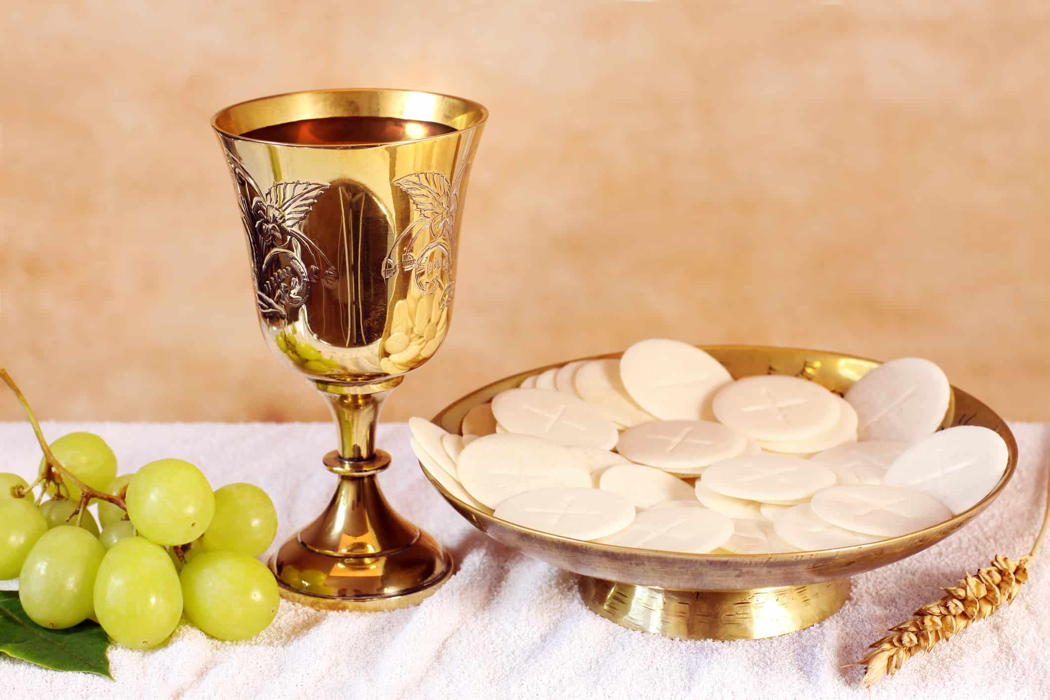
Sticky knowledge
Year group: 5 | Topic: Religion and the individual: What matters to Christians? What is expected of a person in following a religion or belief? What matters most to Christians I their religion? | Term: 3&4
Key vocabulary and definitions:
Religion – guide for what someone believes Christian – a person who follows the Christian religion Spiritual – Believing in a spirit or soul Festival – A day or period of celebration, typically for religious reasons Incarnation – A person who embodies in the flesh a deity, spirit or quality Resurrection – the rising of Christ from the dead Pentecost – The Christian festival celebrating the descent of the Holy Sprit on the disciples of Jesus after his Ascension Eucharist – The Christian service, ceremony, or sacrament commemorating the Last Supper, which bread and wine are consumed Gospel – The teaching or revelation of Christ Trinity – The three persons of the Christian Godhead; Father, Son, and Holy Spirit Holy Spirit – The divine force, quality and influence of God over the universe or his creatures. Community – A group of people who share common attitudes or interests Commitment - Being dedicated to something
Substantive knowledge:
Religious Focus: Christianity Many Christians are devoted and committed to their religion. Christmas is a celebration of Jesus Christ’s birthday and many Christians attend a special midnight church service called Midnight Mass. Many Christians attend church on Christmas day. Christians try and follow the teachings of Jesus to love your enemies. The Christian community helps people to live a good life and Christians’ use of ideas such as Trinity, forgiveness and inspiration. Christians celebrate Easter to remember Jesus’ death and sacrifices and his rising on Easter Sunday. The Eucharist, also known as Holy Communion, the sacrament and the Lord's Supper among other names, is a kind of religious ritual in many Christian churches. It started when Jesus told his followers to eat bread (His body) and drink wine (His blood) in memory of him, at the Last Supper. Pentecost is a Christian holiday that celebrates the time when the Holy Spirit descended to the 12 disciples of Jesus. Christians believe that the Holy Spirit blessed them with the ability to speak different languages, allowing them to spread the word of the Lord and baptize 3000 people in one day
Easter- Christians remember that
Jesus died on the cross…
Eucharist
Pentecost
and resurrected on Easter Sunday

Slide 4
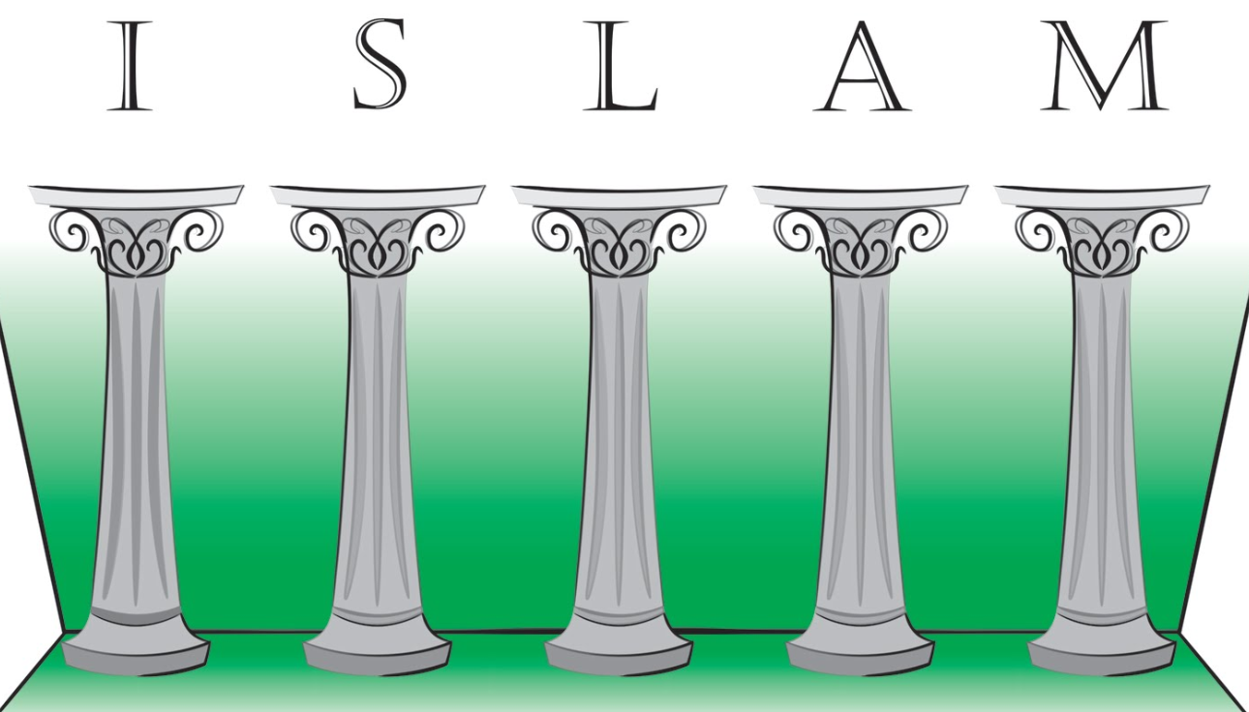
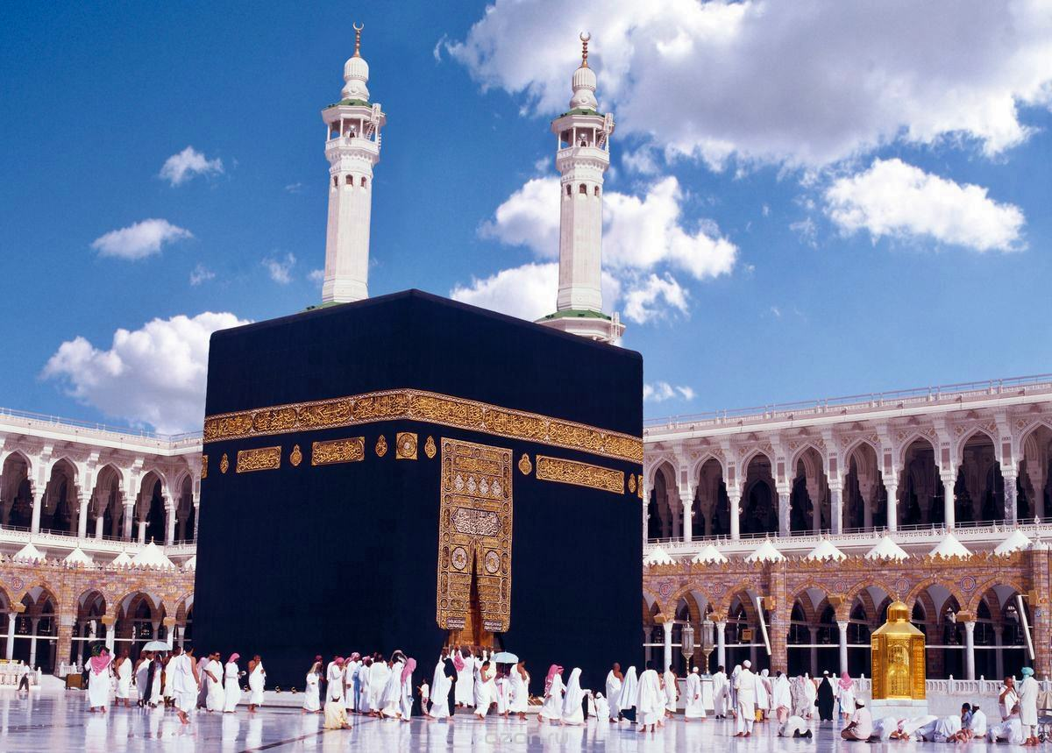
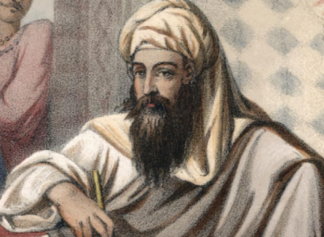
Sticky knowledge
Year group: 5 | Topic: Beliefs and Questions How do people’s beliefs about God, the world and others have impact on their lives? | Term: 5
Key vocabulary and definitions:
5 Pillars – The basic norms of Islamic practice Prophet – A person regarded as an inspired teacher or proclaimer of the will of God Allah – Term for God by Muslims Murtis – A devotional image, statue or icon, of a deity or saint used during ceremony Brahman – A member of the highest Hindu caste Gods and goddesses – The deities of many religions Ahimsa – Respect for all living things and avoidance of violence towards others Atheist – A person who disbelieves or lacks belief in the existence of God or gods Agnostic – A person who believes that nothing is known or can be known of the existence or nature of God
Substantive knowledge:
Religion Focus: Islam The Five Pillars of Islam are: - Profession of Faith (Shahada) - Prayer (Salat) - Alms (Zakat) - Fasting (Sawm) - Pilgrimage (Hajj) Muhammad [PBUH] is the Messenger of God and is central to Islam Muslim people say ‘Peace be upon him’ when saying Muhammad’s name. It is a sign of great respect and honour. Muslims pray 5 times a day every day and must face the Kaaba. The Kaaba is a building in the centre of Mecca. Each prayer has a name, these are: - Fajr, the dawn prayer - Dhur, the early afternoon prayer - Asr, the late afternoon prayer - Maghrib, the sunset prayer - Isha’a, the night prayer Hindus are taught about harmlessness (ahimsa) on what they eat and how they treat animals The term ‘God’ is different in each religion Each religion as a different text and they all have a different way of sharing it.
Muhammad [PBUH] is the
messenger of God and is
central to Islam

Slide 5
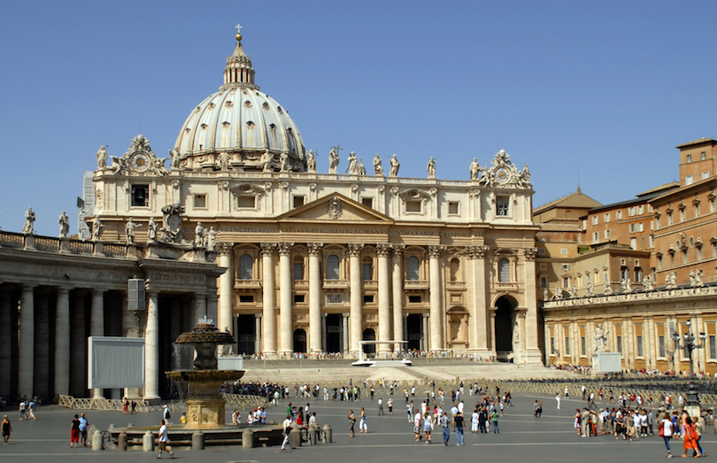
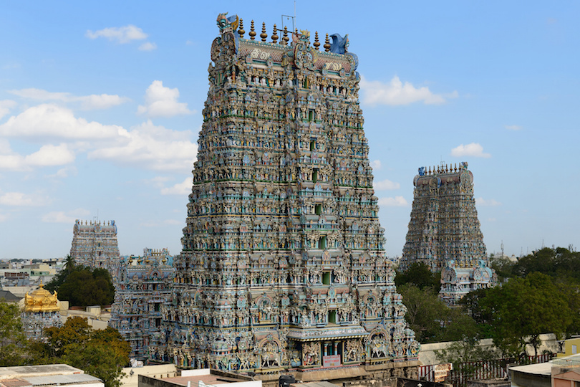
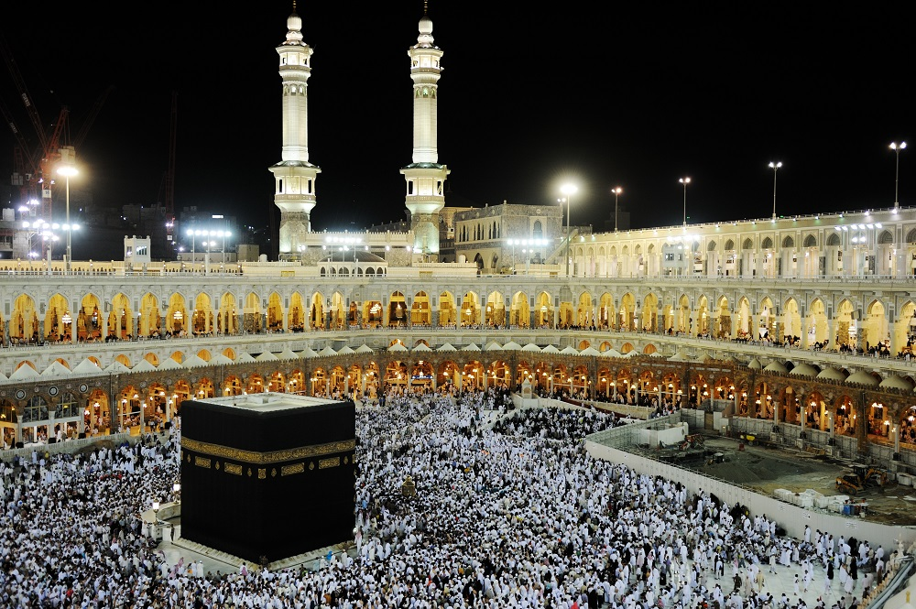
Year group: 5 | Topic: Beliefs in action in the world How are religious and spiritual thoughts and beliefs expressed in arts and architecture and in charity and generosity? | Term: 6
Sticky knowledge
Key vocabulary and definitions:
Religion – guide for what someone believes Muslim – A follower of the religion of Islam Hindu – A follower of Hinduism Christian – a person who follows the Christian religion Humanist – An advocate or follower of the principles of humanism Spiritual – Relating to or affecting the human spirit or soul Golden Rule – A basic principle that should always be followed Charity – Karma – The sum of a person’s actions in this and previous states of existence, viewed as deciding their fate Dharma – A cosmic law underlying right behaviour
Substantive knowledge:
Religious Focus: Christian, Muslim, Hindu and Non-religious worldviews such as Humanism Different religions adorn their places of worship with a variety of art and architecture. These places create space for individuals’ spiritual lives. Christianity, Buddhism and Islam are places for communal worship and participation. God is portrayed in different ways, some with human or animal likenesses, then others without form. Muslims use geometric shapes in their mosques, not the human form. There are a variety of religious charities – such as Sewa International (Hindu) Christian Aid and Muslim Hands (based in Nottingham) that express spiritual ideas.
St. Peter’s Basilica, Vatican City.
The largest church in the world
Meenakshi Amman Temple,
located in the holy city of Madurai.
Elaborately sculptured and
painted.
The Al-Haram Mosque in Makkah,
Saudi Arabia. The largest and prettiest
in the world.

