Slide 1


Year 6 - RE

Slide 2


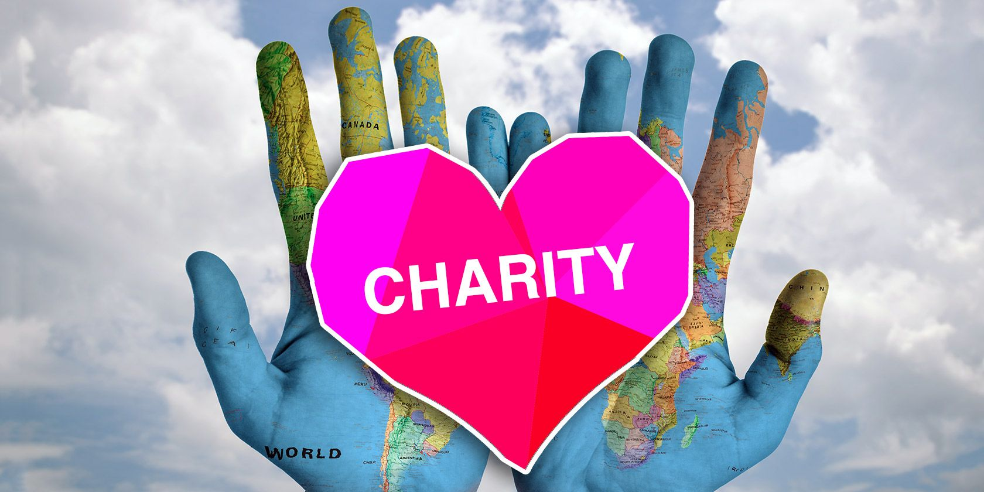
Year group: 6 | Topic: Beliefs in action in the world How do religions and beliefs respond to global issues of human rights, fairness, social justice and the importance of the environment? | Term: Term 1
Sticky knowledge
Key vocabulary and definitions:
Religion – guide for what someone believes Atheist – A person who disbelieves or lacks belief in the existence of God or gods Agnostic – A person who believes that nothing is known or can be known of the existence or nature of God Charity – An organisation set up to provide help and raise money for those in need Ahimsa – Respect for all living things and avoidance of violence towards others Ummah – The whole community of Muslims bound together by ties of religion Agape – Wide open in surprise or wonder Justice – Just behaviour or treatment Faith – Complete trust or confidence in someone or something
Substantive knowledge:
Religious Focus: Christianity, Hinduism, Humanism Many religions support a range of charities that support justice, compassion, fairness and responsibilities linked to global issues. Charities serve a range of purposes: people, animals, the environment both locally, within the UK and globally. Christian Aid is a charity based in the UK and Ireland. It is a Christian charity that helps the world’s poorest people. Islamic Relief is one Muslim charity that provides humanitarian relief and development programmes around the world. Zakat means giving charity to the poor. A Muslim is expected to give zakat as long as they are able. Ummah is the importance of community to Muslims.
“We seek to eradicate extreme
poverty by tackling its root causes”
“Since 1984, our Islamic faith and the teachings
of the Qur’an have guided our approach to providing
ground-breaking relief and development work.”

Slide 3
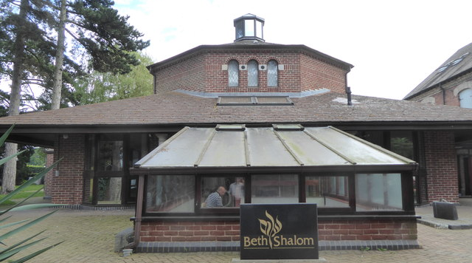
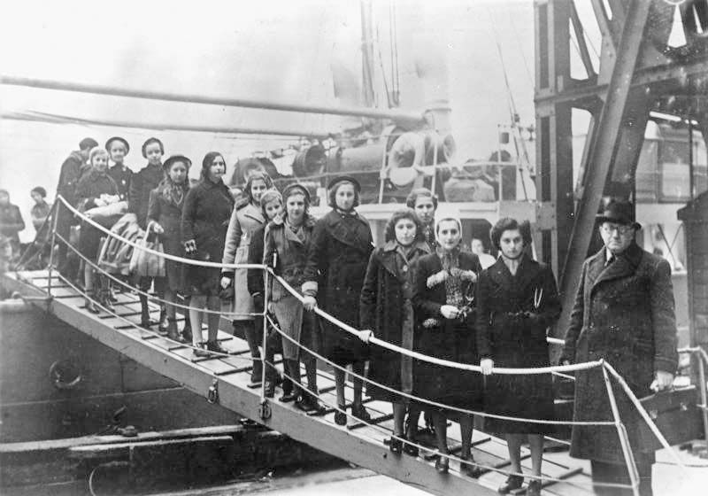
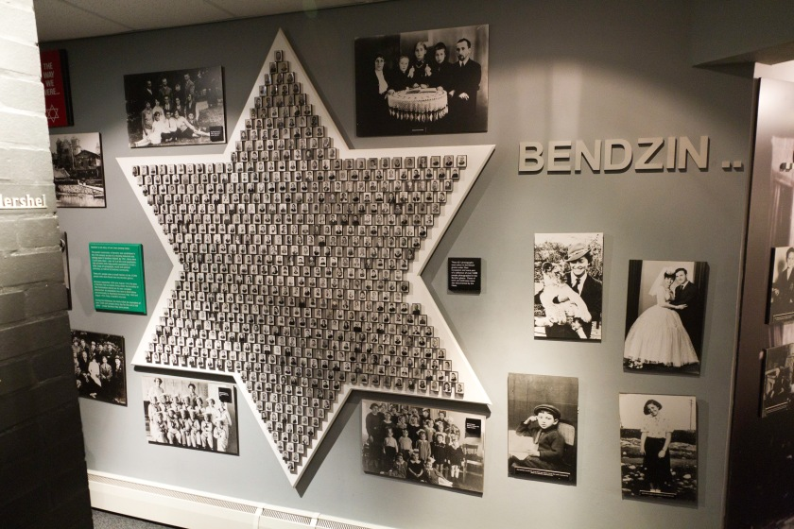
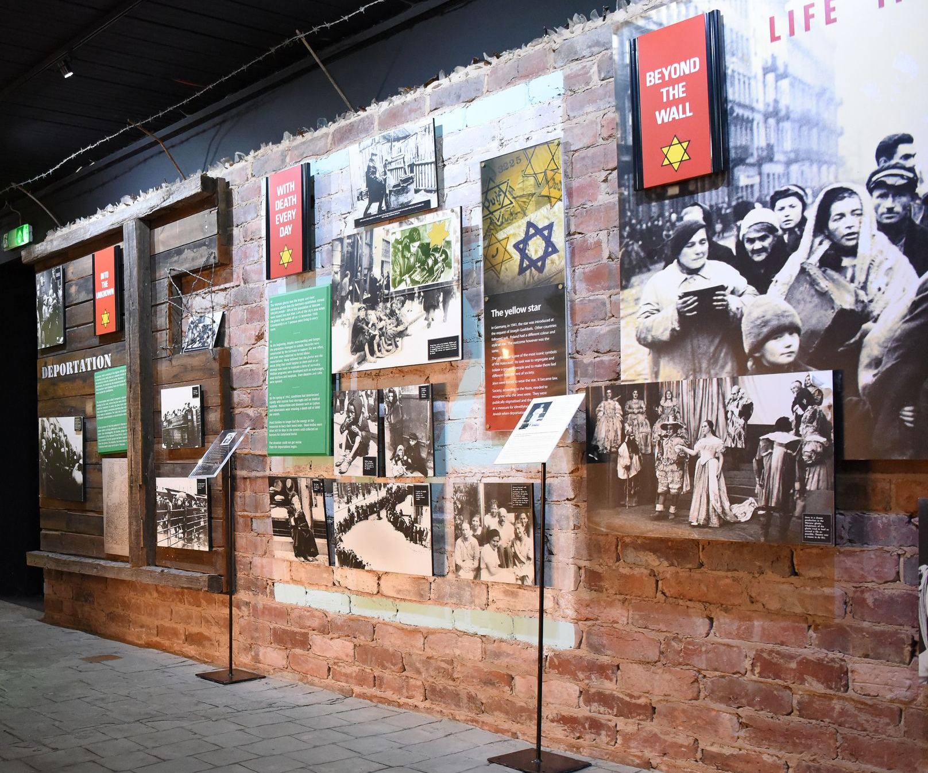
Sticky knowledge
Year group: 6 | Topic: Beliefs in action in the world What was the Kindertransport? Who resisted and rescued? How can we be Upstanders today? | Term: 2
Key vocabulary and definitions:
Religion – guide for what someone believes Harmony – The combination of simultaneously sounded musical notes to produce a pleasing effect Respect – A feeling of deep admiration for someone or something elicited by their abilities, qualities, or achievements Persecution – Hostility and ill-treatment, especially on the basis of ethnicity, religion, or sexual orientation or political beliefs Prejudice – Preconceived opinion that is not based on reason or actual experience Beth Shalom – Holocaust memorial known as ‘House of Peace’ Bystander – A person who is present at an event or incident but does not take part Upstander – A person who speaks or acts in support of an individual or cause
Substantive knowledge:
Religious Focus: Judaism Before World War 2, Jewish people lived in varied communities across Europe with diverse cultures and ways of life. In the 1930s, the Nazis isolated Jewish people in the German society by spreading stereotypes, myths and lies that ignored the diversity of Jewish life. They portrayed Jewish people as different and a dangerous group of people. Hitler and the Nazi Party rose to power in Germany in the early 1930s. Hitler was elected chancellor in 1933. The persecution of Jewish people started in 1933 because of their religious beliefs. Kindertransport is the name given to the rescue efforts by various countries to transport thousands of refugee Jewish children to safety. This started in 1938. Many people who were not Jewish helped Jewish people to safety and escape persecution. Beth Shalom is the UK’s only Holocaust centre and it is here in Nottinghamshire. Beth Shalom means ‘House of Peace’.
National Holocaust centre
and museum, Nottinghamshire
Kindertransport-
rescue effort to bring thousands
of Jewish children to safety

Slide 4
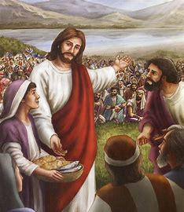
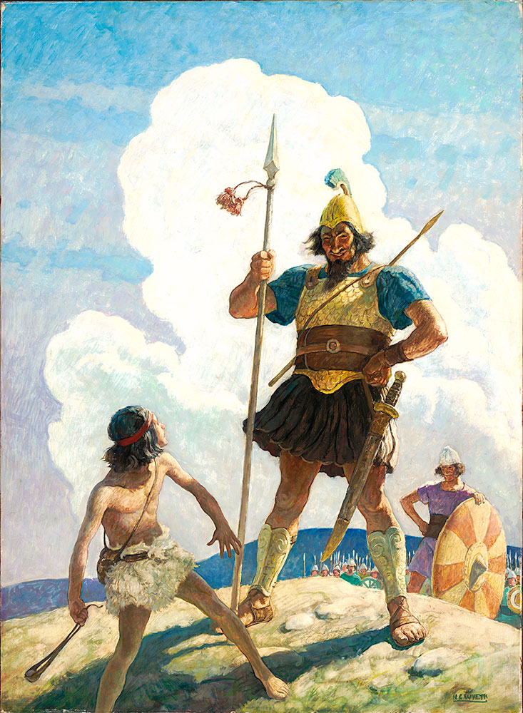
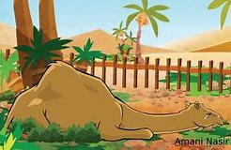
Sticky knowledge
Year group: 6 | Topic: Teachings, wisdom and authority What can we learn by reflecting on words of wisdom from religious and world views? What do sacred texts and other sources say about God, the world and human life? | Term: 3&4
Key vocabulary and definitions:
Religion - guide for what someone believes Moral codes – A set of rules or guidelines that a person or group of people follow in order to live a life that is good. Ten Commandments – A moral guidebook to explain how people should behave towards each other. Letters of Saint Paul – Trinity – The three persons of the Christian Godhead; Father, Son, and Holy Spirit Holy Spirit – The divine force, quality and influence of God over the universe or his creatures. Bible – the Christian holy book Qur’an – the Islamic sacred book Hadith – A collection of traditions containing sayings of the prophet Muhammad Humanist - An advocate or follower of the principles of humanism Rationalist – A person who bases their opinions and actions on reason and knowledge rather than religious belief
Substantive knowledge:
Religion Focus: Islam, Judaism and Christianity Religious people use sacred texts for private study, memorisation and for guidance: - Christians use the bible - Muslims use the Qur’an or Hadith - Jewish people use the Torah Many sacred texts are often best sellers Many of the texts teach similar things Christians believe about love from the bible e.g. 1 Corinthians. The Qur’an consists of 114 chapters. These are called Surahs. The Qur’an instructs Muslims how to behave and sets out what is right and wrong. The Shema is regarded as the most important prayer in Judaism. This is because it reminds them of the key principle of the faith. It says Jewish people should follow his instructions and allow this love to be seen. Many Jewish people will say the Shema every morning and evening. Stillness and silence help us to learn and reflect. Religious moral codes can help everyone live well.
Religious stories:
Christianity (Stories with morals): David and Goliath Loaves and fishes | Islam: The crying camel The Prophet and the ants.
Loaves and fishes
David and Goliath
The crying camel

Slide 5
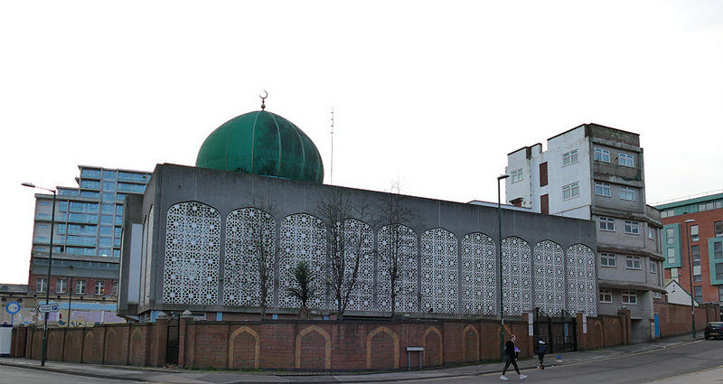
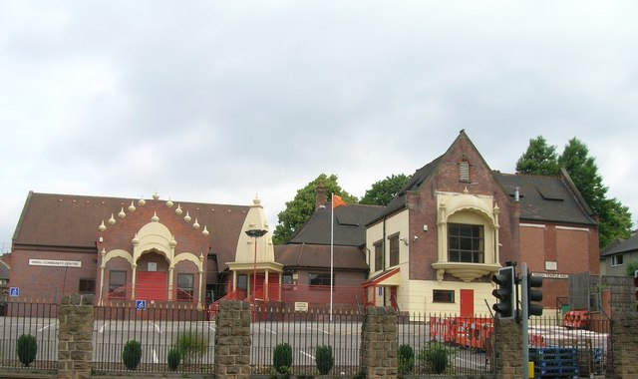
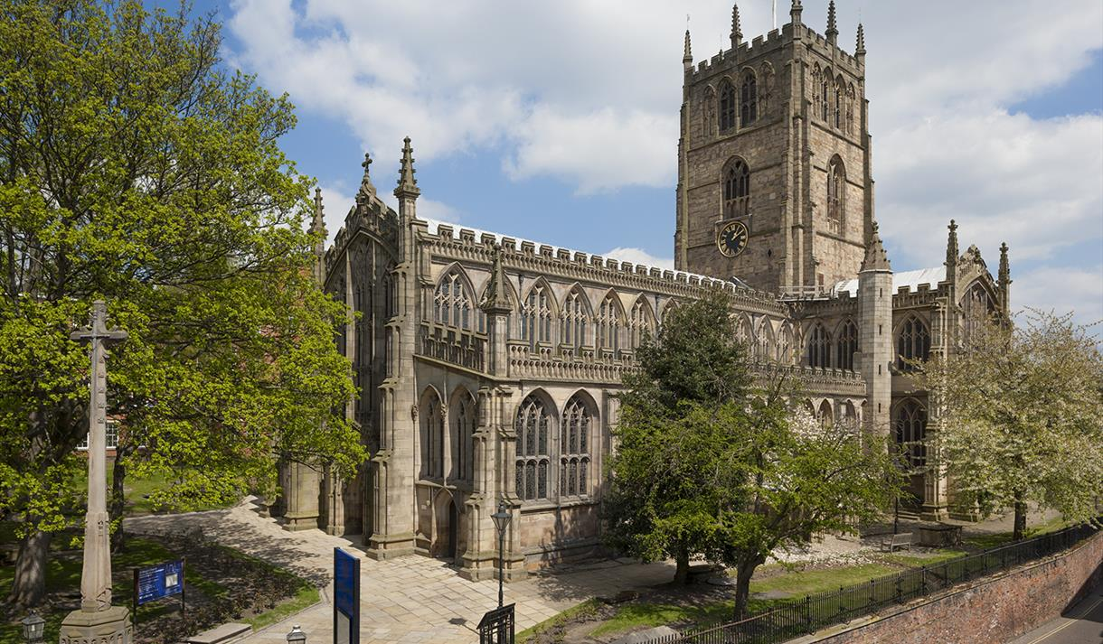
Year group: 6 | Topic: Religion, worldviews, family and community What contributions do religions make to local life in Nottinghamshire? How can we make Nottinghamshire a county of tolerance and respect? | Term: 5&6
Sticky knowledge
Key vocabulary and definitions:
Religion – guide for what someone believes Inter-faith – Relating to or involving different religions or members of different religions Harmony – The combination of simultaneously sounded musical notes to produce a pleasing effect Tolerance – The ability or willingness to tolerate the existence of opinions or behaviour that one dislikes or disagrees with Respect – A feeling of deep admiration for someone or something Moral Values – the standards of good at evil that govern our behaviour and choices
Substantive knowledge:
Religious Focus: Christianity and Islam As one of the five pillars of Islam, all eligible Muslims must donate at least 2.5% of their wealth to the poor. Nottinghamshire is a diverse community. Nottinghamshire is mainly Christian. Different areas of Nottinghamshire have different faiths at the heart of the community. There were no mosques, mandirs or Gudwaras in Nottinghamshire in 1960. Nottinghamshire now have many religious buildings. Each religions has their own religious building, but they serve the same purpose to worship collectively. Census statistics develop an understanding of the population and the religion they follow. It is important to respect and value other’s identity and faith.
Hindu temple, Nottingham
St Mary’s Church,
Nottingham city centre
Nottingham Central Mosque

