Slide 1
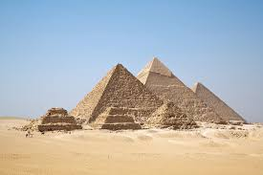
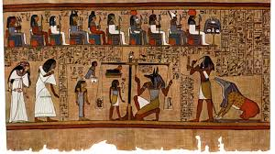
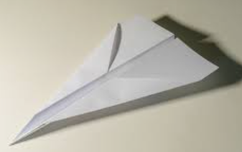
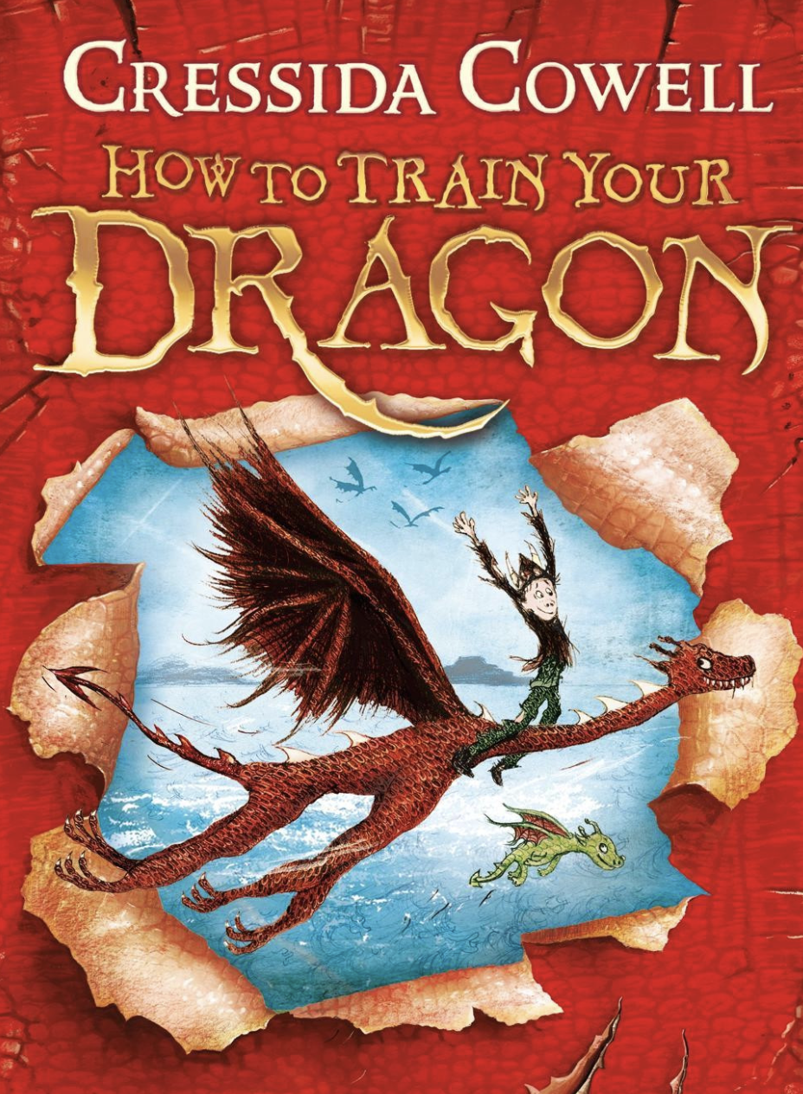


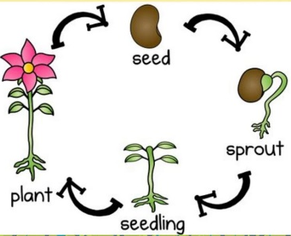
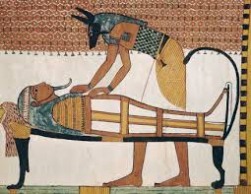
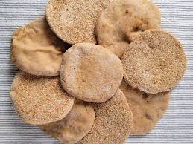
Year 3: Summer 1
In the summer term, our children will be learning a wide range of exciting and fascinating topics.
Our curriculum driver is the Ancient Egyptians.
English
In their writing lessons, the children will be writing a set of
instructions to make a paper airplane. After that, they will be
writing a non-fiction book about the Ancient Egyptians using
their knowledge from our History lessons. They will be using expanded noun phrases, time adverbials and imperative verbs in their writing.
In their guided reading lessons, the children will continue reading
'How to Train Your Dragon'. After this, we will be reading some non-
fiction about the Pharaohs, the River Nile and the great pyramids.
Our class book is the Day the Screens went Blank by Danny Wallace. This book explores the challenges and benefits of living without technology.
Maths
At the start of this term, the children will revisit the
4 operations (addition, subtraction, division and
multiplication).
They will then learn about mass and capacity, before moving
onto addition and subtraction through money.
Please make sure that your child is spending time completing
their TTRS. This is checked by their class teacher every week.
Science and Foundation subjects
In Science, the children will be learning about plants and animals.
In this topic, they will learn about the lifecycle of plants, what their
functions are and conduct some experiments.
During our History lessons, the children will be learning about life during Ancient Egypt. They will use a range of historical sources to learn about the Egyptian society,
Tutankhamun, the pyramids and importance of the River Nile .
In DT, the children will be heading over to the secondary site to make
some Egyptian bread!
During our RE lessons, the children will learn about
religion, family and community through understanding the importance of prayer. This unit will have a focus on Christianity and Islam.
We look forward to sharing our learning with you next term.

