Slide 1
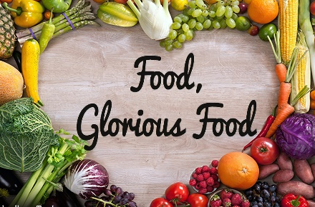


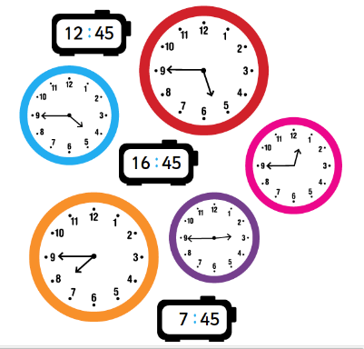



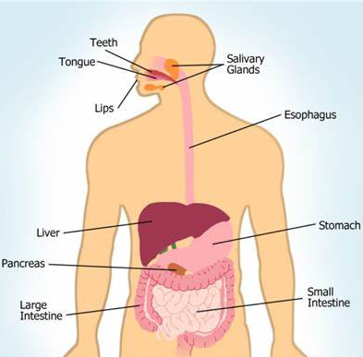
Year 4: Summer 1
In the summer term, our children will be learning a wide range of exciting and fascinating topics.
Our curriculum driver is Food, glorious food.
English
In their writing lessons, the children will be investigating poems, recipes and writing to persuade (based around healthy eating). During this unit, they will use a range of descriptive techniques, such as expanded noun phrases, modal verbs and rhetorical questions. They will also be learning about the different organisational features of different text types.
In their guided reading lessons, the children will be starting to read a novel called ‘Twitch’ by M. G. Leonard. This is a story that focuses on a bird watcher who finds himself tangled up in the hunt for a dangerous prisoner. This will also be our class book and be read to the children at the end of every day.
Maths
The children will begin by recapping the four operations (addition, subtraction, multiplication and division). Later on in the term, we will be continuing our learning on decimals including how they fit into the place value chart. We will also be doing a unit all about time!
Please make sure that your child is spending time completing their TTRS homework. This is checked by their class teacher every week.
Science and Foundation subjects
In Science, the children will be continuing their learning about Living things and their habitats. We will focus on how to classify animals and plants based on their characteristics and how habitats can develop and change over time.
During our Geography lessons, the children will be comparing the UK and Argentina, focussing in on the varying human and physical features of each location. We will be learning about the different types of settlements including hamlets, villages, towns and cities.
During our RE lessons, the children will be learning about the journey of life and death and how life can be viewed as a ‘journey’.
In DT, we will be creating an interactive model to show how the digestive system works, linking to our English topic!
We look forward to sharing our learning with you this term.

