Slide 1
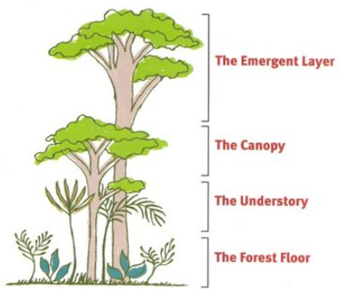



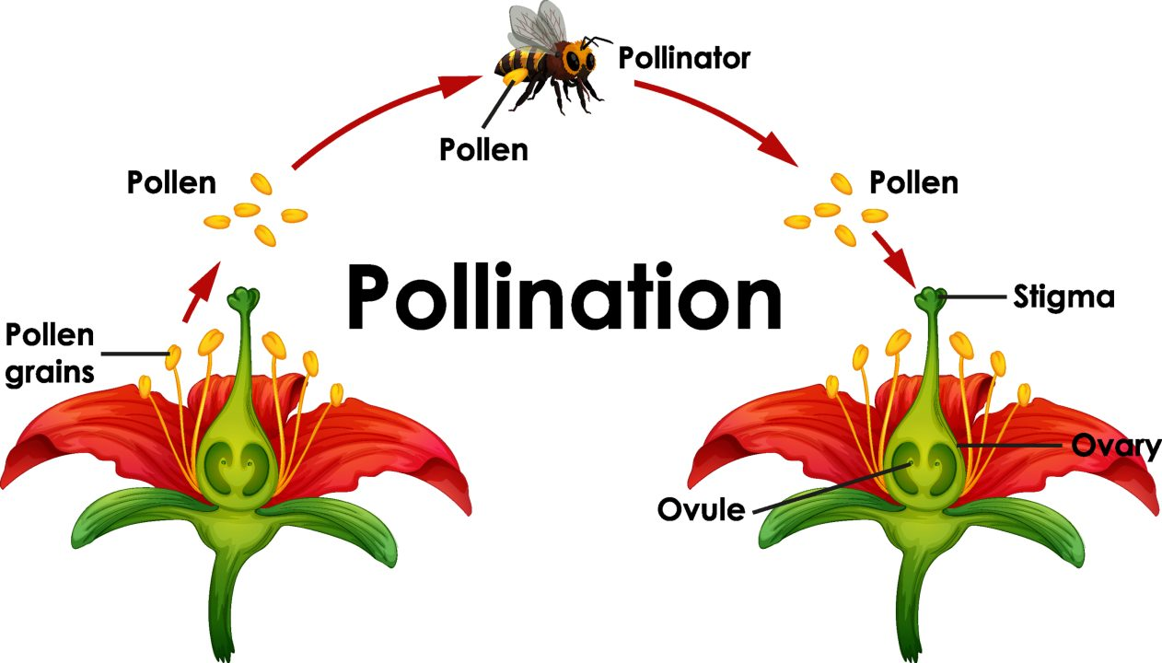
Year 5: Summer 1
In the spring term, our children will be learning a wide range of exciting and fascinating topics.
Our curriculum driver is Under the canopy, as the children will be learning about South America, the Amazon Rainforest and visiting Twycross Zoo this term.
English and Guided Reading
This term for English, we will be writing a story based upon
events in the book, ‘The Explorer’ by Katherine Rundell, as
well as some instructions and a letter.
‘The Explorer’ will also be the focus of our guided reading
for this term. We are really looking forward to delving into
the ins and outs of the book and getting a real
Understanding of the themes throughout!
Maths
The timetable of learning in Maths this term is as follows:
Week 1 – 4 Operations (Addition, Subtraction,
Multiplication and Division).
Week 2 – Properties of Shapes.
Week 3 & 4 – Properties and Direction.
Week 5 – Revisit fractions, decimals and percentages.
We have decided to revisit the 4 operations and fractions, decimals and percentages, as the year 5 team believe these areas will be very helpful in furthering the children as mathematicians, not only this year but heading into year 6 and beyond!
Science
In science this term, we will be looking at reproduction in plants and animals. This will include aspects such as the life cycles of different organisms, including how plants reproduce through the spreading of seeds and how animals reproduce in many ways.
Foundation
Art – The work of Henry Rousseau.
Geography – Place Knowledge (comparing UK and South America).
Computing – Online Safety & Databases.
RE – Beliefs and questions.
Spanish – My Family and In the Café
PSHE – Building positive and healthy relationships.
How can you help?
TTRS – Encouraging your children to play TTRS will help massively with their maths skills across the whole curriculum.
Reading – Will help with both English and Guided Reading.
Purple Mash – Can be used to further their learning – either through work set by teachers or individually.
We look forward to sharing our learning with you next term.

