Slide 1
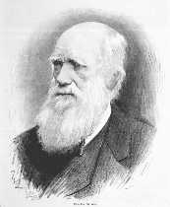
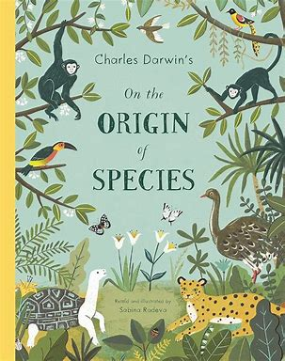


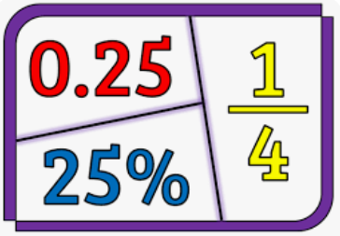


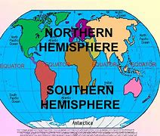


Year :6 Summer 1
In this term, our curriculum driver is Adapting and Evolving, as the children will be researching Charles Darwin’s theory of natural selection.
English
In English, the children will be focussing on grammatical features, such as using brackets, dashes and commas for parenthesis; punctuating speech correctly with inverted commas; identifying passive and active voice; identifying possessive pronouns; differentiating between nouns, adjectives, verbs and adverbs; using subordinating and coordinating conjunctions and identifying noun phrases. The children will be given a variety of opportunities to apply these grammatical features in a descriptive sentence or scene setting. We will then be moving onto writing a non-chronological report on Charles Darwin’s theory of natural selection, using subheadings, facts and fronted adverbials.
This term, the children’s class book is ‘Nightfall in New York’ by Katherine Woodfine. We will also be continuing to develop our understanding of vocabulary within different contexts, our ability to retrieve information from across a range of different texts; and we will be inferring information from the text, providing evidence to support our viewpoints. Another focus of our daily reading sessions will be reading fluency – developing our stamina to read at length.
Maths
With SATs approaching at the end of this half term, the children will use the time leading up to their exams to revisit and consolidate the units they have covered so far this year. While all units will be reviewed, there will be a greater
emphasis on the four operations (addition, subtraction, multiplication
and division) as well as fractions, decimals, and percentages.
Please ensure that your child spends time completing their weekly homework on LBQ and TTRS, as this is checked by their class teacher every week.
Science and Foundation subjects
In Science, the children will be continuing their about
evolution and inheritance. During these lessons, children
will explore how different species have evolved over time,
as well as exploring different features that offspring
inherit from their parents.
          During our Geography lessons, the children will be widening their locational knowledge and using this to draw comparisons.
During RE, our learning will be focussed on Islam and Christianity. The children will be learning about Religion, Worldviews, Family and Community, to understand the contributions that religions make to local life in Nottingham City and Nottinghamshire. We will also be considering how we can make Nottingham City and Nottinghamshire a place of tolerance and respect.
We look forward to sharing our learning with you next term.

