Slide 1
RSE Curriculum
Nottingham Academy Primary
Introducing our PSHE, Relationships and Sex-Education Curriculums for Years 4, 5 and 6

Slide 2
The RSE Curriculum…
The aim of RSE is to give young people the information they need to help them develop healthy, nurturing relationships of all kinds, not just intimate relationships. It should enable them to know what a healthy relationship looks like and what makes a good friend, a good colleague and a successful marriage or other type of committed relationship.
It should teach what is acceptable and unacceptable behaviours in relationships.
Pupils will understand the positive effects that good relationships have on their mental wellbeing, identify when relationships are not right and understand how such situations can be managed.

Slide 3
The RSE Curriculum…
It is important that the transition phase before moving to secondary school supports pupils’ ongoing emotional and physical development effectively.
The Department for Education continues to recommend therefore that all primary schools should have a sex education programme tailored to the age and the physical and emotional maturity of the pupils. It should ensure that both boys and girls are prepared for the changes that adolescence brings and – drawing on knowledge of the human life cycle set out in the national curriculum for science - how a baby is conceived and born.

Slide 4


At NAP we use JIGSAW to teach our PSHE curriculum, including RSE.
All staff who teach these RSE lessons also have additional training on how to teach the material.

Slide 5
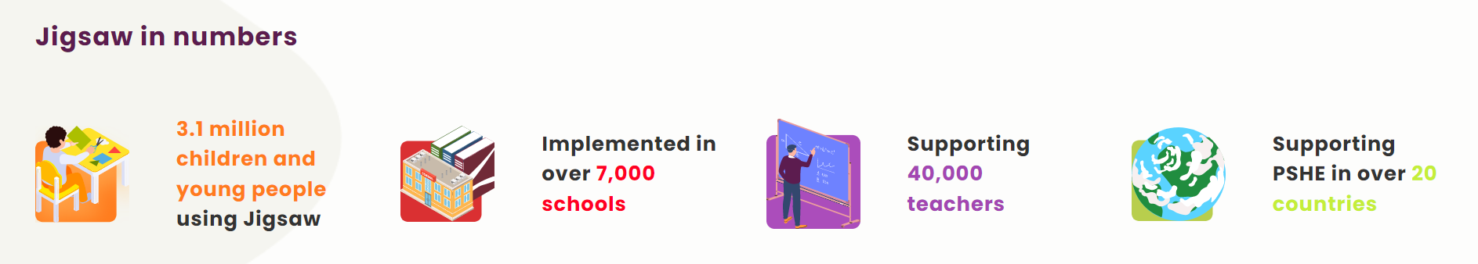

JIGSAW is widely used by schools across the country and is partnered with leading educational organisations including the British Council.

Slide 6
The RSE Curriculum
In Term 6 we teach the Relationships and Sex-Education lessons, which include lessons on puberty.
The Sex-Education lessons are in Year 5 and Year 6 ONLY and the content is put into specific lessons, detailed on the following slides, which parents can opt their children out of.
In Year 4 there are two lessons on puberty, which parents can also opt their children out of if desired.
Years 1-3 do not cover any of these aspects and simply focus on the wider PSHE curriculum, so there is not the option for children to be withdraw from these lessons.

Slide 7
OPTION TO WITHDRAW CHILDREN IN YEARS 4-6
In Years 4-6 the ‘Sex-Education/Puberty’ lessons have been condensed into the following lessons, and parents have the option to withdraw their children from these specific lessons:
Year 4:
Lesson 3 on puberty
Lesson 4 on puberty and periods (taught to girls only)
Year 5:
Lesson 2 on puberty for girls (taught to girls only)
Lesson 3 on puberty for boys (taught to boys only)
Lesson 4 on conception (boys and girls taught separately)
Year 6:
Lesson 2 on puberty (boys and girls taught separately)
Lesson 3 on conception (boys and girls taught separately)
Lesson 4 on how the embryo grows
Lesson 5 on love and relationships
To withdraw your child from one or all of these lessons please ask the office for an RSE Withdrawal Form, and return this to the office no later than Friday 15th May.
Any forms received after this date will be adhered to as quickly as possible, but they must be signed off by the School Principal, so we cannot guarantee students will be withdrawn from all lessons requested.

Slide 8
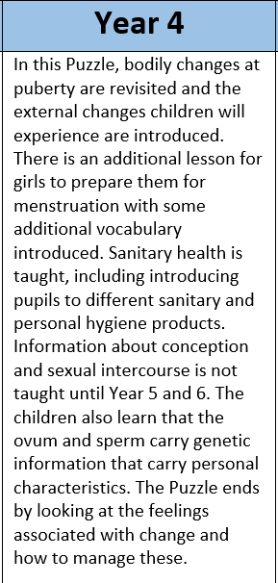
Changing Me Topic – Year 4
LESSON | VOCABULARY
Lesson 1 – Unique Me Children to understand that they get their characteristics from a mix of both their parents | Personal, Unique, Characteristics, Parents, Gene
Lesson 2 – Unique Me Continued Children understand how they get characteristics from their parents but also are impacted by other influences | Feelings, Responsibilities, Carers, Characteristics, Language, Mannerisms, Influence
Lesson 3 – Outside Body Changes (CAN OPT-OUT) Children understand some of the physical changes that will occur during puberty | Change, Puberty, Control, Breasts, Penis, Testicles, Pubic Hair, Hips, Voice, Chest
Lesson 4 – Girls and Puberty (CAN OPT-OUT) Taught to girls only, with a focus on personal hygiene and coping with period | Puberty, Menstruation, Menstrual Cycle, Periods, Menstrual Pads, Period Pants, Tampons, Vagina, Vulva, Ovaries, Oestrogen, Fallopian Tube, Fertilised
Lesson 5 – Circles of Change Children learn that nature works in cycles of change and that change is normal | Circle, Seasons, Change, Control
Lesson 6 – Accepting Change Children are encouraged to look forward to changes ahead | Control, Change, Acceptance, Scared, Empty, Peaceful, Happy, Sad, Nervous, Proud, Excited, Anxious, Shy, Grumpy, Accepting, Apprehensive, Worried, Frustrated, Angry, Disappointed, Hurt, Jealous, Frightened, Unsure, Uncertain, Confused, Miserable
Lesson 7 – Looking Ahead Children learn that change is a necessary part of life. | Change, Looking forward, Excited, Nervous, Anxious, Happy
In Year 4 all the content relating to puberty will be taught in the two opt-out lessons only, so parents have the choice whether or not their child learns about this. To withdraw your child from Lessons 3 and 4 on puberty, please simply let your child’s class teacher know or inform the school office. This request needs to be made at the start of the term.

Slide 9
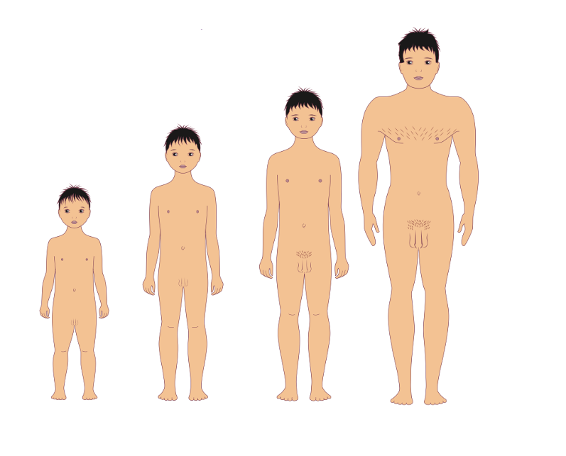
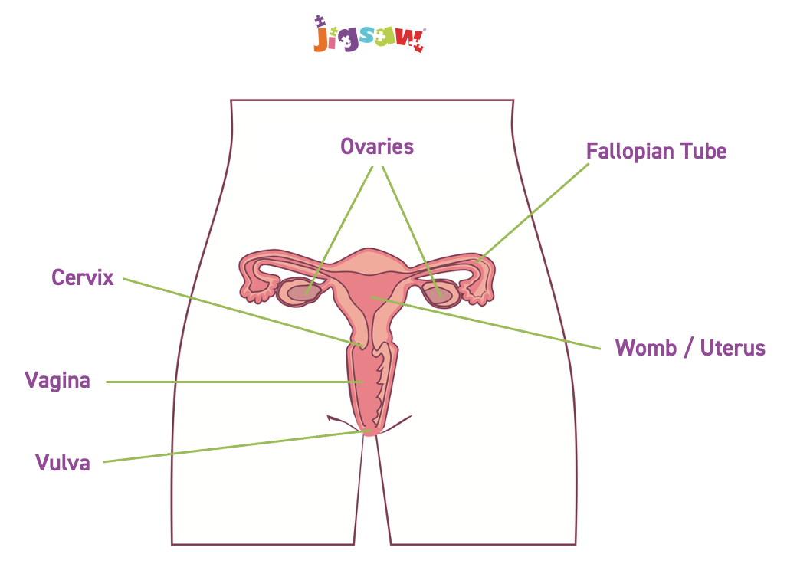

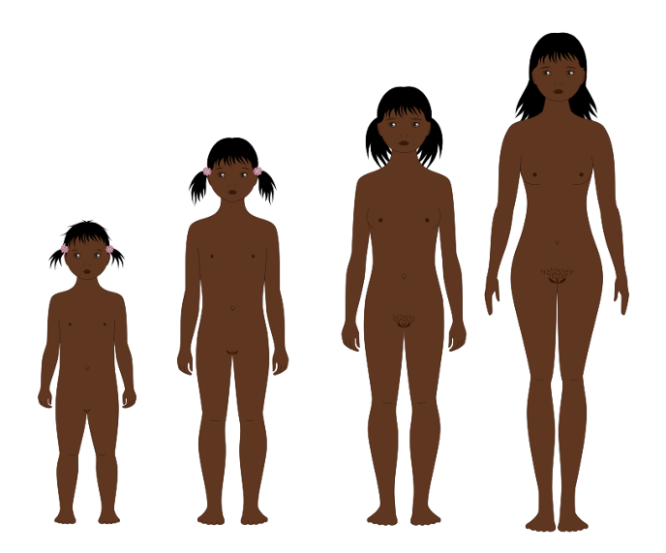
Changing Me - Images
used in Year 4

Slide 10
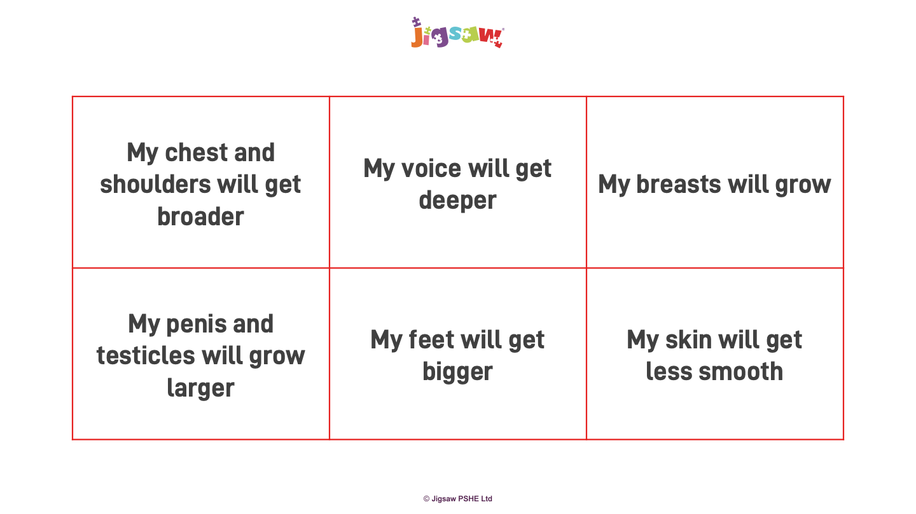
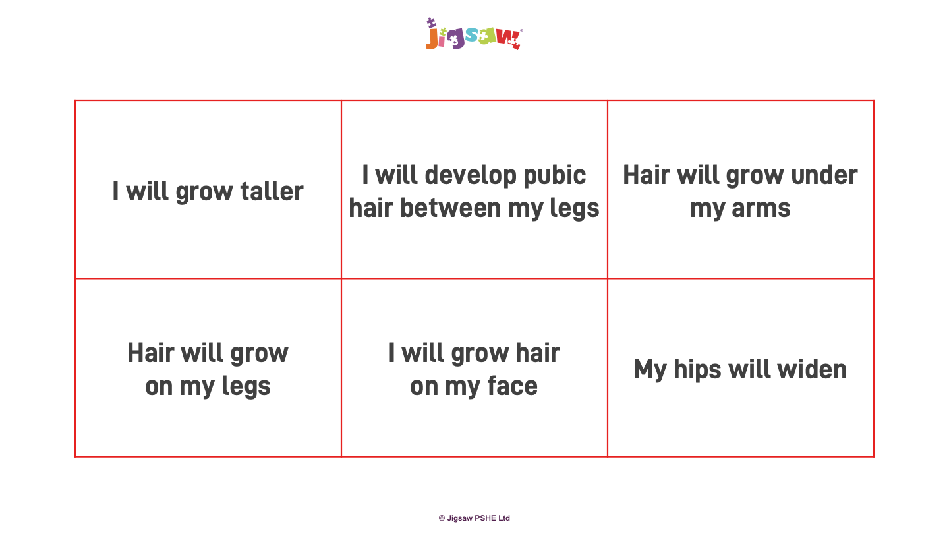
Changes in puberty taught in Year 4:
This is a light introduction to puberty to prepare children for changes they may be starting to experience but without going into detail until Year 5.

Slide 11
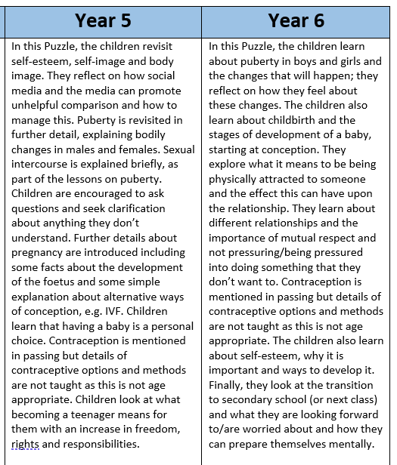
Changing Me Topic – Year 5
LESSON | VOCABULARY
Lesson 1 – Self and Body Image Children to understand that everyone is unique and special | Self, Self-image, Body image, Self-esteem, Perception, Characteristics, Aspects, Affirmation
Lesson 2 – Puberty for Girls (CAN OPT-OUT) Children understand the changes that will happen to them during puberty, especially around periods | Puberty, Menstruation, Periods, Menstrual towels, Menstrual pads, Tampons, Ovary/ Ovaries, Vagina, Oestrogen, Vulva, Womb/Uterus
Lesson 3 – Puberty for Boys (CAN OPT-OUT) Children understand the changes that will happen to them during puberty | Puberty, Sperm, Semen, Testicles/Testes, Erection, Ejaculation, Wet dream, Larynx, Facial hair, Growth spurt, Hormones
Lesson 4 – Conception (CAN OPT-OUT) Children to understand that conception is how babies are made and this is usually done through sexual intercourse | Relationships, Conception, Making love, Sexual intercourse, Fallopian tube, Fertilisation, Pregnancy, Embryo, Umbilical cord, Contraception, Fertility treatment (IVF)
Lesson 5 – Looking Ahead 1 Children learn about becoming responsible young adults | Teenager, Milestone, Perceptions, Responsibilities
Lesson 6 – Looking Ahead 2 Children are encouraged to look forward to changes ahead | Change, Hope, Manage, Cope, Opportunities, Emotions, Fear, Excitement, Anxious
In Year 5 all the content relating to puberty and sex-education will be taught in the three opt-out lessons only, so parents have the choice whether or not their child learns about this. To withdraw your child from Lessons 2, 3 and 4 please simply let your child’s class teacher know or inform the school office. This request needs to be made at the start of the term.

Slide 12
Year 5 vocabulary and teacher support notes about sexual intercourse:
Puberty, Menstruation, Periods, Menstrual towels, Menstrual pads, Tampons, Ovary/ Ovaries, Vagina, Oestrogen, Vulva, Womb/Uterus, Puberty, Sperm, Semen, Testicles/Testes, Erection, Ejaculation, Wet dream, Larynx, Facial hair, Growth spurt, Hormones, Relationships, Conception, Making love, Sexual intercourse, Fallopian tube, Fertilisation, Pregnancy, Embryo, Umbilical cord, Contraception, Fertility treatment (IVF)
Sexual intercourse, or making love, (the penis entering the vagina) is something which can happen between 2 adults who both want this to happen. They give their ‘consent’ to each other to ‘have sex’. No-one in any relationship should ever do anything with their body they feel unsure of or uncomfortable about, and nobody should ever feel pressured into having any kind of sexual relationship.
This is why countries have age restrictions on when people are allowed to have sexual relationships, to protect young people. In England, for example, the ‘age of consent’ is 16.
Having sexual intercourse is a very personal and private part of an adult relationship that both people should feel comfortable with, consent to and be able to enjoy and many young people choose not to have a sexual relationship until they are in a committed relationship where they feel safe and fully ready for this, maybe waiting until they are married.

Slide 13
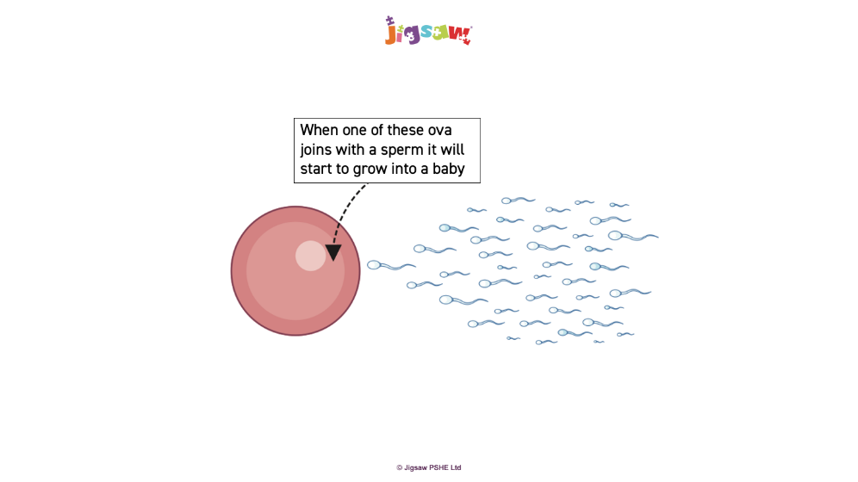
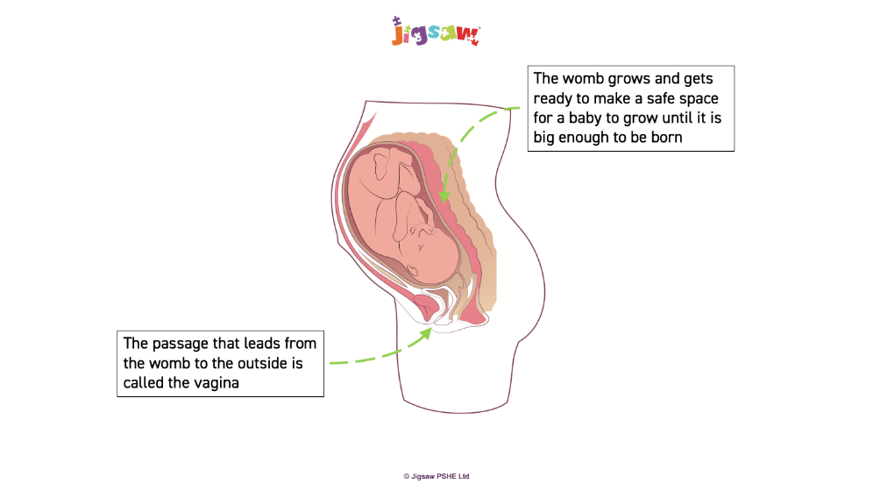
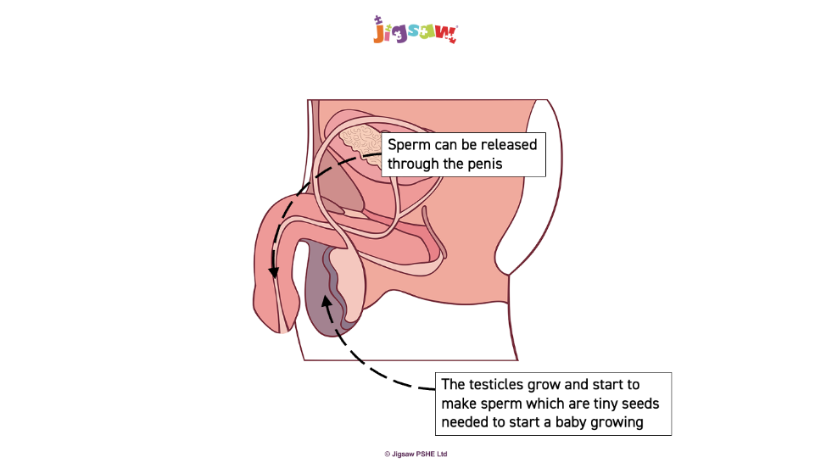
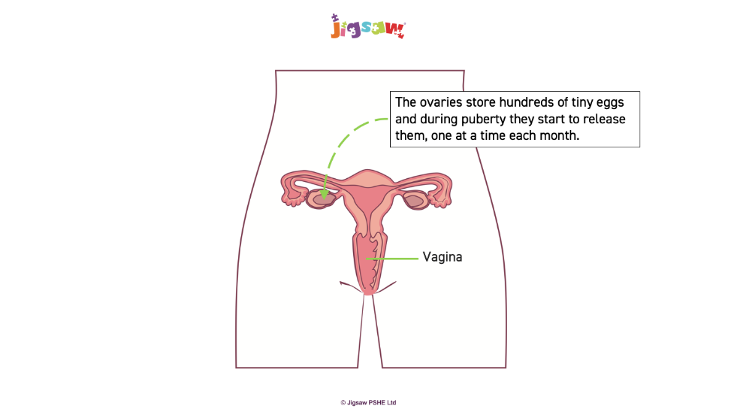
Changing Me – Images used in Year 5

Slide 14
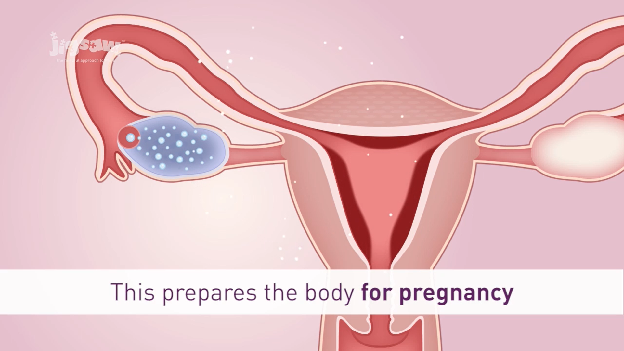
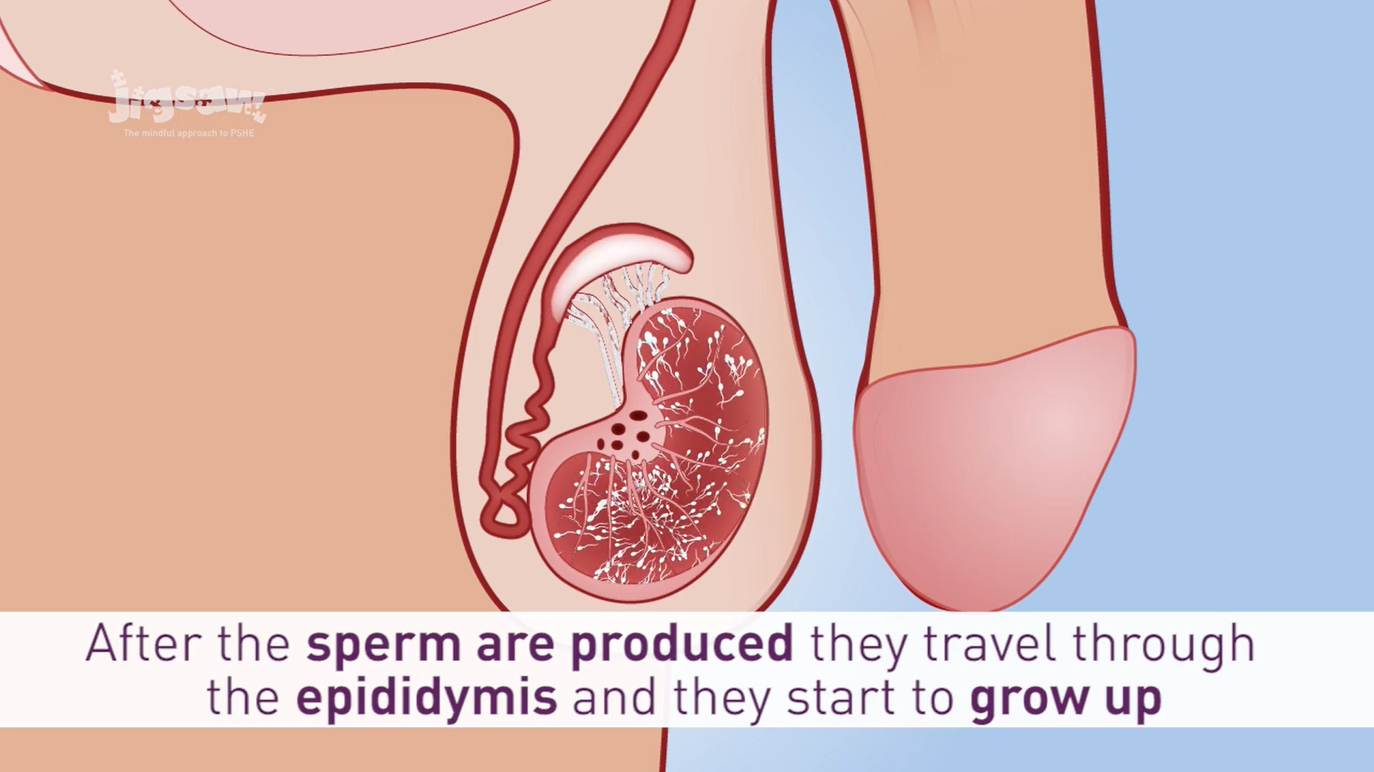
Changing Me – Images used in Year 5
Children are taught in separate groups of boys and girls for the lessons when these images are shown.

Slide 15
Changing Me Topic – Year 6
LESSON | VOCABULARY
Lesson 1 – My Self Image Children to understand how body image fits into their own self-image | Self-image, Self-esteem, Real self, Celebrity
Lesson 2 – Puberty (CAN OPT-OUT) Children understand the changes that will happen to them during puberty, and how to cope with them | Vulva, Fallopian Tube, Womb, Vagina, Feeling Moody, Penis, Underarm Hair, Sperm, Testicles, Clitoris, Menstrual Pad, Masturbation, Menstruation, Wet Dreams, Hormones, Breasts, Tampons, Erection, Facial Hair
Lesson 3 – Conception (CAN OPT-OUT) Children to understand that conception is how babies are made and this is usually done through sexual intercourse | Relationships, Conception, Making love, Sexual intercourse, Fallopian tube, Fertilisation, Pregnancy, Embryo, Umbilical cord, Contraception, Fertility treatment (IVF)
Lesson 4 – Conception (CAN OPT-OUT) Children understand how a baby develops from conception to birth | Pregnancy, Embryo, Foetus, Placenta, Umbilical cord, Labour, Contractions, Cervix, Midwife
Lesson 5 – Boyfriends and Girlfriends (CAN OPT-OUT) Children learn about creating responsible relationships | Attraction, Relationship, Pressure, Love, Sexting, Consent
Lesson 6 – Real Self and Ideal Self Children are encouraged to develop a positive self-esteem | Self-esteem, Negative body-talk, Choice, Feelings/emotions, Challenge, Mental health
Lesson 7 – The Year Ahead Children discuss the transition to secondary and any hopes and fears they have | Transition, Secondary, Looking forward, Journey, Worries, Anxiety, Hopes, Excitement
In Year 6 all the content relating to puberty and sex-education will be taught in the four opt-out lessons only, so parents have the choice whether or not their child learns about this. To withdraw your child from Lessons 2, 3, 4 and 5 please simply let your child’s class teacher know or inform the school office. This request needs to be made at the start of the term.

Slide 16
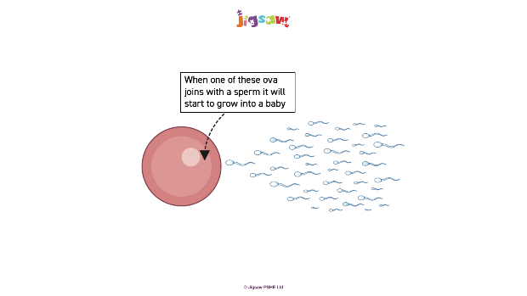
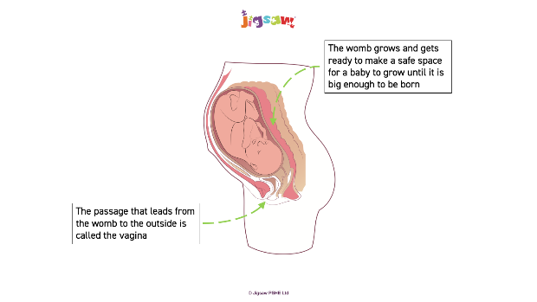
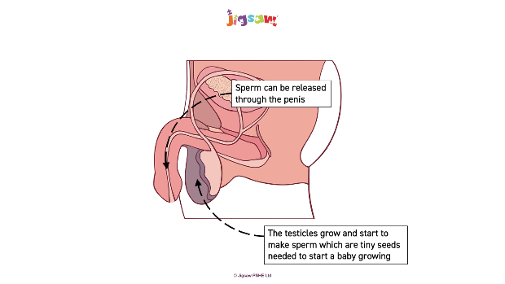
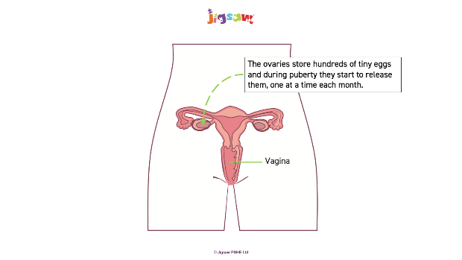
Changing Me – Images used in Year 6
Images and language used in Year 6 very similar to Year 5. The only notable difference is the addition of the vocabulary ‘masturbation’ and ‘clitoris’. The following description is given by Jigsaw as a guide to what to say about these:
Masturbation can be simply explained as a time when a person touches their own private parts for pleasure. Stress that this is perfectly normal and it is a very PRIVATE thing to do.
The clitoris can be explained as the part of a woman’s sexual organs that gives her nice feelings when having sex.
Children are taught in separate groups of boys and girls for the lessons when these images are shown.

Slide 17
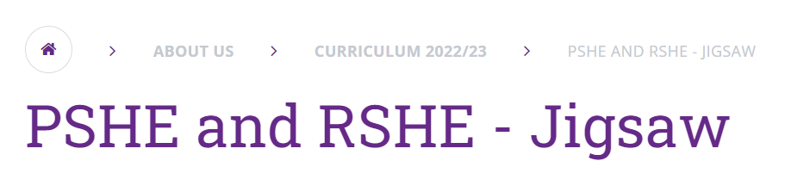
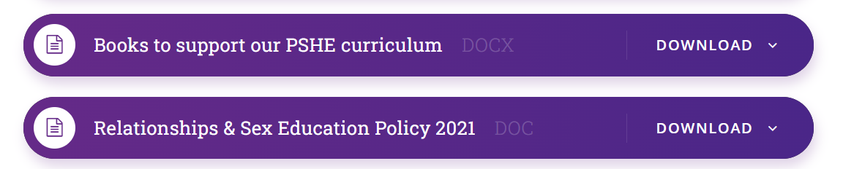
Next Steps…
If you are happy for your child to take part in all these lessons you do not need to do anything. We do encourage families to talk to the pupils about this content, so please ask you children about what they have been learning and continue the discussion at home.
If you want to withdraw your child from one or all of these lessons, please ask the office for an RSE Withdrawal Form, and return this to the office no later than Friday 15th May.
The Trust’s Relationship and Sex Education Policy and other relevant documents can be viewed on the school website under About Us > Curriculum > PSHE

